Slide 1
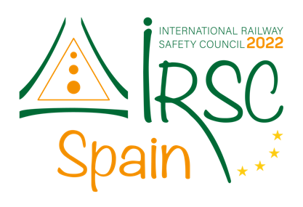

IRSC 2022
INTERNATIONAL RAILWAY
SAFETY COUNCIL
SEVILLA, OCTOBER 16-21, 2022

Slide 2
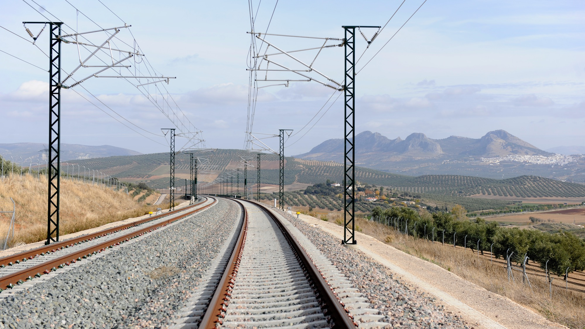



FRANCOISE KENNARD
Group Railway Safety Director - Alstom
IRSC 2022
INTERNATIONAL RAILWAY SAFETY COUNCIL
SEVILLA, OCTOBER 16-21, 2022

Slide 3
RAILWAY SAFETY CULTURE CAMPAIGN
ALSTOM
IRSC 2022
COMPANY LOGO
INTERNATIONAL RAILWAY SAFETY COUNCIL
SEVILLA, OCTOBER 16-21, 2022

Slide 4
INDEX
Introduction
Alstom
Alstom Railway Safety Roadmap
Railway Safety Culture Campaign
Overview
Conclusion
Summary
Next Steps
COMPANY LOGO

Slide 5
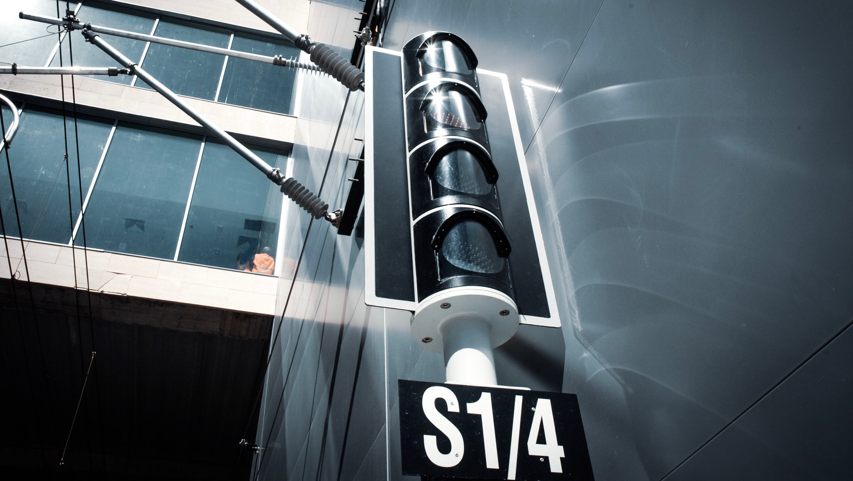
INTRODUCTION
ALSTOM
IRSC 2022
COMPANY LOGO
INTERNATIONAL RAILWAY SAFETY COUNCIL
SEVILLA, OCTOBER 16-21, 2022

Slide 6
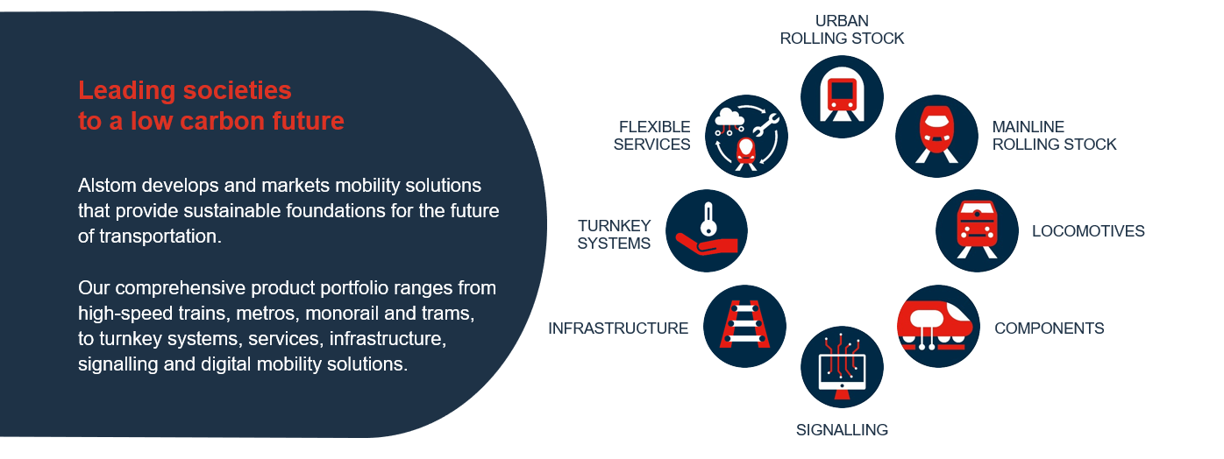
ALSTOM
A global leader in the transportation sector in the digital age
COMPANY LOGO

Slide 7
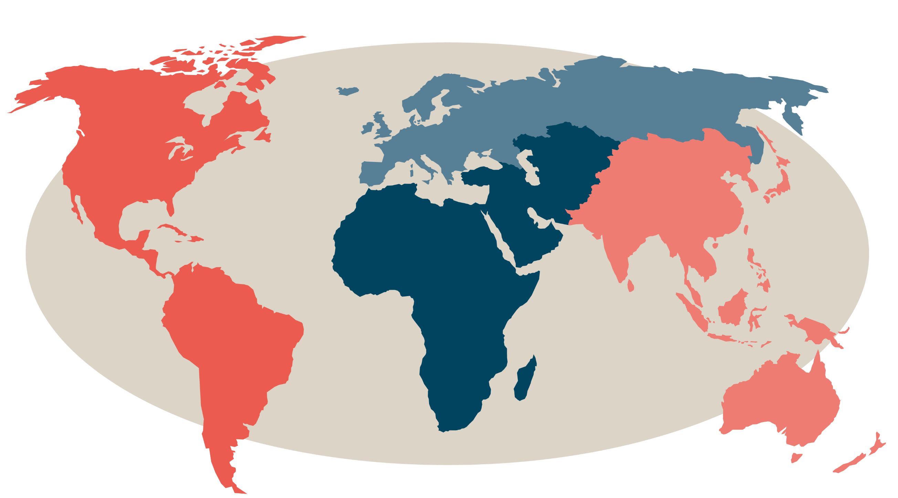
ALSTOM
We are where mobility is needed
Over
74,000
employees worldwide
19,700
engineers
EUROPE
44,350
employees
More than
9,400
patents
From
166
nationalities
AMERICAS
11,900
employees
APAC
(ASIA PACIFIC)
13,000
employees
Over
150,000
vehicles in commercial service
70
countries
Over
250
sites
AMECA
(AFRICA, MIDDLE EAST, CENTRAL ASIA)
4,850
employees
Partner to over
300
cities
COMPANY LOGO
Notes:
Acquisition of Bombardier Transportation – leading to Alstom doubling in size and extending its footprint and product portfolio
With over 74,000 employees in more than 70 countries, it is only natural for us to foster a solid culture of inclusion and diversity, so that every employee feels they are part of One Alstom team.

Slide 8


Alstom Railway Safety Roadmap
Our Strategy
GROWTH
by offering
greater value
to customers
…Committed and Ready for Growth
INNOVATION
by pioneering smarter
and greener mobility
solutions for all
...Drive efficient and Robust Risk Management
EFFICIENCY
at scale
powered
by digital
Leading the way to greener
and smarter mobility worldwide
… Contributor to Innovative solutions
Driven by One Alstom team,
Agile, Inclusive, Responsible
… Skilled People promoting a positive Railway Safety Culture
COMPANY LOGO
Notes:
Moving as One team (people – values – process)
AIR
Our values are the principles affecting the way we drive our business and make decisions to meet
the company's objectives
With over 74,000 employees in more than 70 countries, it is only natural for us to foster a solid culture of inclusion and diversity, so that every employee feels they are part of One Alstom team
Insert a diagram of the roadmap
Focus on the need for culture
OBJECTIVE

Slide 9
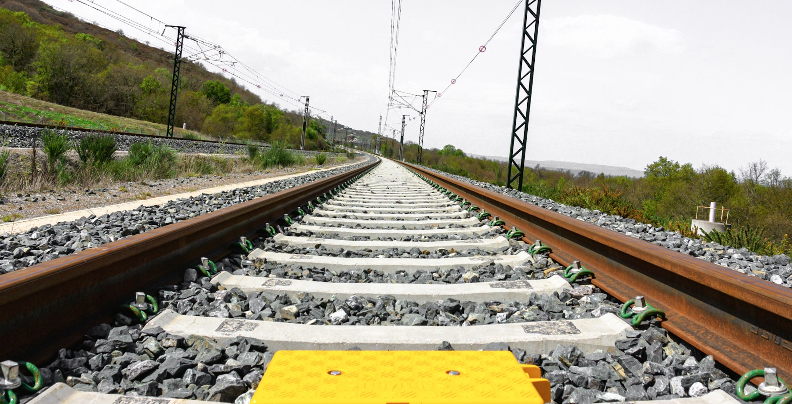
RAILWAY SAFETY CULTURE CAMPAIGN
OVERVIEW
IRSC 2022
COMPANY LOGO
INTERNATIONAL RAILWAY SAFETY COUNCIL
SEVILLA, OCTOBER 16-21, 2022

Slide 10





Alstom Railway Safety Culture Campaign
Railway Safety Governance
2022-23
Railway Safety Training
2023-24
2024-25
Railway Safety Communication
2025-26
Railway Safety Champions
Target populations:
Leadership & Management
All Employees
Safety Network
Customers & Suppliers & External

Slide 11
Alstom Railway Safety Governance
Improved and integrated in Alstom Governance
Objectives
  SMS Performance monitoring and Support
  Share learning
  Drive Improvement Programs
  Promote positive behaviours
Benefits:
  Empowerement – Engagement - Informed teams
  Collaboration boosting – Proactive mindset
  Targetted awareness initiatives
Alstom Railway Safety Board
Chair: Alstom President or COO
Quality - Alstom Steering Committee
Alstom Railway Safety
Assurance Committee
Region RSA Boards **
Min twice a year
Chair: Reg President
Quality – Region Steering Committee
Region Railway Safety
Product Line Railway Safety
ISA Management Board*
Quality – Local
Steering Committee
Local Railway safety
Product Line Network
Management of Safety Events Operational Railway Safety KPI
Implementation of Railway SMS
Railway SMS Assurance and Improvement
ISA: Independent Safety Assessment

Slide 12

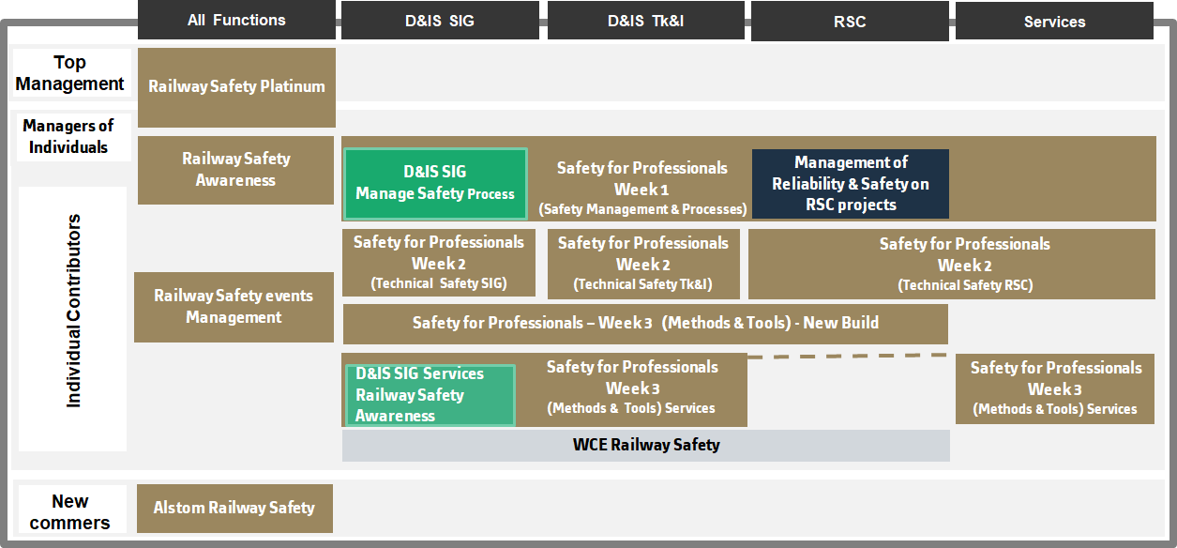
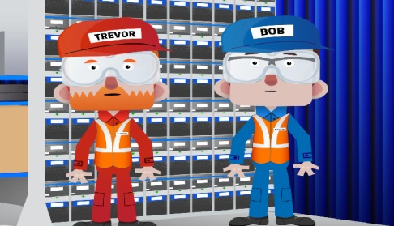
Railway Safety Training
A specific Railway Safety Academy part of Alstom University
A training offer for all Alstom “Managers, Engineers & professionals”:
  Covering different levels of the organization and the different businesses
  Using different means as classroom, webinar and e-learning
The deployment at site level of dedicated awareness sessions for “blue collars” using Alstom training materials to be adapted according to site specificities

Slide 13
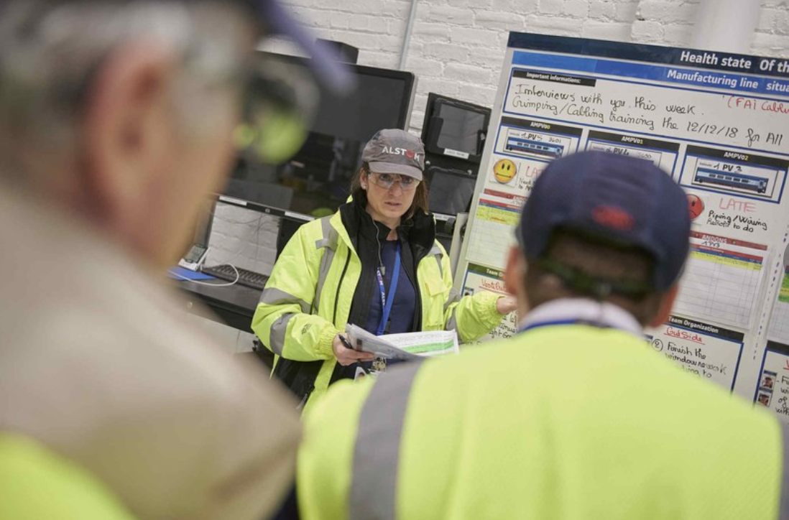
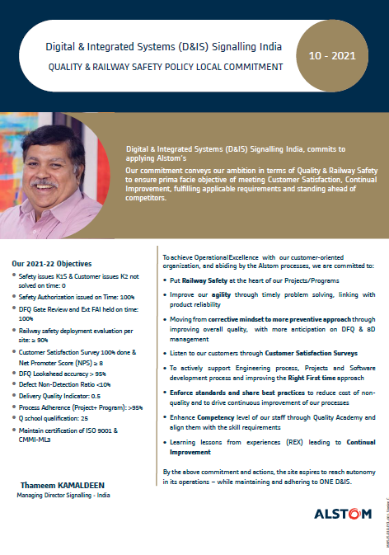
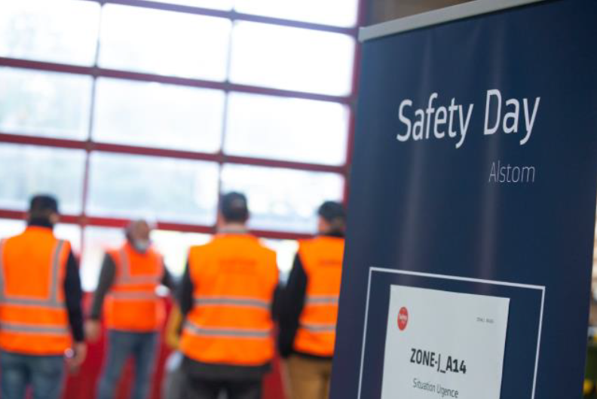
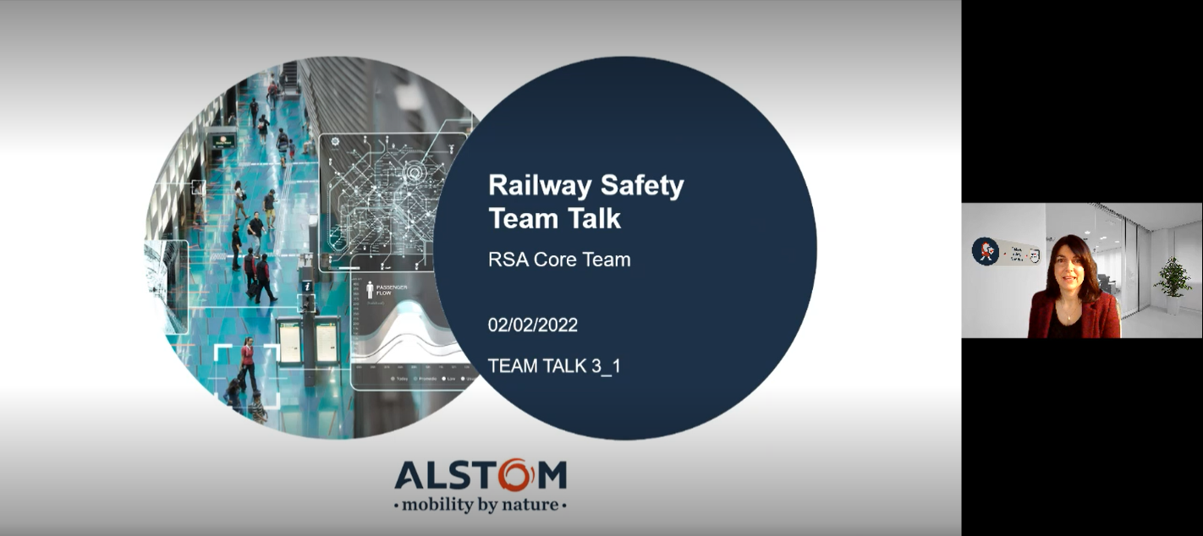

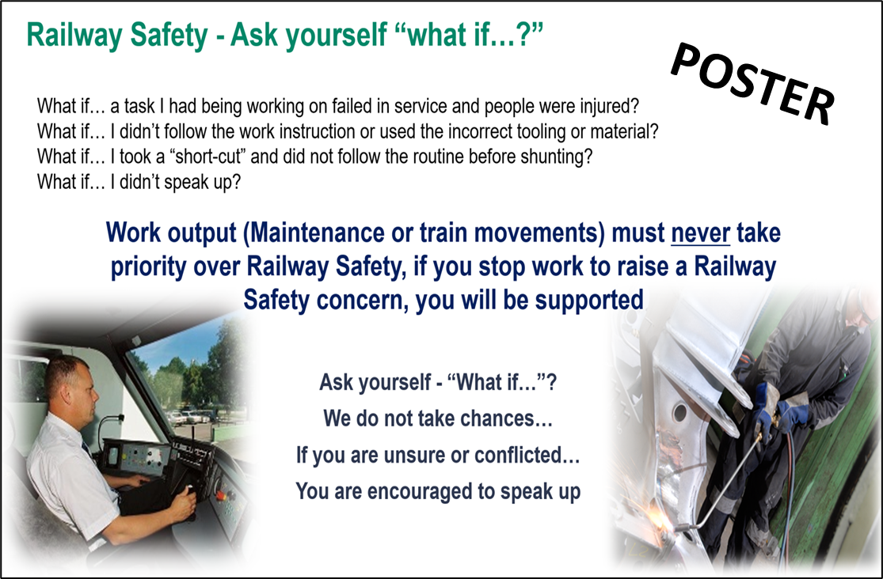
Railway Safety Communication
The program covers all Alstom employees, suppliers and customers.
Dedicated topics are issued to targeted populations, at specific intervals via various media.
An all-employee campaign is also planned to reinforce key messages and boost discussions at team levels.

Slide 14
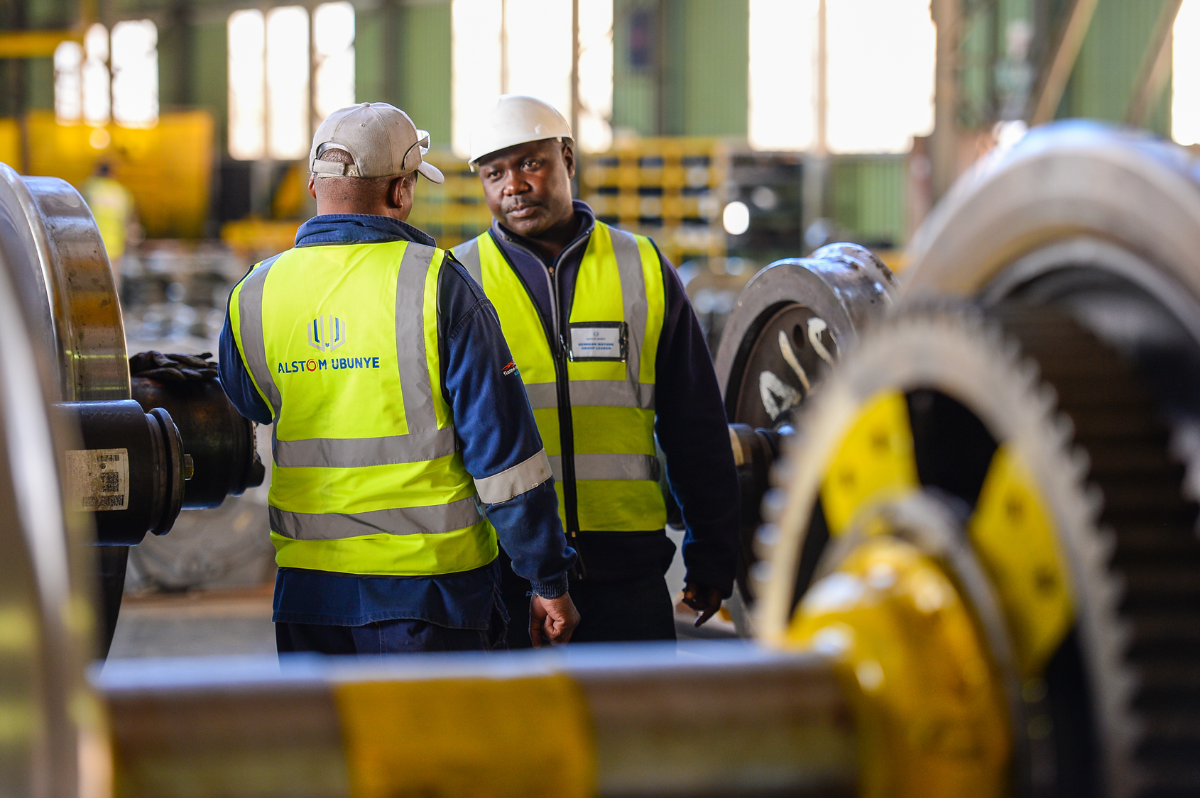
Railway Safety culture champions
To create momentum, we plan to develop Railway Safety Culture Champions.
They will come from all levels in the organisation from shop floor to top management
Their role is to challenge, mentor and encourage others with practical ways to implement a positive RSA culture.

Slide 15
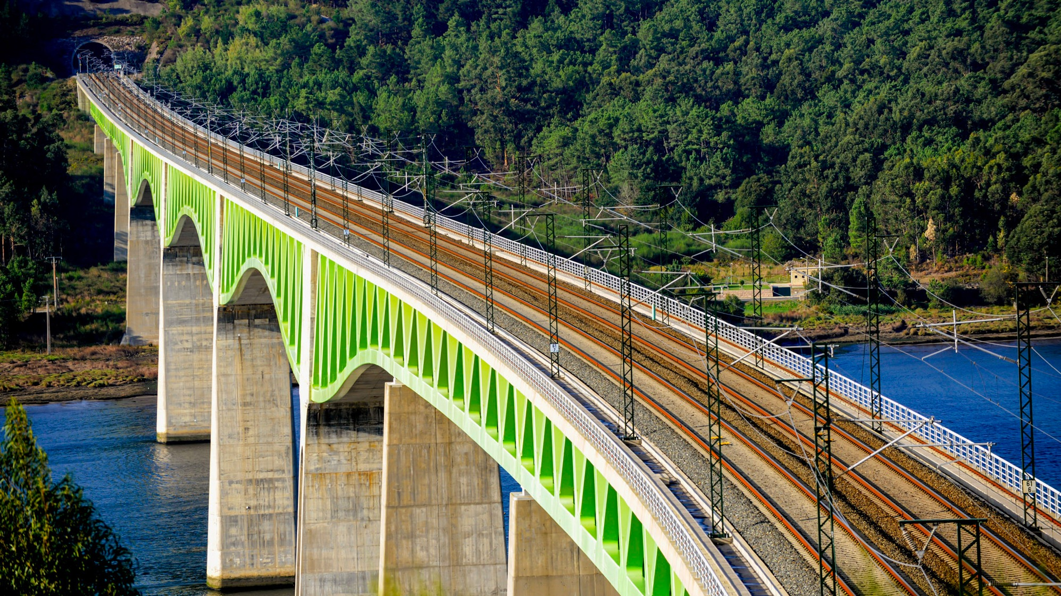
CONCLUSION
NEXT STEPS
IRSC 2022
COMPANY LOGO
INTERNATIONAL RAILWAY SAFETY COUNCIL
SEVILLA, OCTOBER 16-21, 2022

Slide 16
Railway Safety Culture Campaign
3 year program sponsored by Alstom Leadership
This culminates in a survey planned in 2025, which, when combined with our Return of Experience and industry best practises
will enable Alstom to establish its next priorities to fulfil Alsom commitment of being a sustainable organisation responsible for the safety of its product, systems and services
Supporting the overall company mission to
Governance
Training
Communications
Champions
.. lead the way to a greener and smarter mobility solutions worldwide
COMPANY LOGO

Slide 17


