Slide 1
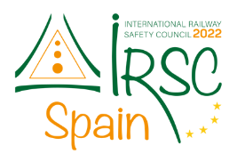

IRSC 2022
INTERNATIONAL RAILWAY
SAFETY COUNCIL
SEVILLA, OCTOBER 16-21, 2022

Slide 2
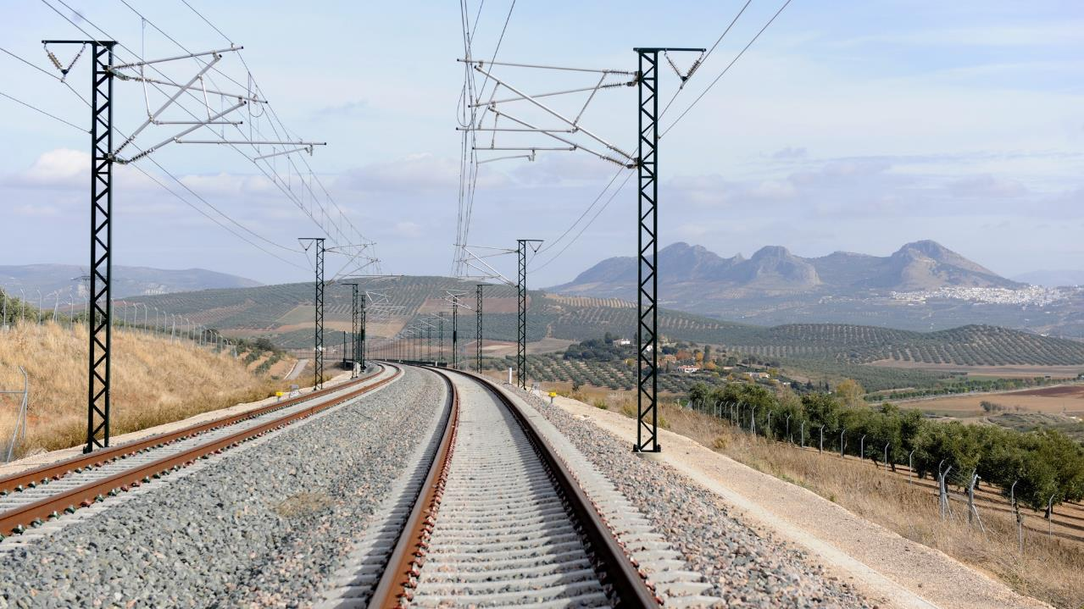



Ms Zoe Y.Y. Tse
Acting General Manager – Operations Safety & Quality
MTR Corporation
Mr H.K. Chan
General Manager – Engineering & Innovative Centre
MTR Corporation
IRSC 2022
COMPANY LOGO
INTERNATIONAL RAILWAY SAFETY COUNCIL
SEVILLA, OCTOBER 16-21, 2022

Slide 3
STRENGTHEN SAFETY CULTURE IN THE ASPECTS OF CONSEQUENCE, COMPLIANCE, COMMUNICATION AND COMPETENCE
IRSC 2022
COMPANY LOGO
INTERNATIONAL RAILWAY SAFETY COUNCIL
SEVILLA, OCTOBER 16-21, 2022

Slide 4
INDEX
CHAPTER 1
Background
CHAPTER 2
The 5C concept
CHAPTER 3
Intelligence Safety for Risk Mitigation
COMPANY LOGO

Slide 5
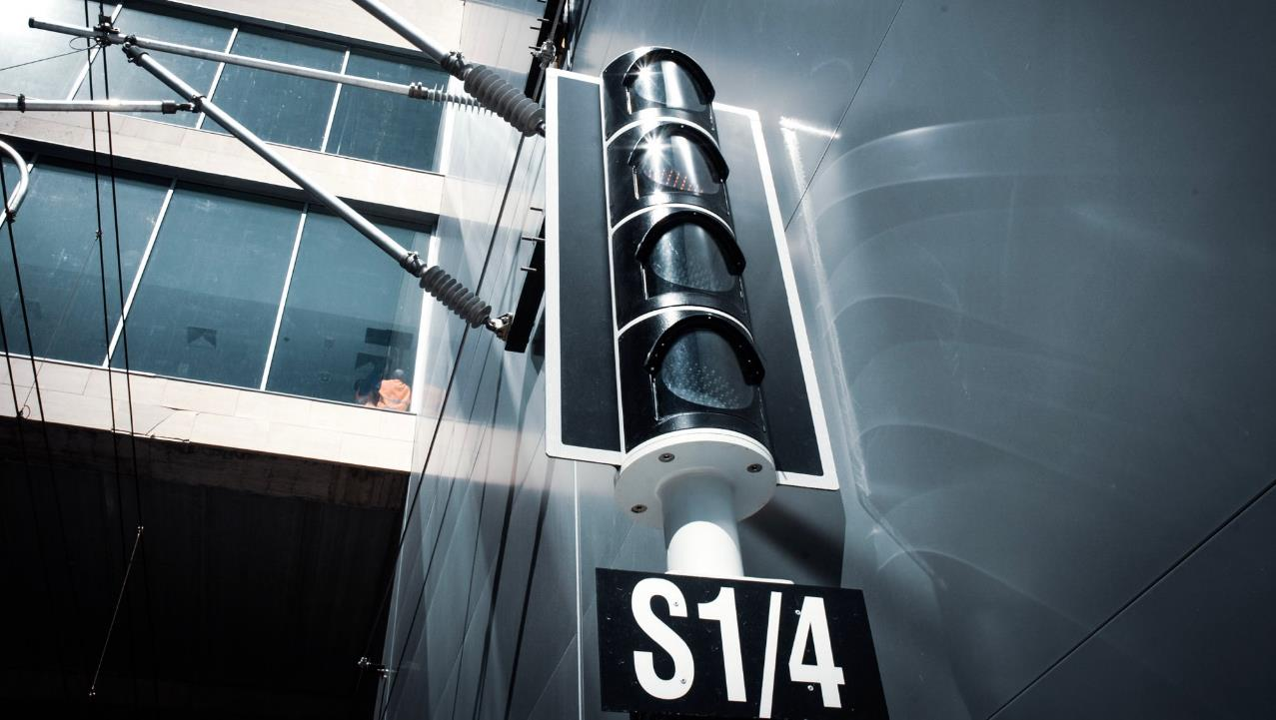
CHAPTER 1
Background
IRSC 2022
COMPANY LOGO
INTERNATIONAL RAILWAY SAFETY COUNCIL
SEVILLA, OCTOBER 16-21, 2022

Slide 6
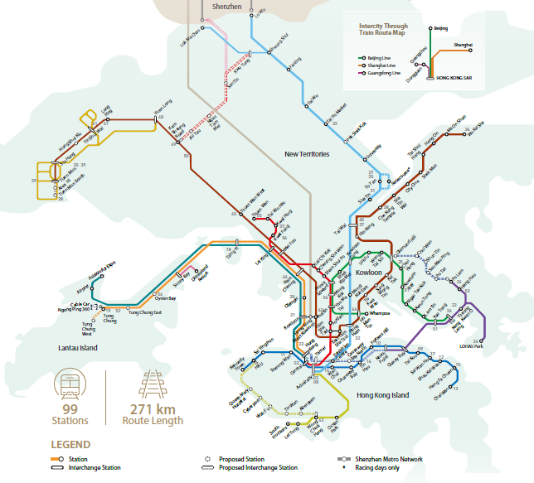

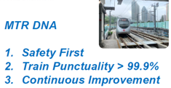
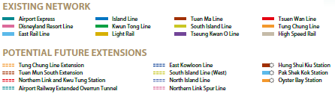
COMPANY LOGO

Slide 7
Development of Human Factors Management in MTR
Requirements on investigation, training, identification and management of HF issues included in Safety Management System
Awareness campaign for general staff
Leveraging technology in managing HF issues
HF Leadership in Line management
Building internal capability and expanding scope of application
Initial understanding
Management system development
Technology integration and
enhanced HF leadership
Understanding the subject
General awareness within management team
Part-time human factors team in safety department
Full time HF team in safety department
Internal HF specialist training
Development of HF analysis tools
COMPANY LOGO

Slide 8
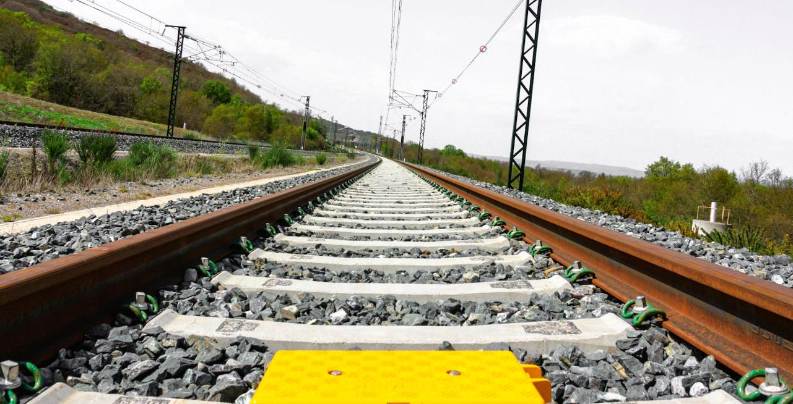
CHAPTER 2
The 5C concept
IRSC 2022
COMPANY LOGO
INTERNATIONAL RAILWAY SAFETY COUNCIL
SEVILLA, OCTOBER 16-21, 2022

Slide 9
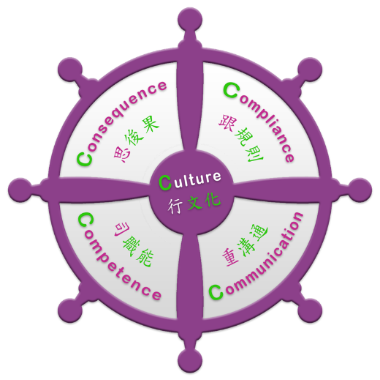

5C Concept launched
Staff culture and implementation are key to safety and quality works
launched to reinforce our Safety First Quality Always culture
Serves as a common language easily understandable by all
Not just promotion and communication, but extensive implementation in daily works e.g.
  pre-work safety briefing
  incident review & lessons learnt
COMPANY LOGO

Slide 10
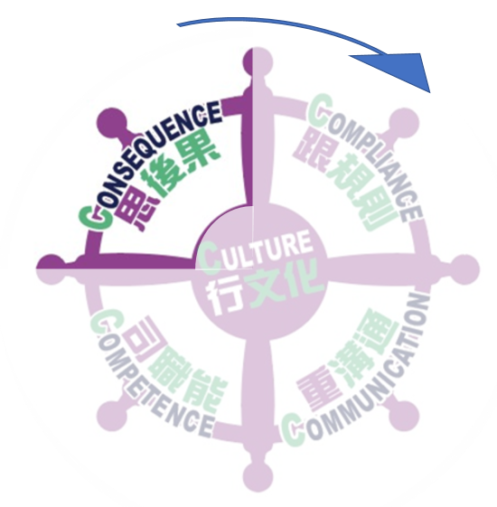
Think of the Consequence before starting a work
What are the risks and consequences of failure to meet job requirements?
Look into Compliance , Communication & Competence
Any of the above-mentioned not doing well or not fulfilling the requirements，there could be serious consequences on Safety, Operations and Personnel
  Safety: Causing injuries / casualties
  Operations: Affecting train operations and work progress, or even leading to suspension of service or work
  Personnel: May be summoned by court and subject to legal liabilities
5C starts with Consequence
COMPANY LOGO

Slide 11
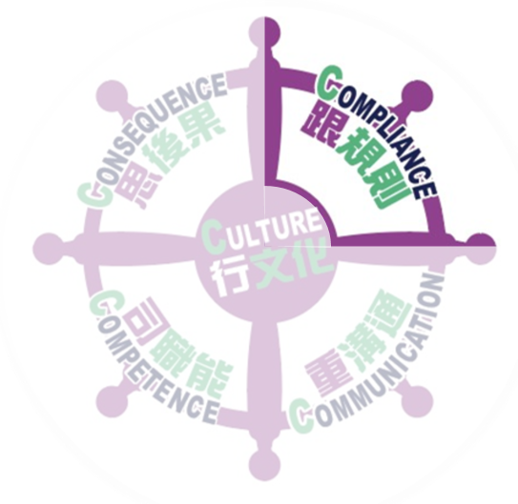
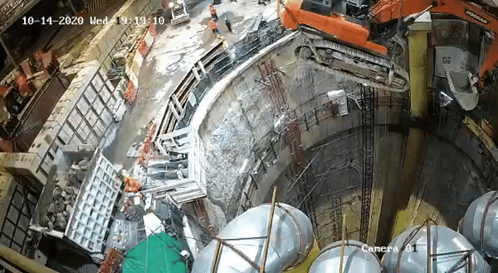
Always ensure COMPLIANCE at work
Accidents are often caused by non-compliances. If you don’t want it happen, you must know clearly what work procedures, guidelines and legislative requirements are in place, and ensure that they are fully complied with.
When conducting lifting operations:
  Lifting appliances and lifting gear must be inspected regularly and examined & tested thoroughly
  The load shall not exceed the safe working load
  Ensure that the load to be raised or lowered by the lifting appliance is safe and secure
COMPANY LOGO

Slide 12

Reinforce Communication for teamwork
Understand the roles and key points to be communicated at work
Most of our daily works are carried out in the form of teamwork. There must be mutual understandings between work partners. It requires standard protocols and consensus on work requirements to ensure accurate and effective communication to complete work smoothly and safely.
be proactive to clarify any doubts, and avoid assumptions
COMPANY LOGO

Slide 13

Possess qualifications and maintain Competence
Competence refers to the necessary qualifications and abilities and skills that staff should possess
regular review with staff to identify knowledge and/or skill gaps
  attend adequate trainings and refresher courses
  possess valid qualifications for work implementation, including relevant work experiences
  receive proper guidance and update on changes in process or working environment
  handle critical tasks under good health conditions
COMPANY LOGO

Slide 14

Achieving a Safety First and Quality Always Culture
How can we achieve Safety First Quality Always?
The key is implementing the aforementioned 4C’s satisfactorily
  Have you thought Consequence before work?
  Have you checked Compliance during work?
  Have you maintained Communication at work?
  Have you ensured Competence for the work?
To build our safety Culture, we must promote it, do it and realize it.
Culture
Complementary to each other
Behavior
Attitude
Culture affects Attitude. Attitude affect Behavior. Behavior affects Culture
COMPANY LOGO

Slide 15

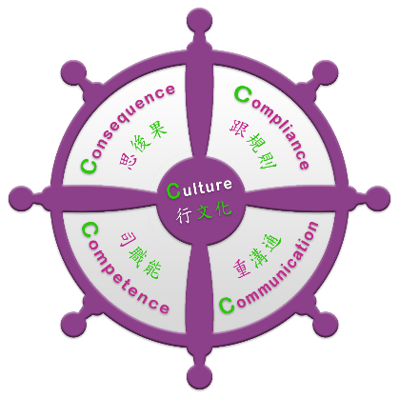
Incident Review Checklist
Have work procedures, guidelines, rules/ legislation requirements strictly followed?
2. Are records duly documented?
3. Should the procedures be practical and clear?
Any impact (or potential impact) to safety, operation or personnel?
What’s the staff understanding to change, if any?
Any relevant risk assessment conducted?
Common culture/ attitude:
Be careful
Stop unsafe act
Report the abnormality
Don’t take shortcuts
Any gap in performing safety acts?
Any missing steps of the procedure?
Are staff with adequate knowledge and skill?
Are staff with relevant valid qualification?
Is there sufficient or adequate communication?
Any communication protocol?
Has the communication conducted in right timing?
Be cautious
Courage to improve
Improvement action: Individual and System
COMPANY LOGO

Slide 16
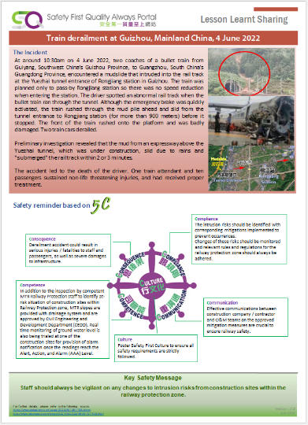
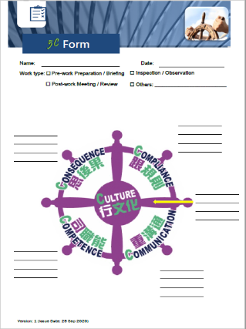
Tools
COMPANY LOGO

Slide 17



Think 5C before you act
A: 5C is a thinking tool that allows colleagues to think about and analyze potential issues related to a work in a simply way to avoid mistakes.
Q: What is ?
A: We hope all O&M colleagues of different Segments/Departments to have a common ‘language’ (thus understanding) for communicating and analyzing work-related issues
Q: Why do we need ?
A: The 5C programme is not for short-term promotion but continual safety culture development. It is also a relatively simple and easy tool for daily implementation by shopfloor colleagues.
Q: What’s so special about ?
Strong management leadership and commitment
COMPANY LOGO

Slide 18
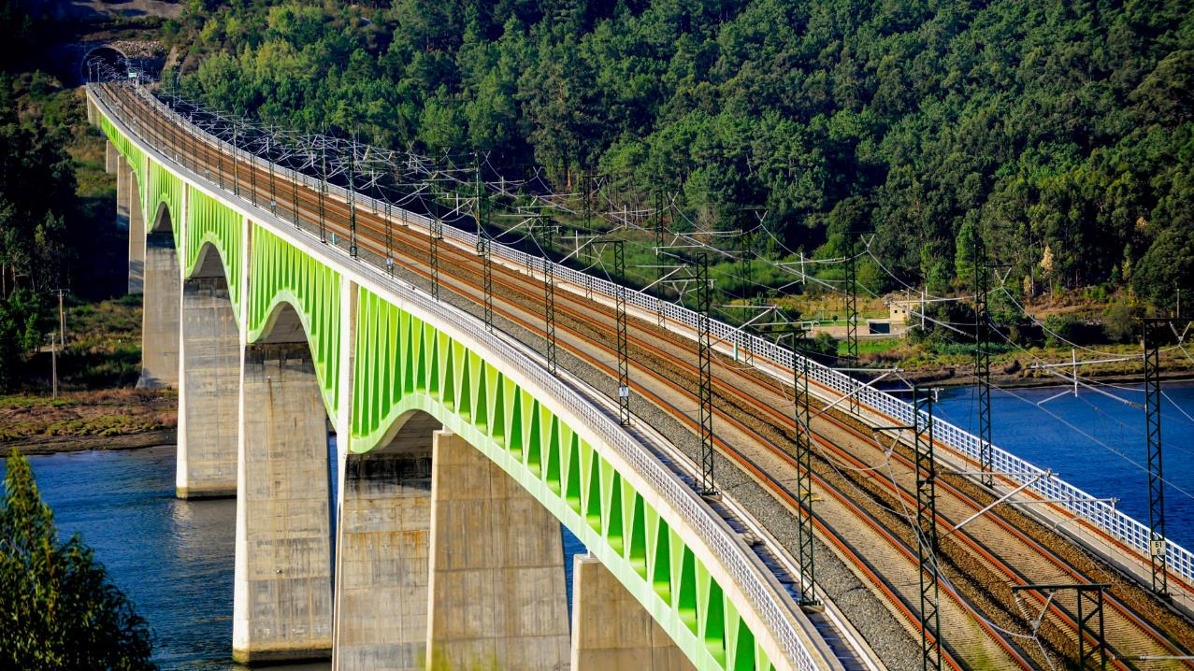
CHAPTER 3
Intelligence Safety for Risk Mitigation
IRSC 2022
COMPANY LOGO
INTERNATIONAL RAILWAY SAFETY COUNCIL
SEVILLA, OCTOBER 16-21, 2022

Slide 19
Intelligence Safety
makes use of appropriate technology, system integration and intelligence to bring an even safer railway for our passengers, colleagues, and stakeholders
Functional based technology application
Integration to reinforce impact
Anticipative prevention with intelligence
3.0
2.0
1.0
Evolution from risk mitigation to anticipative prevention

Slide 20
Intelligence Safety 1.0
- Functional based technology application
Individual System A
Individual System B
Individual System C
Managing risks to reduce the frequency of happening
Individual solution is designed to focus on specific risk mitigation using ALARP approach.

Slide 21
Intelligence Safety 2.0
- Integration to reinforce impact
Individual System A
Individual System B
Individual System C
Enhanced
Impact
System D
System E
System G
System F
Reinforce impact of the engineering solution,
system integration to maximize the effect by linkage with the similar mitigation across different systems.

Slide 22
Intelligence Safety 3.0
- Anticipative prevention with intelligence
Individual System A
Individual System B
Individual System C
Early Warning/Action & Anticipative Prevention
Advancement of digitation and connectivity across different systems
System intelligence could be interchanged and collaborated
New era of anticipating prevention with intelligence to provide multi dimension insight

Slide 23
Intelligence Safety 3.0
- Anticipative prevention with intelligence
Individual System A
Individual System B
Individual System C
Anticipative Prevention with Enhanced
Impact
System D
System E
System G
System F

Slide 24
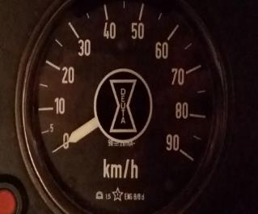
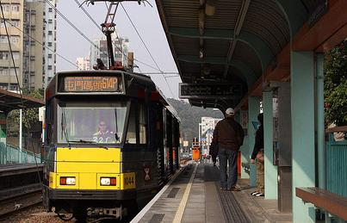
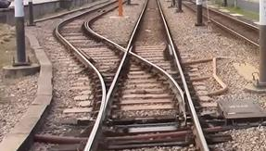
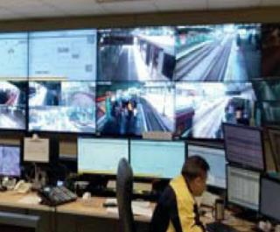




Intelligence Safety 1.0
- Functional based technology application
Integrated Speed & Position Supervision System (iSPS)
Provide intelligent & integrated digital solution to enhance driving safety of Light Rail with
Speed
Supervision
Platform
Management
Turnout
Management
Fleet
Management

Slide 25




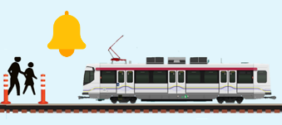
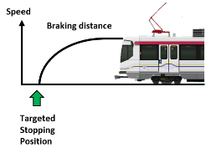
Intelligence Safety 2.0
- Integration to reinforce impact
Integrated Speed & Position Supervision System (iSPS)
Intra-system Integration
Close-up Monitoring
Conflicting
Movement
Integrating iSPS data from multiple LRVs to provide enhanced functions
Inter-system Integration
Automatic Train Bell
Automatic Braking
System integration to provide enhanced functions

Slide 26
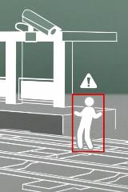

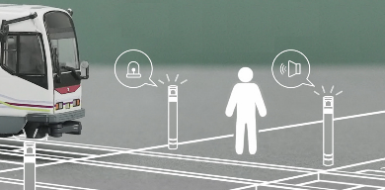
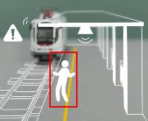
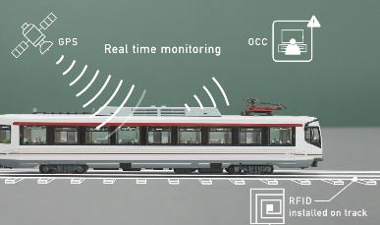
Intelligence Safety 3.0
- Anticipative prevention with intelligence
Smart Junction & Platform Analytics
iSPS
Pedestrian Flashing Bollard
Video analytics to detect track intrusion
Multiple driving alerts enhancing safety
Early warning and anticipative prevention against track intrusion with analytics results
Visual and audio alert, with on-ground LED strip to enhance pedestrian awareness
Early warning and anticipative prevention of pedestrian dashing out with iSPS LRV data

Slide 27
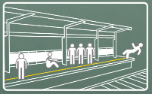
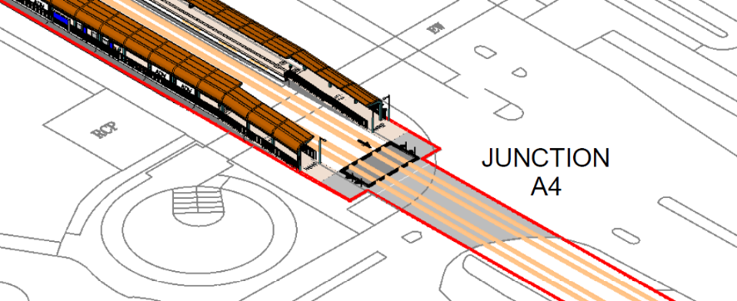

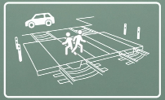



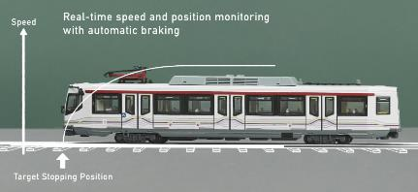
Intelligence Safety 3.0
- Anticipative prevention with intelligence
Smart Junction
Platform Analytics
Automatic PA reminder
Early warning based on VA results
iSPS Driving Reminders
Automatic Bell Triggering & Braking
Early warning based on iSPS LRV data
Pedestrian Warning Bollard

Slide 28
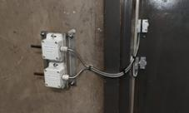
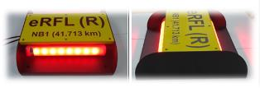
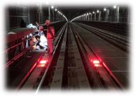
Intelligence Safety 1.0
- Functional based technology application
Smart
Tunnel
Trackside Access Door Detection System (TADDS)
Remote Flashing Light Remote-Control System (eRFL)
  Indoor positioning along Tunnel
  Overview of real-time positions of all workers
  Enhancing trackwork safety
  Real-time trackside door status
  Intrusion detection and access control
  Enhancing efficiency and maximizing maintenance window with remote control of flashing light
  Enhancing safety with real-time status of flashing light

Slide 29
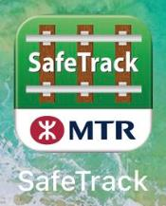
Intelligence Safety 2.0
- Integration to reinforce impact
System Integration
One-stop shop user interface to allow track workers switching between functions seamlessly on mobile
Real-time status available on hand
Enhanced efficiency with digitalized workflow with electronic records
SafeTrack
Smart Tunnel
Red Flashing Light Remote Control
Trackside Access Door Detection

Slide 30
Intelligence Safety 3.0
- Anticipative prevention with intelligence
Cross-Platform AI as Validation and Verification Interlocking to Ensure Safety
Smart
Tunnel
Trackside Access Door Detection System (TADDS)
Remote Flashing Light Remote-Control System (eRFL)
Smart Authorization: book-on and off through one-stop platform
Smart Protection: remote set up and turn off flashing light via eRFL
Traffic Hours
Non-Traffic Hours (NTH)
Traffic Hours
Smart Supervision: trackside worker overview along Tunnel
Smart Access Control: real-time trackside access door status

Slide 31

COMPANY LOGO

