Slide 1


IRSC 2022
INTERNATIONAL RAILWAY
SAFETY COUNCIL
COMPANY LOGO
SEVILLA, OCTOBER 16-21, 2022

Slide 2
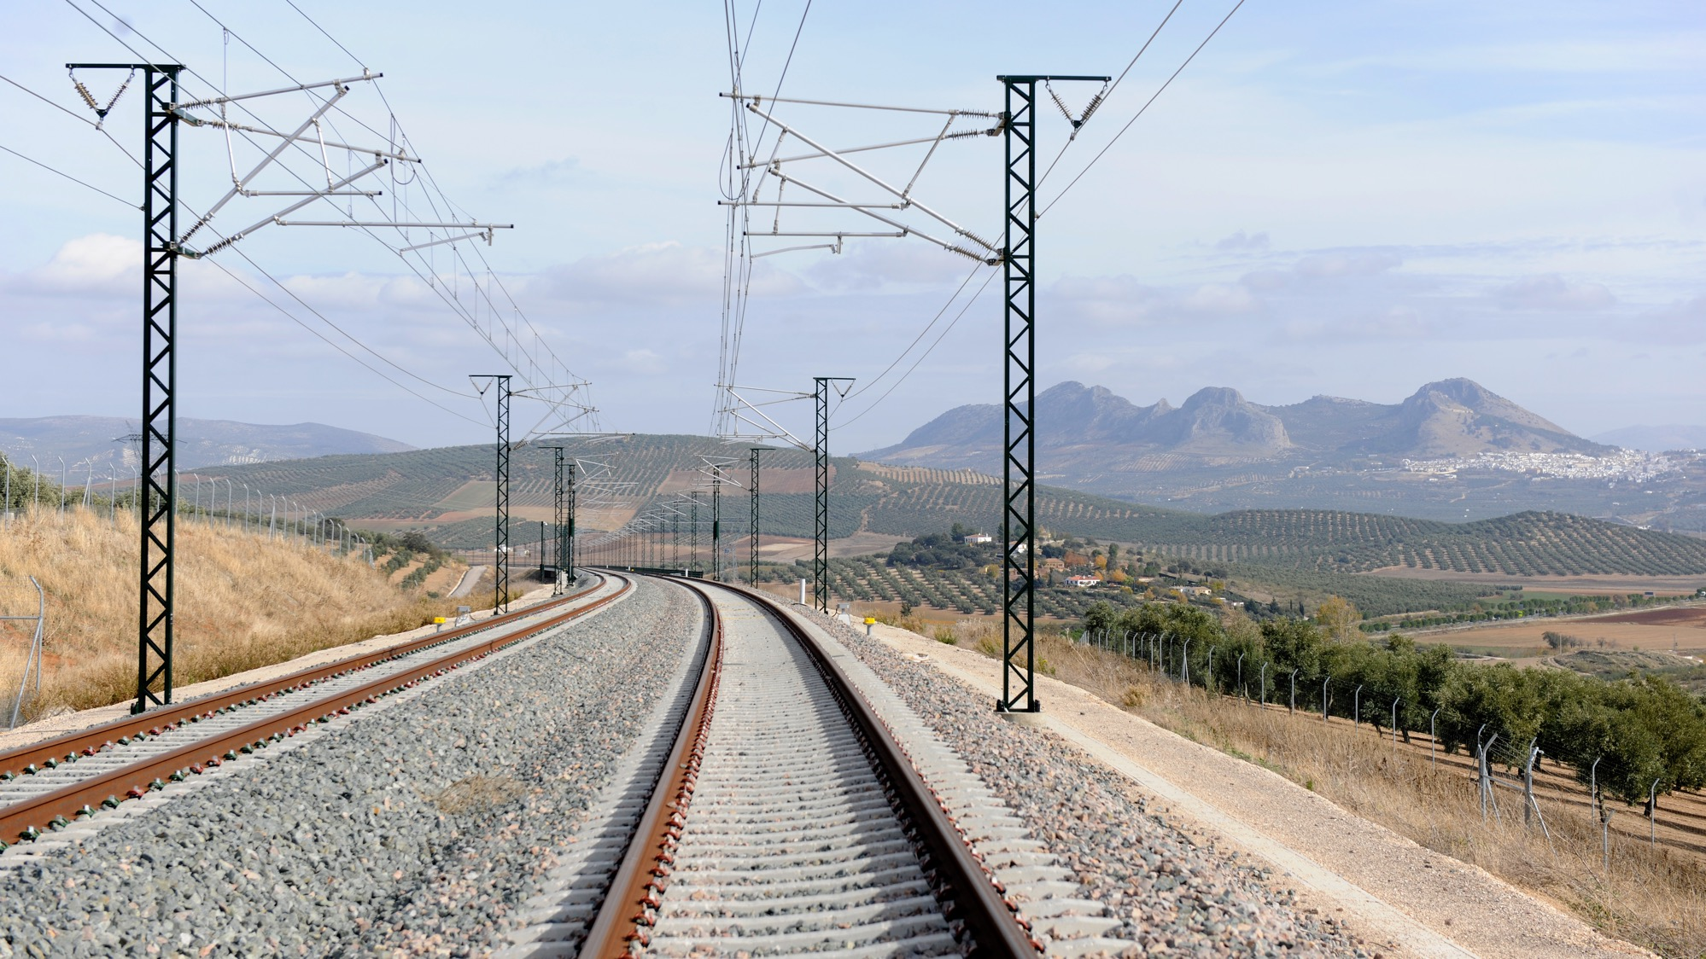



GARRY STIMPSON
Head of Capability, Rail Safety Directorate (RSD), Office of Rail and Road (ORR)
IRSC 2022
COMPANY LOGO
INTERNATIONAL RAILWAY SAFETY COUNCIL
SEVILLA, OCTOBER 16-21, 2022

Slide 3
MAKING BEST USE OF DATA and Intelligence in DETERMINING REGULATORY ACTIVITIES on GreAT BRITAIN’S RAILWAYs
IRSC 2022
INTERNATIONAL RAILWAY SAFETY COUNCIL
SEVILLA, OCTOBER 16-21, 2022

Slide 4
Rail Safety Directorate (RSD) – what do we do?
We regulate health and safety for the entire mainline rail network in Britain, as well as London Underground, light rail, trams and the heritage sector:
provide health and safety guidance and conducting research to promote continuous improvement
publish reports on the rail industry's health and safety performance
carry out inspections to ensure that the train and freight operating companies and Network Rail manage both passenger and occupational health and safety risks appropriately
investigate breaches of health and safety regulation on the railways
take informal and formal enforcement action, including improvement notices and prosecutions

Slide 5
Rail Safety Directorate (RSD) – what do we do?
We regulate health and safety for the entire mainline rail network in Britain, as well as London Underground, light rail, trams and the heritage sector:
provide health and safety guidance and conducting research to promote continuous improvement
publish reports on the rail industry's health and safety performance
carry out inspections to ensure that the train and freight operating companies and Network Rail manage both passenger and occupational health and safety risks appropriately
investigate breaches of health and safety regulation on the railways
take informal and formal enforcement action, including improvement notices and prosecutions
ORR Strategic Objective No 1: a Safer Railway

Slide 6
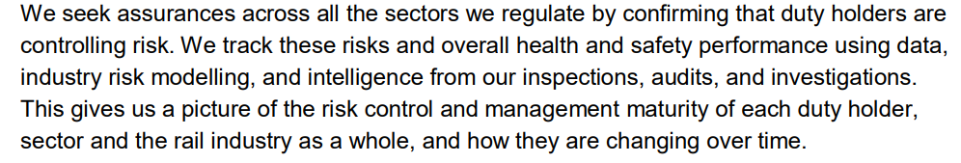
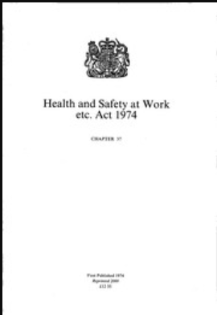
A Safer Railway
Identifying and prioritising significant risks helps us to focus our resources where we can make the greatest impact on reducing risk. We structure our inspections, audits and activities accordingly.

Slide 7
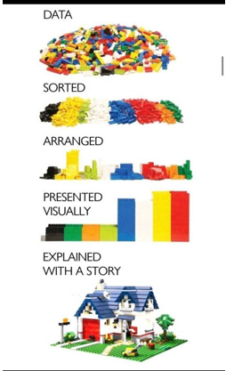
Use of data to support decision making on priorities
RSD has access to lots of data, both internal and external:
  RSSB data
  RDG data
  RIDDOR data
  Daily logs
  Inspection reports
  RM3 End of Year reports
  Complaints
  Investigations
Reality is we did not do much with any data in terms of intelligence and/or analysis

Slide 8
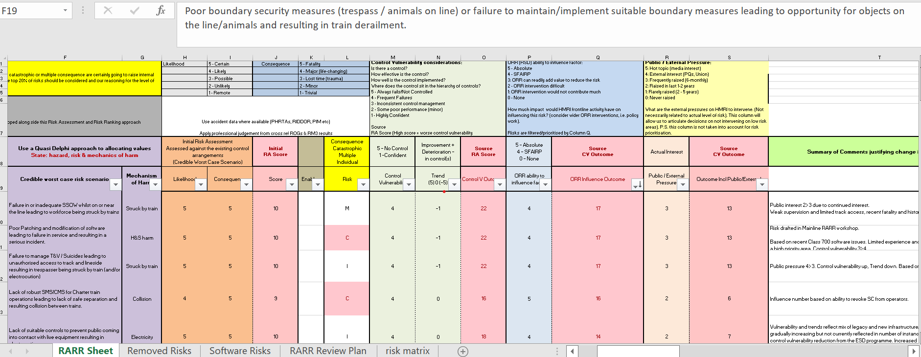
Risk Assessment and Risk Ranking Process

Slide 9



But there were problems
Did not meet the needs of all users, and without confidence in the data or the process, unsupported professional “judgement” usually won the day

Slide 10
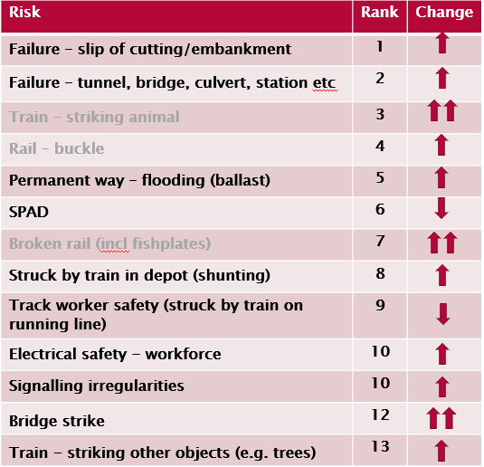
End result did not have confidence of anyone involved
No clear link to any data or evidence source to support priorities
Changing definitions every year meant could not identify trends
Over-reliance on professional judgement as sole deciding factor
We were (sort of) confident we were (probably) looking at the right topics (but could not prove it if questioned)
We needed a clear audit trail to explain why we prioritized some topics over others

Slide 11
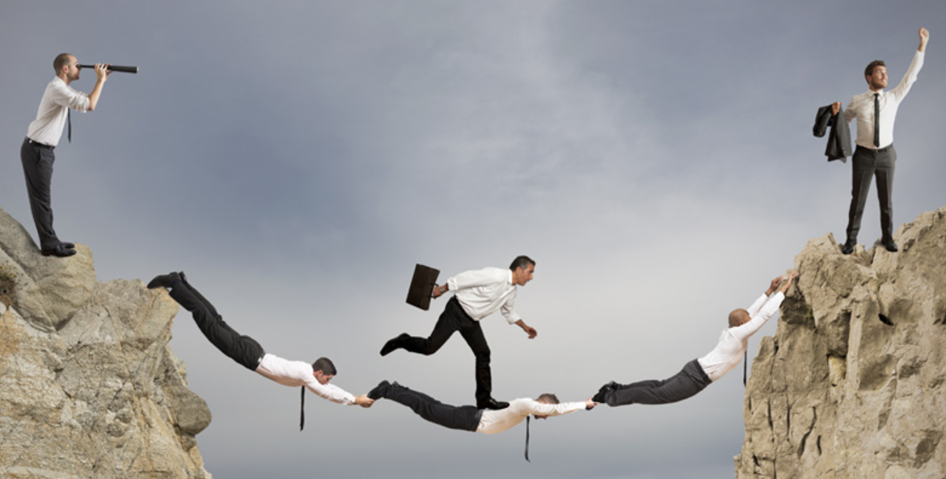
How did we deal with these multiple challenges?

Slide 12
If at first you do not succeed…
2020 tried to improve existing RARR process and use a particular data set (RIDDOR) to benchmark hazards and risks – FAILED, but senior leaders were supportive and understanding
2021 started from complete scratch, changed name from RARR to Risk Profiling
worked with ORR Analysis Team to identify and better present data to support decision making
removed the complicated weightings
Used an agreed list of hazard topics (linked to RSSB Safety Risk Model (SRM) categories) to allow us to spot trends longer term
after a lot of consultation with stakeholders to reassure them professional judgement remained an important component – BETTER
2022 went to an outside contractor to build us a properly designed process:
Benchmarked against other regulators both in GB and internationally
Keep it simple was the mantra
Lots of engagement and identified RSD risk champions who sold it to their colleagues

Slide 13
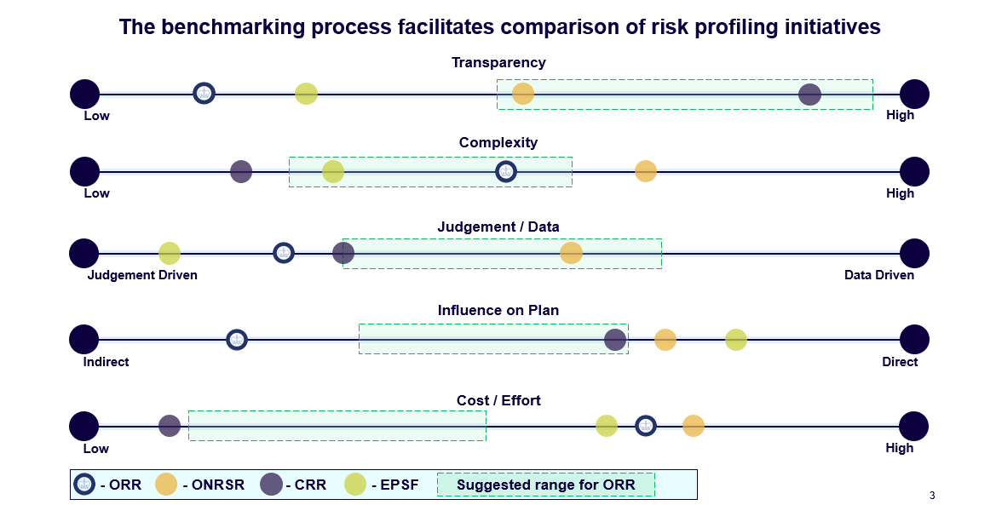
Now have a “best in class” process for our risk profiling

Slide 14
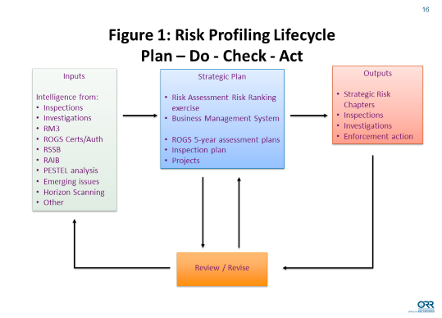

Slide 15
Aims and objectives of new risk profiling exercise
A process that draws from all of the credible sources of information available to us:
Inspectors’ experience
Inspection findings
Safety reports
A tool that facilitates the methodical assimilation of all the factors above
A record of the deliberation and decisions made…
…and why

Slide 16
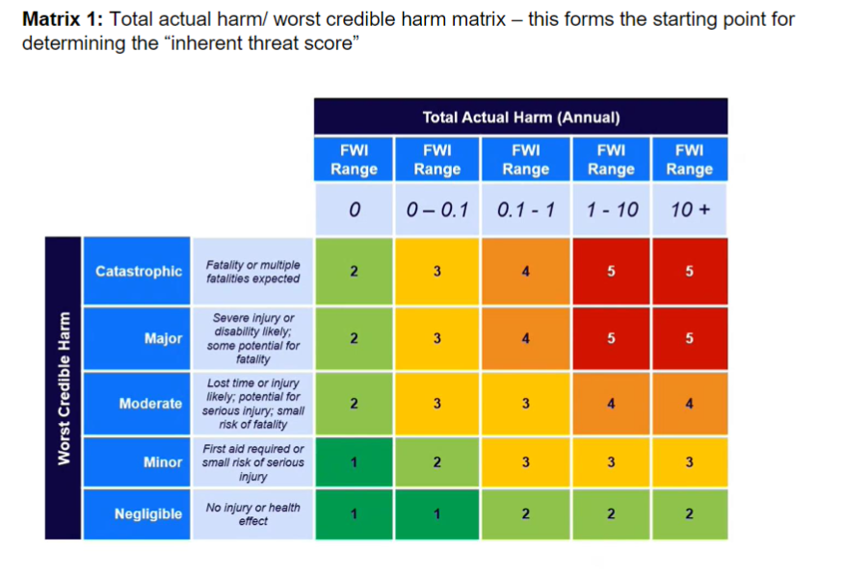
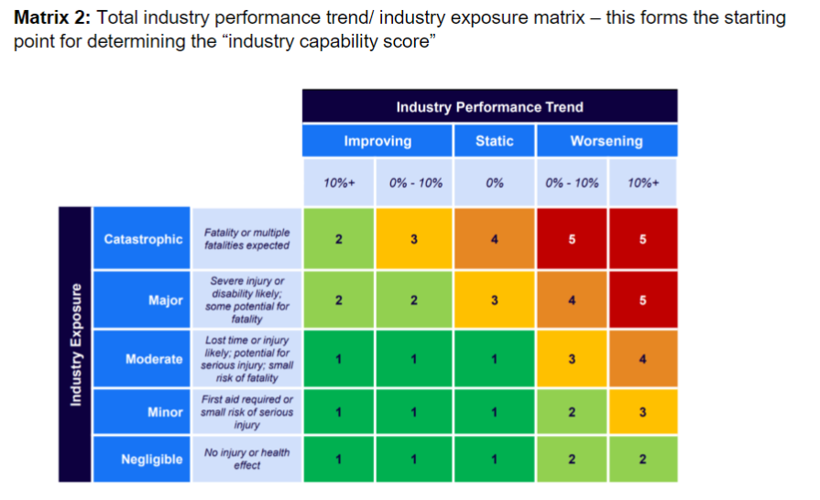

Slide 17
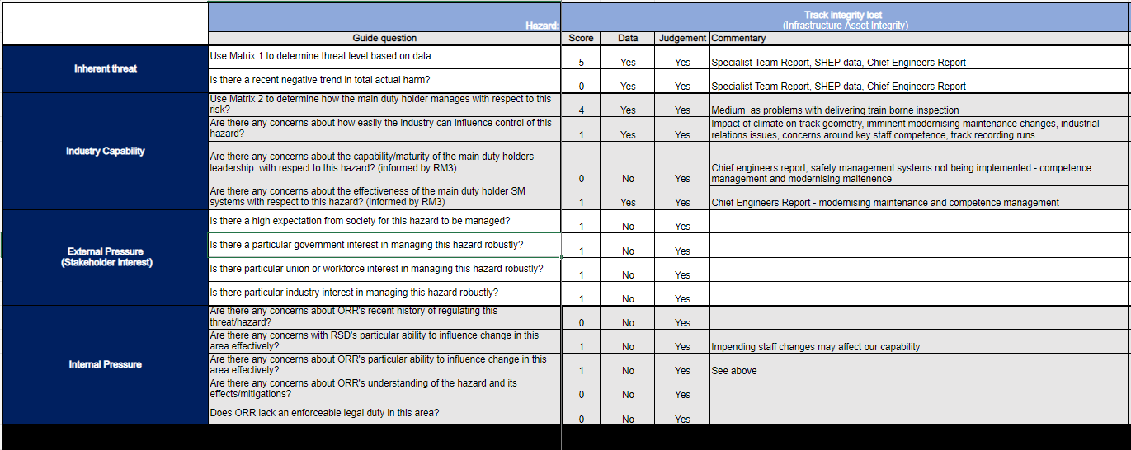

Slide 18
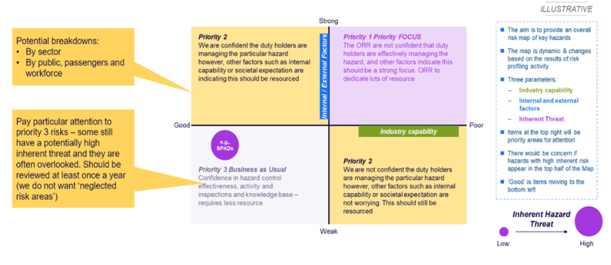

Slide 19
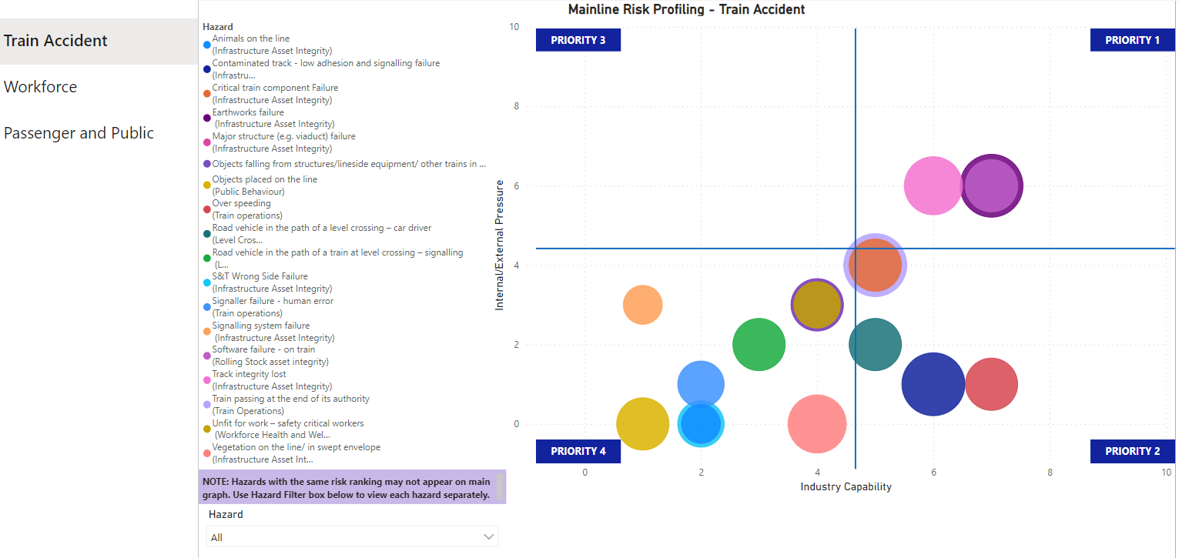

Slide 20
Benefits of the new risk profiling exercise
Will ensure we have a transparent, accountable and targeted decision-making process
  Can show what evidence is used to support decisions
Has the confidence of the users and was not “imposed” top-down on them but instead developed in consultation with them
It is ok to get it wrong, to take a risk – provided you learn the lessons!
Sometimes keeping it simple is the way forward
  Reduced the number of hazard topics from several hundred to about 40
Now have a properly designed, best in class risk profiling process, which can be adapted to focus on needs of the different sectors: Mainline, Heritage, Transport for London, Trams and Light Rail

Slide 21
COMPANY LOGO

