Slide 1


IRSC 2022
INTERNATIONAL RAILWAY
SAFETY COUNCIL
SEVILLA, OCTOBER 16-21, 2022

Slide 2




SEMANTIC AI FOR PREDICTIVE MAINTENANCE OF RAILWAY TRACK SYSTEM
Mr S. H. CHEONG Edmond
Chief Engineer/Railways
Electrical and Mechanical Services Department, Government of HKSAR, China
IRSC 2022
INTERNATIONAL RAILWAY SAFETY COUNCIL
SEVILLA, OCTOBER 16-21, 2022

Slide 3
AGENDA
Part 1
Background
Part 2
Semantic Artificial Intellgence (AI) Modelling
Part 3
Results
Part 4
Conclusion

Slide 4

Part 1
Background
IRSC 2022
INTERNATIONAL RAILWAY SAFETY COUNCIL
SEVILLA, OCTOBER 16-21, 2022

Slide 5
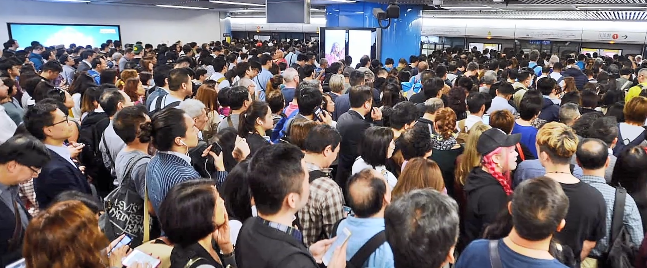

Background
Railway Network of Hong Kong, China
Over 5 million passenger journeys are made each day
Very long daily service hours
Extremely short maintenance window
Numerous railway assets required maintenance
Need an effective way to minimize breakdown maintenance and incidents

Slide 6

Background
Data-driven Era
Wide range of data available
  Static data
  Dynamic data
  Online data
Extraction of knowledge/ information from data
Develop Artificial Intelligence (AI) model for decision making / prediction

Slide 7
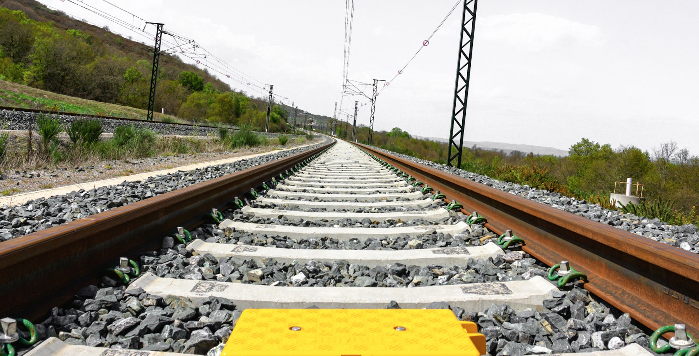
Part 2
Semantic Artificial Intelligence (AI) Modelling
IRSC 2022
INTERNATIONAL RAILWAY SAFETY COUNCIL
SEVILLA, OCTOBER 16-21, 2022

Slide 8

Semantic AI Modelling
Challenges
  Massive / Missing data
  Data in different types and formats
  Missing of correlation among data
  Resources and time consuming for data standardization and cleansing
  Expert knowledge required to transform data into structured knowledge/information

Slide 9

Semantic AI Modelling
Novel Approach on AI Modelling
Standardization – Railway Schema
Adopt Semantic AI Technology
Transform raw data into structured data
Find out correlation, contribution factors and ranking of incident
Develop AI Predictive Maintenance Model – based on incident prediction probability
Pilot trial application on Permanent Way (Pway) System in Hong Kong railway network
Silver medal award wining project
Invention of Geneva 2022

Slide 10
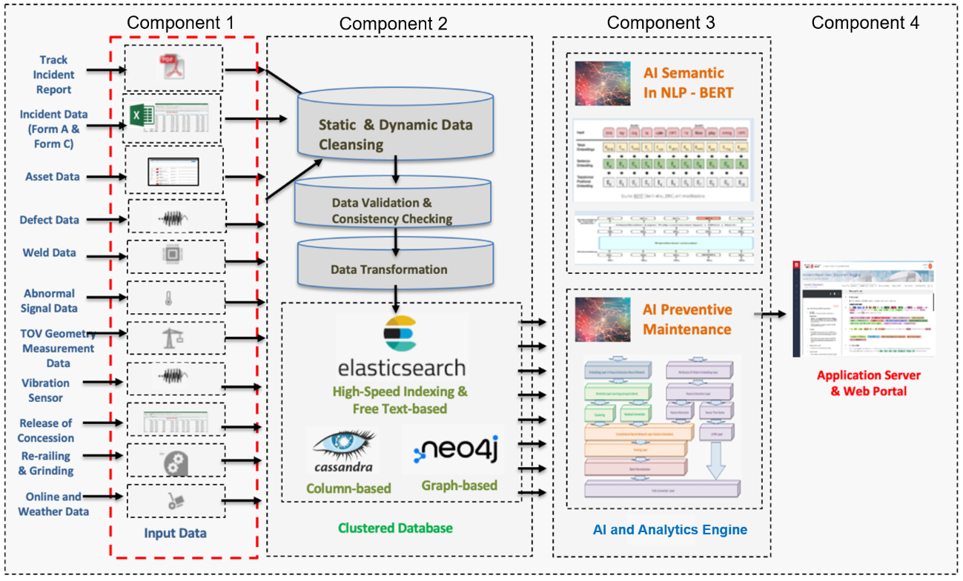
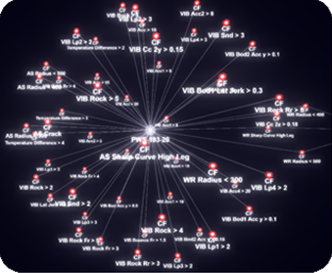
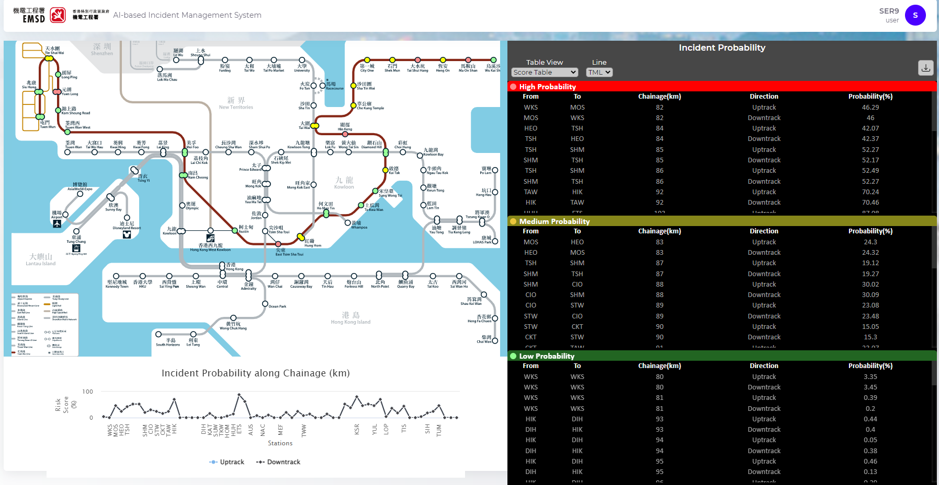
Semantic AI Modelling
System Hierarchy
Semantic AI
Model – Data Processing
Semantic AI
Model – Incident Prediction

Slide 11
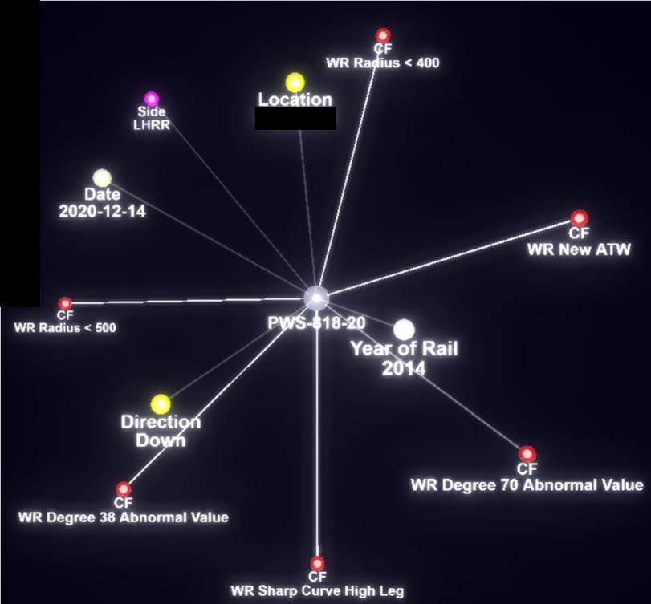
Semantic AI Modelling
  Output
  Knowledge Graph
      Visually Display
      Relationship between Contributing Factors and incident
      Strength of Edges

Slide 12
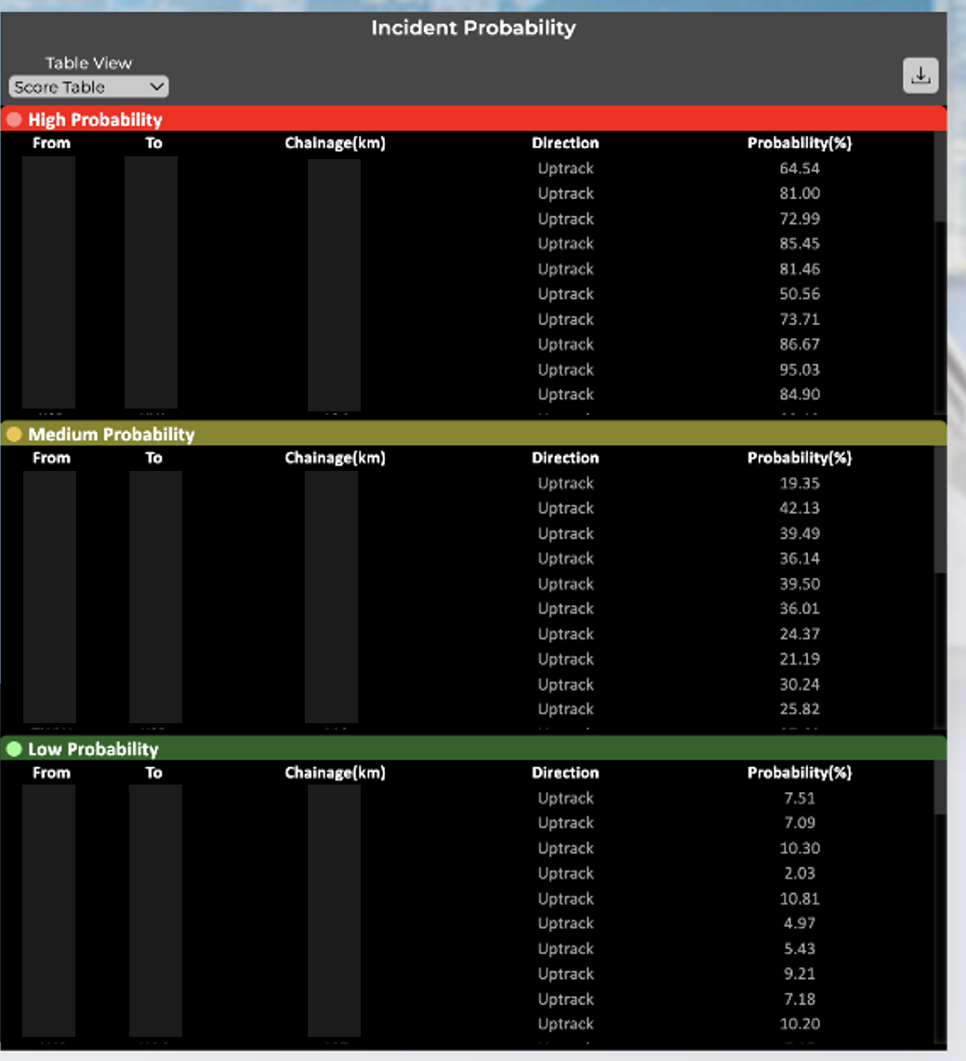
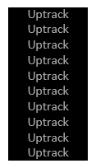
Semantic AI Modelling
Output
    Probability of incident along Pway chainage
    Ranked
    High Risk
      Medium Risk
      Low Risk
Incident Probability
Location A1
Location A2
Location A3
Location A4
Location A5
Location A6
Location A7
Location A8
Location A9
Location A10
Location B1
Location B2
Location B3
Location B4
Location B5
Location B6
Location B7
Location B8
Location B9
Location B10
1
2
3
4
5
6
7
8
9
10
64.54
81.00
72.99
85.45
81.46
50.56
73.71
86.67
95.03
84.90
Location A11
Location A12
Location A13
Location A14
Location A15
Location A16
Location A17
Location A18
Location A19
Location A20
Location B11
Location B12
Location B13
Location B14
Location B15
Location B16
Location B17
Location B18
Location B19
Location B20
11
12
13
14
15
16
17
18
19
20
19.35
42.13
39.49
36.14
39.50
36.01
24.37
21.19
30.24
25.82
Location A21
Location A22
Location A23
Location A14
Location A15
Location A16
Location A17
Location A18
Location A19
Location A20
Location B11
Location B12
Location B13
Location B14
Location B15
Location B16
Location B17
Location B18
Location B19
Location B20
21
22
23
24
25
26
27
28
29
30
7.51
7.09
10.30
2.03
10.81
4.97
5.43
9.21
7.18
10.20

Slide 13

Part 3
Results
IRSC 2022
INTERNATIONAL RAILWAY SAFETY COUNCIL
SEVILLA, OCTOBER 16-21, 2022

Slide 14
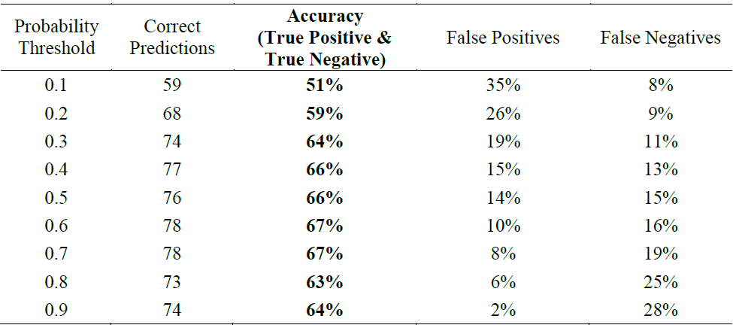
Results
Incident Probability Prediction
Accuracy Test (Round 1)
  Training data: Jan 2016 – Aug 2021 (68 Months, Line 1 data)
  Testing data: Sep 2021 – Apr 2022 (8 Months, Line 1 data)
  Accuracy is 67% with Probability Threshold at 0.7

Slide 15
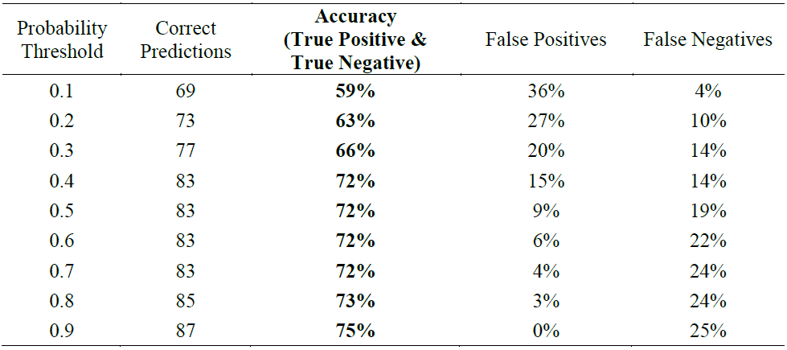
Results
Incident Probability Prediction
Accuracy Test (Round 2)
  Training data: Jan 2016 – Dec 2021 (68 + 4 Months, Line 1 data)
  Testing data: Jan 2022 – Jun 2022 (6 Months, Line 1 data)
  Accuracy is 72% with Probability Threshold at 0.7
Accuracy increased by 5%
False Positives improved by 4%

Slide 16
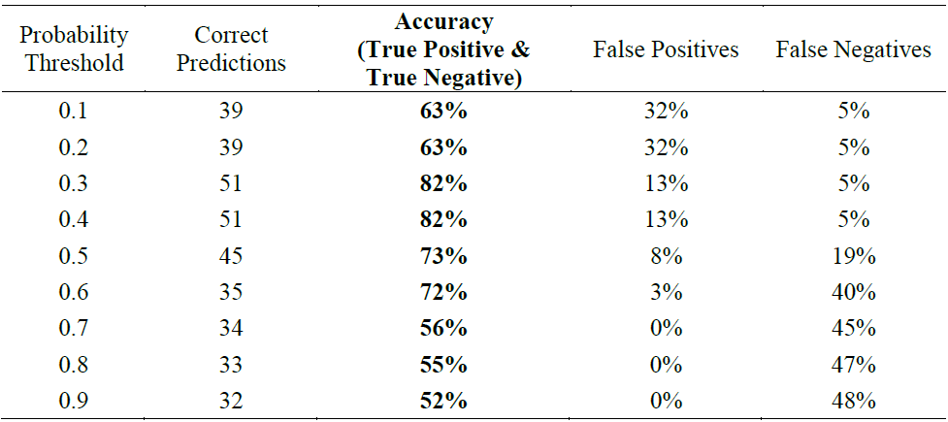
Results
Incident Probability Prediction
Accuracy Test (Round 3)
  Training data: Jan 2016 – Dec 2021 (68 + 4 Months, Line 1 data)
  Testing data: Jan 2022 – Apr 2022 (4 Months, Line 2 data)
  Accuracy is 56% with Probability Threshold at 0.7

Slide 17
Part 4
Conclusion
IRSC 2022
INTERNATIONAL RAILWAY SAFETY COUNCIL
SEVILLA, OCTOBER 16-21, 2022

Slide 18
Conclusion
    Semantic AI Model
    Schema standardization allows integration of wide range data into a clustered database more easily
    Semantic technology (Q&A module) enables recovery and visualization of structured knowledge/ information from data more efficiently
    Identified contributing factors and not easily noticeable indicators (Pway incidents in this case)
    Incident prediction accuracy improves with more data are used to train up the AI model
    Ranking of incident probability empower maintainer with predictive early warnings, historical case matching, and actionable intelligence (predictive maintenance)
    Application in other railway systems is feasible

Slide 19


Acknowledgement
Organizations participated in this pilot trial
Mass Transit Railway Corporation Limited
Infrastructure Maintenance
City University of Hong Kong
School of Data Science

Slide 20
Thank You !

