Slide 1


IRSC 2022
INTERNATIONAL RAILWAY
SAFETY COUNCIL
SEVILLA, OCTOBER 16-21, 2022

Slide 2
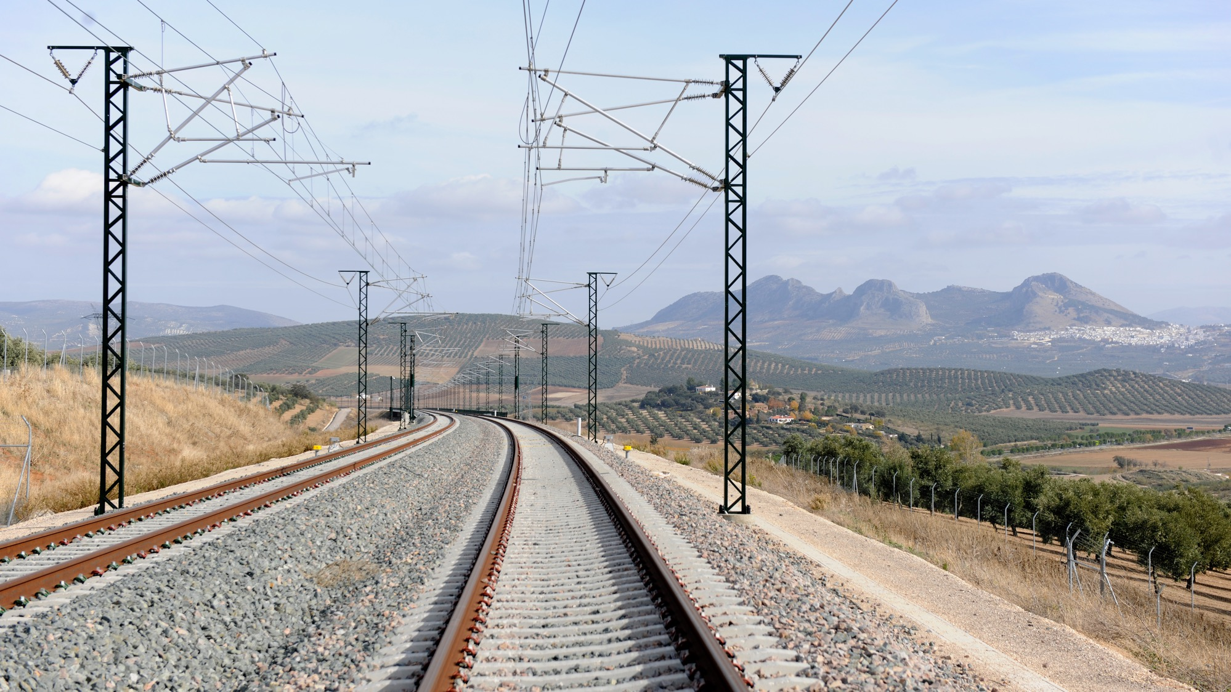



TATIANA RUEDA MARTÍNEZ
Technical Manager. INECO
IRSC 2022
INTERNATIONAL RAILWAY SAFETY COUNCIL
SEVILLA, OCTOBER 16-21, 2022

Slide 3
HUMAN FIRST
When Human Factors and Safety Walk Together
IRSC 2022
INTERNATIONAL RAILWAY SAFETY COUNCIL
SEVILLA, OCTOBER 16-21, 2022

Slide 4
INDEX
CHAPTER 1
Introduction
CHAPTER 2
Integrating Human Factors in Risk Analysis
CHAPTER 3
Next steps: Process automation and the use of the data science

Slide 5

CHAPTER 1
Introduction
IRSC 2022
INTERNATIONAL RAILWAY SAFETY COUNCIL
SEVILLA, OCTOBER 16-21, 2022

Slide 6
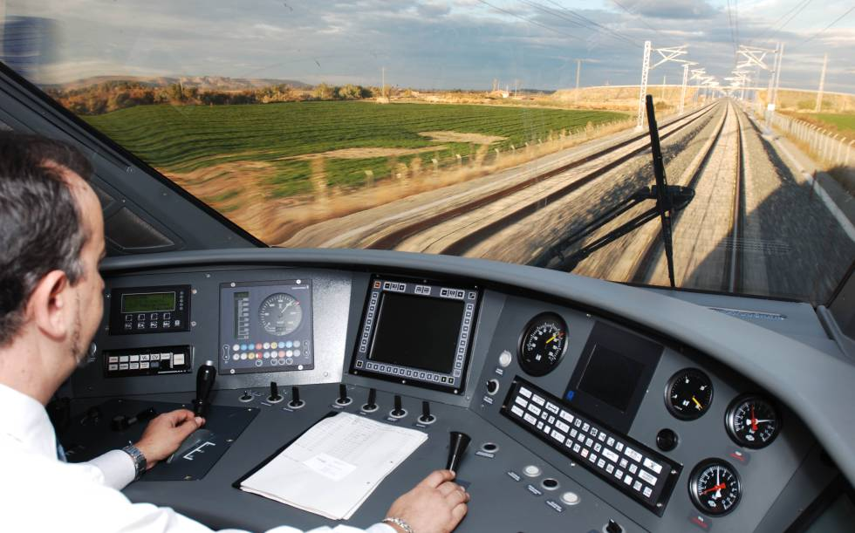
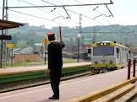
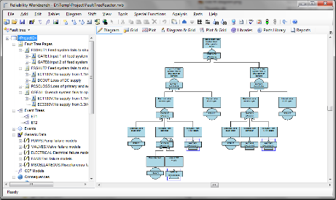
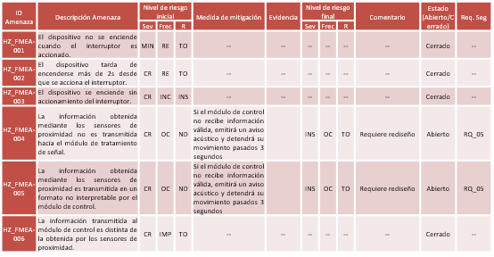
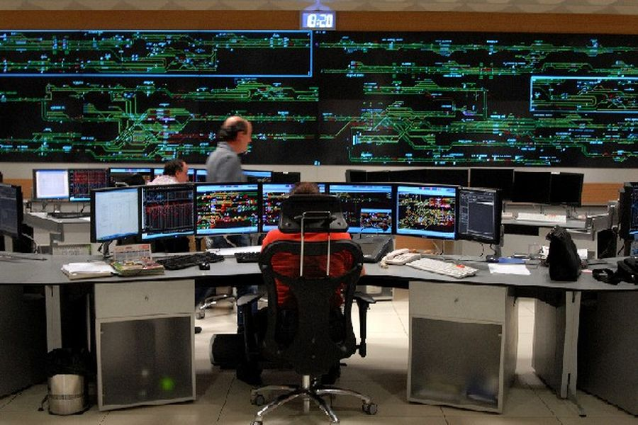
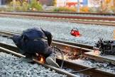
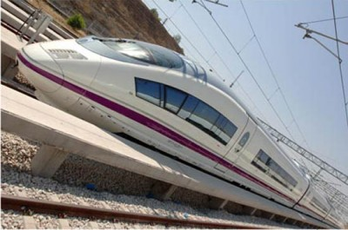

INTRODUCTION

Slide 7
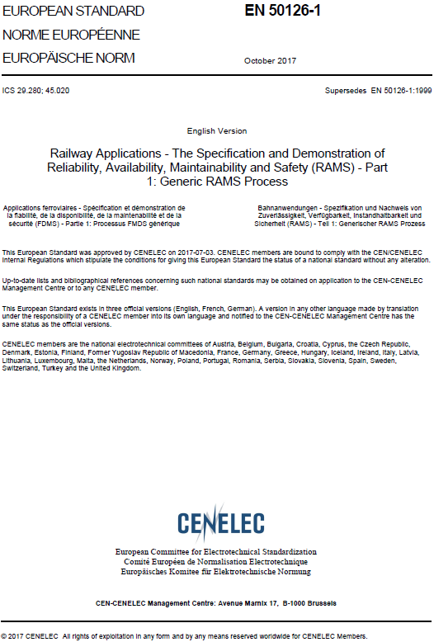

INTRODUCTION

Slide 8
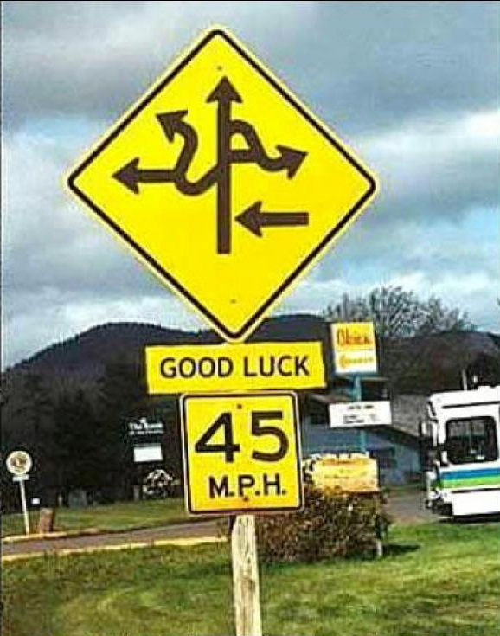
INTRODUCTION

Slide 9



INTRODUCTION

Slide 10

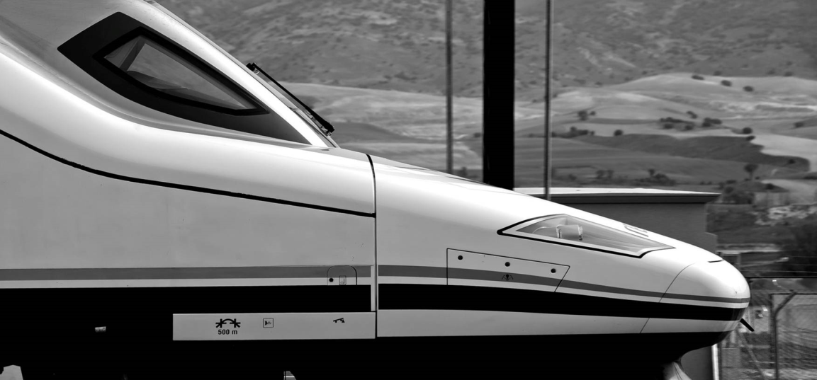


INTRODUCTION
Railway Safety Area
Aeronautical Safety Area
Innovation Area
First benefits, before even starting!
  Finding a lot in common, knowledge and experience to share
  Transversal orientation of the project
  method valid for Railways and Aircraft operation, would be suitable for any other sector

Slide 11



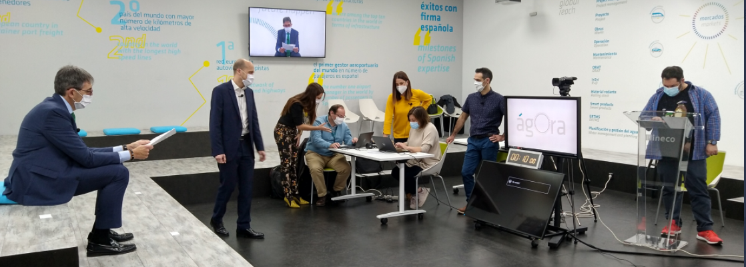


INTRODUCTION
Benchmarking of the Human Factors techniques
Integration into risk analysis processes : practical and transversal
First version of the Integration of the Human Factor into the Risk Assessments methodology
2016-2017
2018
Improving methodology, changing the process, adapting and improving evaluation techniques
University cooperation in the project
Award for the best Ineco innovation project.
CANSO Award
Firts international Ineco’s webinar
2019-2020
2021-2022
Development of a tool for the application of the methodology.
Human Performance Analysis using Data Science.
Development of new products within the product line“Human First”: InFact, BioMaF and GFA tool.
NEXT
Consolidation of the Human First line product.
Research on new trends (resilience engineering, Safety II).

Slide 12
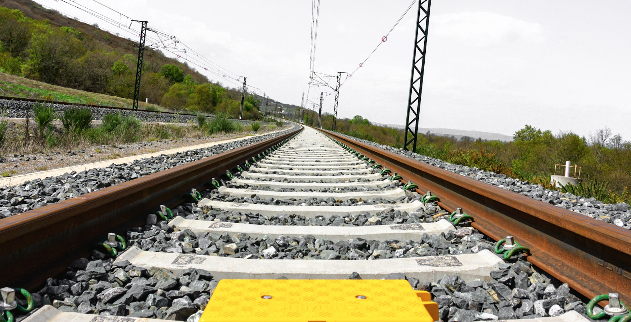
CHAPTER 2
Integrating Human Factors in Risk Analysis
IRSC 2022
INTERNATIONAL RAILWAY SAFETY COUNCIL
SEVILLA, OCTOBER 16-21, 2022

Slide 13
INTEGRATING HUMAN FACTORS IN RISK ANALYSIS
1
2
TASK ANALYSIS
TASK ASSESSMENT
Task classification
HUMAN PERFORMANCE FACTORS
Brainstornming with experts:
MITIGATION MEASURES
Proposal of recommendations
System description
Time-line Analysis
Tabular Task Analysis
Task ranking
Identification
Assessments
Prioritisation
4
3

Slide 14

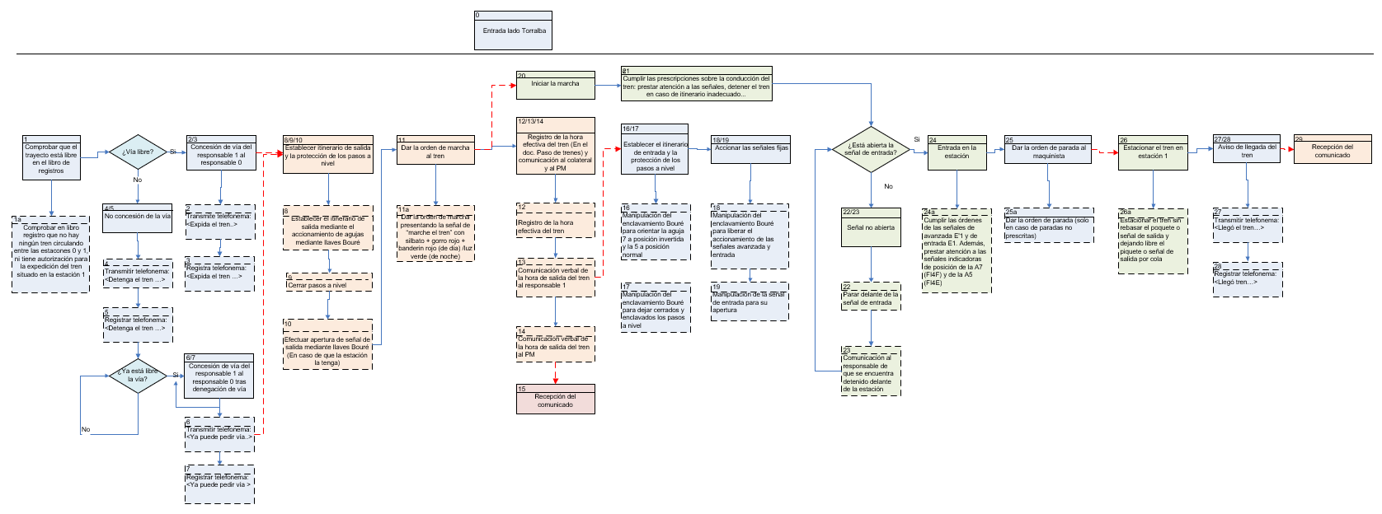
INTEGRATING HUMAN FACTORS IN RISK ANALYSIS
1
System Description

Slide 15

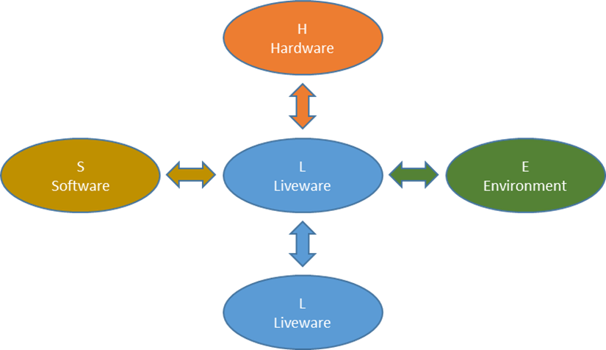
INTEGRATING HUMAN FACTORS IN RISK ANALYSIS
1
System Description
Shell Model

Slide 16

INTEGRATING HUMAN FACTORS IN RISK ANALYSIS
2
Task Assessment
EXECUTION TIME
FREQUENCY
TASK PARAMETERS
COMPLEXITY
LOCATION
DIFFERENT SHIFTS

Slide 17

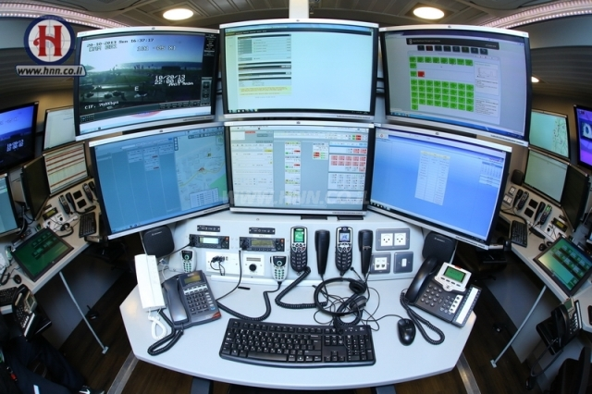




INTEGRATING HUMAN FACTORS IN RISK ANALYSIS
3
Human Performance Factors
HMI DESIGN
FATIGUE
STRESS MANAGEMENT
TRAINING
WORK ENVIRONMENT

Slide 18
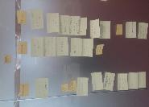
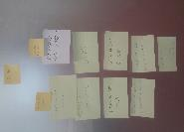
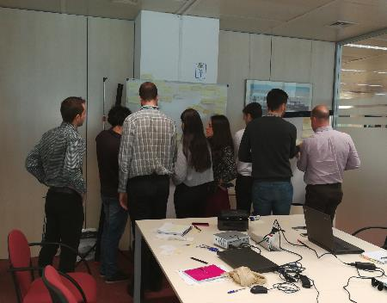
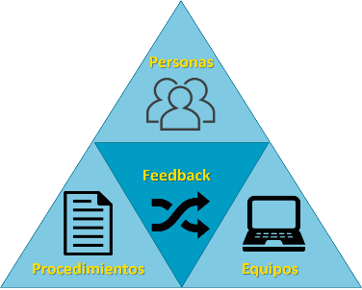
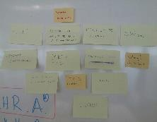
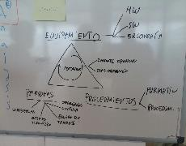
INTEGRATING HUMAN FACTORS IN RISK ANALYSIS
4
Mitigation Measures
FARHRA
People:
- Competencies
- Psychophysical condition
- Organizational culture
- Human team
Feedback:
- Feedback during operation
- Feedback after operation
People
Procedures:
- Procedures
- Standards
Feedback
Equipment:
- Software
- Hardware
- Ergonomics
Procedures
Equipment
Feasible Action Rules for Human Reliability Assessment

Slide 19
INTEGRATING HUMAN FACTORS IN RISK ANALYSIS
Systematic and practical methodology
Work as done VS work as imagine
Comprehensive and transversal
Specific recommendations for the improvement of human performance
CANSO Award Winning Methodology
https://www.atc-network.com/atc-news/canso-and-ineco/ineco-wins-canso-global-safety-achievement-award-2019

Slide 20
CHAPTER 3
Next steps: Process automation and the use of the data science
IRSC 2022
COMPANY LOGO
INTERNATIONAL RAILWAY SAFETY COUNCIL
SEVILLA, OCTOBER 16-21, 2022

Slide 21

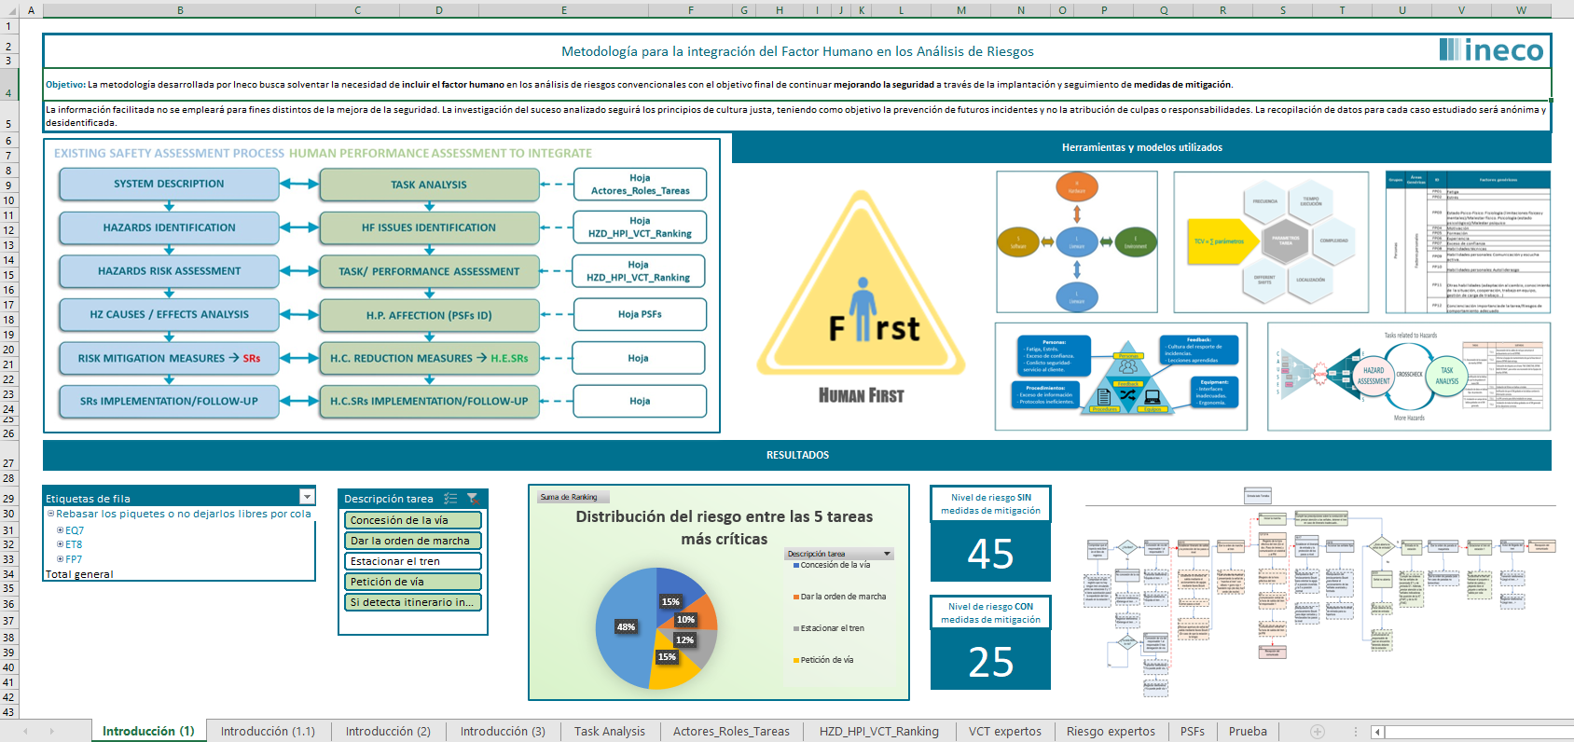
NEXT STEPS: PROCESS AUTOMATION AND THE USE OF THE DATA SCIENCE
Our iHISA tool…

Slide 22
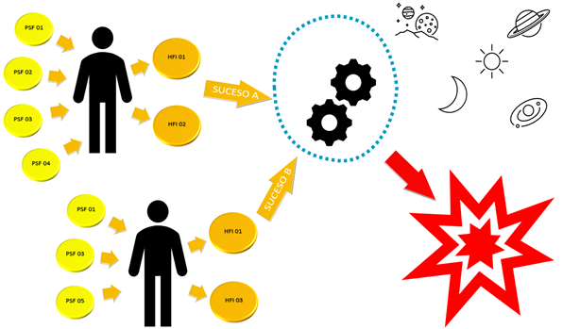
NEXT STEPS: PROCESS AUTOMATION AND THE USE OF THE DATA SCIENCE
The InFact tool and data base
Coincidence in time and space
Undesired event/event

Slide 23

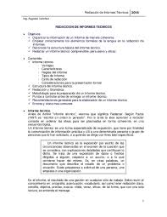
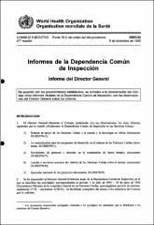
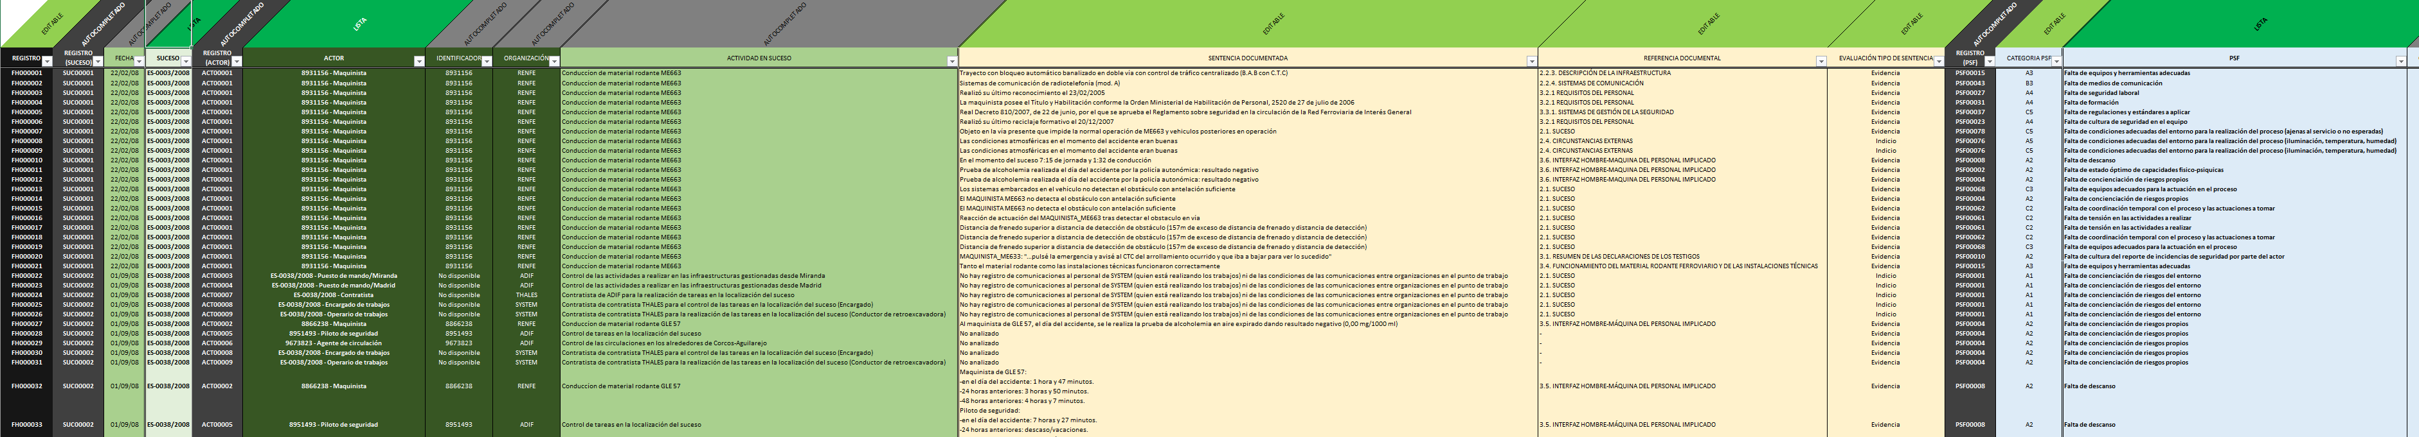
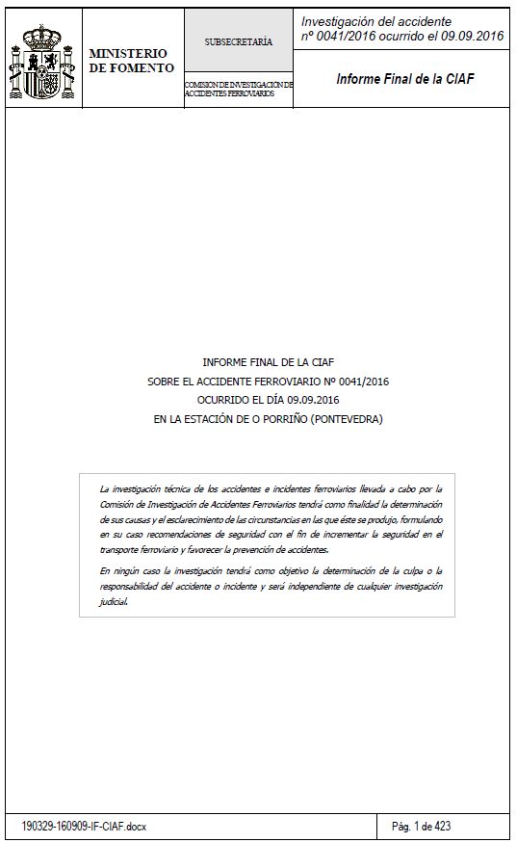
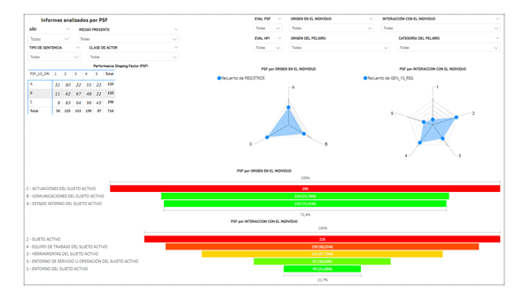
NEXT STEPS: PROCESS AUTOMATION AND THE USE OF THE DATA SCIENCE
The InFact tool and data base

Slide 24
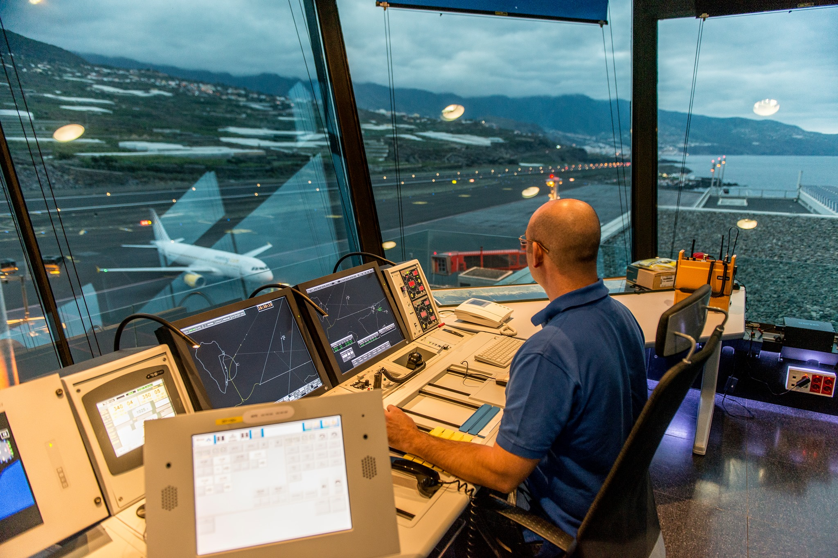
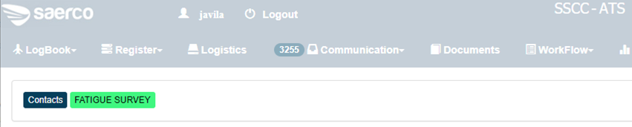
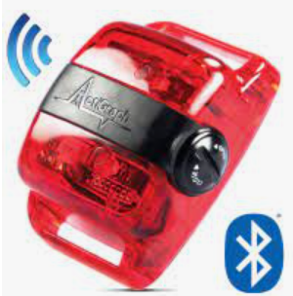
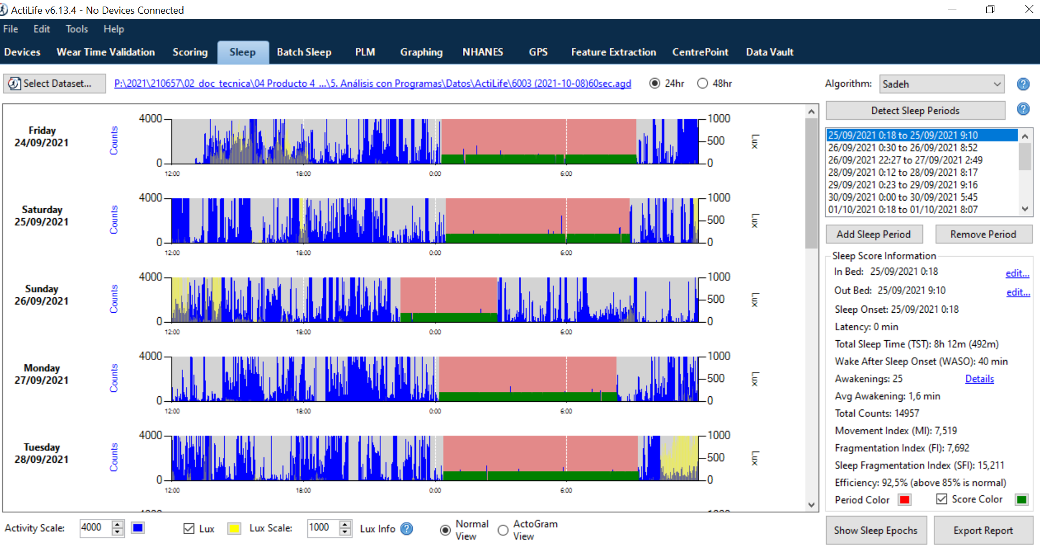
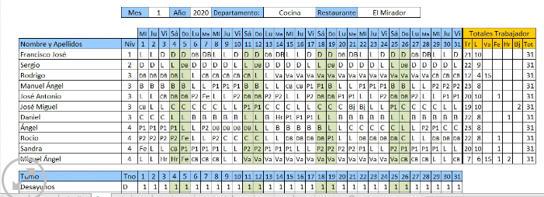


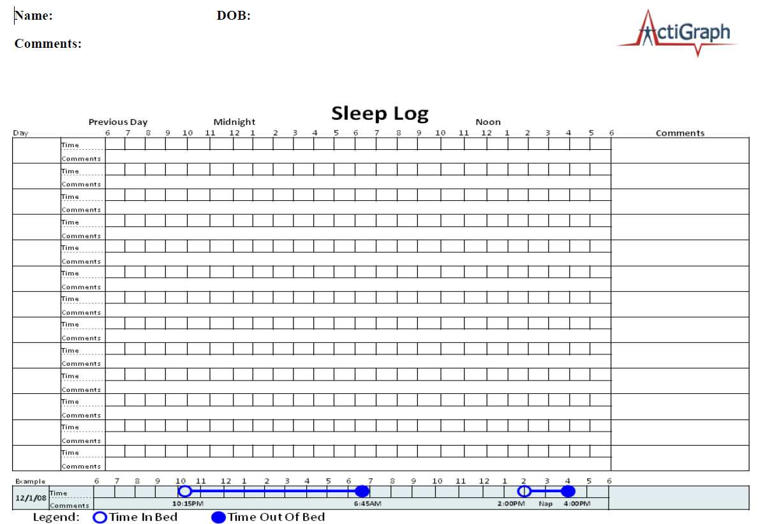
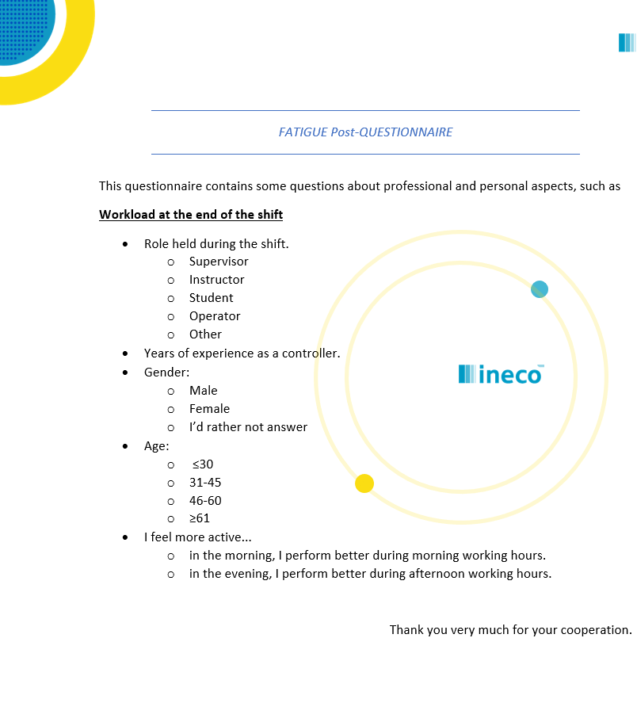

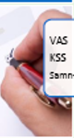
NEXT STEPS: PROCESS AUTOMATION AND THE USE OF THE DATA SCIENCE
The BioMaF model
Performance monitoring
Objective
Actigraphy
WAQ
CREW Quest.
SamnPerelli
Subjective
Sleep diaries
(Samn & Perelli, 1982; Samel et al, 1997)

Slide 25
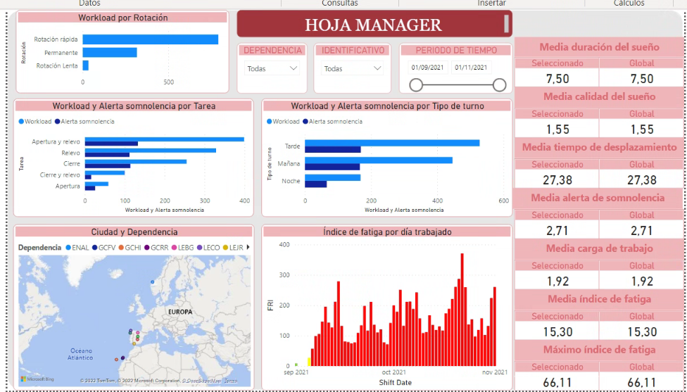
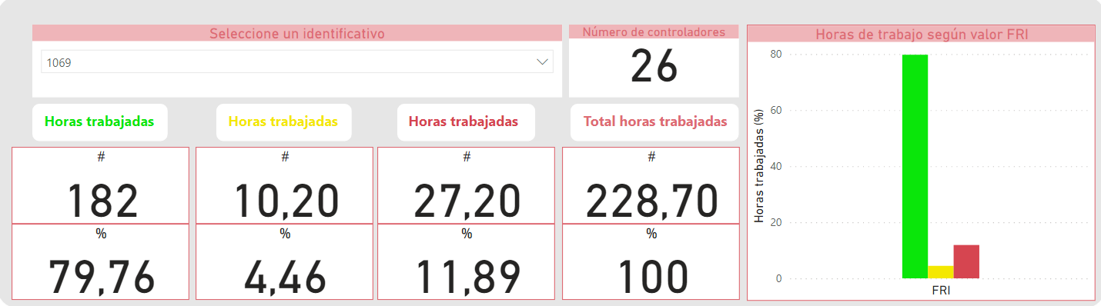

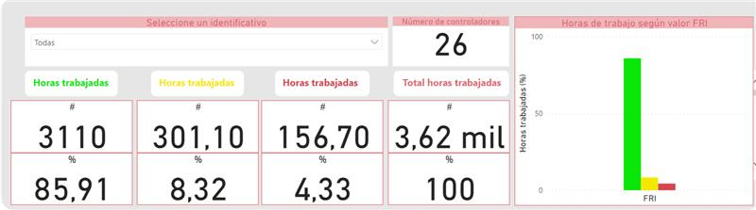

NEXT STEPS: PROCESS AUTOMATION AND THE USE OF THE DATA SCIENCE
The BioMaF model

Slide 26


NEXT STEPS: PROCESS AUTOMATION AND THE USE OF THE DATA SCIENCE
The GFA tool
Module 1. Evaluation and assessment panel
Hazard identification and analysis, approach:
  Reactive (inFact)
  Proactive (iHISA)
Exposure to operational fatigue (BioMaF)
(Hazard Log
-> Human factor risk catalogue)
iHISA Register
GFA
InFact Register
Module 2. Control panel
Status of FFHH in the organisation
Customised dashboard
BioMaF Register
Module 3. Monitoring Panel
Other possible registrations
Follow-up of corrective and/or improvement actions.
Monitoring of the system's indicators (KPIs)

Slide 27
COMPANY LOGO

