Slide 1
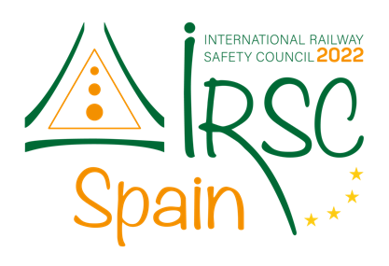




IRSC 2022
INTERNATIONAL RAILWAY
SAFETY COUNCIL
SEVILLA, OCTOBER 16-21, 2022

Slide 2
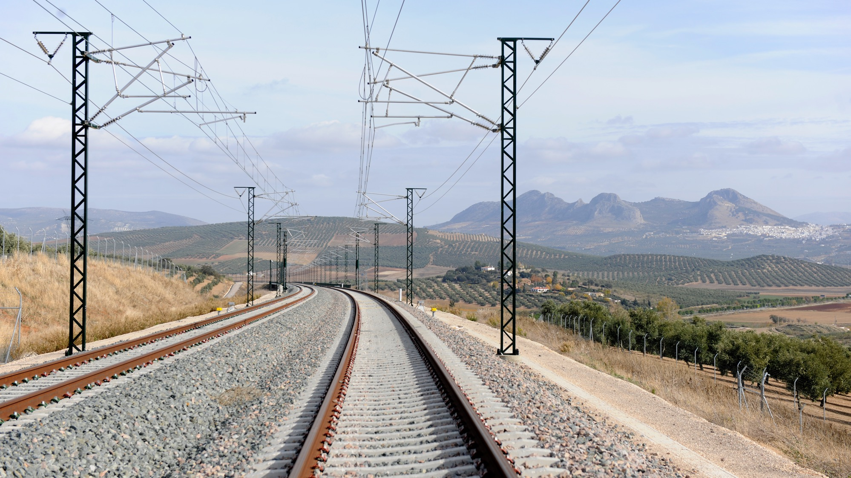



Coen van Gulijk / George Bearfield / Richard Thomas
University of Huddersfield / Birmingham & ROCK
IRSC 2022
INTERNATIONAL RAILWAY SAFETY COUNCIL
SEVILLA, OCTOBER 16-21, 2022

Slide 3
Security/Safety assessment with the STAIRCASE model
Transformation of rail Cyber/Safety and Security (paper 61, speaker 34)
IRSC 2022
INTERNATIONAL RAILWAY SAFETY COUNCIL
SEVILLA, OCTOBER 16-21, 2022

Slide 4
INDEX
CHAPTER 1 (PREAMBULE)
An incident heralding the digital future
ERMTS Cambrian line
CHAPTER 2
Moving over
Digitalisation and Rolling Stock
CHAPTER 3
Proposal for strengthening verification process
the STAIRCASE

Slide 5

CHAPTER 1
ERMTS Cambrian Line
IRSC 2022
INTERNATIONAL RAILWAY SAFETY COUNCIL
SEVILLA, OCTOBER 16-21, 2022

Slide 6
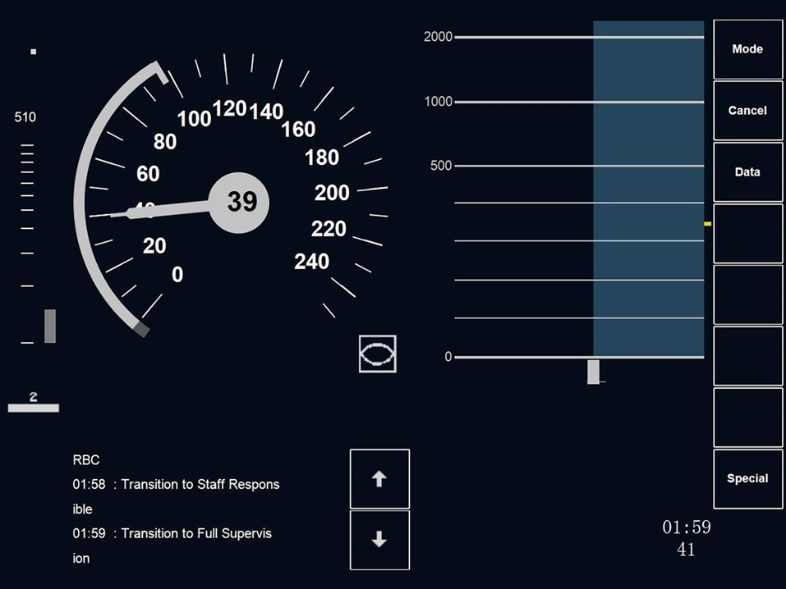
Preambule: ERMTS Cambrian line: Machynlleth signalling control centre [RAIB 17/2019]
Signaling system stopped transmitting temporary speed restriction data after it had experienced a shutdown and restart at around 23:10 hrs the previous evening.
Drivers did not see the TSR in their display so they crossed TSR areas at speeds they shouldn’t. No-one was hurt and no damage was done to equipment.
https://www.gov.uk/raib-reports/report-17-2019-loss-of-safety-critical-signalling-data-on-the-cambrian-coast-line
Notes:
In 2017, a train driver travelling on the Cambrian Coast line in North Wales, UK reported a fault with the information provided on his in-cab display. Temporary speed restrictions were not being transmitted to several trains under their control. The temporary speed restrictions were required on the approach to seven level crossings to provide level crossing users with sufficient warning of approaching trains so that they could cross safely. The line was equipped with a pilot installation of the European Rail Traffic Management System (ERTMS), a form of railway signalling which transmits signalling and control data directly to the train. Investigation, by the local maintenance staff, found that the signalling system stopped transmitting temporary speed restriction data after it had experienced a shutdown the previous evening. The signallers had no indication of an abnormal condition and the display at the signalling control centre (on the ‘poste de GEstion des Signalisations Temporaires’ or ‘GEST’ system) wrongly showed these restrictions as being applied correctly.

Slide 7
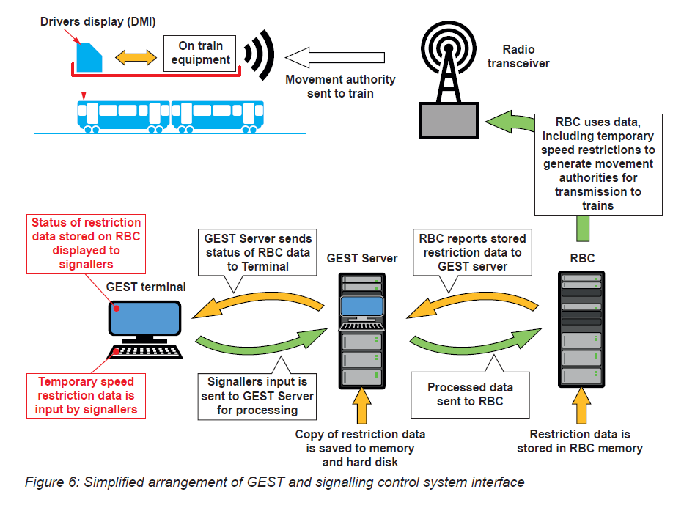
Complex digital system confounded safety assessment [RAIB 17/2019]
Internally triggered
software rollover (reset)
due to conflincting
movement authorities
(10-12 per year!)
TSR in memory: lost.
GEST in failure mode (latent condition)
TSR was not communicated to:
RBC/TMI/Driver
RBC/Signaller
Notes:
RBC = raido block centre
GEST = poste de GEstions des Signalleurs Temporaires: plans temporary speed restrictions.

Slide 8
RAIB recommendations
IMs {..} aided by the wider rail industry, should improve its safety assurance process for high integrity software-based systems and improve safety learning from failures of such systems, and develop a process to capture data needed to understand these failures.
{..} should review its safety assurance processes in the light of the learning from this investigation, and should provide a technical solution for the Cambrian lines that avoids the need for signallers to verify automatically uploaded speed restrictions.
Drivers {..} reporting inconsistencies information provided to them; the need for ISA to understand the scope of checks undertaken by other bodies and to apply extra vigilance if documents form part of a non-standard process; the importance of clients undertaking their client role when procuring high integrity software; and achieving the specified level of safety when implementing temporary speed restrictions in ERTMS.
“Better safety assurance needed”
https://www.gov.uk/raib-reports/report-17-2019-loss-of-safety-critical-signalling-data-on-the-cambrian-coast-line

Slide 9
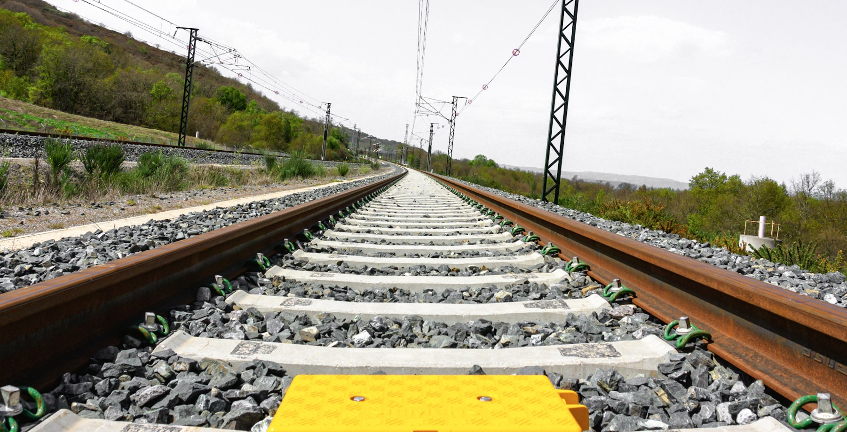
CHAPTER 2
Digitalisation of Rolling stock
IRSC 2022
INTERNATIONAL RAILWAY SAFETY COUNCIL
SEVILLA, OCTOBER 16-21, 2022

Slide 10
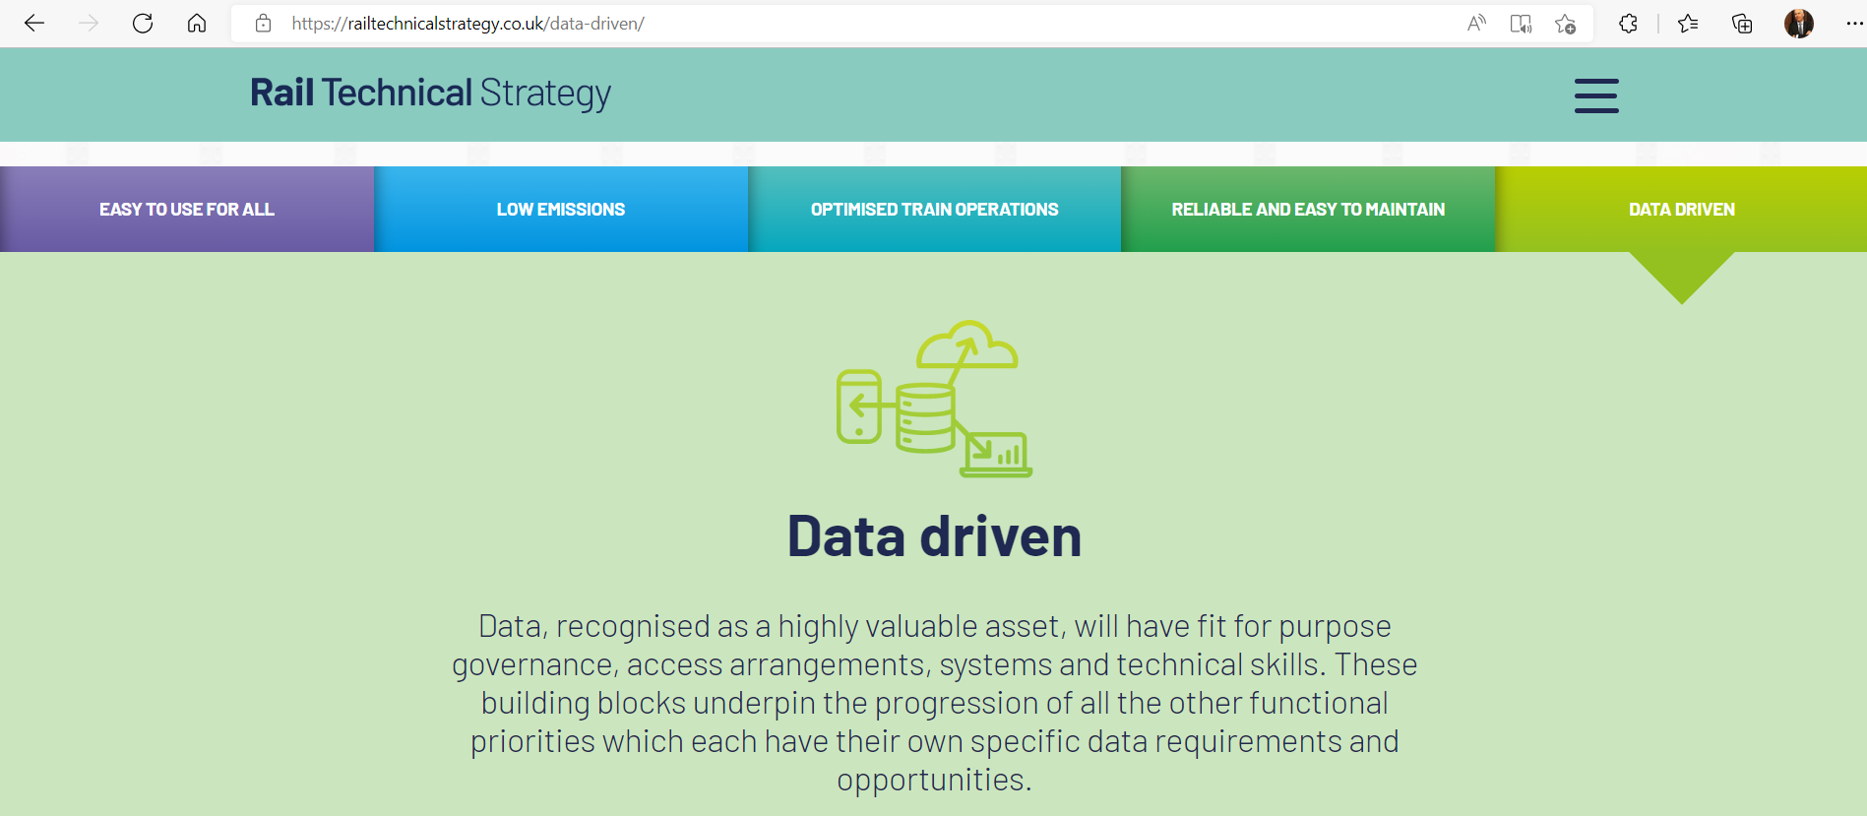


And software Solutions are promoted by industry in a broad sense
Data becomes the proverbial oil that greases the wheels of progress
It is a keystone technology in the UK’s Rail Technical Strategy
It introduces cybersecurity liabilities that are attracting attention
Notes:
Alemberto: unprecedented change

Slide 11
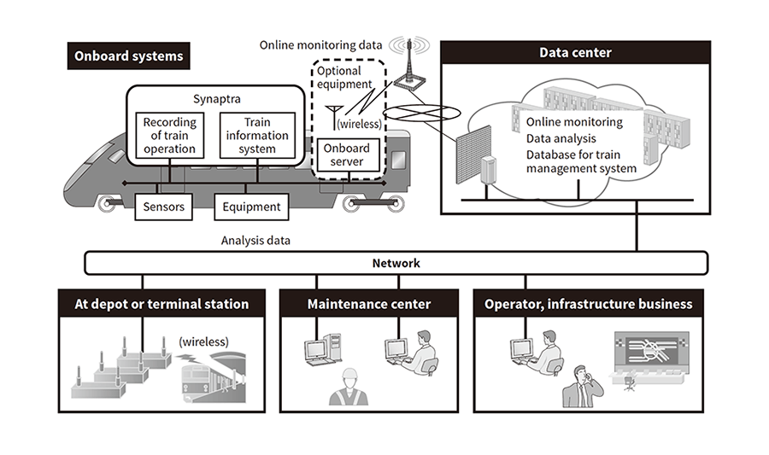
Rolling stock at the pinnacle of digitalization
“Computer on Wheels?”
https://www.hitachi.com/rev/archive/2018/r2018_07/07a03/index.html

Slide 12
Security zones
Notes:
On-board of trains are identified the following zones:
• TCMS safety zone, dealing with safety and operation critical data (e.g. brakes, doors). The
safety zone is typically embedded in the operational on-board network as defined in
IEC 61375-2-3.
• TCMS regular zone, dealing with non-safety related data (e.g. diagnostics, HVAC). The
regular zone is typically embedded in the operational on-board network as defined in
IEC 61375-2-3.
• OMTS zone, dealing with multimedia and telematics services oriented data. The OMTS
zone is typically embedded in the multimedia on-board network as defined in
IEC 61375-2-3.
The counterparts on ground could be for example:
• Operational centre zone, dealing with operation control data
• OMTS centre zone, dealing with multimedia and telemetric services oriented data

Slide 13
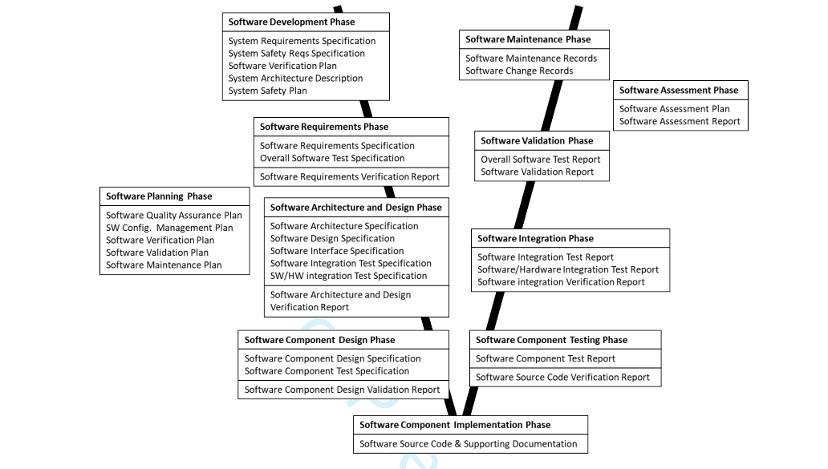
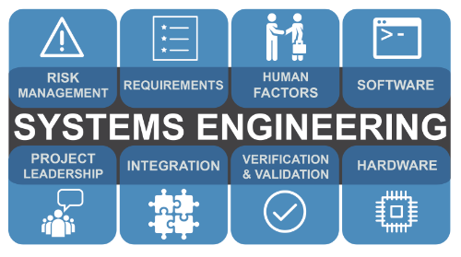
Safety Standards built on systems engineering with V&V cycle
https://www.incose.org/systems-engineering
Based on EN50128
https://journals.sagepub.com/doi/full/10.1177/09544097221102292
Notes:
Traditionally OEMs were masters of their product; controlling every aspect of the system. It is for that context that the standards were developed and where the V&V model works well for the development of systems and system interface. But digital systems are changing rapidly.

Slide 14
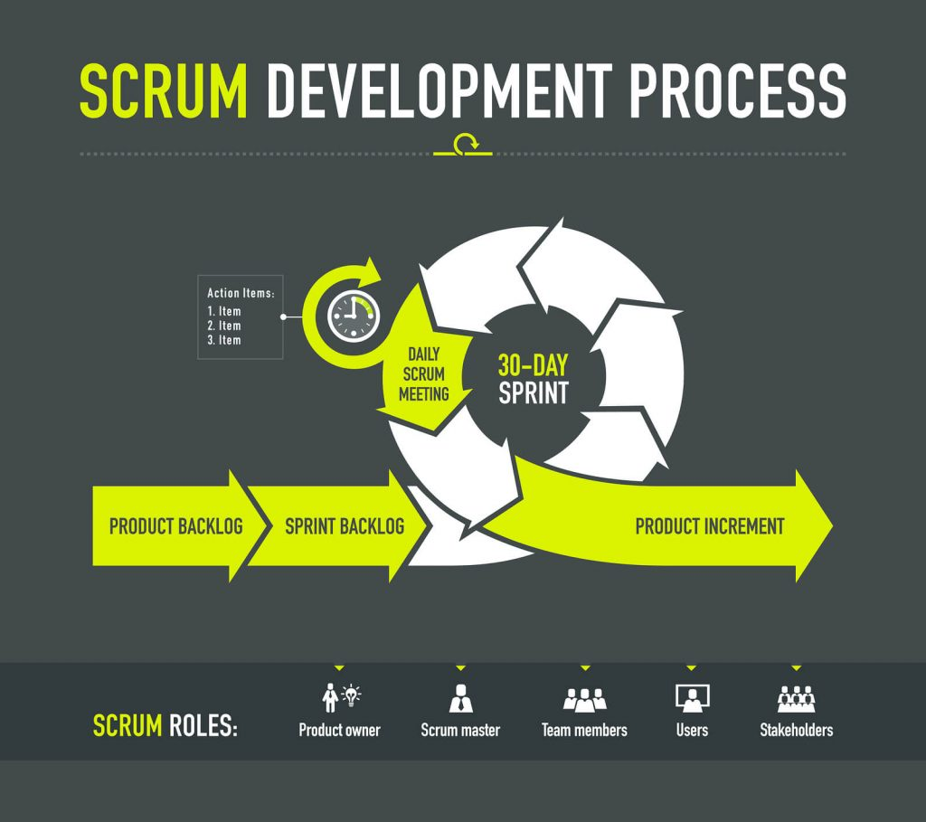
But software engineering is quite a different animal
https://www.digite.com/agile/scrum-methodology/
Notes:
Different dynamics, clashing cultures?

Slide 15
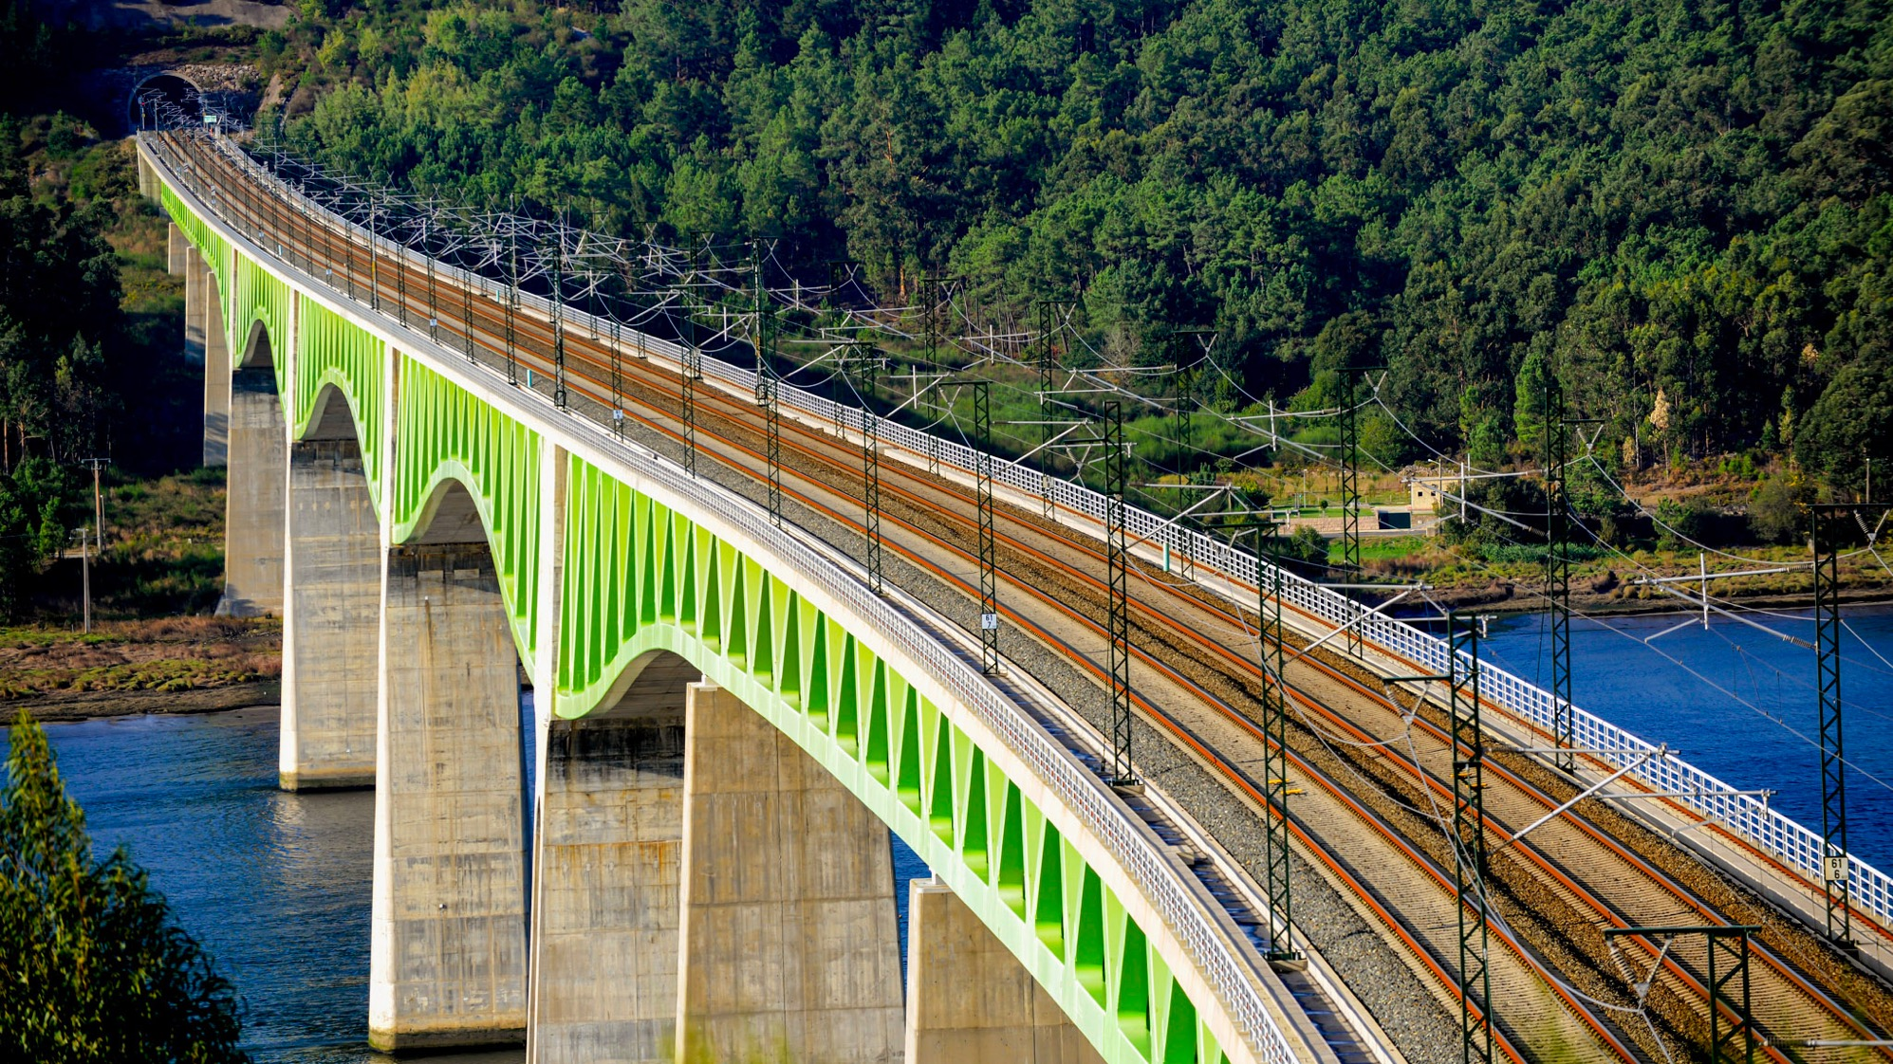
CHAPTER 3
Proposal for strengthening verification process; the STAIRCASE
IRSC 2022
INTERNATIONAL RAILWAY SAFETY COUNCIL
SEVILLA, OCTOBER 16-21, 2022
Notes:
To marry the two worlds up.

Slide 16
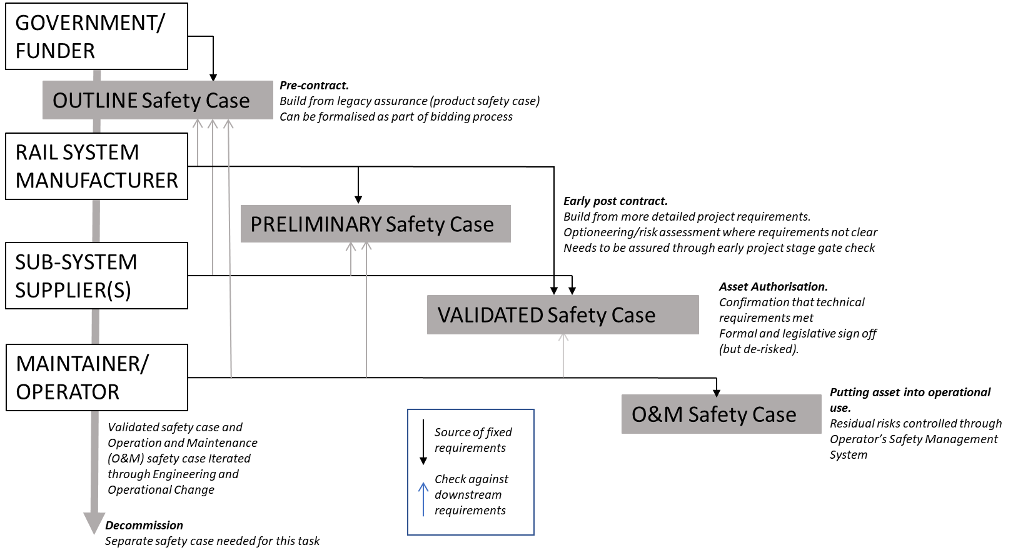
So we want to bring the validation forward in steps: the STAIRCASE
https://journals.sagepub.com/doi/full/10.1177/09544097221102292
Notes:
Relatively small change to verification process (the traditional Validated safety case is still there)
Change the culture of talking about risks earlier
Engage manufacturers, buyers, regulators, TOCs early-on in the process

Slide 17
When fundamental changes are needed
Notes:
Safety issues can also be caught too late.
The graph is an indicative one which shows how the costs of changing a design rapidly increase from the outset of a project.
If safety requirements have been missed this is a problem. It either increases risk unnecessarily or stops the project.
With an asset – need to thinking about its use at the very outset. And requirements for it need to be specified and set way ahead of time.
The costs of change increase almost exponentially if things are not caught early.
Risk acceptance - is not time dependent. If you missed it, and costs have since ramped up, that isn’t a defence. You still need to do it.
The longer safety issues are left and not considered the more costly they can be to resolve, and the harder it can be to surface them.
Difficult discussions are then needed.

Slide 18
Outline safety case: pre contract
We propose that the first significant evaluation of the (outline) safety case should be a part of the tender process, and a basis on of which the contract is selected
This puts some (more) onus on train manufacturers on formulating core safety arguments and a commercial incentive to enhance safety and security by design.
It also offers opportunities to gather initial ideas and architectures to address the rapidly evolving digital assurance risks and (dynamic) software updates and, as a bonus, thoughts about how to deal with emerging design assurance issues.

Slide 19
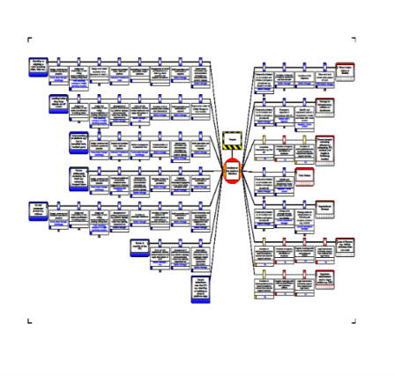
Preliminary safety case: early post-contract
With the core safety arguments of the outline safety case as a starting point, the safety case can develop as a preliminary safety case to provide transparency.
This offers opportunities for early engagement with the future user/ operator on operational risks and controls for the cyber safety, cybersecurity and sensitivities for the local operation conditions. Clear safety requirements can then be cascaded into the tier 1 and tier 2 supply chain.
The preliminary safety case offers ongoing clarity on progress in compliance, project delivery and the assurance process. It also offers clarity in things that might have been missed and how they were solved.

Slide 20
Validated safety case: asset authorisation
The validated safety case remains a well defined process associated with the key regulatory stage gate; but it follows from earlier stages in a relatively straightforward manner.
It should be about gathering the necessary information to evidence the safety argument and provide assurance that is already in place since the preliminary safety case
The STAIRCASE makes authorization a more mechanical process, bringing greater assurance, ensuring that there is a clear audit trail for the safety argument and a solid basis for risk transfer into the operation and maintenance phases.

Slide 21
O&M safety case: operating in a dynamic environment
With a robust validated safety case there is room for an O&M safety case which is envisaged as a space where the asset owner, the operator and the maintenance supplier deal with the dynamic (cyber) safety/security world.
It offers a platform where residual risks are transferred into an operators/infrastructure manager’s SMS that provides space for attention to (weak) signals of software failures and breaches.

Slide 22
Returning to RAIB recommendations
IM/Man {..} aided by the wider rail industry, should improve its safety assurance process for high integrity software-based systems and improve safety learning from failures of such systems, and develop a process to capture data needed to understand these failures.
{..} should review its safety assurance processes in the light of the learning from this investigation, and should provide a technical solution for the Cambrian lines that avoids the need for signallers to verify automatically uploaded speed restrictions.
Drivers {..} reporting inconsistencies information provided to them; the need for ISA to understand the scope of checks undertaken by other bodies and to apply extra vigilance if documents form part of a non-standard process; the importance of clients undertaking their client role when procuring high integrity software; and achieving the specified level of safety when implementing temporary speed restrictions in ERTMS.

Slide 23
Conclusions for the STAIRCASE
It changes the safety culture by talking about core safety arguments throughout the asset lifecycle
Interactions with stakeholders are improved
Gives room to discussing digital risks early stage
Puts owners and operators in a better position to understand and control dynamic risks
ALSO: it builds on current practice (doesn’t replace it)
It addresses concerns that RAIB expressed and
When done well shouldn’t take excessive amounts of time
The staircase codifies what you could consider ‘better practice’

Slide 24

Call to Action.
We propose research to develop the STAIRCASE addressing:
Collate cyber threats landscape for rolling stock and its sprawling networks
Assess vulnerabilities for cyber safety and cyber security to inform software architectures
Investigate cyber safety/security barriers and mechanisms
Rules to set performance levels for integrated (cyber)safety and cyber security systems and

Slide 25
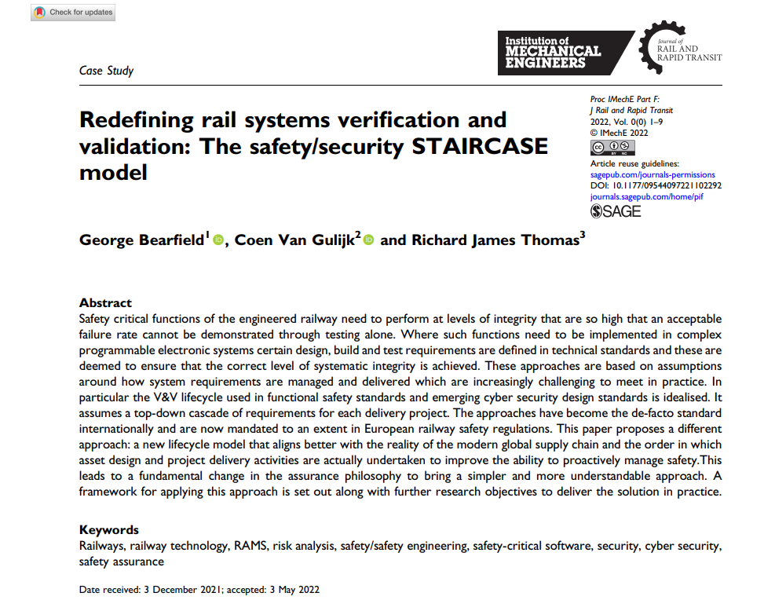
Further reading
From IEC61375
https://journals.sagepub.com/doi/full/10.1177/09544097221102292

Slide 26
Thank you!
c.vangulijk@hud.ac.uk

