Slide 1
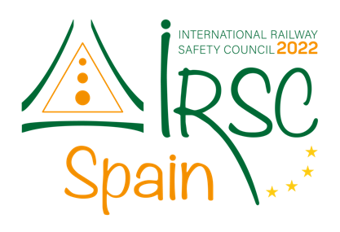

IRSC 2022
INTERNATIONAL RAILWAY
SAFETY COUNCIL
SEVILLA, OCTOBER 16-21, 2022
Notes:
Good morning

Slide 2
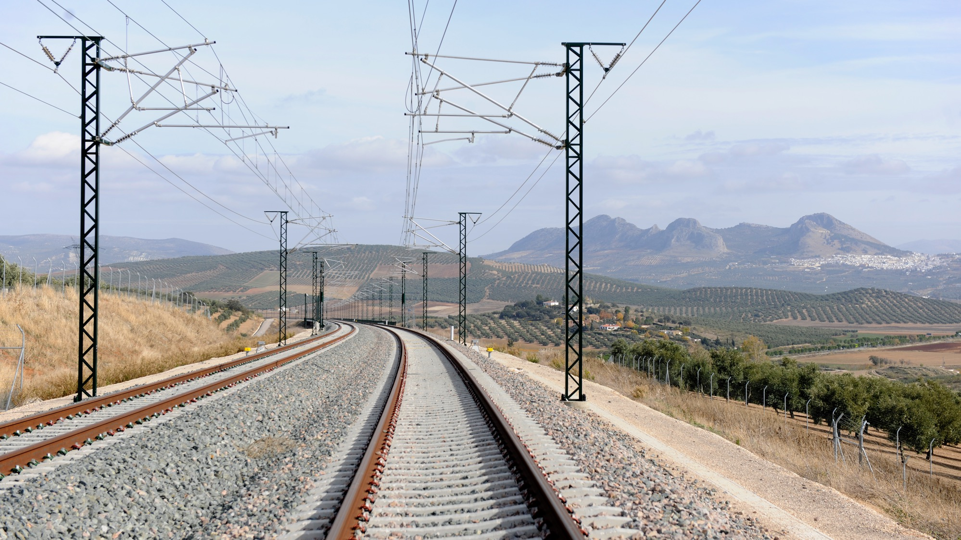



Smart Assurance
Risk Based Assurance
Nicola Uijen and Pablo Forteza
Head of HSE and Head of Engineering
Network Rail
IRSC 2022
INTERNATIONAL RAILWAY SAFETY COUNCIL
SEVILLA, OCTOBER 16-21, 2022
Notes:
My colleague, Pablo Forteza, Head of Engineering and I, Nicola Uijen Head of health, safety and environment for the capital delivery arm, in Network Rail would like to spend this session explaining to you the work we have done in changing the culture in the way we assure our supply chain.
As I say we work for the Capital Delivery arm of Network Rail in North West and Central Region. This part of the business is accountable for leading capital expenditure programmes, works include large scale enhancement projects, renewals and minor works programmes up the western side of England, from London to Carlisle (just south of the border with Scotland).

Slide 3

CHAPTER 1
Context
IRSC 2022
INTERNATIONAL RAILWAY SAFETY COUNCIL
SEVILLA, OCTOBER 16-21, 2022
Notes:
When we started our journey we were in a position where we undertook an awful lot of assurance activity on our supply chain but we had a scattergun approach. The approach we have moved to is more structured and based upon our significant risks. We have named this approach Smart Assurance as it is a risk based model, working smarter not harder!

Slide 4

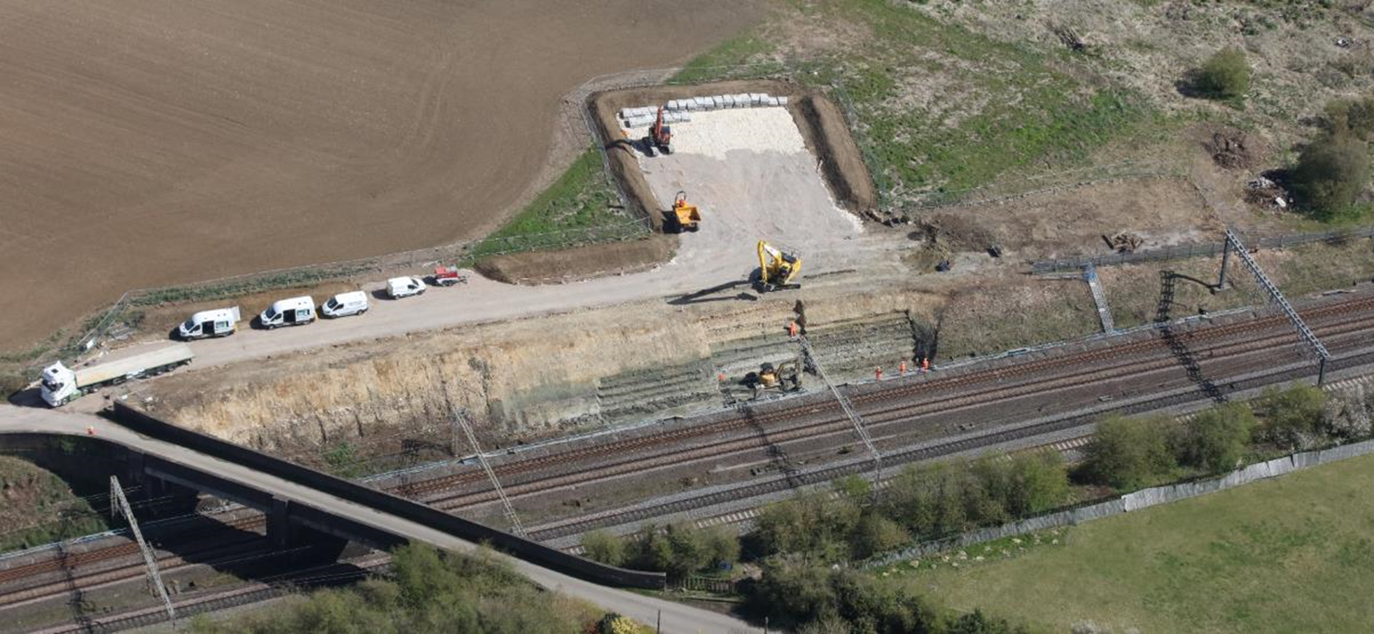
Context
Management Information
Organisational Change
Construction (Design & Management) Regulations
Plan, Do, Check, Act
Notes:
The picture you see on the screen is one of tragedy. This picture is of a site where in April 2020 we suffered a terrible accident to a member of our team, Aden Ashurst who was struck by a train when setting up protection and tragically died at the scene.
As the investigation unfolded it will not surprise any of you that we discovered we had similarities to previous tragic incidents which demonstrated a lack of appropriate management information leading to ineffective decision making, Challenger Space Shuttle and Clapham Rail crash being two such prominent examples.
Two of the immediate learnings we took from our tragedy, which had rocked the core of our team from top to bottom, were appropriate assurance and co-ordinated improvements.
We went back to basics and started to think about the Plan, Do, Check, Act model and focussed on the checking and acting.
We had become wholly focussed on quantitative assurance rather than qualitative, and whilst we did hundreds of pieces of assurance every month, it was in effect meaningless as other than beating people with a stick to close out there actions we did very little trending, we did very little with learning from the outputs and because we were in the mindset of lots mean better we were focussed on minor issues such as a missing signature or housekeeping, which take us into a world or virtual safety that may preventing minor accidents but rarely, if ever, prevents fatal or life changing injuries.
We established through this process that there had been a blurring of lines of accountability under the Construction (Design & Management) Regulations. These regulations set out the legislative requirements for undertaking construction works in the UK with duties on Client, Designer and Principal Contractor. In general Network Rail undertake the role of Client and Principal Designer with our supply chain being utilised to undertake the role of Principal Contractor. In our world of assurance we had become confused on where risk lay and therefore we were assuring the Principal Contractor risk and not the Client and Principal Designer risk. This left a two fold problem, one that we were not protecting our own liabilities, but secondly we were making ourselves accountable for a risk we were paying others to manage.
I have mentioned we were not acting on the learnings from the assurance, this was also exasperated by an organisational change, which again we know often leads to a decline in safety performance. This protracted change to our establishment lead to a lack of co-ordination in the way we approached improvements with our supply chain. Leading to multiple workstreams all trying to solve the same problem in a slightly different way. This in turn lead to confusion, duplication of effort and inefficient working.
Finally our regulator, the Office of Road and Rail regulation were also concerned about signs of weakness with our assurance processes. All leading to us deciding that we had to take some specific and targeted measures.

Slide 5
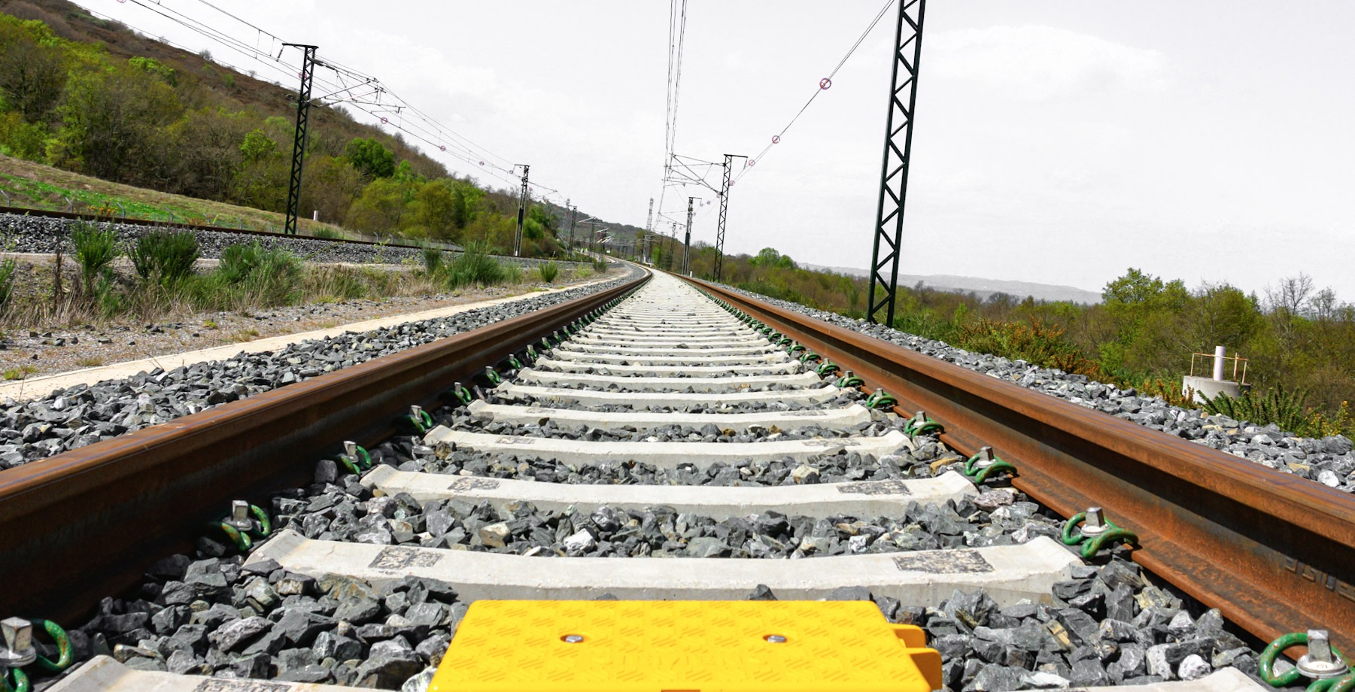
CHAPTER 2
Hypothesis
IRSC 2022
INTERNATIONAL RAILWAY SAFETY COUNCIL
SEVILLA, OCTOBER 16-21, 2022
Notes:
So what action did we decide to take?
I have already articulated that our focus had to be on the Checking and acting of the plan, do, check, act model.

Slide 6
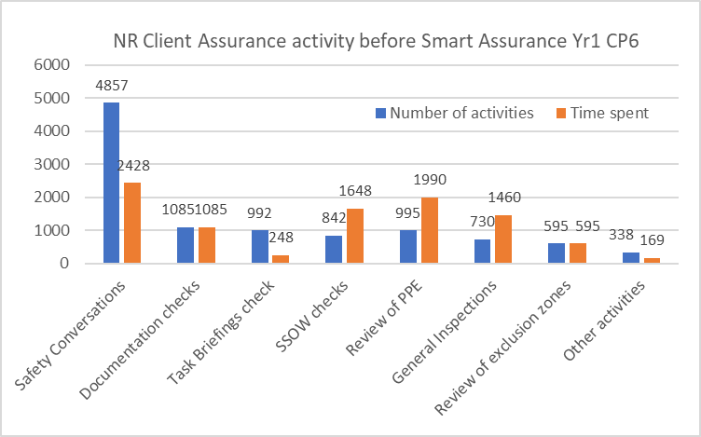
Hypothesis
The level 1 assurance being undertaken by Capital Delivery NW&C is insufficient.
Improvement actions are risk focussed, have a single approach and avoid duplication of effort
Notes:
We had two hypothesis
One that the assurance we were doing was insufficient
and Secondly that we were duplicating (with our supply chain) our effort on issues which were not the things that were hurting us the most.
As can be demonstrated by this graph, there was an extensive assurance regime in place, conducting a large number of assurance activities in accordance with the company processes. The checking was scatter gun and prioritisation on risk was not happening. Assurance was focussed on the site based obvious issues that were low hanging fruit as this was believed to be the right thing to do. Prior to the Smart Assurance approach, there were circa 11,000 Client led assurance activities conducted per year and Pablo will discuss this further shortly.
To make improvements we collaborate with our supply chain.T he reorganisation I referenced at the beginning had implemented a Regional model, as opposed to national, which led to us asking our supply chain to work on improving the same risks in 5 slightly different ways. This resulted in duplication of effort, discussion and debate, highly inefficient and confusing. Equally, the improvements being identified were either knee jerk responses or based on gut feeling and not on management information which would identify significant risks and prioritise action in a systematic manner.
The governance framework for improvement actions was through Regional Safety, Health, Environment Leadership Teams (SHELT’s). These were not co-ordinated and had numbers of independent workstreams that were similar in nature and duplicating effort. These were not risk based.
As you can see we were busy fools doing lots of stuff that gave us limited value and did not deal with our significant risk.
Pablo will now discuss with you how we began unravelling these issues.

Slide 7
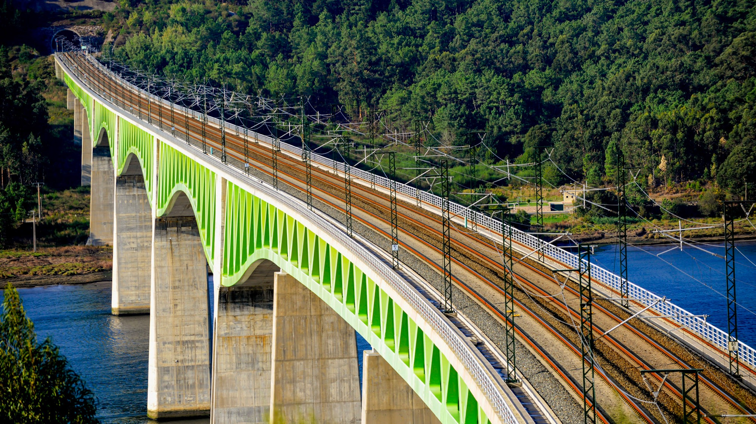
CHAPTER 3
Smart Assurance
IRSC 2022
INTERNATIONAL RAILWAY SAFETY COUNCIL
SEVILLA, OCTOBER 16-21, 2022

Slide 8
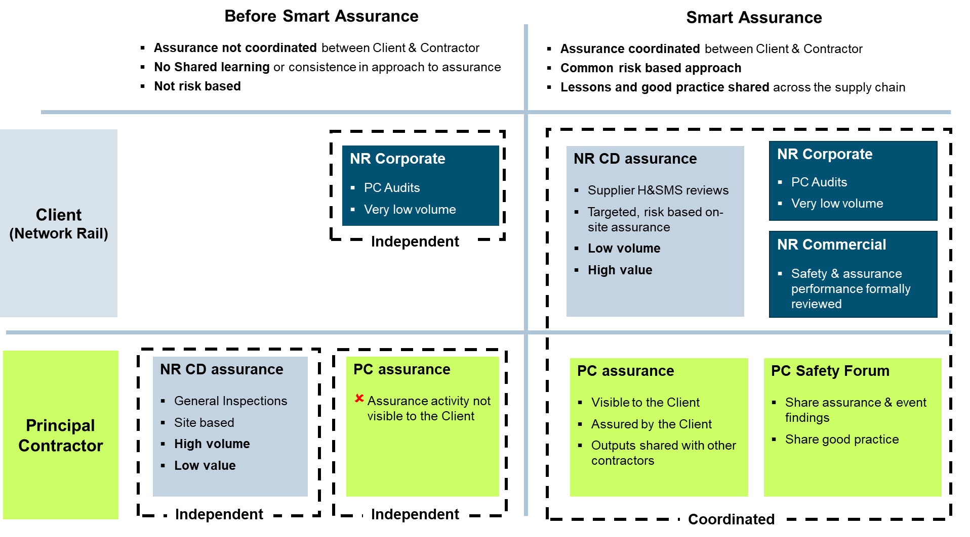
Smart Assurance
A coordinated approach
Client moves out of Contractor’s area of accountability
Increased focus on Contractor’s Management Systems
Notes:
Thanks Nicola
This schematic illustrates some of the elements that Nicola has been describing. It looks at the relationship between Network Rail as the Client and our Supply Chain in the ‘Check’ part of the Plan, Do, Check, Act model. How were we collectively Checking, or assuring ourselves, that the Controls designed to mitigate Risks were being implemented and were effective?
As Nicola described, we reflected that as the Client, we were in effect operating in the Principal Contractor’s space – in their swim lane as illustrated above. We were doing lots of assurance or checking – 11,000 individual checks each year. Lots of these were paperwork checks, PPE site welfare. Of course these are important but do they relate to our biggest risks? While there may have been some action resulting from this activity we concluded a lot of it was tactical. So in effect our assurance was misplaced, of high volume but low value.
We also reflected that as the Client we didn’t know what the supplier was doing to assure themselves. We had no visibility of this but in fairness to them we hadn’t really asked the question either.
Our Corporate Principal Contractor licencing team also audits each supplier once a year but again as the Capital Delivery function we had very little visibility or input into the corporate audit programme. So to summarise, while there was assurance activity happening, it wasn’t risk based and it wasn’t coordinated.
In the SMART assurance model, we have moved to a risk based and integrated approach. As Client we are consciously stepping out of the Principal Contractors swim lane. Our focus now is on assuring ourselves that our Principal Contractors are undertaking an appropriate level of risk based self-assurance. We also assure ourselves that our Principal Contractors have adequate and functioning Safety Management Systems in place. We still carry out a level of site based assurance but this is now of lower volume and Targeted based on risk to test that the supplier’s Safety Management Systems are working as intended.
Another important feature of the SMART assurance model is to coordinate assurance activity between ourselves in Capital Delivery, Our supply chain and our Corporate and Commercial functions. We also want to encourage learning and sharing between NR and all Principal Contractors. This is something that we do as part of the SHELT forums that Nicola described.

Slide 9
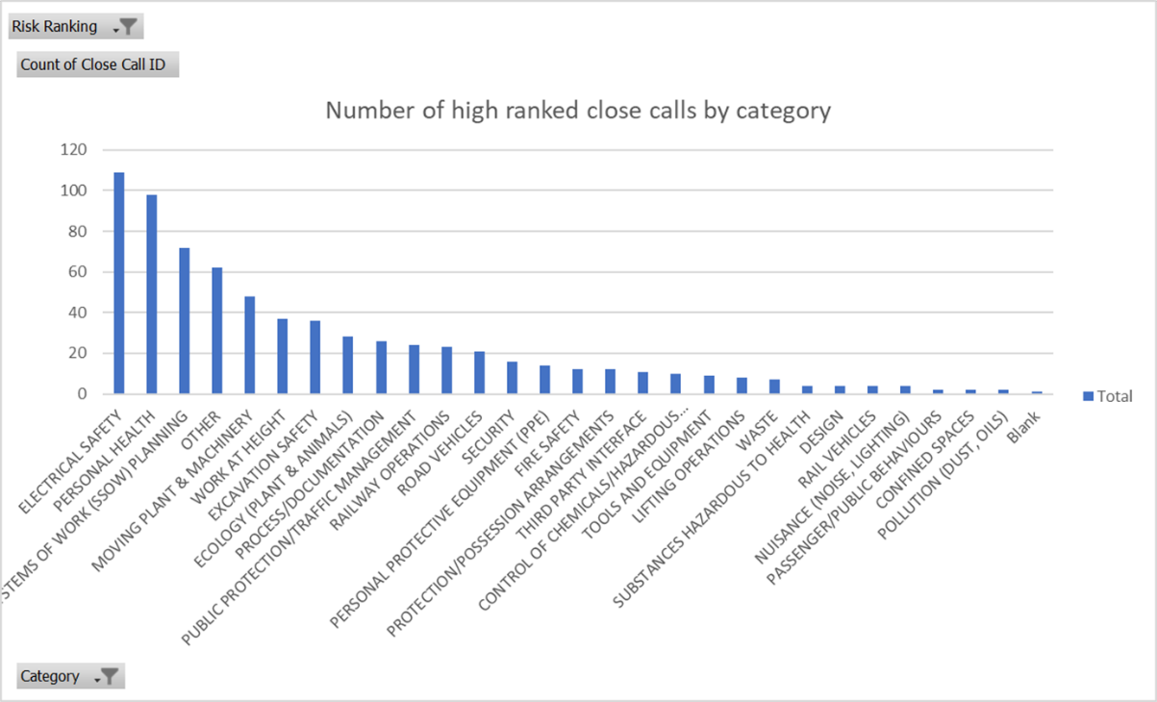
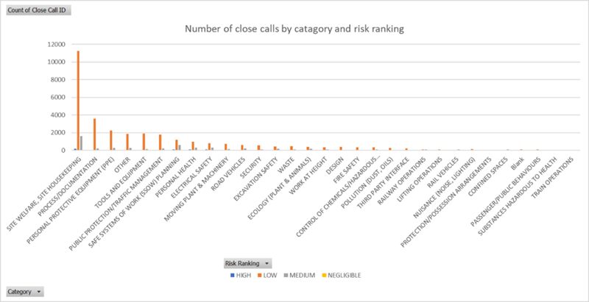
Smart Assurance
A risk based approach
Data Analysis
  Close calls
  Volume vs risk
Improving Together
Notes:
A key feature of SMART assurance is being risk based on our approach to what we assure, what we check. What are the highest risks to workforce safety? And how can we be sure that the controls and processes that mitigate those risks are working?
We have taken a data driven approach to help us become more risk based. We have looked at accident data, investigation findings and also close call data. Here I am going to give an example of how we have used close call data to focus our assurance effort. Around 16,000 close calls are reported each year.
Close calls are reported to capture an event or behaviour which could have led to harm. I some cases the close call has been resolved immediately, in others it is sent to another responsible organisation to resolve. But the resulting data-set is rich in information and tells us something about where our risks are.
However, one of the first problems we encounter when looking at the dataset is that the most numerous things reported are the things that in some respect are the most visible and easy to report – for example, site welfare, housekeeping and PPE – these dominate the pareto and take a lot of our attention. Note that things like Electrical Safety and Safe Systems of Work Planning are in the middle of the pareto. In this respect close calls are similar to the general assurance activity that we were doing before SMART assurance. We incentivise our teams and the supply chain to raise close calls and this can result in lots of low risk, easy and visible things being reported.
If we now look at the same dataset and focus on the high risk close calls we can see a different pattern emerging – around 2.5% or 400 of the 16,000 reported each year are classified as high risk. Risks like Electrical Safety and Safe System of work planning are far more prominent. And the information contained in the narrative of these high risk close calls is more inciteful. So we have used this type of analysis to help focus our assurance effort to tests whether the controls are being applied and whether they are effective.
I will now hand-back to Nicola who is going to talk more about how we share and collaborate with our supply chain.

Slide 10
CHAPTER 4
Learn & Share
IRSC 2022
INTERNATIONAL RAILWAY SAFETY COUNCIL
SEVILLA, OCTOBER 16-21, 2022

Slide 11
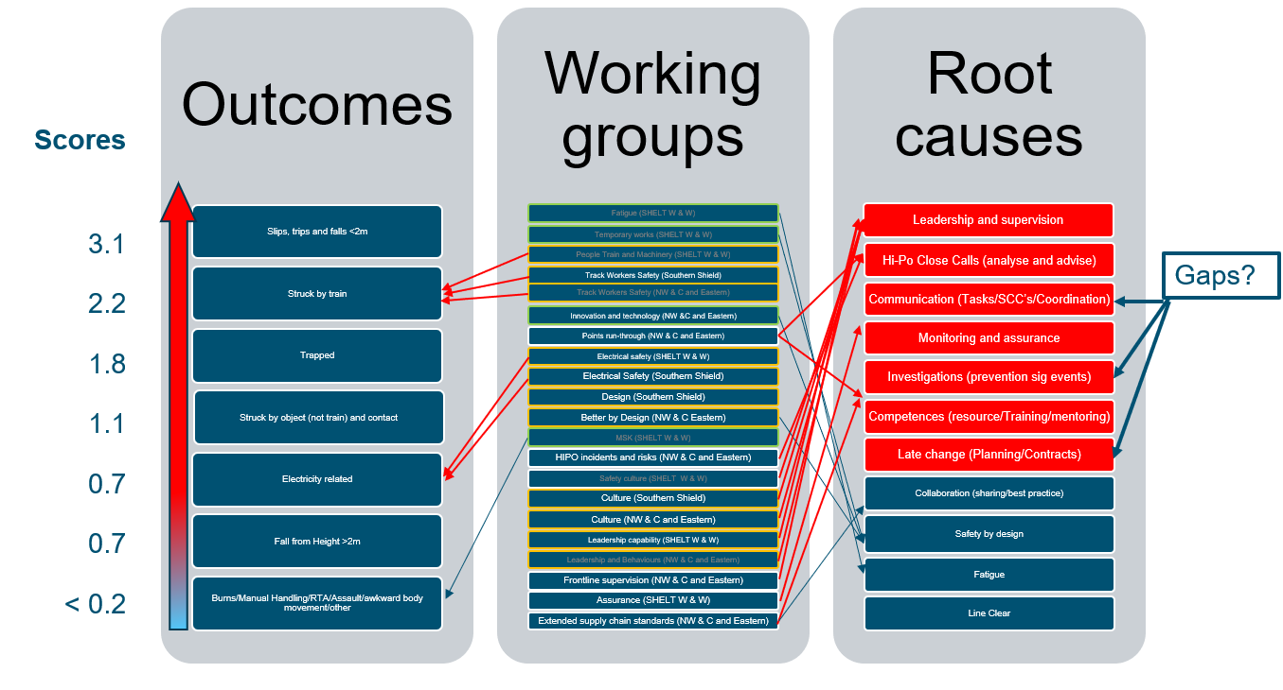
Learn & Share
Making Improvements
Reorganisation
SHELT Structure
Risk Based Improvement Streams
Award and Reward
Best practise forums
Notes:
Xxxxx
We also streamlined our improvements, we introduced a collaboration meeting, with consultation with our supply chain. This assessed our significant risks nationally, directed the SHELT’s for which one was going to take what improvement area with only one working on each topic area. This work has now concluded and work has commenced on problem statements for each of our highest risks – communication, planning and late change, investigation & embedment of learning, monitoring & assurance and close calls. Specifically the SHELT I belong to will be working on communication. This then feeds back into both Network Rail internal governance and industry regulation.
We instigated best practise forums which give the opportunity to learn and share. These are in place for both our Principal Contractor and Plant Contractor communities. Once a quarter they get together and share with pride. This is an opportunity for cross pollination and to acknowledge all the good work we are identifying through the Smart Assurance process. We now have many examples of where Contractor A has presented and you see Contractor B, C and D saying ‘Can you share more details and show me how I could implement something similar in my organisation?’ There is no competitive advantage in health and safety and this is great to see.
Finally we have started an awards ceremony which takes place annually to make sure that we are capturing all the best practise we see, or more importantly don’t see until we introduced these sessions. This year we had over 70 entries, with 5 awards and a further 10 given recognition. We have, of course, shared all the entries so people can learn from each other.
So what does the data say now?
It was period 1 of 2020 when we lost Aden Ashurst and our performance continued to decline whilst we investigated. We also had a further significant incident at the beginning of 2021. However as we began to understand the problem we began to formulate plans to improve you will see an improvement in performance, just by understanding the problem and talking about it. We began trials of Smart assurance in period 2 of 2021 and you will see at first this had limited impact on our performance of LTIFR but absolutely strong impact on our significant harm incidents through a reduction in FWI. And from period 8 21/22 we had full roll out and apart from an initial peak we have continued to see steady improvement. The first 4 periods of 22/23 have been the best ever safety performance for CD NW&C and the latter 3 we have flat lined.
Improvements have been identified which include linking our assurance to our suppliers assurance to gain even greater understanding of our risk and integrating with our national assurance and investigations teams to link the assurance across Network Rail. Our findings from our assurance are being used to influence our improvement actions, delivery plans and strategies helping us to predict and more importantly prevent our next major incident.
Thanks
Any questions

