Slide 1


IRSC 2022
INTERNATIONAL RAILWAY
SAFETY COUNCIL
SEVILLA, OCTOBER 16-21, 2022

Slide 2
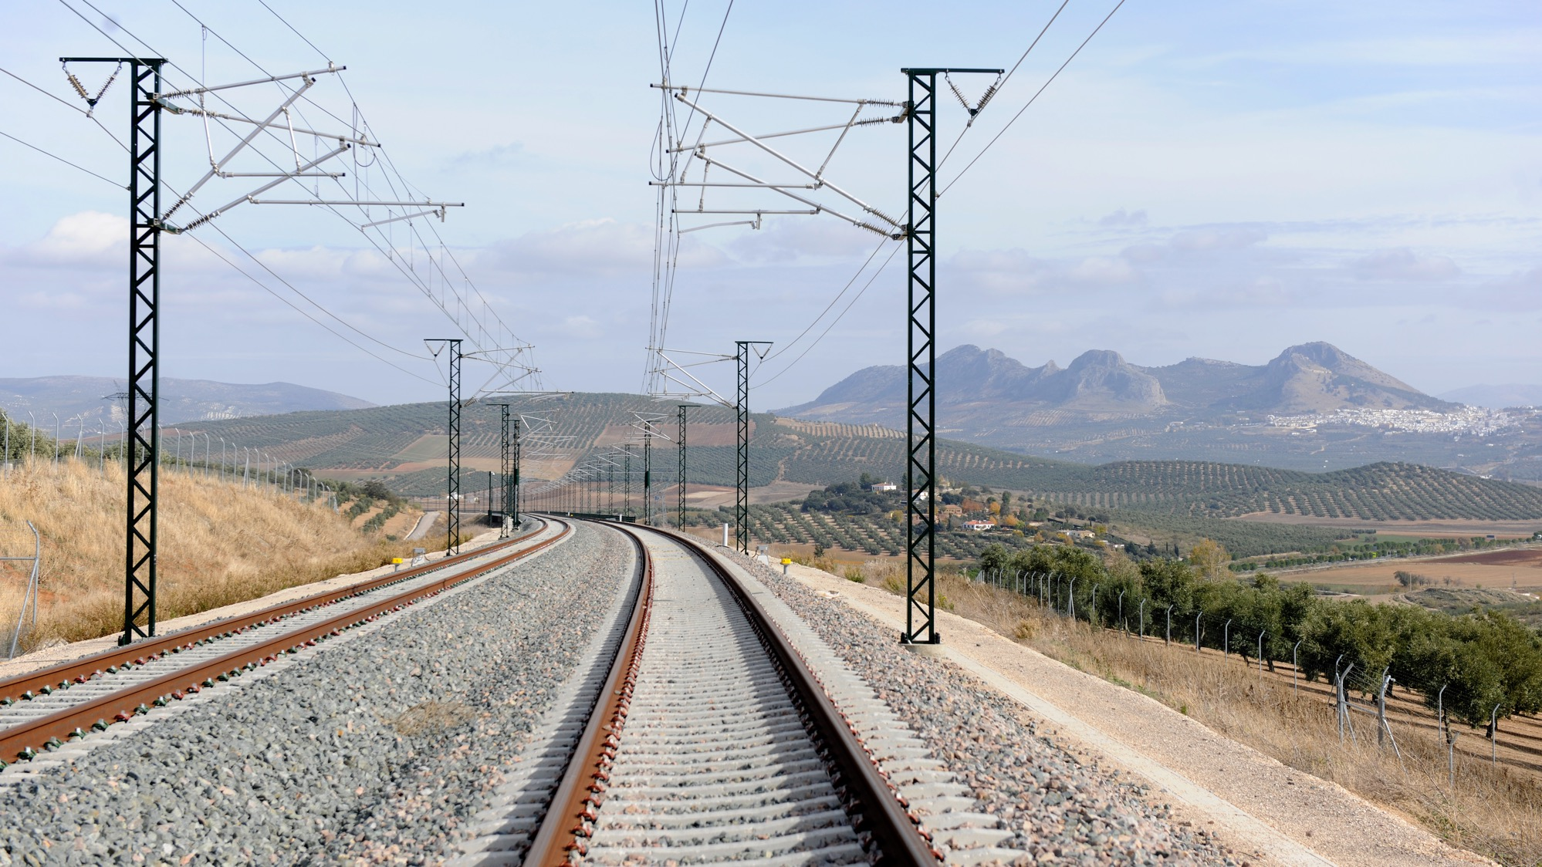



Nathalie DUQUENNE-Anna VOGKLI – Nikola ILIEVSKI
Giuseppe RAGUSA
Project Officer – European Union Agency for Railway
Maintenance Engineering Project Officer at Trenitalia,
IRSC 2022
INTERNATIONAL RAILWAY SAFETY COUNCIL
SEVILLA, OCTOBER 16-21, 2022

Slide 3
LET’S DISCUSS RAILWAY VEHICLE MAINTENANCE
IRSC 2022
INTERNATIONAL RAILWAY SAFETY COUNCIL
SEVILLA, OCTOBER 16-21, 2022

Slide 4
INDEX
ARCHITECTURE OF THE RAILWAY SYSTEM
THE ECM CONCEPT
SAFETY CRITICAL COMPONENTS, A WAY TO IMPROVE THE COMMUNICATION
THE SAFETY ALERTS IT (SAIT) TOOL, ANOTHER WAY TO IMPROVE COMMUNICATION
CONCLUSIONS

Slide 5
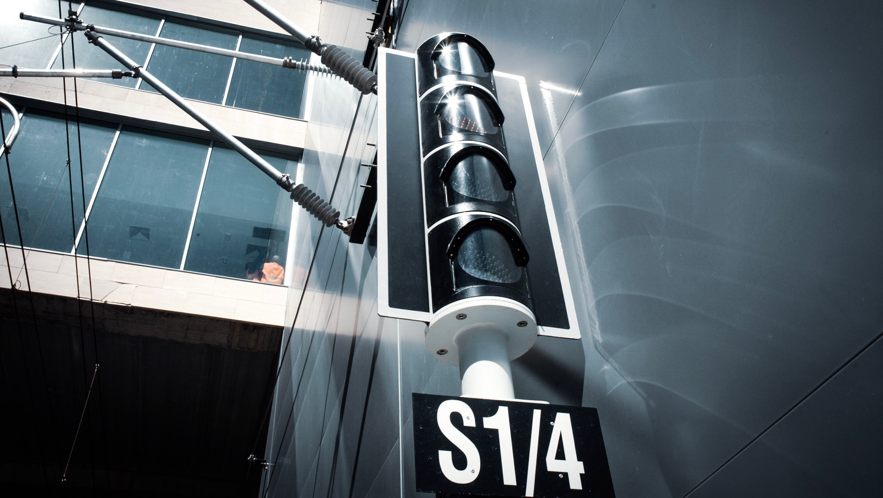
ARCHITECTURE OF THE RAILWAY SYSTEM
IRSC 2022
INTERNATIONAL RAILWAY SAFETY COUNCIL
SEVILLA, OCTOBER 16-21, 2022

Slide 6
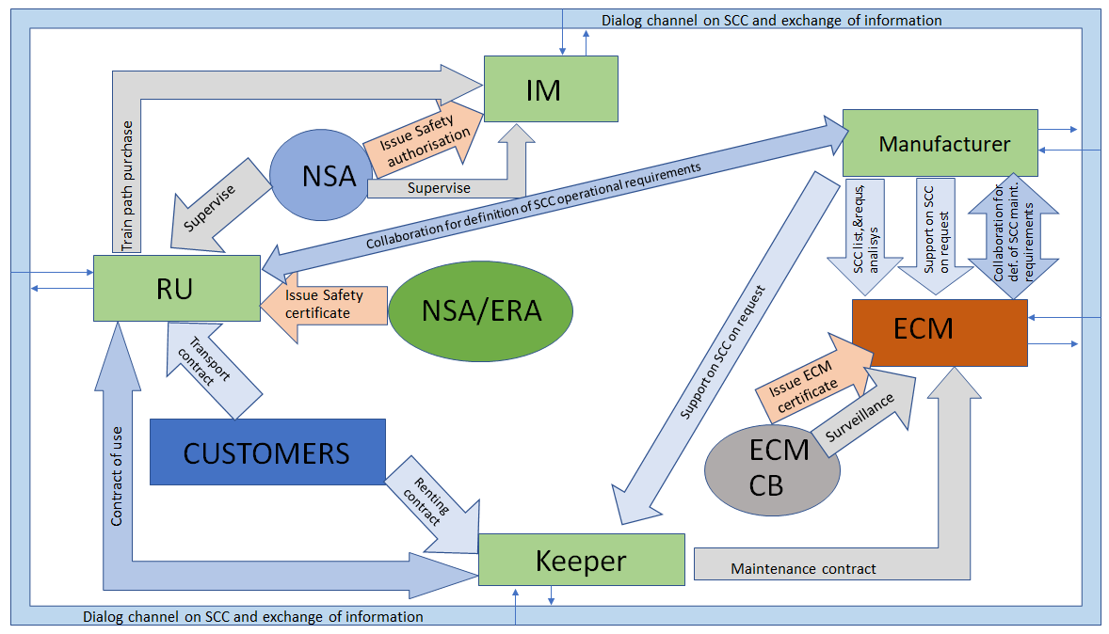
RAILWAY SYSTEM
Actors
Roles
Links

Slide 7
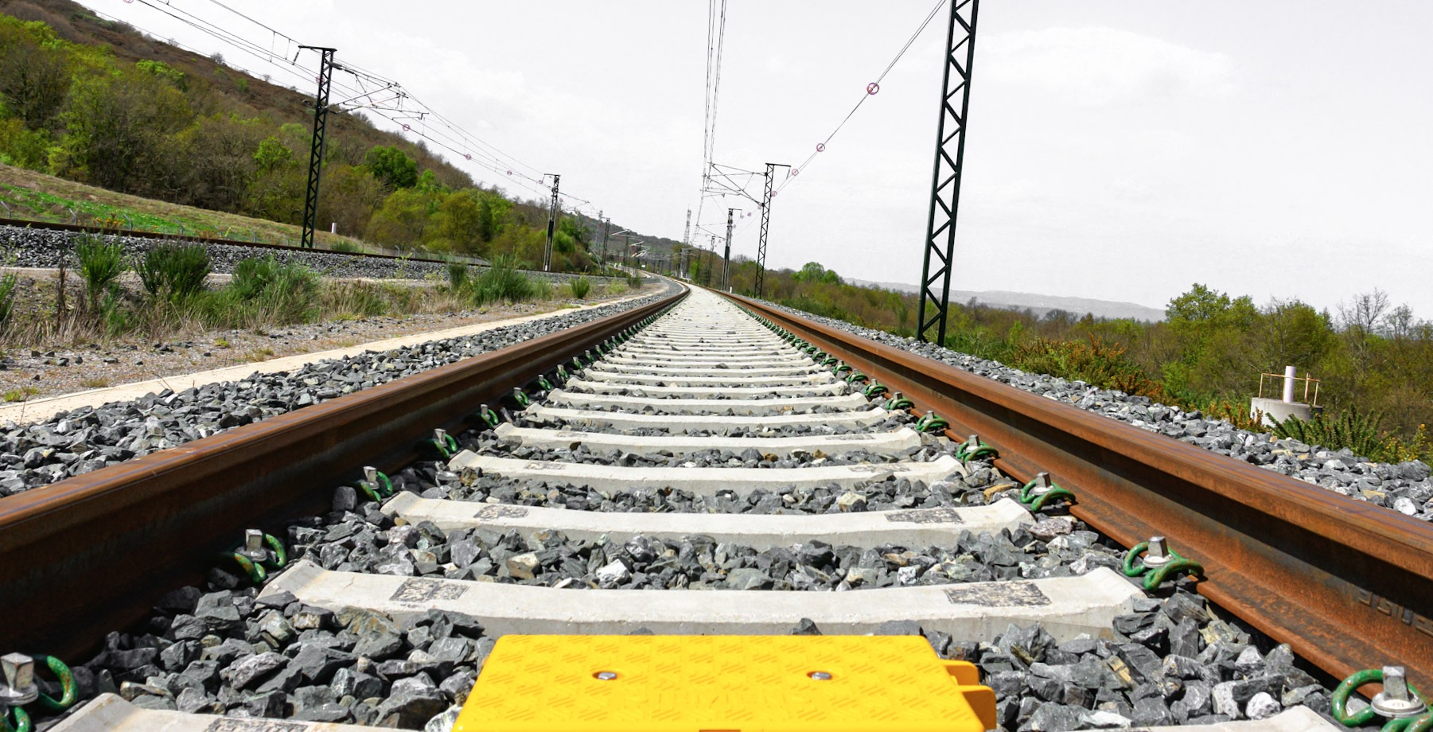
THE ECM CONCEPT
IRSC 2022
INTERNATIONAL RAILWAY SAFETY COUNCIL
SEVILLA, OCTOBER 16-21, 2022

Slide 8
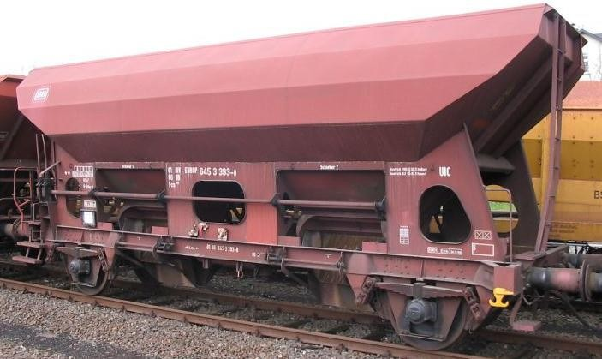
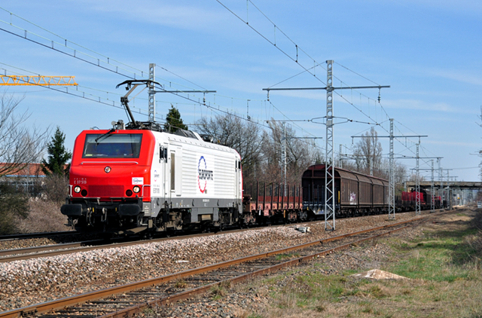
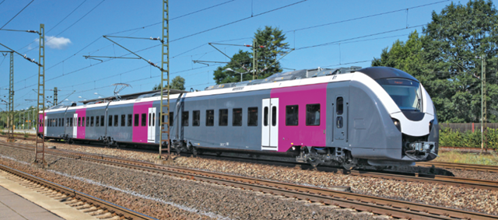
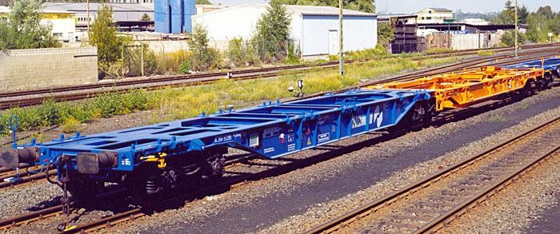
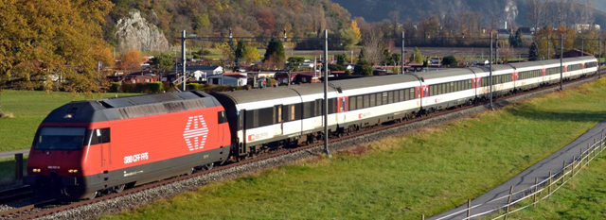
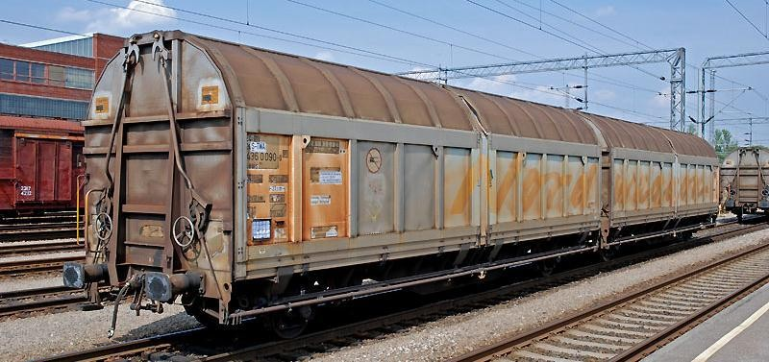
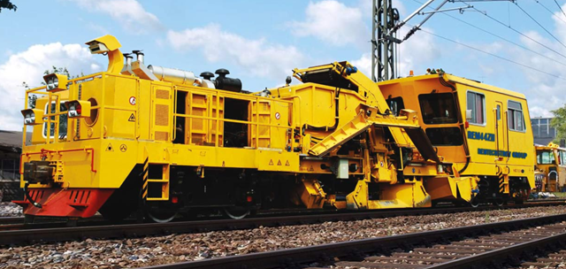
Maintenance of railway vehicles

Slide 9
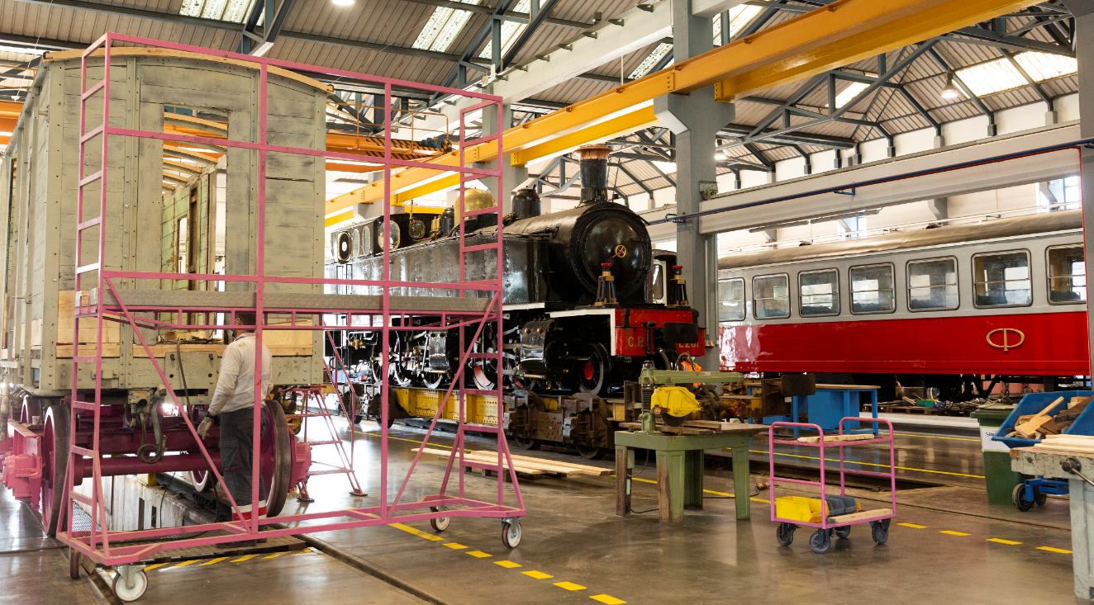
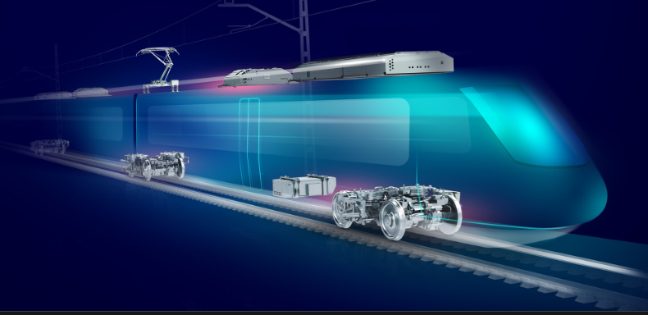
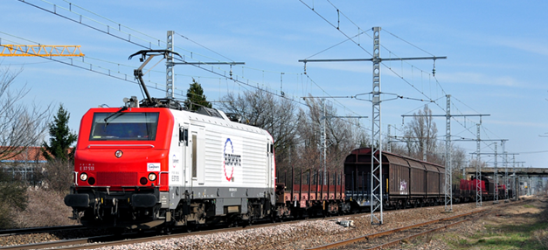
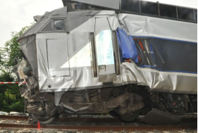
MAINTENANCE
OF
VEHICLE

Slide 10


















E
C
M
Maintenance management
Maintenance development
Fleet management
Maintenance delivery

Slide 11
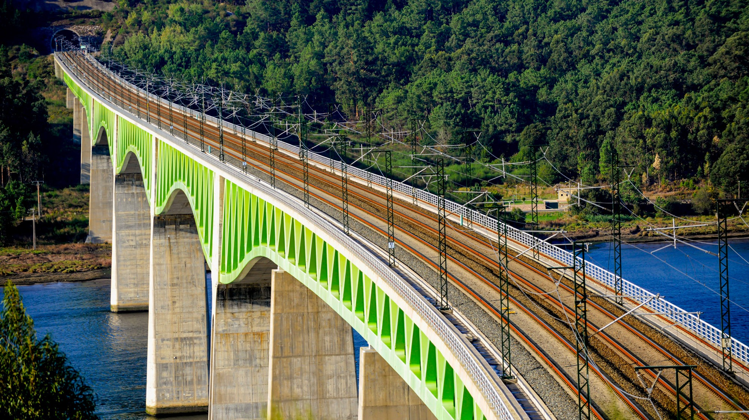
SAFETY CRITICAL COMPONENTS, A WAY TO IMPROVE THE COMMUNICATION
IRSC 2022
INTERNATIONAL RAILWAY SAFETY COUNCIL
SEVILLA, OCTOBER 16-21, 2022

Slide 12
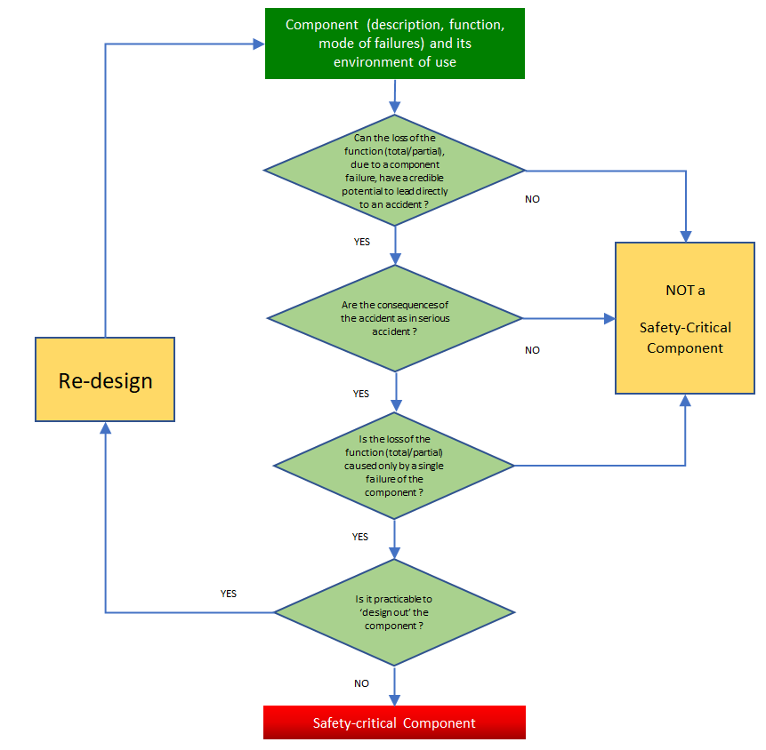
SCCs
Identification process

Slide 13
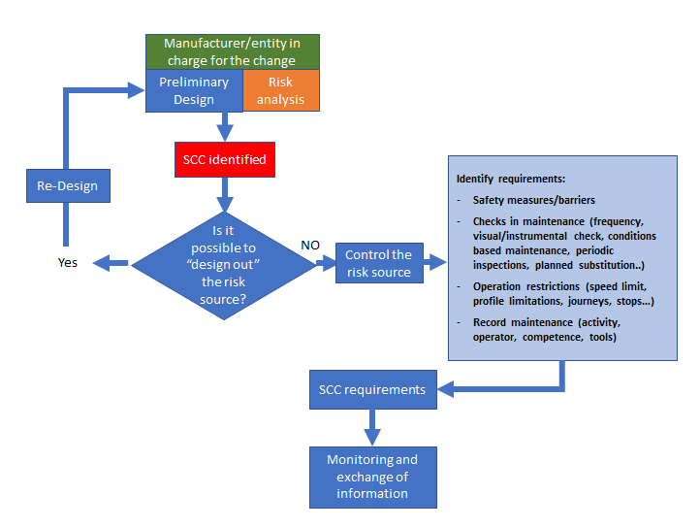
SCCs
Management process
https://www.era.europa.eu/sites/default/files/activities/docs/guidance-ecm-certification-process_en.pdf

Slide 14
THE SAFETY ALERTS IT (SAIT) TOOL, ANOTHER WAY TO IMPROVE COMMUNICATION
IRSC 2022
INTERNATIONAL RAILWAY SAFETY COUNCIL
SEVILLA, OCTOBER 16-21, 2022

Slide 15
SAIT
Process
https://www.era.europa.eu/sites/default/files/activities/docs/guidance-entities-maintenance-sait_en.pdf

Slide 16
CONCLUSIONS
IRSC 2022
INTERNATIONAL RAILWAY SAFETY COUNCIL
SEVILLA, OCTOBER 16-21, 2022

