Slide 1
IRSC 2022
I N T E R N A T I O N A L R A I L W A Y
S A F E T Y C O U N C I L
S E V I L L A , O C T O B E R 1 6 - 2 1 , 2 0 2 2

Slide 2
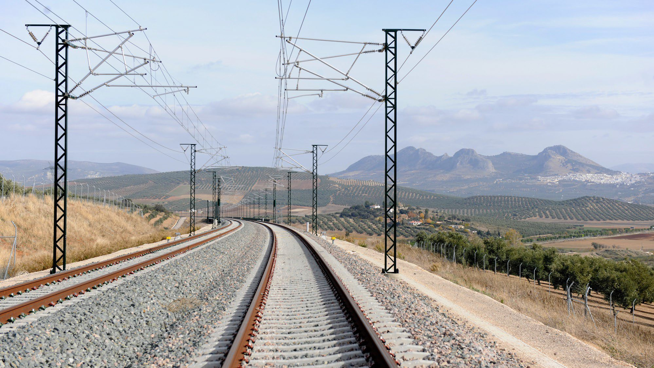
V ir gin ie P a p illa u lt
H uma n a nd O r gan i s a t i o n a l F a c t o r s & S a fet y C u lt u r e Ma n a g er , UI C - In t er n a t io n a l U n io n o f R ai l way s
Jay n e Yeo
H uma n a nd O r gan i s a t i o n a l F a ct ors P ro g ra m m e M an age r , ER A – Eu r o p e an U n io n Age n c y f or R ai l way s
I R S C 2 0 2 2
I N T E R N A T I O N A L R A I L W A Y S A F E T Y C O U N C I L
S E V I L L A , O C T O B E R 1 6 - 2 1 , 2 0 2 2

Slide 3
RAIL HOF – A DIG ITAL P L AT F ORM TO IM P ROVE SAF ET Y
I R S C 2 0 2 2
I N T E R N A T I O N A L R A I L W A Y S A F E T Y C O U N C I L
S E V I L L A , O C T O B E R 1 6 - 2 1 , 2 0 2 2

Slide 4
INDEX
CHA P T ER 1
WORKING BETTER TOGETHER FOR RAILWAY SAFETY
CHA P T ER 2
A CORNERSTONE FOR BUILDING & SHARING KNOWLEDGE ON HOF
CHA P T ER 3
RAIL HOF DIGITAL PLATFORM DEVELOPMENT
CHA P T ER 4
AIL HOF PLATFORM IN ACTION
I R S C 2 0 2 2
I N T E R N A T I O N A L R A I L W A Y S A F E T Y C O U N C I L
S E V I L L A , O C T O B E R 1 6 - 2 1 , 2 0 2 2

Slide 5
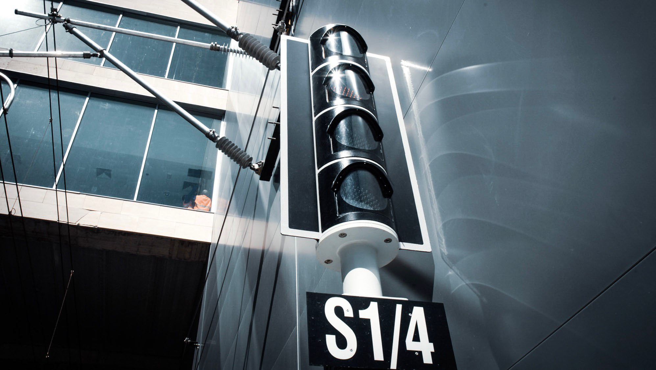
CHAP T ER 1
W O R K IN G B E T T E R T O GE T H E R F O R R A IL WAY SA F E T Y
I R S C 2 0 2 2
I N T E R N A T I O N A L R A I L W A Y S A F E T Y C O U N C I L
S E V I L L A , O C T O B E R 1 6 - 2 1 , 2 0 2 2

Slide 6
HIGH LEVEL OBJECTIVES
Aviation and nuclear have global networks to build and share knowledge aiming to improve safety and performance in their respective domains;
The railway sector does not yet have free access to a similar global network or platform;
Concrete cooperation between UIC and ERA and members to promote HOF in the railway sector.
I R S C 2 0 2 2
I N T E R N A T I O N A L R A I L W A Y S A F E T Y C O U N C I L
S E V I L L A , O C T O B E R 1 6 - 2 1 , 2 0 2 2

Slide 7
A HOF DIGITAL PLATFORM AT THE SERVICE OF THE RAIL SECTOR
A user-centred approach has been applied to better capture user needs and then use these to determine design requirements, content and functionality and usability.
This approach was used all along the development process of RAIL HOF from the needs analysis to the development of the platform.
What will RAIL HOF be for members?
a knowledge network on HOF and safety
a virtual platform which will evolve according to their needs
I R S C 2 0 2 2
I N T E R N A T I O N A L R A I L W A Y S A F E T Y C O U N C I L
S E V I L L A , O C T O B E R 1 6 - 2 1 , 2 0 2 2

Slide 8
CHAP T ER 2
A C OR N E R S T ON E FOR B UILD IN G & S H A R IN G K N O WLE D GE O N H O F
I R S C 2 0 2 2
I N T E R N A T I O N A L R A I L W A Y S A F E T Y C O U N C I L
S E V I L L A , O C T O B E R 1 6 - 2 1 , 2 0 2 2

Slide 9
NEEDS ANALYSIS
Needs analysis - at the beginning of 2019 a short questionnaire was sent to all contacts in ERA’s database who had expressed an interest in HOF issues;
It was composed of 5 questions:
What websites did they consult at the moment;
What did they like or dislike about those websites;
What type of content they would find useful.
Analysis of the results produced recommendations on:
Content
Platform Functionality
Editorial policy
I R S C 2 0 2 2
I N T E R N A T I O N A L R A I L W A Y S A F E T Y C O U N C I L
S E V I L L A , O C T O B E R 1 6 - 2 1 , 2 0 2 2

Slide 10
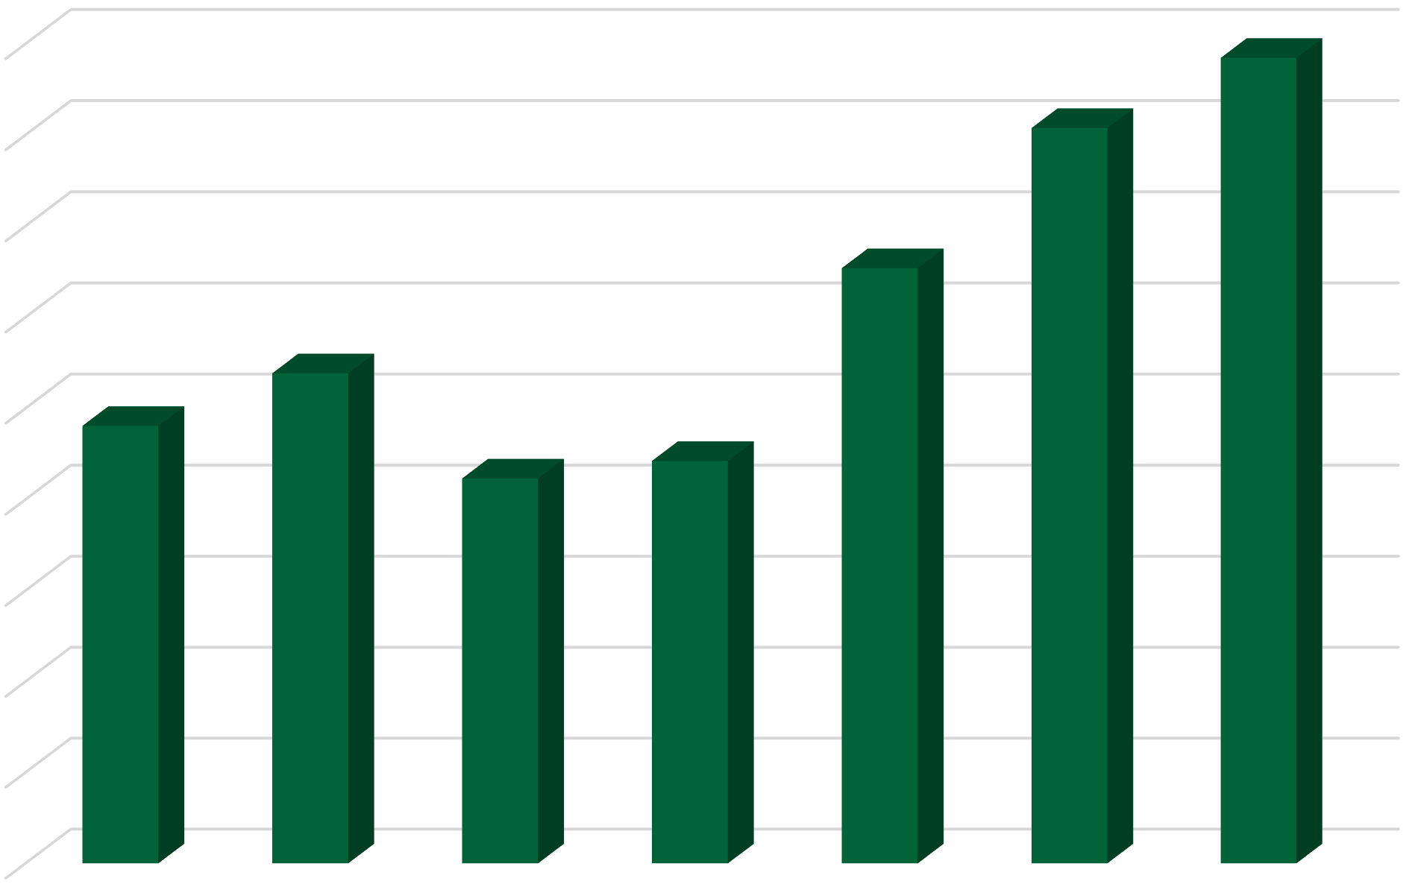
RESULTS SUMMARY OF THE NEEDS ANALYSIS
90%
Digital platform content preferences
Platform Functionality
Free access
Easy to navigate
Good search engine
80%
70%
60%
50%
Editorial policy
Trustworthy
Independent (unbiased)
No commercial interest
40%
30%
20%
10%
0%
Interviews
Academic Discussion papers forums
FAQ
Videos
Practical tips
Examples of best practice
I R S C 2 0 2 2
I N T E R N A T I O N A L R A I L W A Y S A F E T Y C O U N C I L
S E V I L L A , O C T O B E R 1 6 - 2 1 , 2 0 2 2

Slide 11
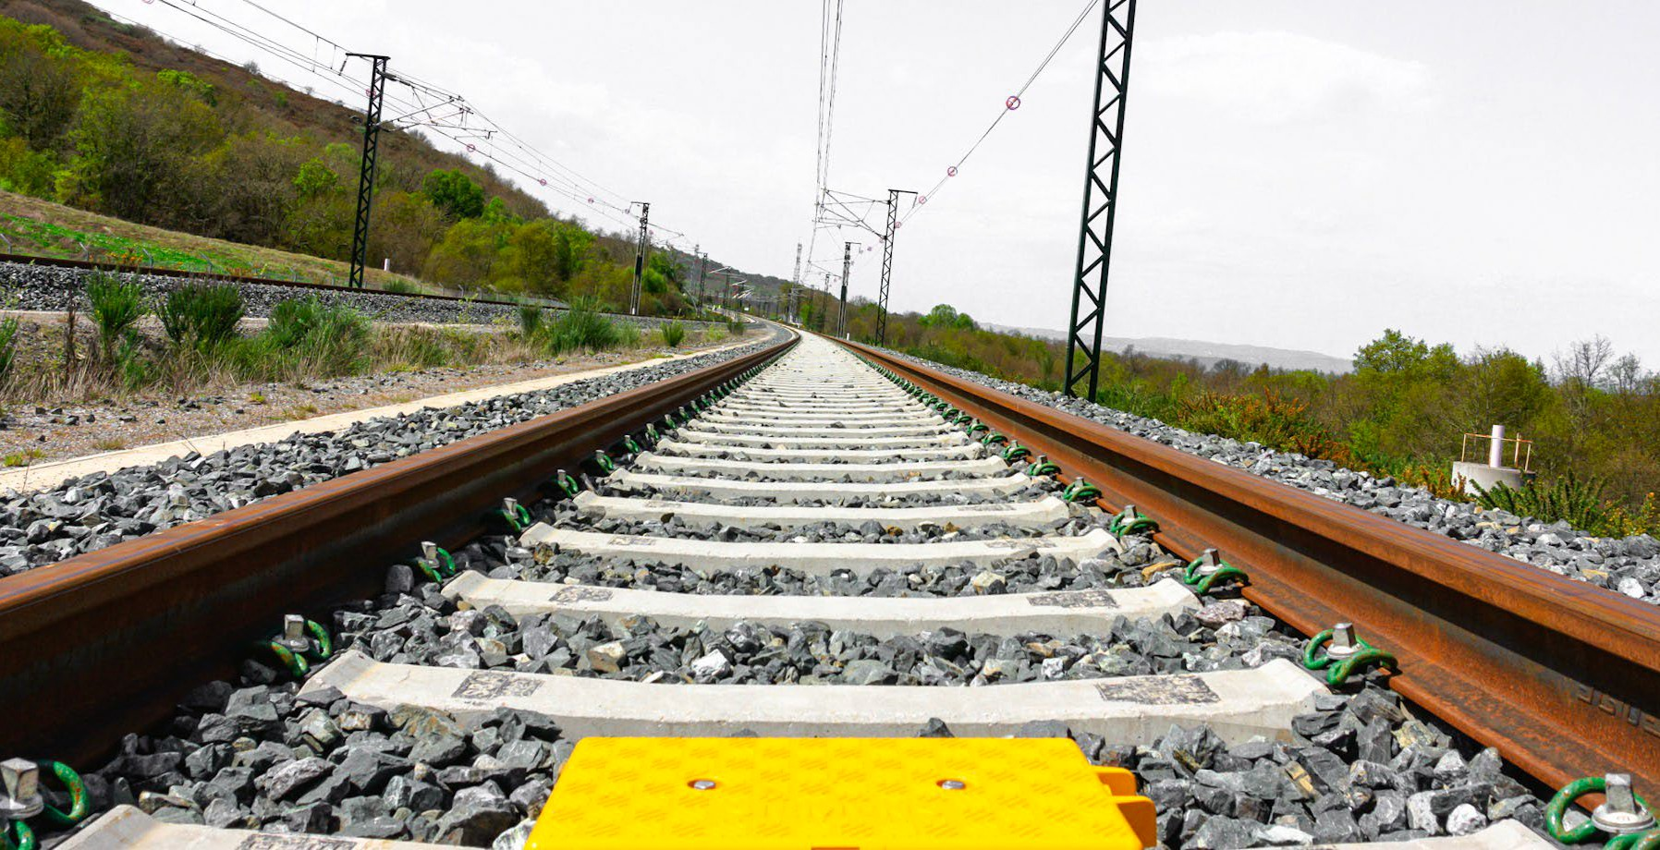
CHAP T ER 3
R A IL H O F D IGI TA L PL AT F O R M D E V E L O PM E N T
I R S C 2 0 2 2
I N T E R N A T I O N A L R A I L W A Y S A F E T Y C O U N C I L
S E V I L L A , O C T O B E R 1 6 - 2 1 , 2 0 2 2

Slide 12
INVOLVEMENT OF THE RAILWAY SECTOR
UIC’s Human and Organisational Factors Working Group (HOFWG) - a global group of HOF experts decided on:
a visual and digital identity;
A structure composed of 3 sections:
a LinkedIn group to develop the HOF community of experts and increase visibility;
a Website to act as an entry point to access the appropriate information depending on needs and the level of HOF expertise and experience and;
a Private area for members to manage events and create a forum for sharing working documents.
“RAIL HOF Digital Platform is a Website, a LinkedIn group & a Private area for members”
I R S C 2 0 2 2
I N T E R N A T I O N A L R A I L W A Y S A F E T Y C O U N C I L
S E V I L L A , O C T O B E R 1 6 - 2 1 , 2 0 2 2

Slide 13
INVOLVEMENT OF THE RAILWAY SECTOR
The HOFWG also determined the end users of this platform from HOF specialists, through frontline and safety managers, to CEOs as well as their more specific needs in terms of content.
An editorial team was established to:
Structure the website's headings and subheadings and to initially populate the site with content.
Moderate the LinkedIn group
Validate the information and new content that will be proposed
The Editorial Team is composed of 7 volunteers:
Nora Balfe - IRISH RAIL
Fiona Kenvyn - METRO TRAINS MELBOURNE
Paul Leach - RSSB
Huw Gibson - TRIMETIS
Bernard Penners - INFRABEL
Jayne Yeo – ERA
Virginie Papillault – UIC
“An editorial team will ensure the evolution of the RAIL HOF”
I R S C 2 0 2 2
I N T E R N A T I O N A L R A I L W A Y S A F E T Y C O U N C I L
S E V I L L A , O C T O B E R 1 6 - 2 1 , 2 0 2 2

Slide 14
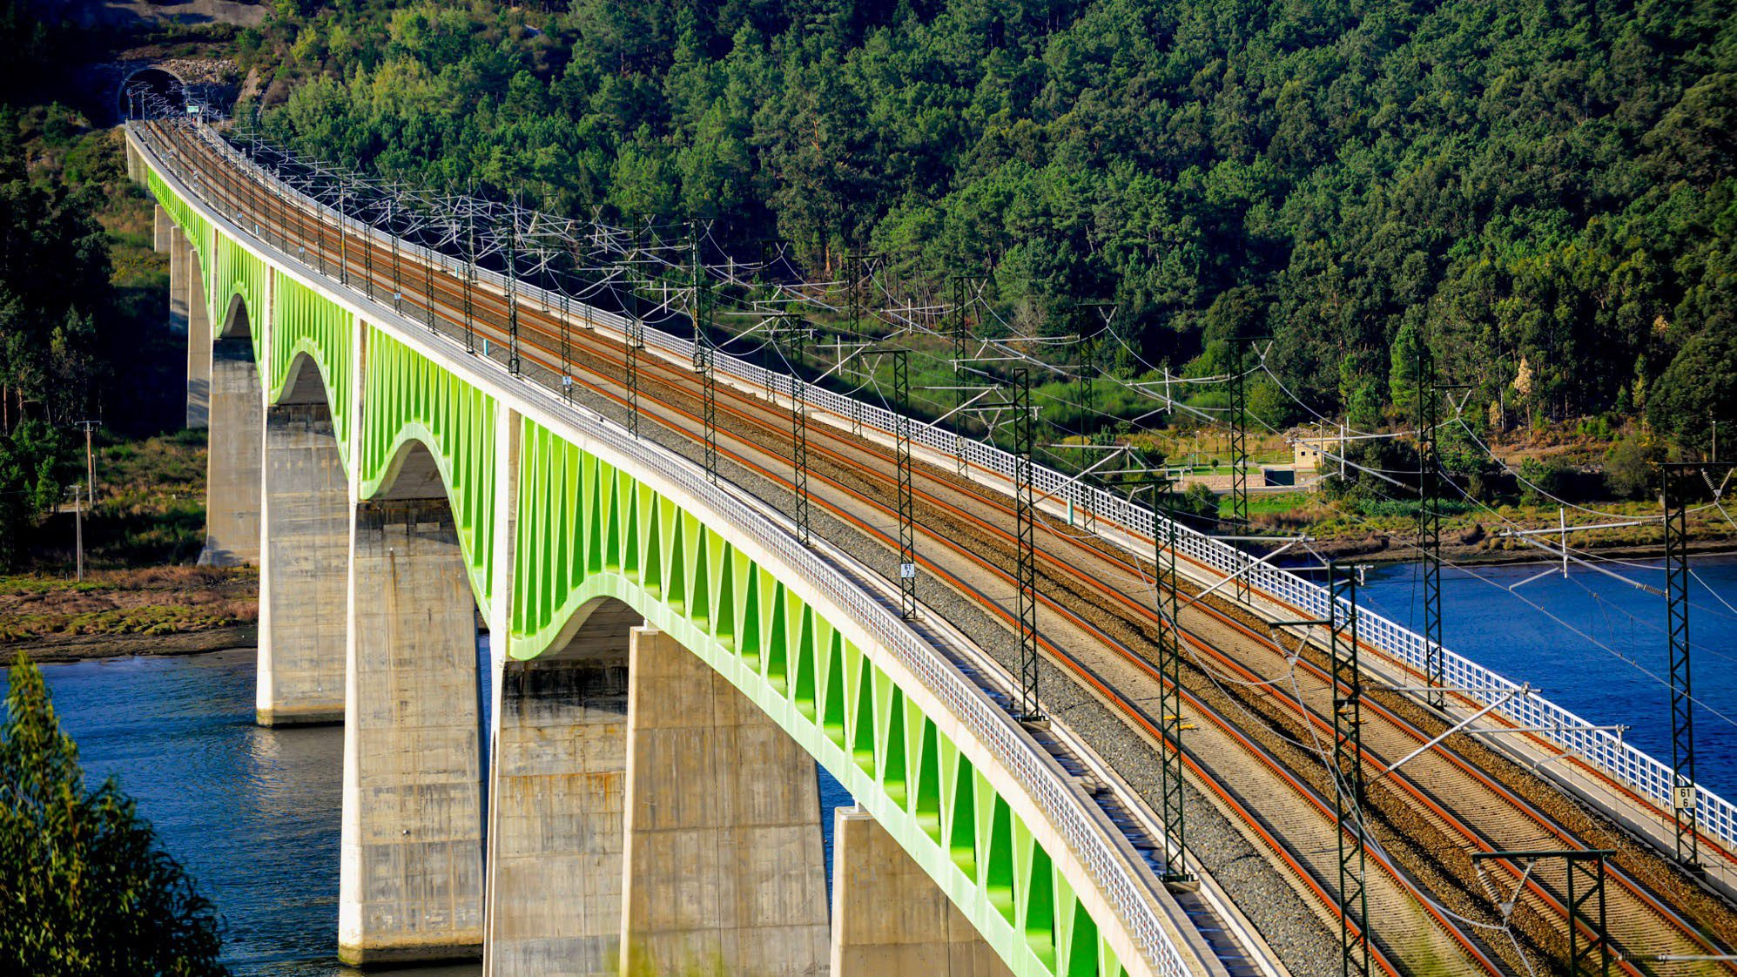
CHAP T ER 4
R A IL H O F PL AT F O R M IN A C T IO N
I R S C 2 0 2 2
I N T E R N A T I O N A L R A I L W A Y S A F E T Y C O U N C I L
S E V I L L A , O C T O B E R 1 6 - 2 1 , 2 0 2 2

Slide 15
RAIL HOF LINK
https://railhof.org/
I R S C 2 0 2 2
I N T E R N A T I O N A L R A I L W A Y S A F E T Y C O U N C I L
S E V I L L A , O C T O B E R 1 6 - 2 1 , 2 0 2 2

Slide 16
BENEFITS OF RAIL HOF FOR MEMBERS
Develop and share knowledge, practical experience, case studies and expertise on HOF,
Encourage the further development of HOF knowledge and expertise in the sector,
Help to build and connect a network of
rail professionals active in the area of HOF,
Support the global implementation of a high level of railway safety and performance,
Address their legislative requirements in the area of HOF,
Provide an easily accessible and reliable source of HOF information
Help all organisations achieve safety and performance benefits from the application of HOF best practice and knowledge.
“ R A IL H O F is ma d e f o r yo u , b y yo u a n d n eed s to b e ke p t a liv e b y yo u - th e r a i l way s e c tor ”
I R S C 2 0 2 2
I N T E R N A T I O N A L R A I L W A Y S A F E T Y C O U N C I L
S E V I L L A , O C T O B E R 1 6 - 2 1 , 2 0 2 2

Slide 17
RAIL HOF IN CON CRET E T ERM S
I NT R O D U C T I O N A ND H O M E PA G E
I R S C 2 0 2 2
I N T E R N A T I O N A L R A I L W A Y S A F E T Y C O U N C I L
S E V I L L A , O C T O B E R 1 6 - 2 1 , 2 0 2 2

Slide 18
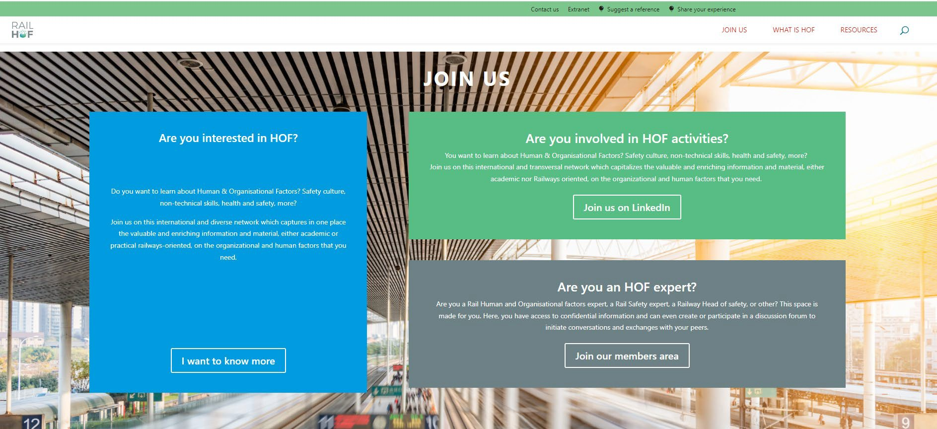
RAIL HOF IN CON CRET E T ERM S
JO IN US
I R S C 2 0 2 2
I N T E R N A T I O N A L R A I L W A Y S A F E T Y C O U N C I L
S E V I L L A , O C T O B E R 1 6 - 2 1 , 2 0 2 2

Slide 19
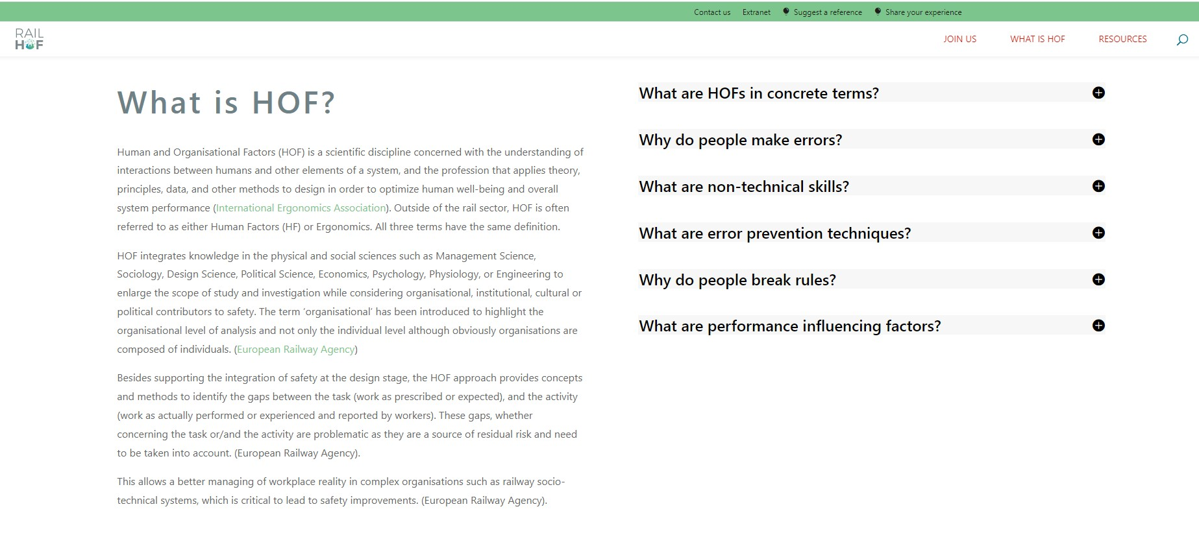
RAIL HOF IN CON CRET E T ERM S
WH AT IS H O F & F A Q
I R S C 2 0 2 2
I N T E R N A T I O N A L R A I L W A Y S A F E T Y C O U N C I L
S E V I L L A , O C T O B E R 1 6 - 2 1 , 2 0 2 2

Slide 20
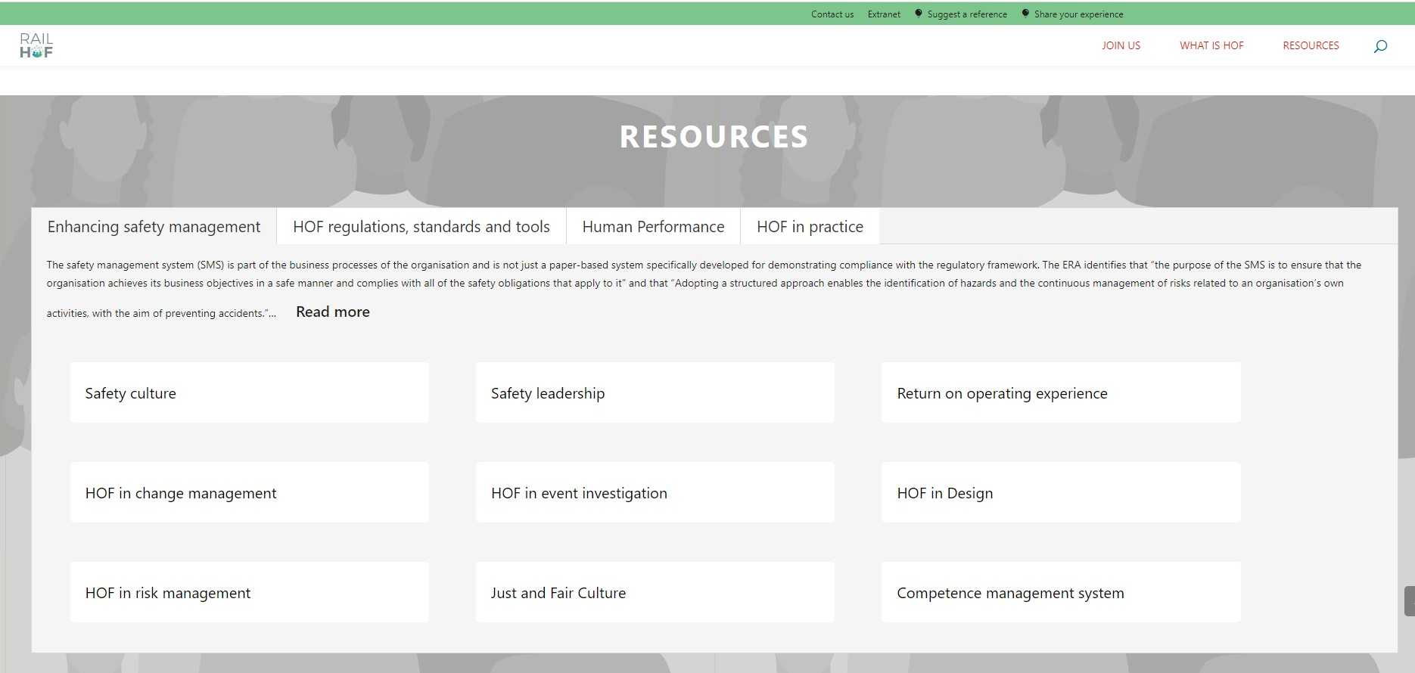
RAIL HOF IN CON CRET E T ERM S
R E S O U R C E S : E NH A NC I NG S A F E T Y M A NA G E M E NT
I R S C 2 0 2 2
I N T E R N A T I O N A L R A I L W A Y S A F E T Y C O U N C I L
S E V I L L A , O C T O B E R 1 6 - 2 1 , 2 0 2 2

Slide 21
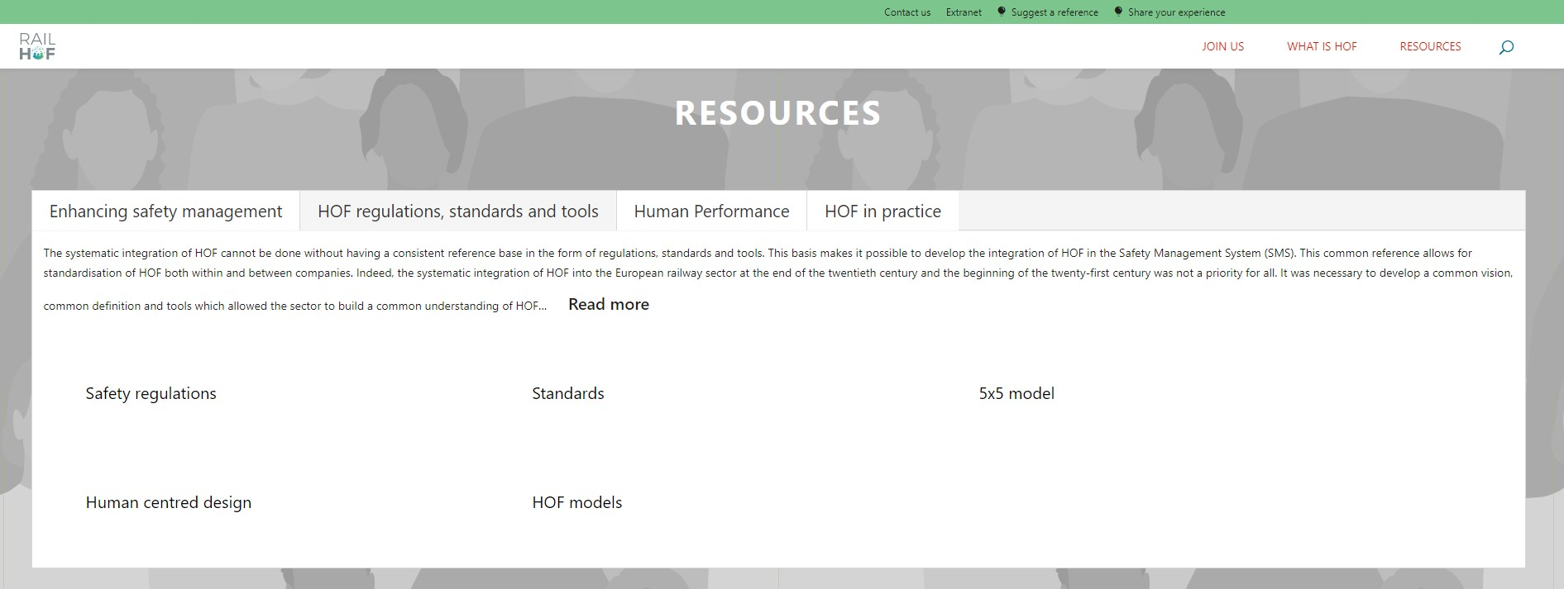
RAIL HOF IN CON CRET E T ERM S
R E SO UR C E S: H O F R E GUL AT IO N S, S TA N D A R D S & T O O LS
I R S C 2 0 2 2
I N T E R N A T I O N A L R A I L W A Y S A F E T Y C O U N C I L
S E V I L L A , O C T O B E R 1 6 - 2 1 , 2 0 2 2

Slide 22
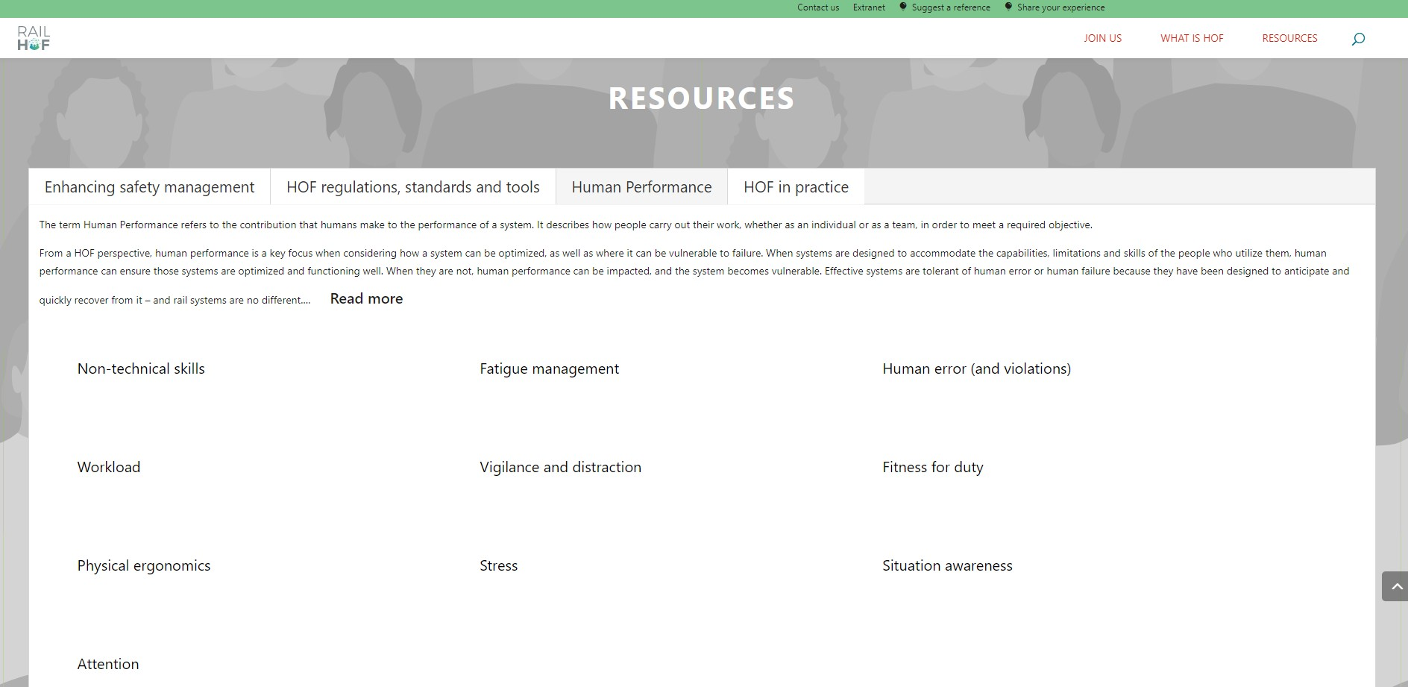
RAIL HOF IN CON CRET E T ERM S
RE S O U RC E S : HU M A N P E RF O RM A N C E
I R S C 2 0 2 2
I N T E R N A T I O N A L R A I L W A Y S A F E T Y C O U N C I L
S E V I L L A , O C T O B E R 1 6 - 2 1 , 2 0 2 2

Slide 23
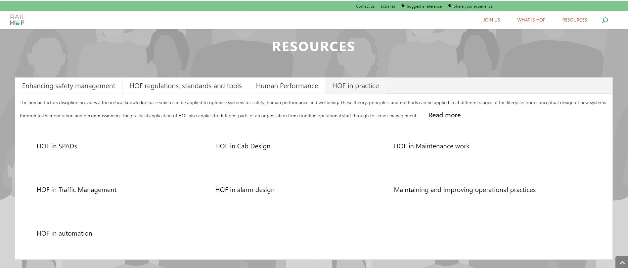
RAIL HOF IN CON CRET E T ERM S
RE S O U RC E S : HO F I N P RA C TI C E
I R S C 2 0 2 2
I N T E R N A T I O N A L R A I L W A Y S A F E T Y C O U N C I L
S E V I L L A , O C T O B E R 1 6 - 2 1 , 2 0 2 2

Slide 24
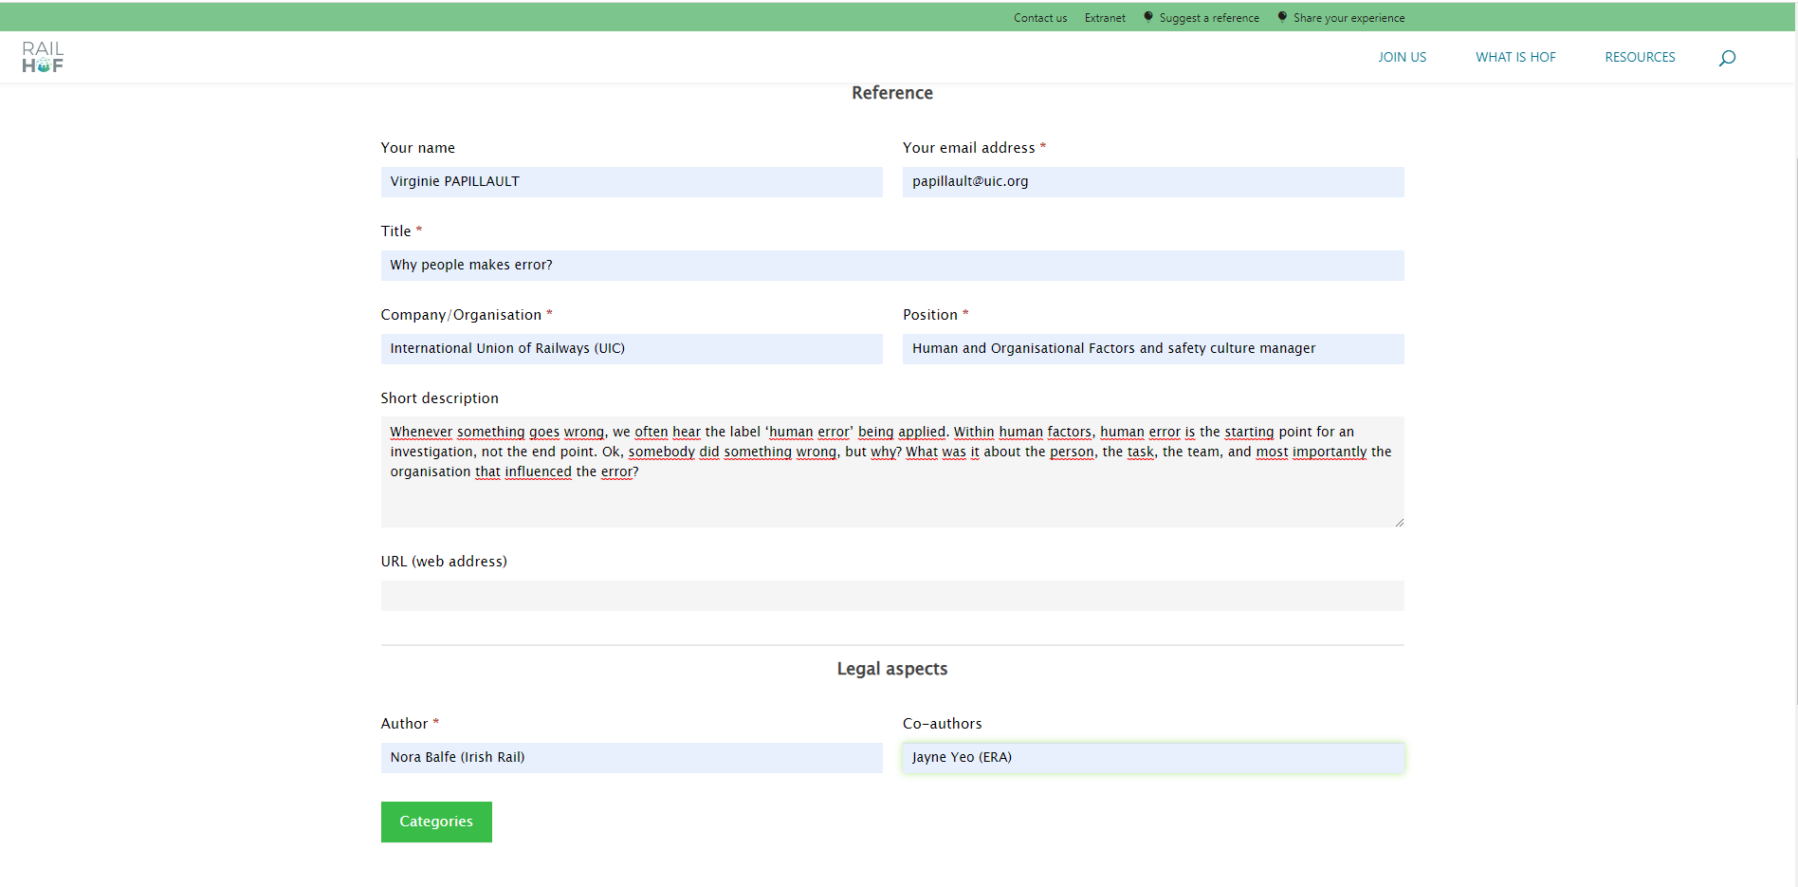
RAIL HOF IN CON CRET E T ERM S
H O W T O SH A R E A R E F E R E N C E IN R A IL H O F ?
I R S C 2 0 2 2
I N T E R N A T I O N A L R A I L W A Y S A F E T Y C O U N C I L
S E V I L L A , O C T O B E R 1 6 - 2 1 , 2 0 2 2

Slide 25
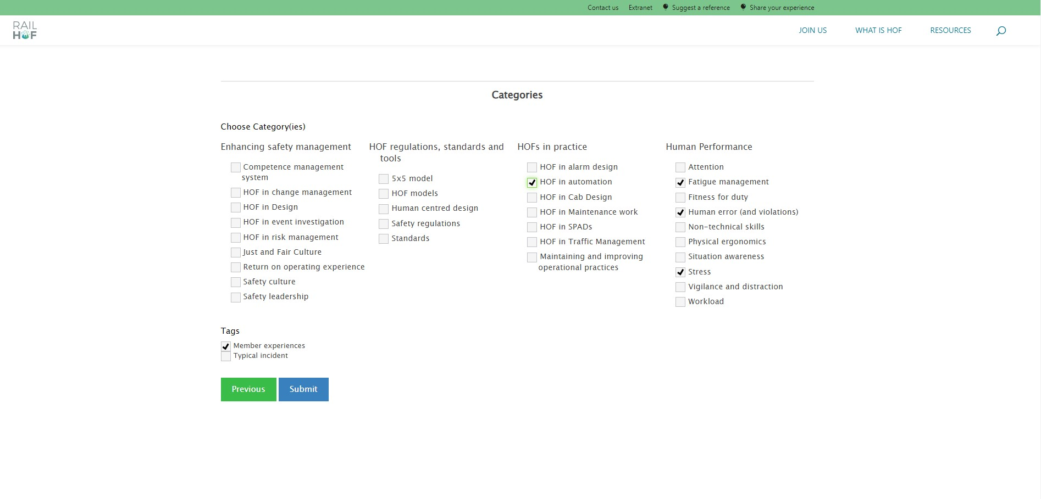
RAIL HOF IN CON CRET E T ERM S
H O W T O SH A R E A R E F E R E N C E IN R A IL H O F ?
I R S C 2 0 2 2
I N T E R N A T I O N A L R A I L W A Y S A F E T Y C O U N C I L
S E V I L L A , O C T O B E R 1 6 - 2 1 , 2 0 2 2

Slide 26
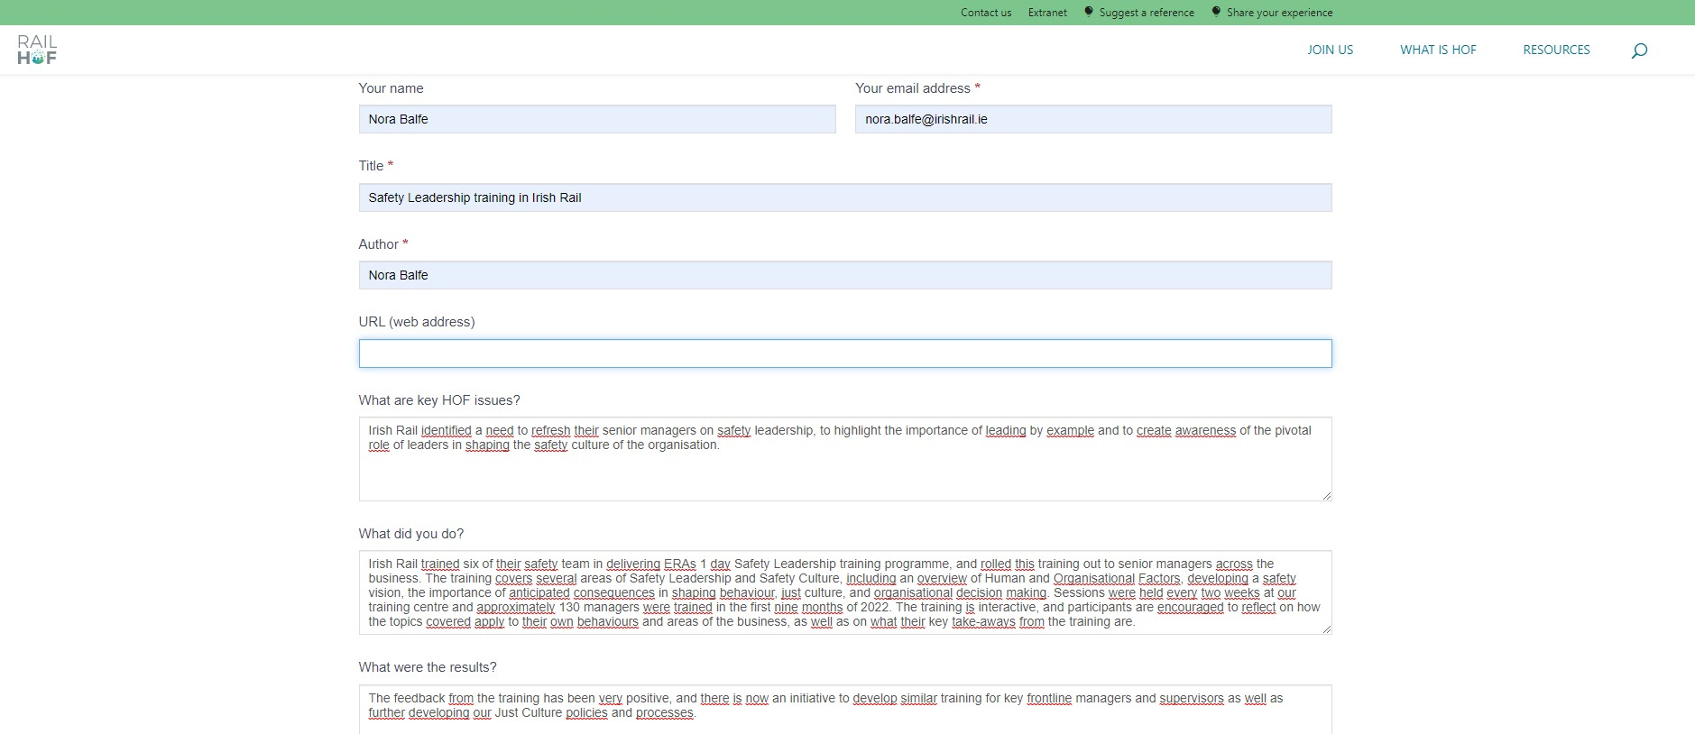
RAIL HOF IN CON CRET E T ERM S
H O W T O SH A R E Y O UR E X PE R IE N C E IN R A IL H O F ?
I R S C 2 0 2 2
I N T E R N A T I O N A L R A I L W A Y S A F E T Y C O U N C I L
S E V I L L A , O C T O B E R 1 6 - 2 1 , 2 0 2 2

Slide 27
w w w .i r sc 2 0 2 2 .c om

