Slide 1



IRSC 2022
INTERNATIONAL RAILWAY
SAFETY COUNCIL
SEVILLA, OCTOBER 16-21, 2022

Slide 2
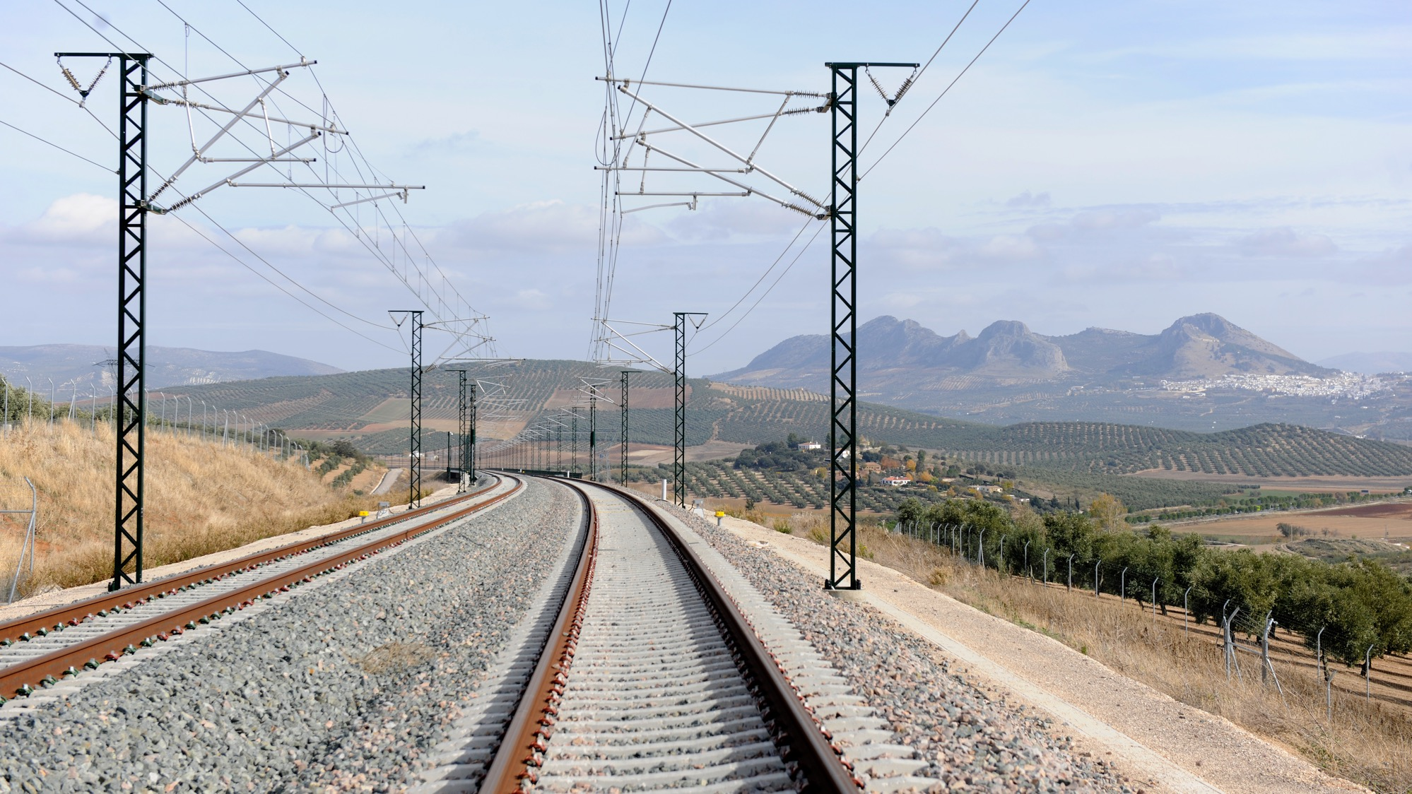



KIRSI PAJUNEN
Finnish Transport and Communications Agency (Traficom)
HEIDI NIEMIMUUKKO
Finnish Transport Infrastructure Agency (FTIA)
IRSC 2022
INTERNATIONAL RAILWAY SAFETY COUNCIL
SEVILLA, OCTOBER 16-21, 2022

Slide 3
SAFETY DIALOGUE BETWEEN SAFETY AUTHORITY AND INFRASTRUCTURE MANAGER
IRSC 2022
INTERNATIONAL RAILWAY SAFETY COUNCIL
SEVILLA, OCTOBER 16-21, 2022

Slide 4
INDEX
GENERAL ON SAFETY DIALOGUES
EXAMPLE ON SAFETY DIALOGUES BETWEEN TRAFICOM AND FTIA

Slide 5

GENERAL ON SAFETY DIALOGUES
IRSC 2022
INTERNATIONAL RAILWAY SAFETY COUNCIL
SEVILLA, OCTOBER 16-21, 2022

Slide 6
OBJECTIVES OF SAFETY DIALOGUES
Support supervision and evaluation of SMS
Decrease misunderstandings
Enable open discussion
Understanding risks
Improve safety performance and safety culture

Slide 7
GENERAL ON SAFETY DIALOGUES
3-4 times per year
Not as formal as audit, no evidence needed
Preparing well
Making notes and to-do-table
Follow-up

Slide 8
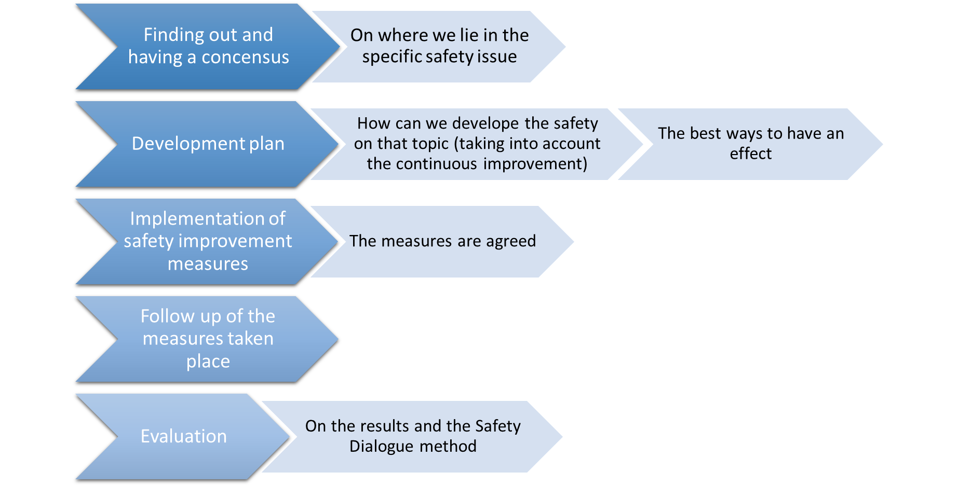
SAFETY DIALOGUE PROCESS

Slide 9
EXAMPLES OF TOPICS
Safety targets
Training of staff
HOF
Safety improvement program
Cyber security
Resilience of organisation
Development of SMS

Slide 10
EXPERIENCES
Pilot during 2021 -> all piloting organisations continued
Safety dialogues found useful and improving understanding of safety issues
Best suited for “soft” issues (safety culture, HOF, resilience)
Well suited for processes under development
Not so well for purely technical issues
Important to have relevant experts participating

Slide 11
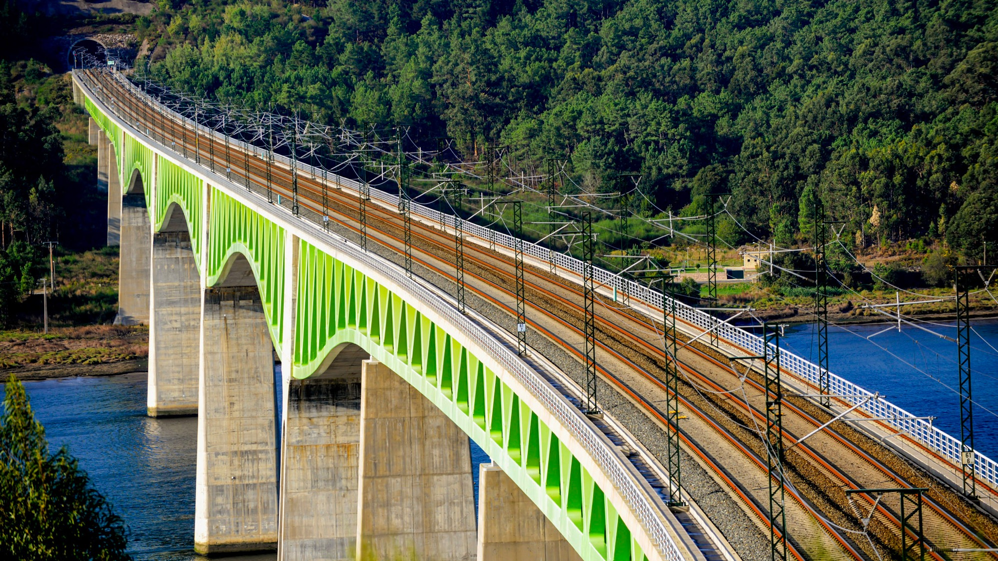
EXAMPLE OF SAFETY DIALOGUE
IRSC 2022
INTERNATIONAL RAILWAY SAFETY COUNCIL
SEVILLA, OCTOBER 16-21, 2022

Slide 12
SELF-ASSESSMENT OF SAFETY MANAGEMENT SYSTEM
9 safety experts participated at FTIA
Silent workshop
Made with the similar SMS maturity model at Traficom
Assessment made as a group
5 experts participated at Traficom
Results compared at the safety dialogue
Interesting discussions on differences
Averages of the results
At some points the assessment varied

Slide 13
EXAMPLES OF RESULTS
HOF integration (FTIA)
Situation at SMS level is good, but on the practical side there’s still a lot work to be done. Especially to change everyones attitude
Operational planning and control (Traficom)
Riskanalysis has been done, but residual risks have not sufficently been taken into account or the need to analyse risks is not always identified. There are good examples, but diversity is still too great. This need a more systematic implementation.
Operational planning and control (FTIA)
Planning of functions has a sound process and it is adhered to. However there is a lack in resourses.
HOF integration (Traficom)
HOF has been successfully integrated into operation and a lot of work has been done. HOF is a part of all training.
Looking at the whole railway system in Finland the actions and operations of FTIA concerning HOF are on a good level.

