Slide 1


IRSC 2022
INTERNATIONAL RAILWAY
SAFETY COUNCIL
SEVILLA, OCTOBER 16-21, 2022

Slide 2
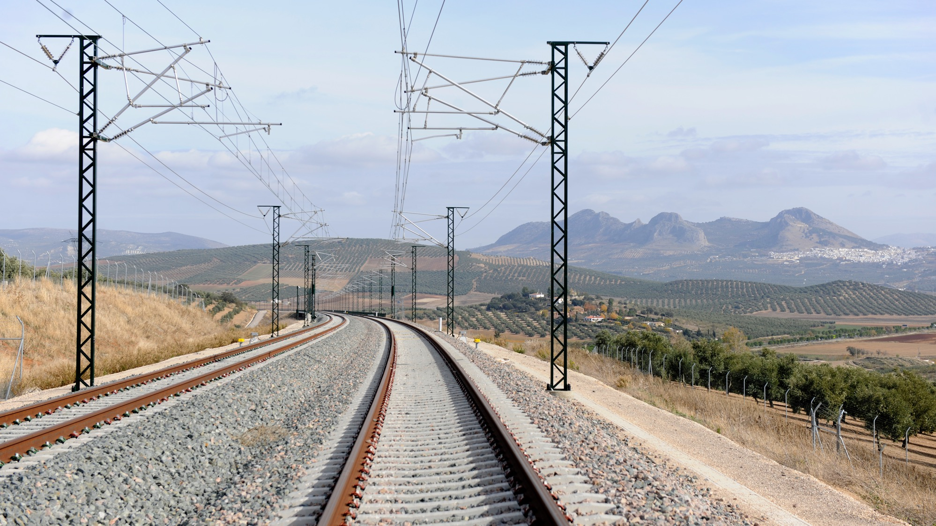



Heidi Niemimuukko
Safety Director, Finnish Transport Infrastructure Agency
IRSC 2022
INTERNATIONAL RAILWAY SAFETY COUNCIL
SEVILLA, OCTOBER 16-21, 2022

Slide 3
DIGITAL SAFETY AND SAFETY MANAGEMENT
CYBER SECURITY MANAGEMENT AND PERFORMANCE AT INFRASTRUCTURE MANAGER
IRSC 2022
INTERNATIONAL RAILWAY SAFETY COUNCIL
SEVILLA, OCTOBER 16-21, 2022

Slide 4
INDEX
CURRENT STATE OF TRAFFIC CYBER SECURITY
KEEPING US AND DATA SAFE- BUILDING AND LIVING CYBER SECURITY AS PART OF A MANAGEMENT SYSTEM
CONCLUSION

Slide 5
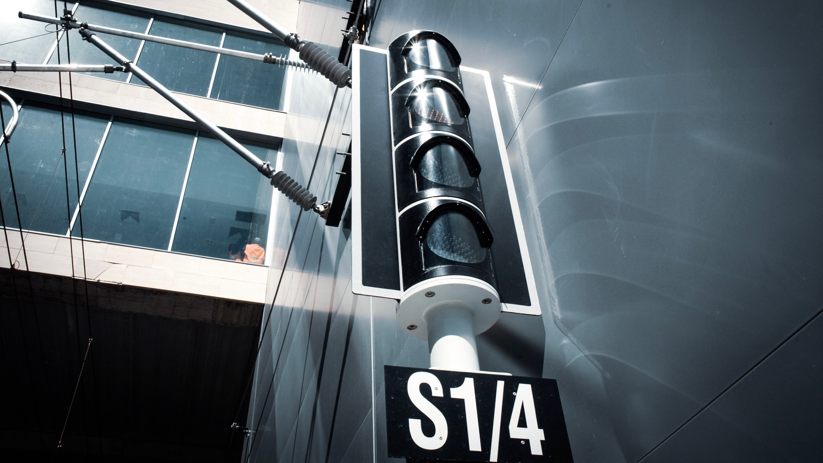
CURRENT STATE OF TRAFFIC CYBER SECURITY
IRSC 2022
INTERNATIONAL RAILWAY SAFETY COUNCIL
SEVILLA, OCTOBER 16-21, 2022

Slide 6
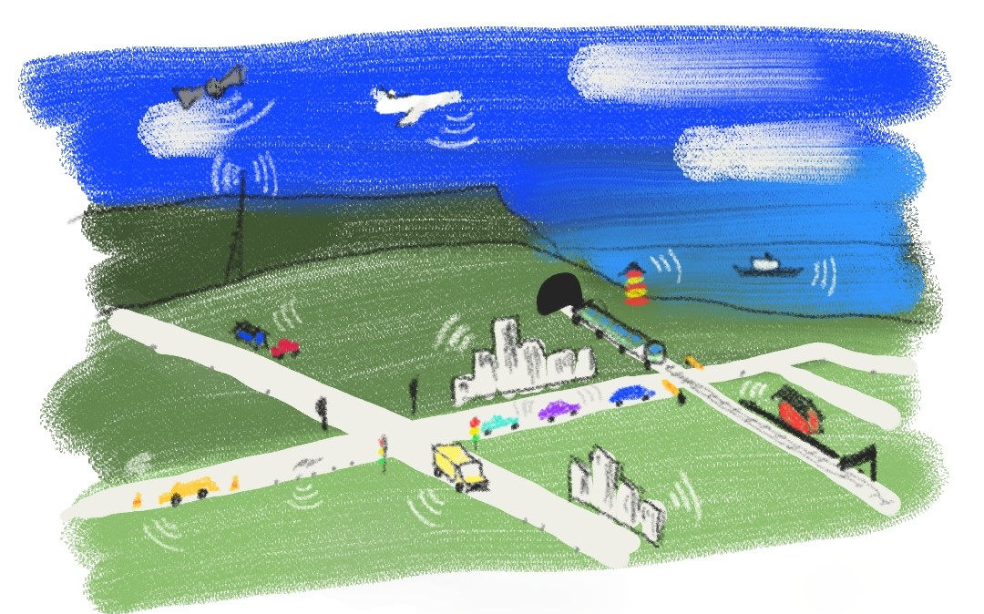
TRAFFIC IS INFORMATION

Slide 7
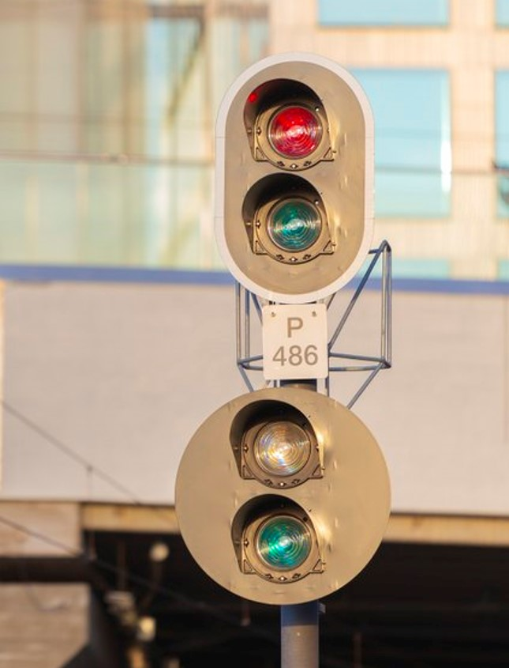
CYBER CHALLENGES IN RAIL TODAY
According to European Network and Infromation Security Agency railway cyber challenges are
  Low digital security awareness
  Difficulty in reconciling safty and cyber security worlds
  Digital transformation on railway core business
  Dependence on supply chain
  Geographic spread and legacy systems
  The need to balance security, competitiveness and operational efficiency
  Complexity and lack of harmonization of regulations

Slide 8
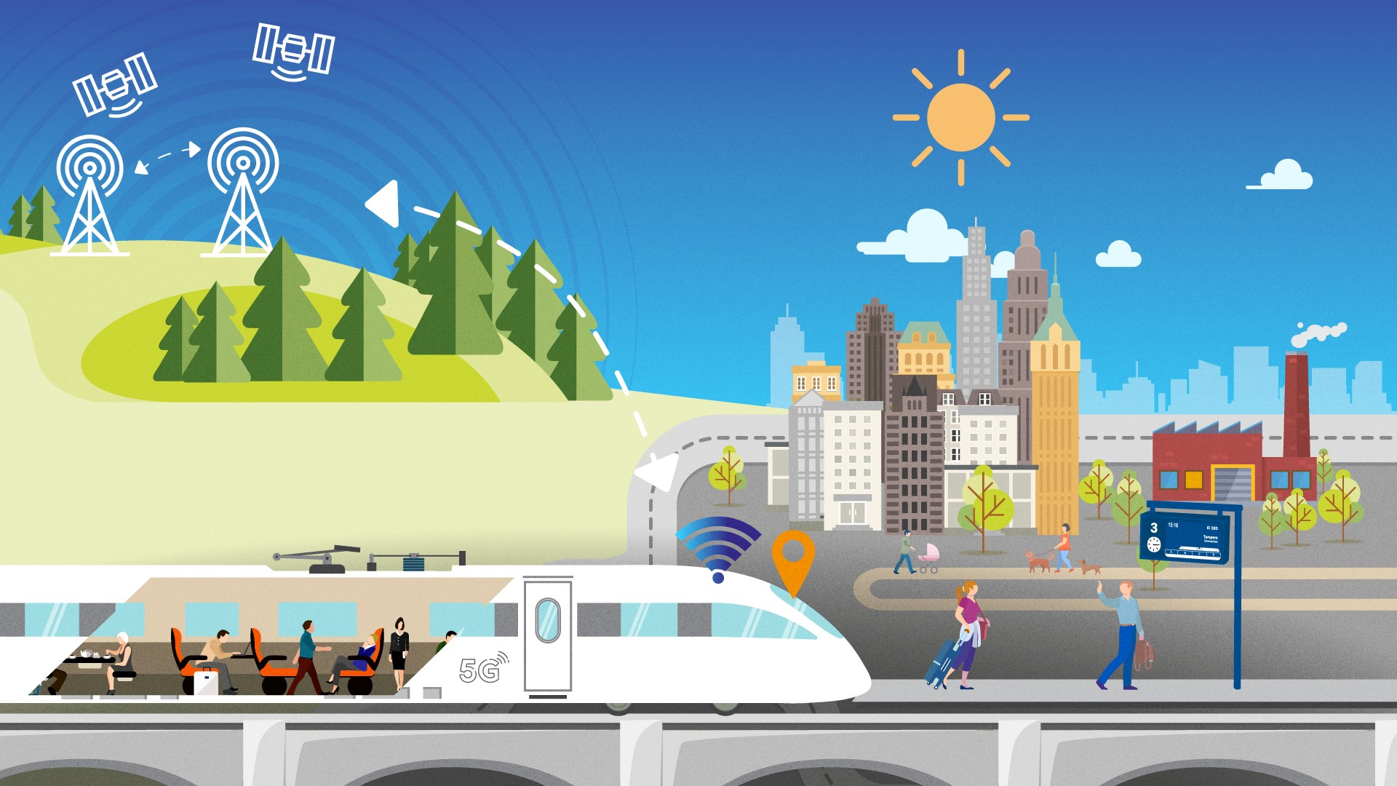

DIGIRATA – DIGIRAIL
DigiRail
FOR THE ENVIRONMENT
Reduced CO2 emissions
Shifting transport volumes to the rails from other modes of transport
Energy efficiency through capacity optimisation and more economical and energy-saving driving
YMPÄRISTÖLLE
Vähemmän CO2 -päästöjä
Liikennettä raiteille muista liikennemuodoista
Energiatehokkuutta kapasiteetin optimoinnilla sekä taloudellisemmalla, energiaa säästävällä ajamisella
Foundation for the future railway traffic is formed now
A SOLUTION THAT STANDS THE TEST OF TIME
AI-based optimisation of traffic management
real-time refining of data
continuously updated capacity and schedule data
dynamic reactions
FOR BUSINESS
More flexible transport services for industry
A platform for the growth of new services
Conditions for more sustainable business
ELINKEINOELÄMÄLLE
Joustavampaa kuljetusta teollisuudelle
Kasvualusta uusille palveluille
Edellytyksiä vastuullisempaan liiketoimintaan
FOR FINLAND’S RAILWAY NETWORK
Maximum utilisation of investments
Proactive maintenance, also by digital methods
Safety in e.g. railway maintenance and level crossings
Simplifying the infrastructure, less trackside equipment
MATKUSTAJILLE
Täsmällinen ja turvallinen matka
Enemmän yhteyksiä ja sujuvat matkaketjut
Yksilöityä matkustajainformaatiota
FOR PASSENGERS
Punctual and safe journeys
More connections and smooth travel chains
Personalised passenger information
RAUTATIEVERKOLLE
Enemmän irti investoinneista
Ennakoivaa kunnossapitoa myös digitaalisesti
Turvallisuutta mm. ratatöihin ja tasoristeyksiin
Infrastruktuurin yksinkertaistaminen, vähemmän ratalaitteita

Slide 9
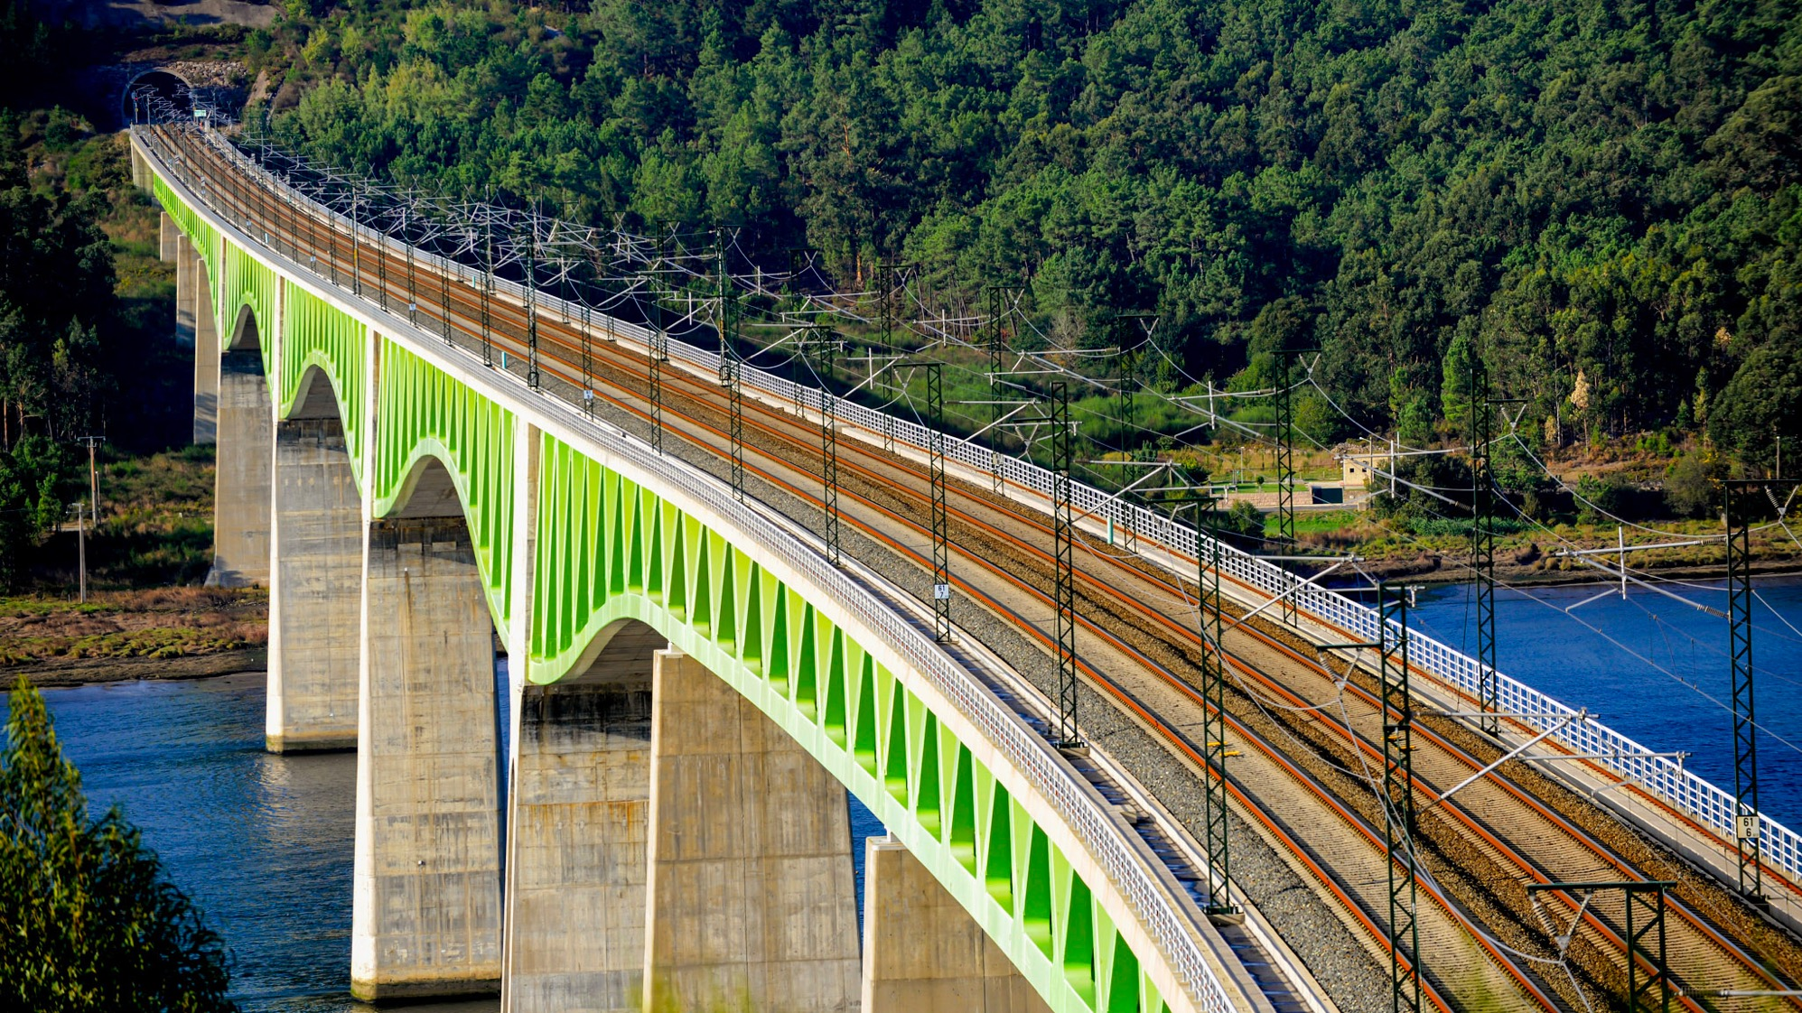
KEEPING US AND DATA SAFE - BUILDING AND LIVING CYBER SECURITY AS PART OF A MANAGEMENT SYSTEM
IRSC 2022
INTERNATIONAL RAILWAY SAFETY COUNCIL
SEVILLA, OCTOBER 16-21, 2022

Slide 10
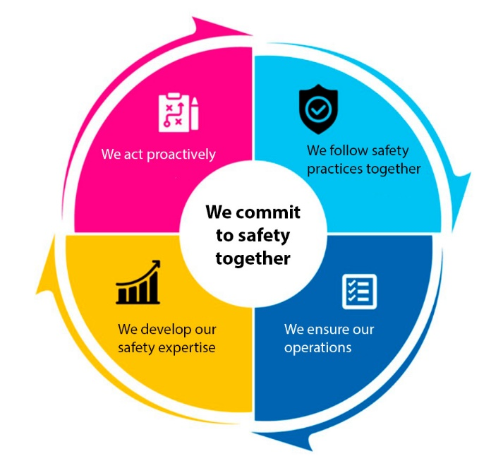
CYBER SECURITY MANAGEMENT SYSTEM
  Changes in working environmet and effects on ”traditional” cyber security workstreams
  Risk identification, assessment and management
  Identification and analysis
  Competences
  Sharing of information
  Identification and protection of business critical environments
  Contingency planning

Slide 11
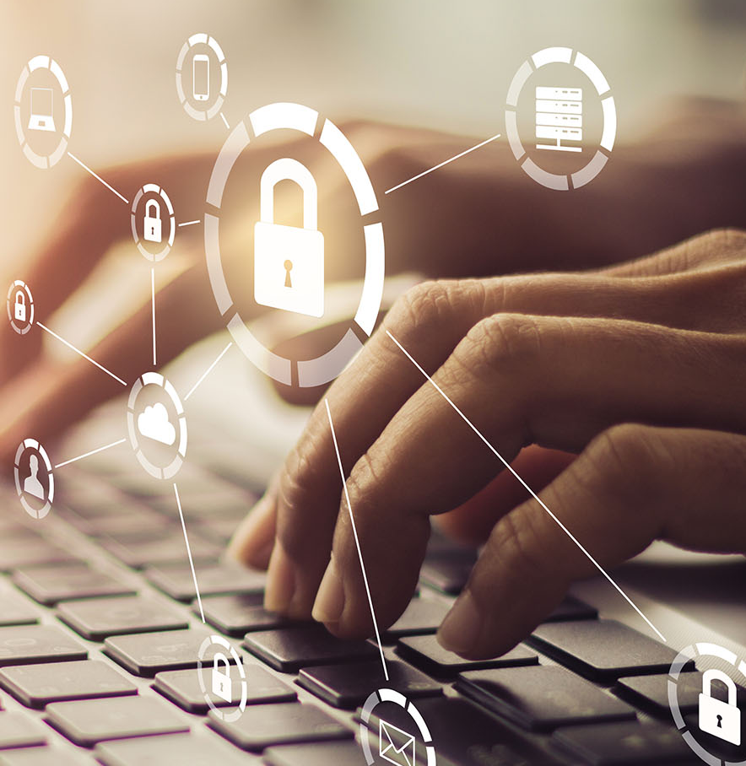
CYBER PREPAREDNESS
Contingency plan
  Updated regularly
  Adds to normal traffic procedures for degraded operations (ie. OPE TSI EU/773/2019)
Training
Auditing
Analysing potential threats
Risk management
Programmes to continuously improve cyber security

Slide 12
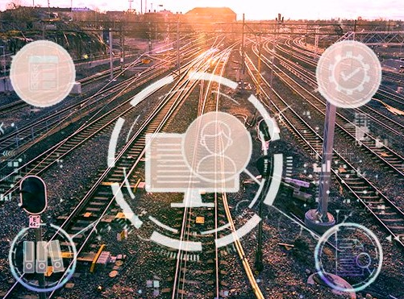
RAIL CYBER SECURITY PROGRAMME
Goal is to further strengthen reliability of the rail system and its various components through administrative, physical and IT measures
Accomplishments so far
Subsystem and present state of cyber security mapped
Boost on knowledge
Information security requirements done
Cyber security principles and requirements for traffic management done
Cyber risk management concept improved
2020
2021
2022
2023
2024

Slide 13
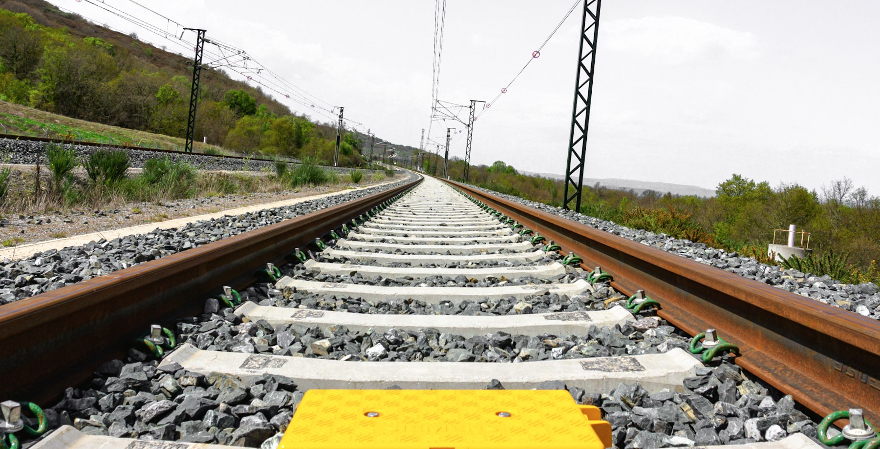
CONCLUSION
IRSC 2022
INTERNATIONAL RAILWAY SAFETY COUNCIL
SEVILLA, OCTOBER 16-21, 2022

Slide 14
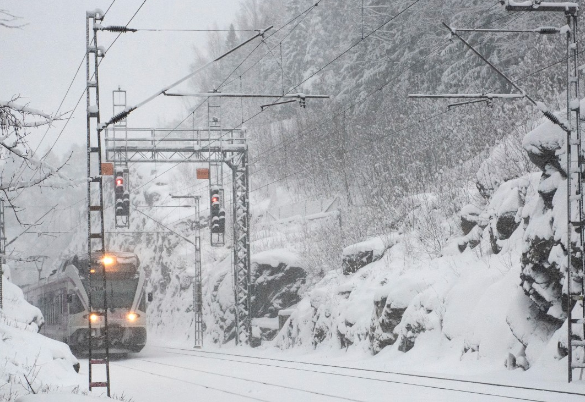
CYBER SECURITY IS NOT JUST TECHNICS
Attempts to influence start with people and end with people
We together make our operations cyber secure!

