Slide 1


IRSC 2022
INTERNATIONAL RAILWAY
SAFETY COUNCIL
SEVILLA, OCTOBER 16-21, 2022

Slide 2
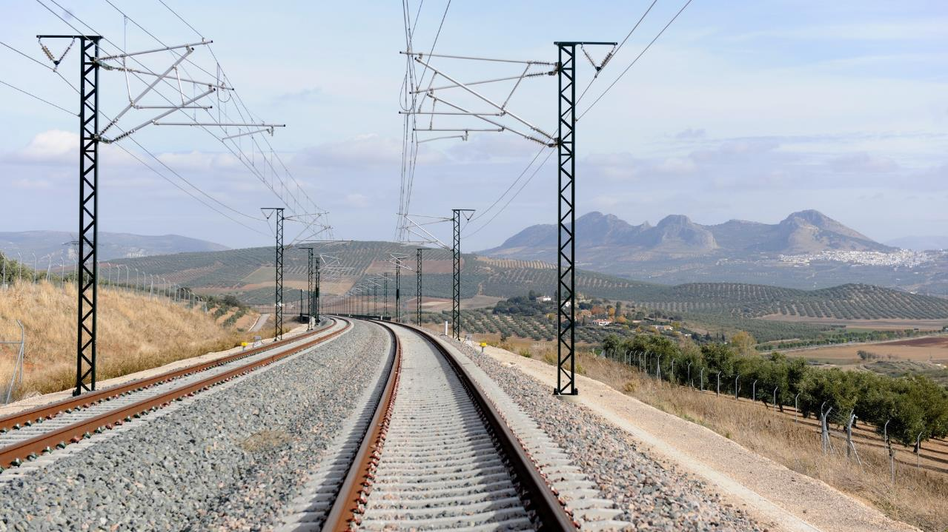



Dr. Miguel Figueres-Esteban
DPISC - Renfe
IRSC 2022
INTERNATIONAL RAILWAY SAFETY COUNCIL
SEVILLA, OCTOBER 16-21, 2022

Slide 3
Designing a confidential reporting system at Renfe
IRSC 2022
COMANY LOGO
INTERNATIONAL RAILWAY SAFETY COUNCIL
SEVILLA, OCTOBER 16-21, 2022

Slide 4
INDEX
CHAPTER 1
Background
CHAPTER 2
Methodology
CHAPTER 3
Results
CHAPTER 4
Discussion
CHAPTER 5
Conclusions

Slide 5
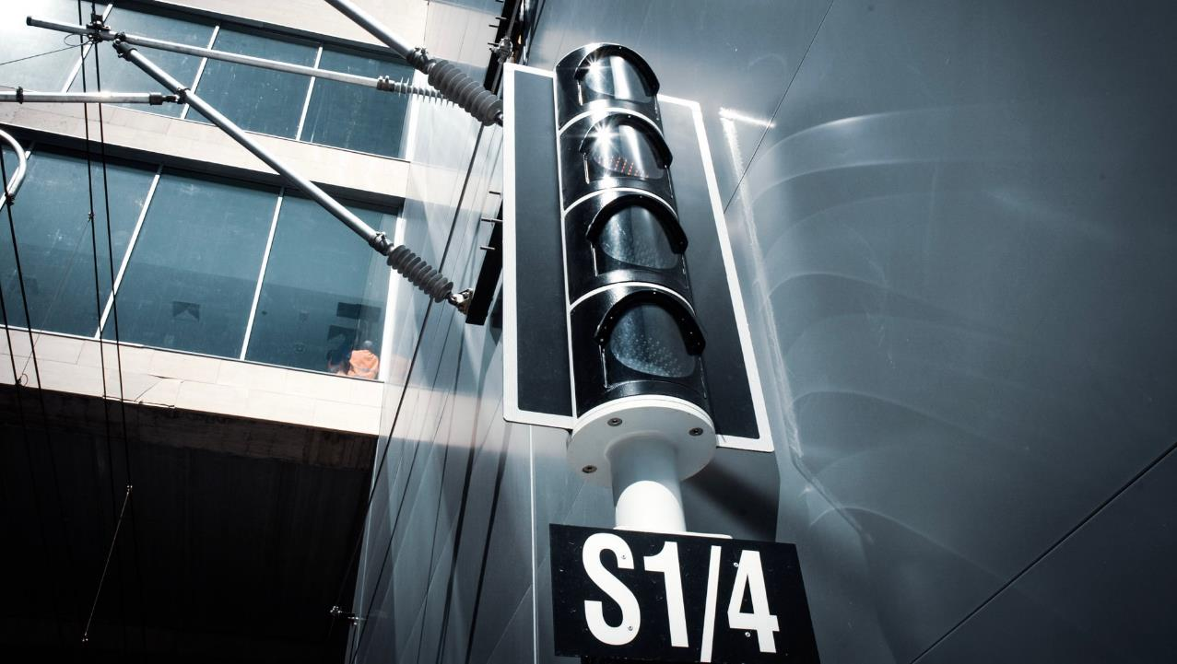
CHAPTER 1
BACKGROUND
IRSC 2022
COMPANY LOGO
INTERNATIONAL RAILWAY SAFETY COUNCIL
SEVILLA, OCTOBER 16-21, 2022

Slide 6
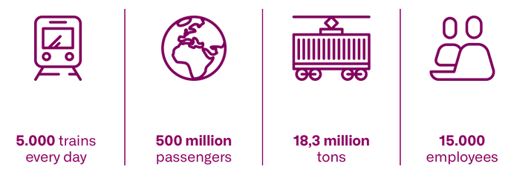
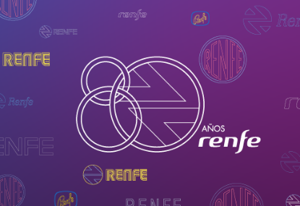
WHO IS Renfe

Slide 7
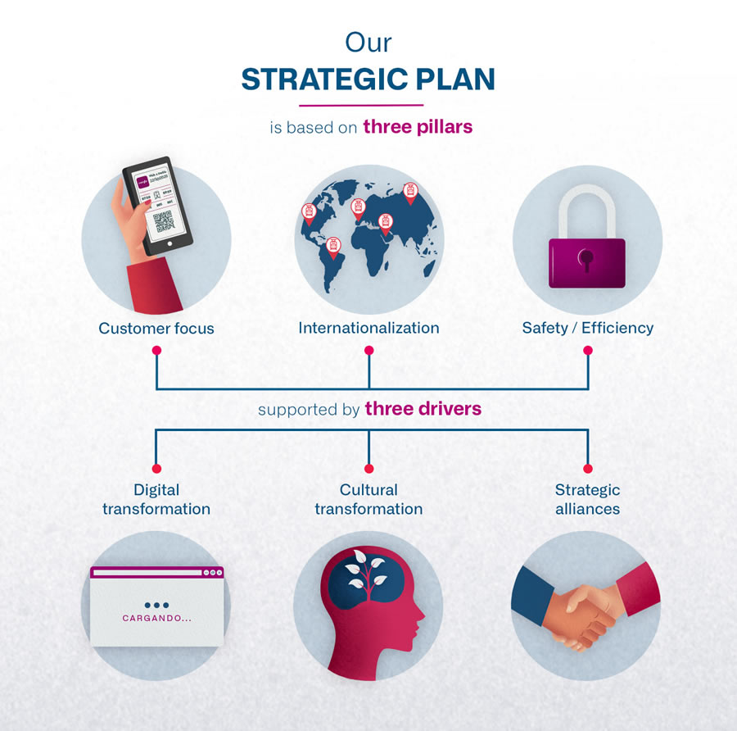
OUR STRATEGIC PLAN

Slide 8
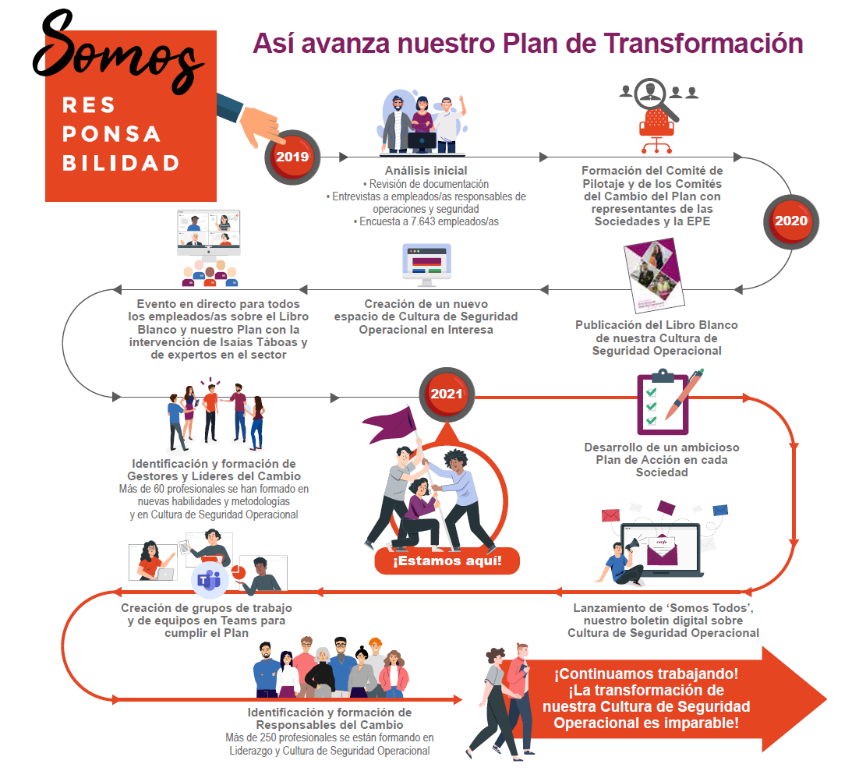

AND…HOW IS OUR CULTURAL TRANSFORMATION PROGRESSING?
…
…
Developing a reporting system for all the staff of Renfe
…
…

Slide 9
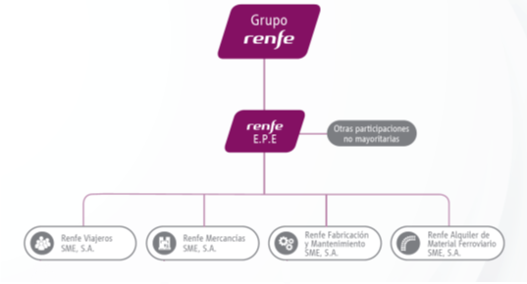
WHY DOES RENFE NEED A REPORTING SYSTEM?
We need a system tailored to the organisational structure and the management systems.
  It would not cover real time events.
  It would be independent of existing communication channels.
  It would be used by any employee.
  The final scope would be to extend it to any person through the website of Renfe (in the coming years)
Management system (MS)
Safety
Management
System (SMS)
Safety
Management
System (SMS)
Maintenance
Management
System (MMS)

Slide 10
WHAT TYPE OF REPORTING SYSTEM?
Near-miss management system
Event identification and reporting
Event assessment: Prioritization, distribution and cause analysis
Prevention measure application
Follow-up action: verify effectiveness and dissemination
Based on near-miss management systems (NMS)
Excerpt from Gnoni, M. G. and G. Lettera (2012). "Near-miss management systems: A methodological comparison."

Slide 11
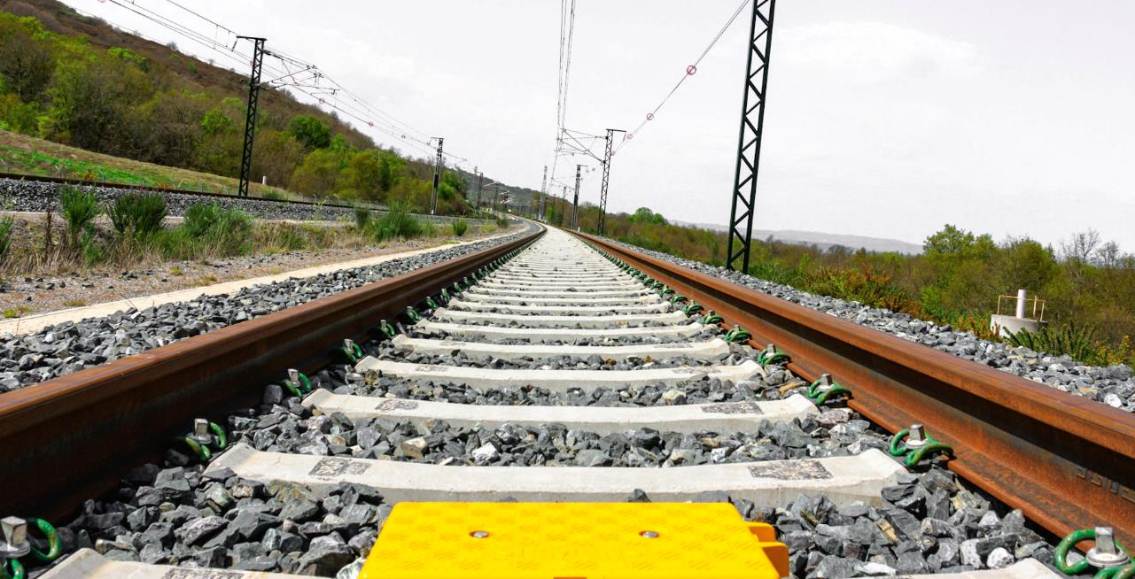
CHAPTER 2
METHODOLOGY
IRSC 2022
COMPANY LOGO
INTERNATIONAL RAILWAY SAFETY COUNCIL
SEVILLA, OCTOBER 16-21, 2022

Slide 12
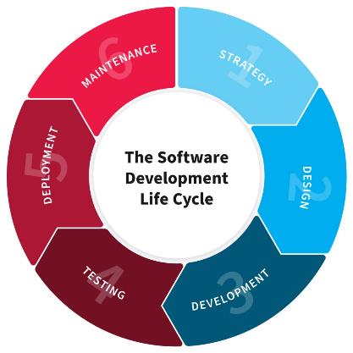
WHAT METHODOLOGY WAS USED?
Analysis
  Review of existing reporting systems
  Lessons learned
Design
  Defining the procedures of the reporting system
  Defining functional requirements.
  Defining system requirements and risk analysis.
  Defining the data model, UX requirements and visual style
Development
Integration and quality test
Deployment
Maintenance

Slide 13


LESSONS LEARNED
An event could be classified using different categories (lack of knowledge, ambiguity,…)
The descriptions could contain sensitive information (names of persons, phones numbers, addresses,…)
The CCS system could receive 150.000 reports per year.
Understanding the text was not straightforward (misspellings, ambiguity, abbreviations, different ways of naming a place,…). It was even found incomprehensible records.
The main outcome was a report.

Slide 14
EARLY REQUIREMENTS
We started the project defining an early requirements from the lessons learned
  Taxonomies should be easily configurable and they should defined for technical and non-technical staff.
  In case of receiving hundreds of reports, the application should have a configurable priority system.
  The application should be confidential and it should allow to remove sensitive information from records (including free text) before being processed.
  The information of the records should be comprehensive and complete (free-text vs structured data).
  The main outcome should be the state of the designed control measures.

Slide 15




DESIGN: PROCESSES OF THE REPORTING SYSTEM
Email the report and agreement
Email the state
of the report
User of Renfe
Renfe Group
Process to complete and anonymise the report
accept
fill in
Confidentiality agreement
Report
The report is accepted and sent to the right company
Company
Company
Renfe Group
Process to manage the anonymous report
Process to manage the risk control measures
Continuous improvement process
if applicable
the report is closed
Email outcomes and feedback form

Slide 16
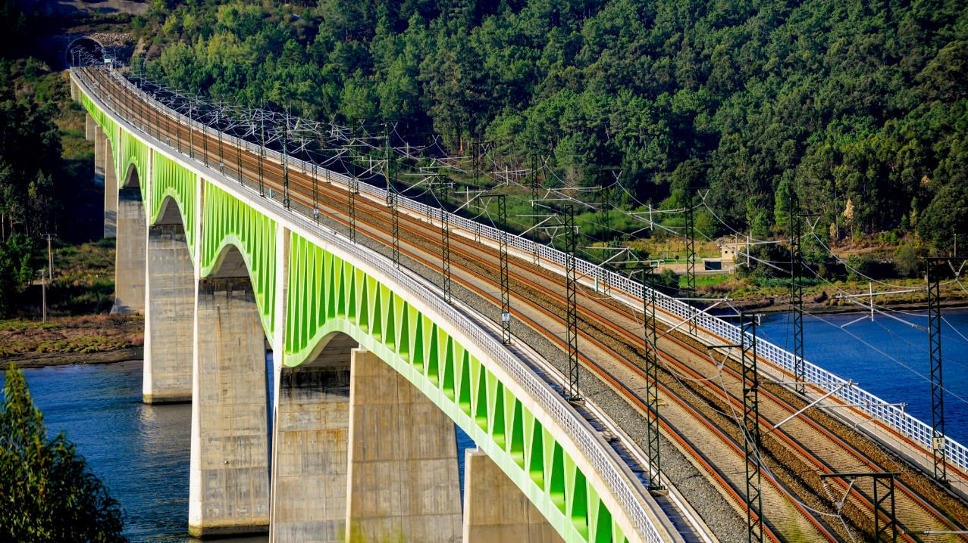
CHAPTER 3
RESULTS: RCI
IRSC 2022
COMPANY LOGO
INTERNATIONAL RAILWAY SAFETY COUNCIL
SEVILLA, OCTOBER 16-21, 2022

Slide 17
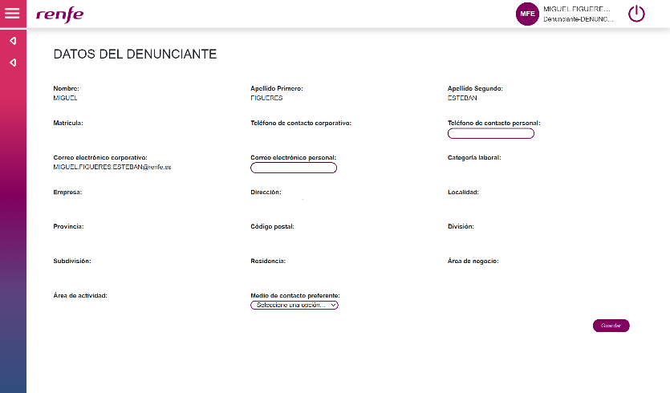
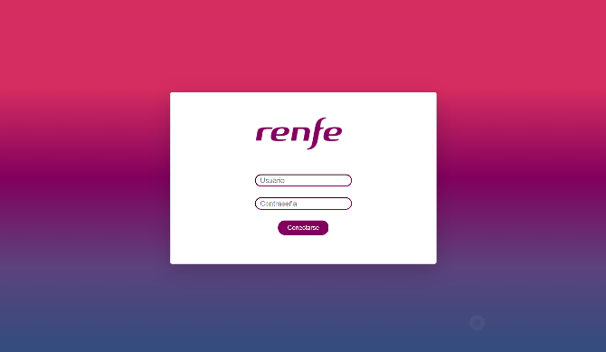
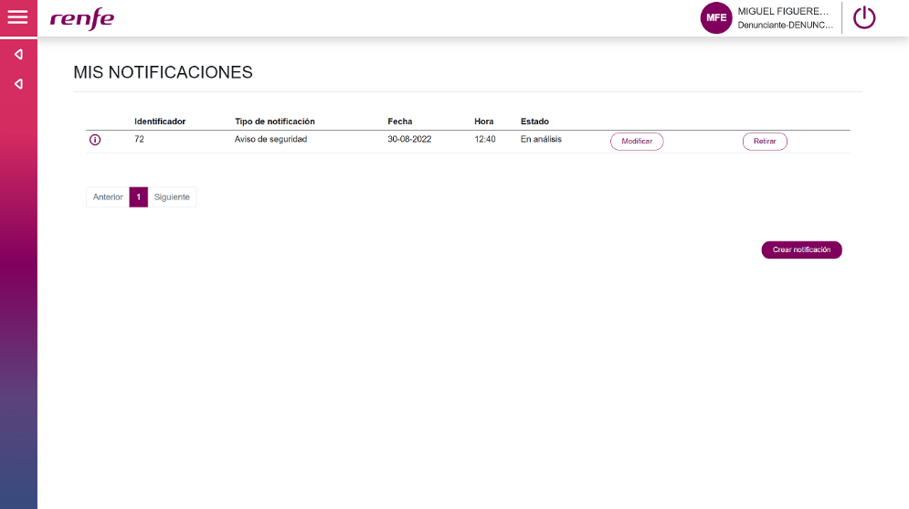
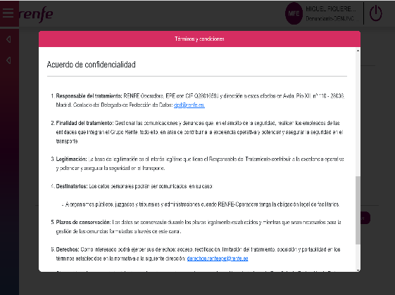

RESULTS: CREATING A REPORT
Inbox

Slide 18
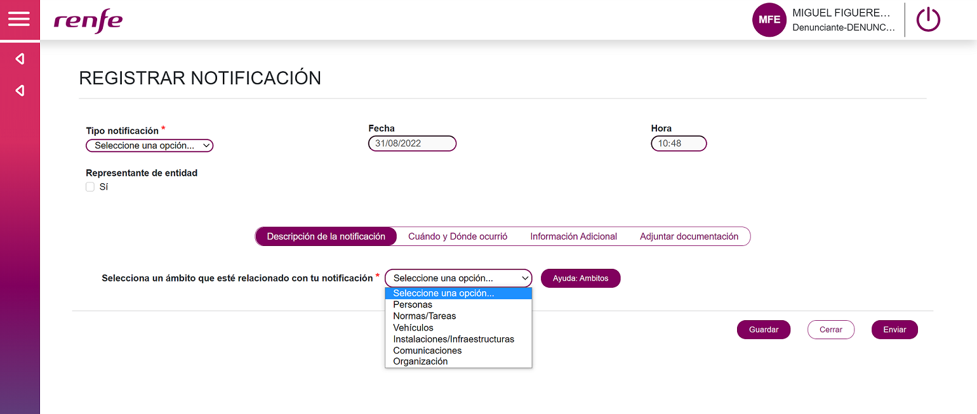
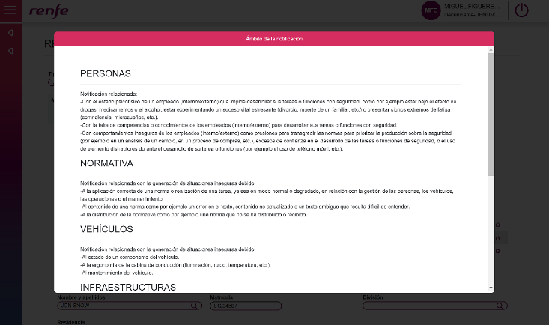
RESULTS: CREATING A REPORT (FIRST STEP)

Slide 19
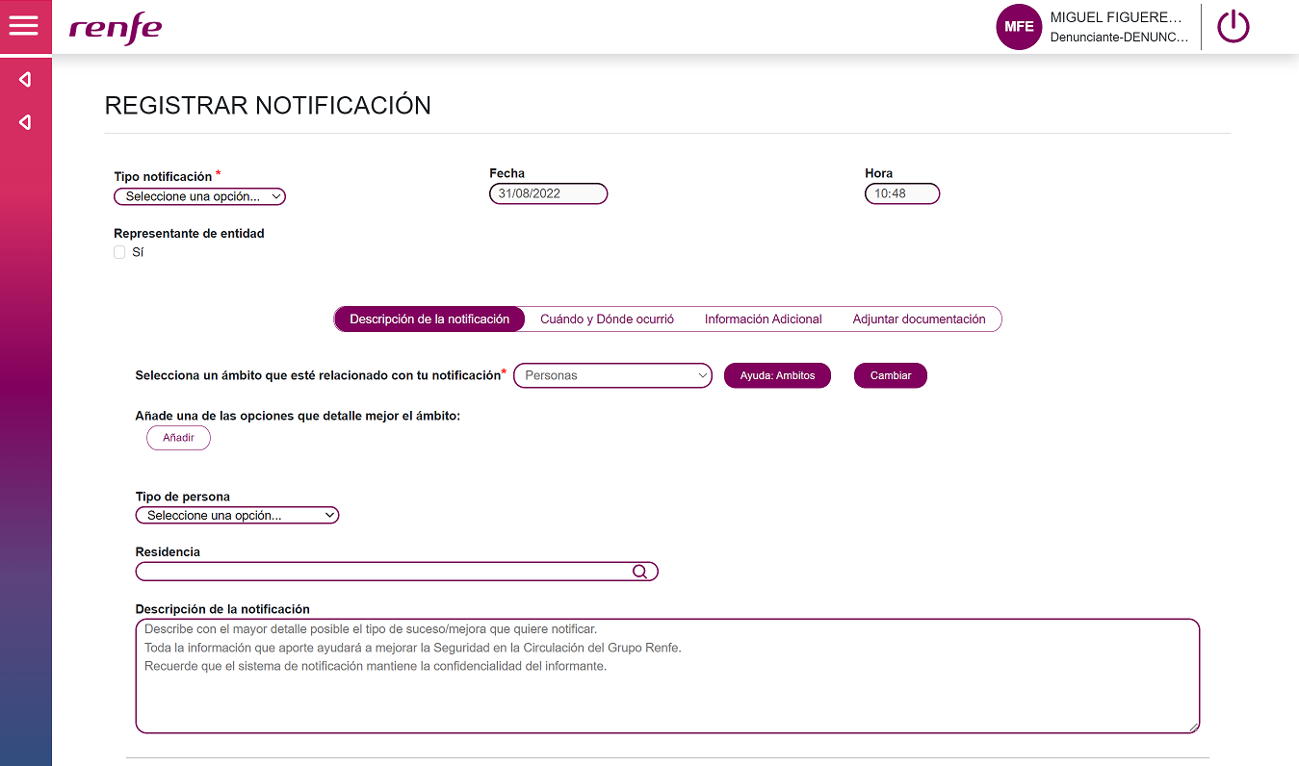
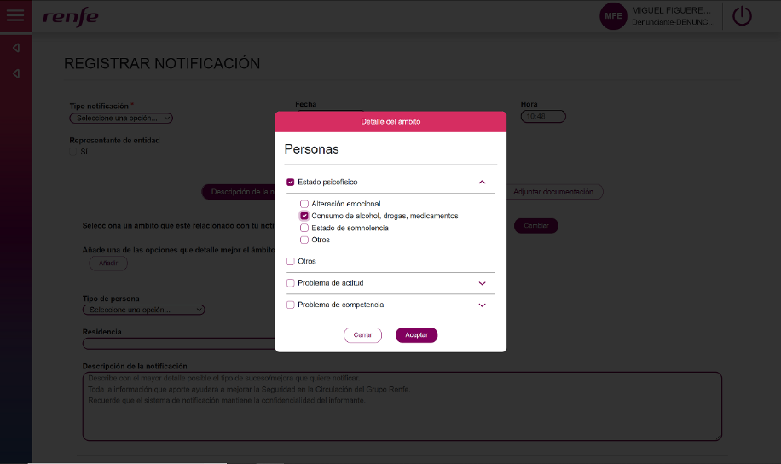
RESULTS: CREATING A REPORT (FIRST STEP)

Slide 20
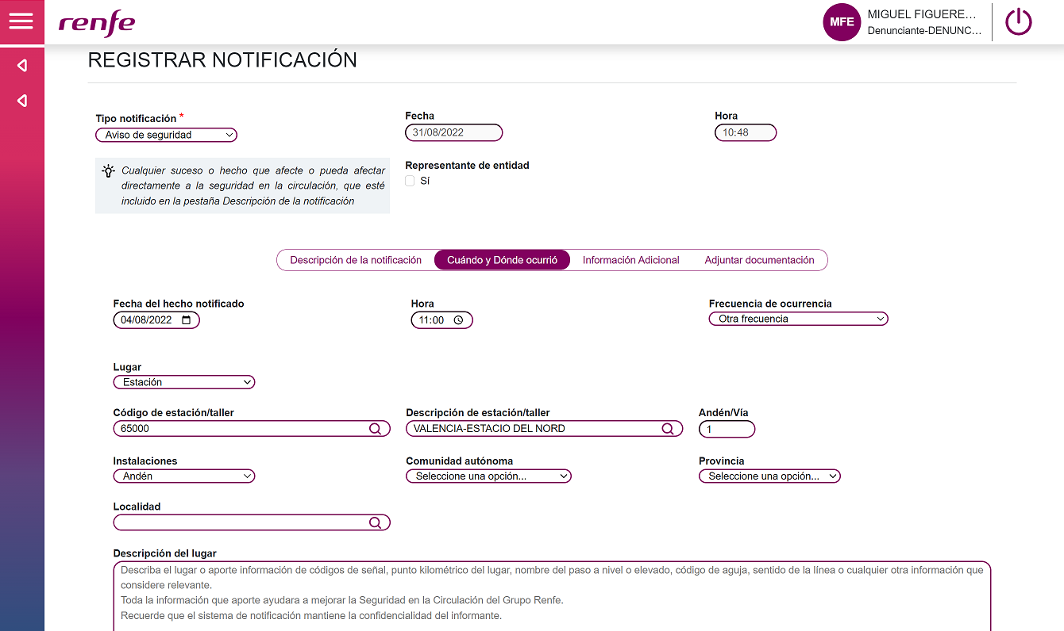
RESULTS: CREATING A REPORT (SECOND STEP)

Slide 21
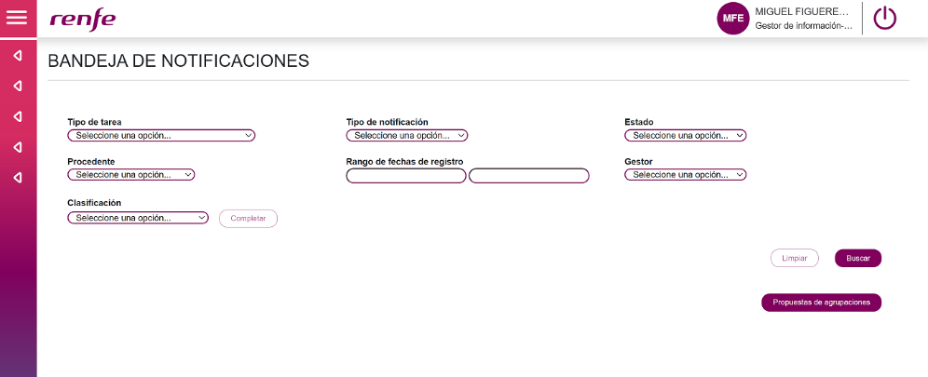
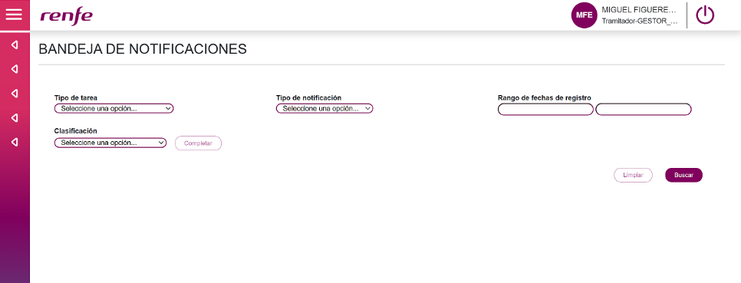
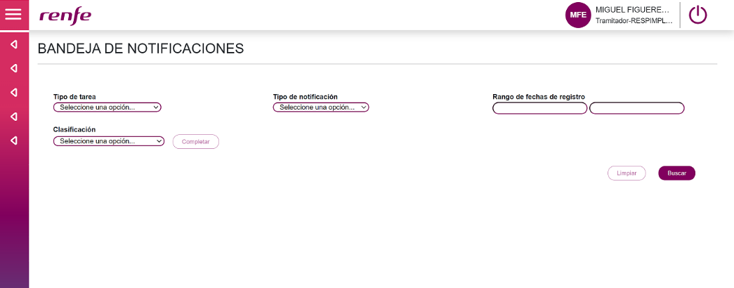
RESULTS: PROCESSING THE REPORT

Slide 22
CHAPTER 4
DISCUSSION
IRSC 2022
COMPANY LOGO
INTERNATIONAL RAILWAY SAFETY COUNCIL
SEVILLA, OCTOBER 16-21, 2022

Slide 23

DISCUSSION

Slide 24
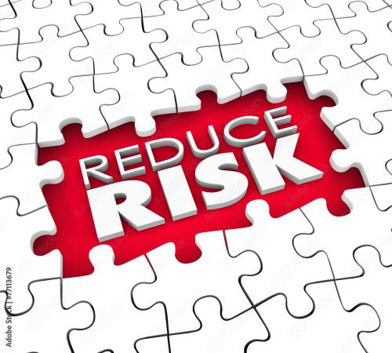
DISCUSSION
The reporting system by itself is not enough, it is just a piece of the safety management puzzle

Slide 25
DISCUSSION
Digital transformation
Dynamic risk management
Cultural transformation
RCI

Slide 26
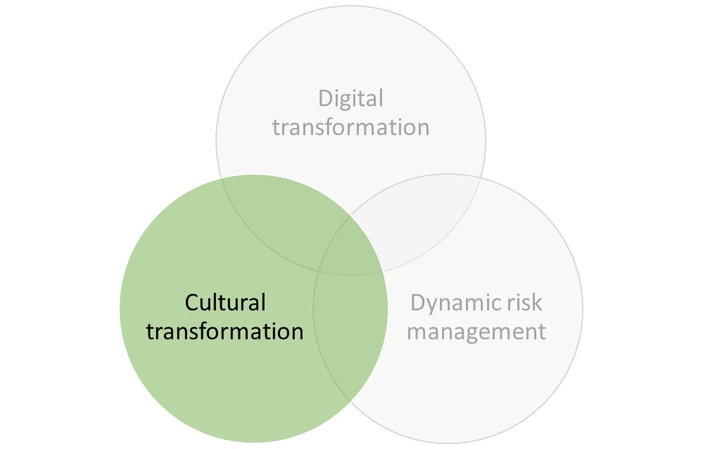
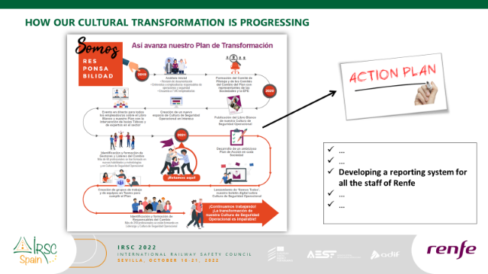
DISCUSSION

Slide 27
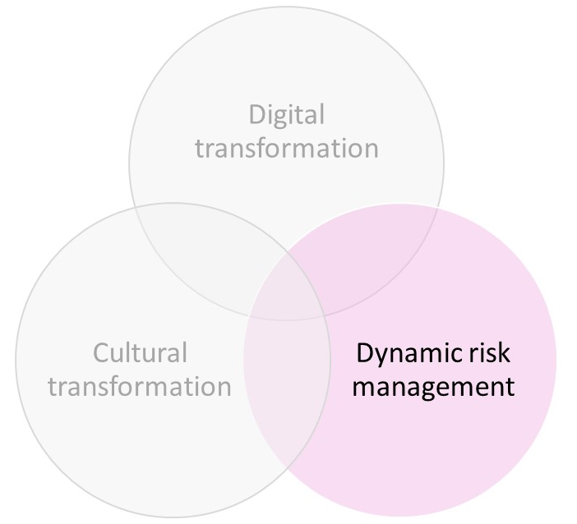
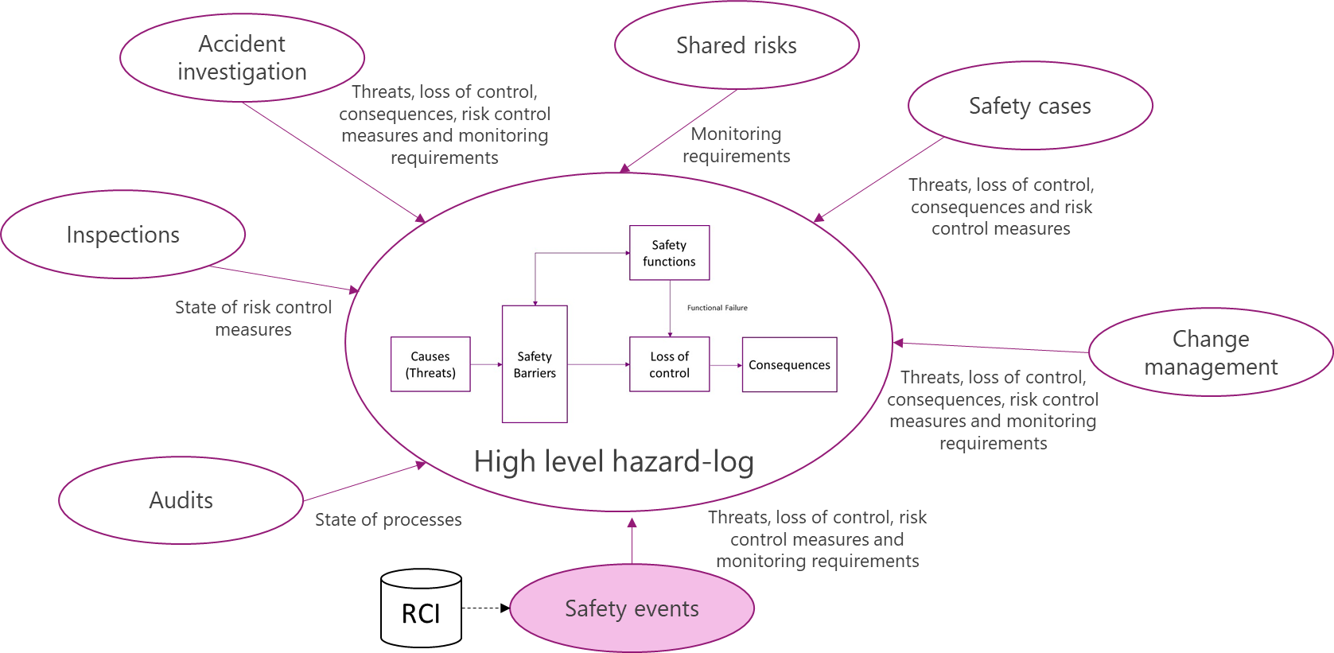
DISCUSSION
Barrier management

Slide 28
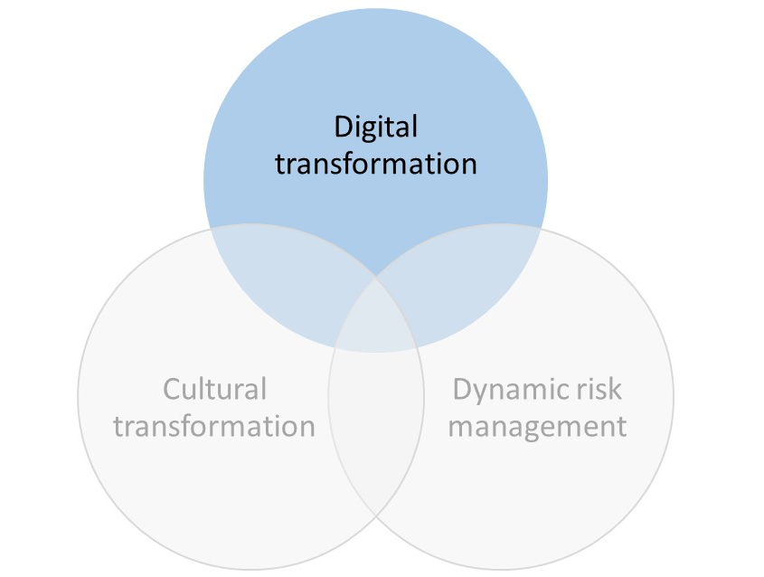
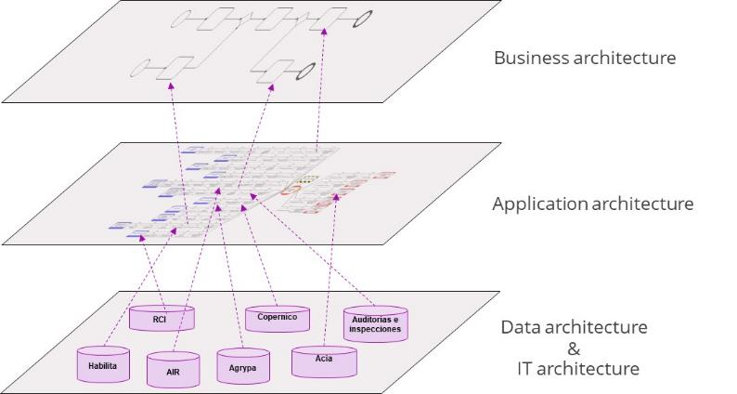
DISCUSSION
A safety enterprise architecture solution to digitise safety management systems

Slide 29
CHAPTER 5
CONCLUSION
IRSC 2022
COMPANY LOGO
INTERNATIONAL RAILWAY SAFETY COUNCIL
SEVILLA, OCTOBER 16-21, 2022

Slide 30
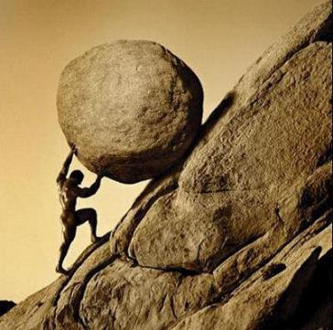
CONCLUSION
There is a lot of literature about reporting systems, but the functional requirements have to be tailored to the structure of the organisation and its management systems.
A balance between free-text and structured data is needed to manage the data.
RCI is just a small piece of a safety management strategy based on a digital and cultural transformation.
The main contribution is to support barrier management through an IT safety architecture for an integrated safety management system (SISIFO)

Slide 31


