Slide 1


IRSC 2022
INTERNATIONAL RAILWAY
SAFETY COUNCIL
COMPANY LOGO
SEVILLA, OCTOBER 16-21, 2022

Slide 2
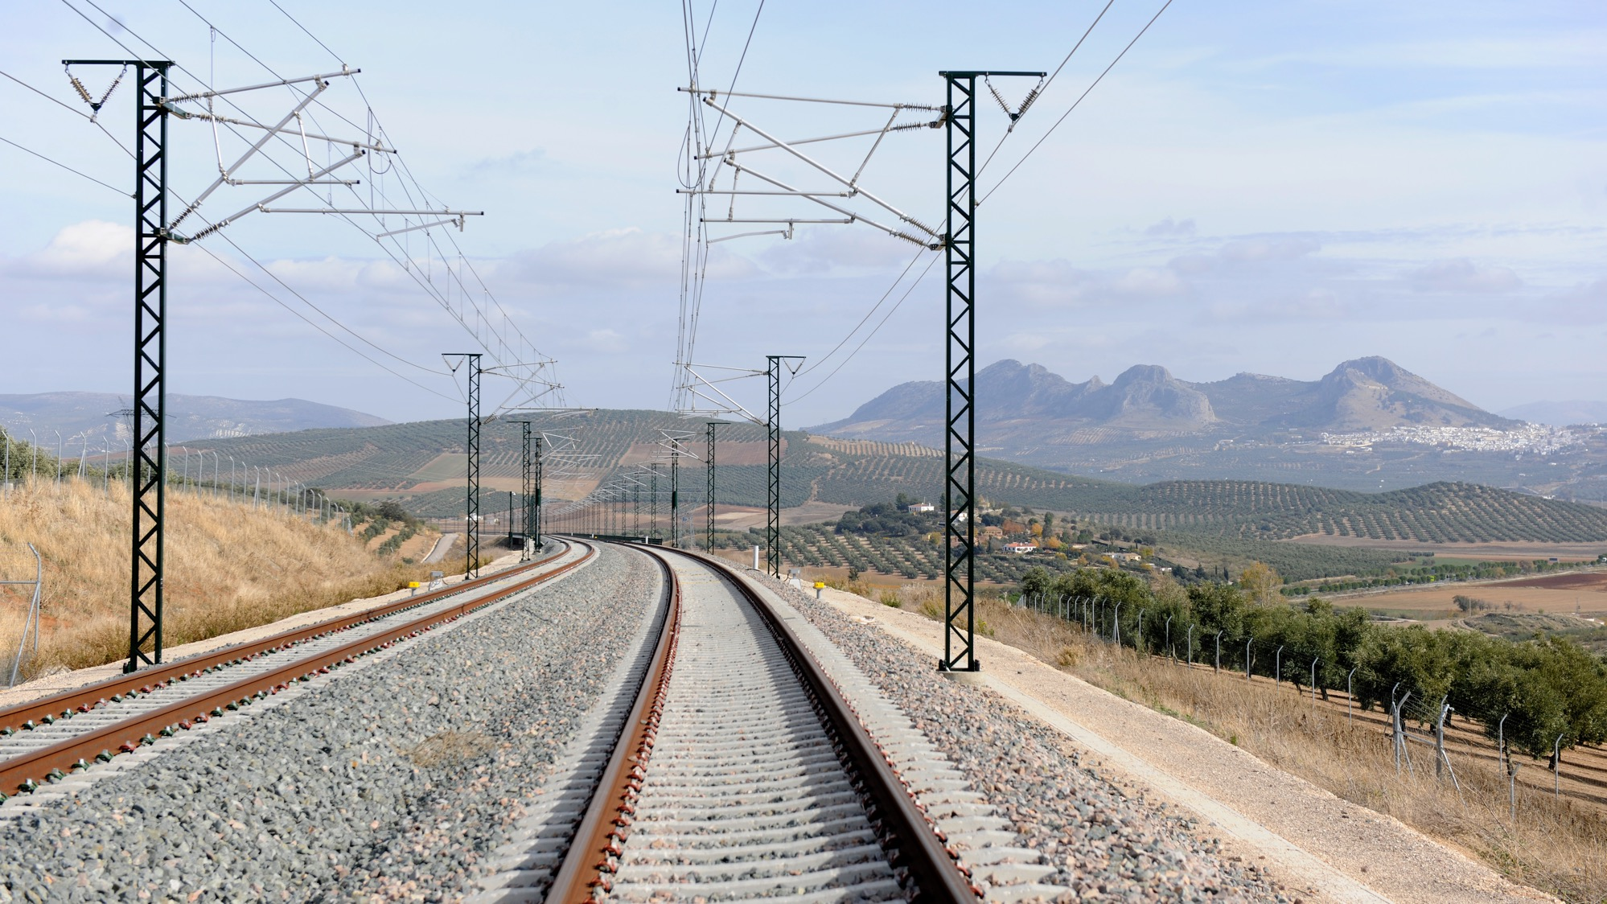



Florence MAGNIN-LOT
Human and Organisational Factors & Safety Culture Specialist – SA SNCF
IRSC 2022
INTERNATIONAL RAILWAY SAFETY COUNCIL
SEVILLA, OCTOBER 16-21, 2022

Slide 3
Just & Fair Approach within the SNCF Group
An example of Just Culture development
IRSC 2022
INTERNATIONAL RAILWAY SAFETY COUNCIL
SEVILLA, OCTOBER 16-21, 2022

Slide 4
INDEX
CHAPTER 1
Background & Objective of the Approach
CHAPTER 2
Method
CHAPTER 3
Results

Slide 5

CHAPTER 1
Background & Objective of the approach
IRSC 2022
INTERNATIONAL RAILWAY SAFETY COUNCIL
SEVILLA, OCTOBER 16-21, 2022

Slide 6
Background & Objective of the approach
2015 : program launch.
  Objective : Safety performance improvement
  Observation : All situations impacting safety are not known due to a lack of spontaneous feedback from operational
2016 : Just & Fair approach launch with 2 objectives :
  Create a climate of trust to encourage everyone to report safety problems and thus being able to fix them
  Get a better understanding of its system’s strengths and weaknesses
P
R
I
S
M
E

Slide 7
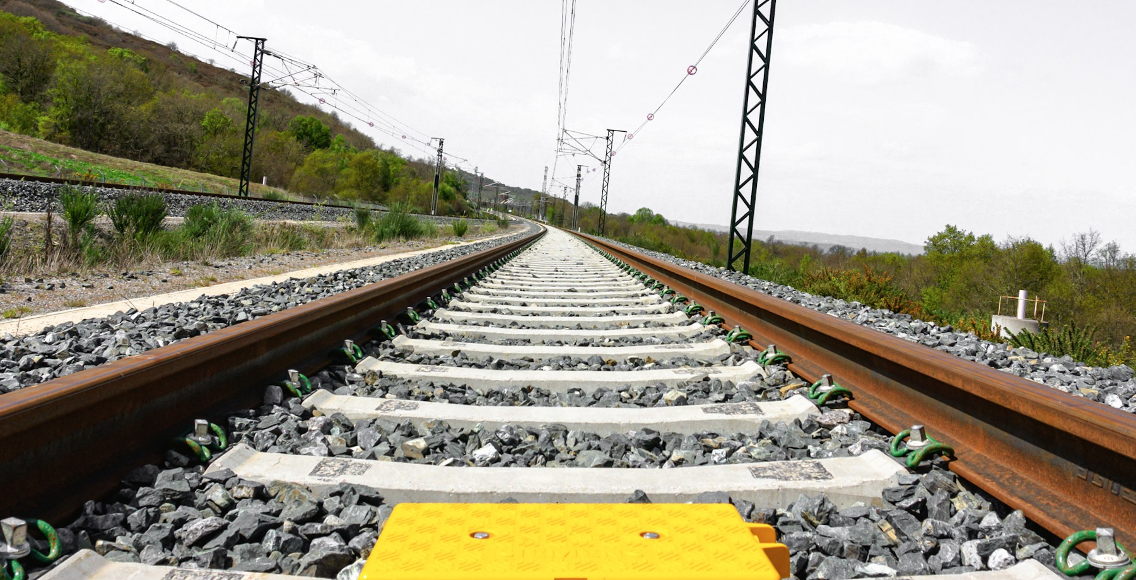
CHAPTER 2
Method
IRSC 2022
INTERNATIONAL RAILWAY SAFETY COUNCIL
SEVILLA, OCTOBER 16-21, 2022

Slide 8
Method
Origins of the approach (2015-2021)
Benchmark
Creation of a working group
Booklet elaboration
Experimentation in 20 pilot entities
Generalization throughout the group
A Just & Fair Referents’ network to rely on
Recent changes (2021-2022)
  State of play (questionnaire and survey)
  Definition of an action plan
  Creation of a new working group
  Booklet review
  Test of the new booklet by operational staff
  Dissemination

Slide 9

CHAPTER 3
Results
IRSC 2022
INTERNATIONAL RAILWAY SAFETY COUNCIL
SEVILLA, OCTOBER 16-21, 2022

Slide 10
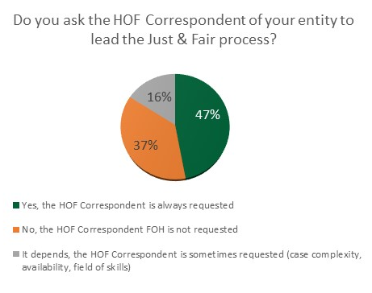
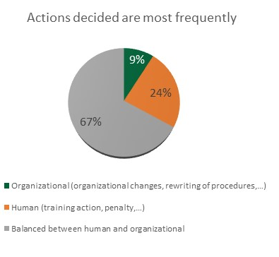
State of play’s results
Positive findings
Areas fOR improvement
The J&F approach is deployed in 89% of entities
The booklet is almost always used (90% of respondents always use it)
79% of the respondents consider the approach effective to improve the global awareness of risks situations.
The process is sometimes used incorrectly because :
  the goal is not always understood
  the HOF expert is not systematically involved.
The actions decided are not enough organizational
“Thanks to the approach, we had spontaneous feedback from operators about events that might not have been seen otherwise”

Slide 11
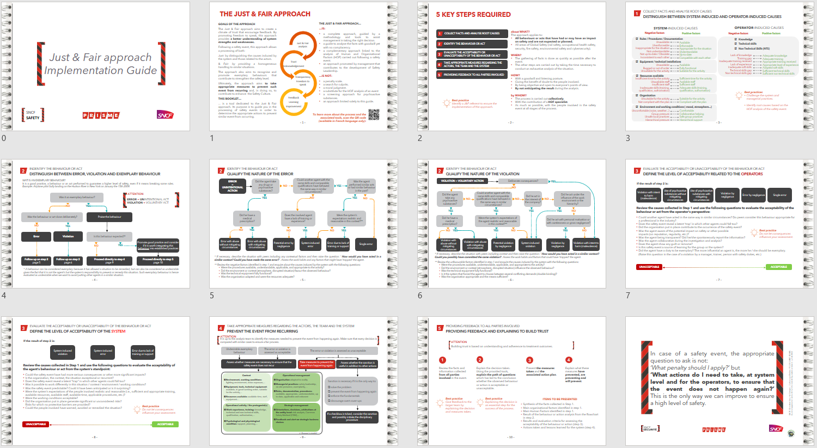

Action plan
Remind the purpose of the approach i.e., having a better risk awareness.
Give some practical advice to apply the approach.
Reinforce organisational factors :
  in the data collection and analysis
  in the assessment of the behavior’s acceptability regarding with the system
  in the measures decided
Encourage the involvement of the HOF network.
+ Clarify and promote the exemplary behaviour’s treatments.
+ Expand the scope of the approach.

Slide 12
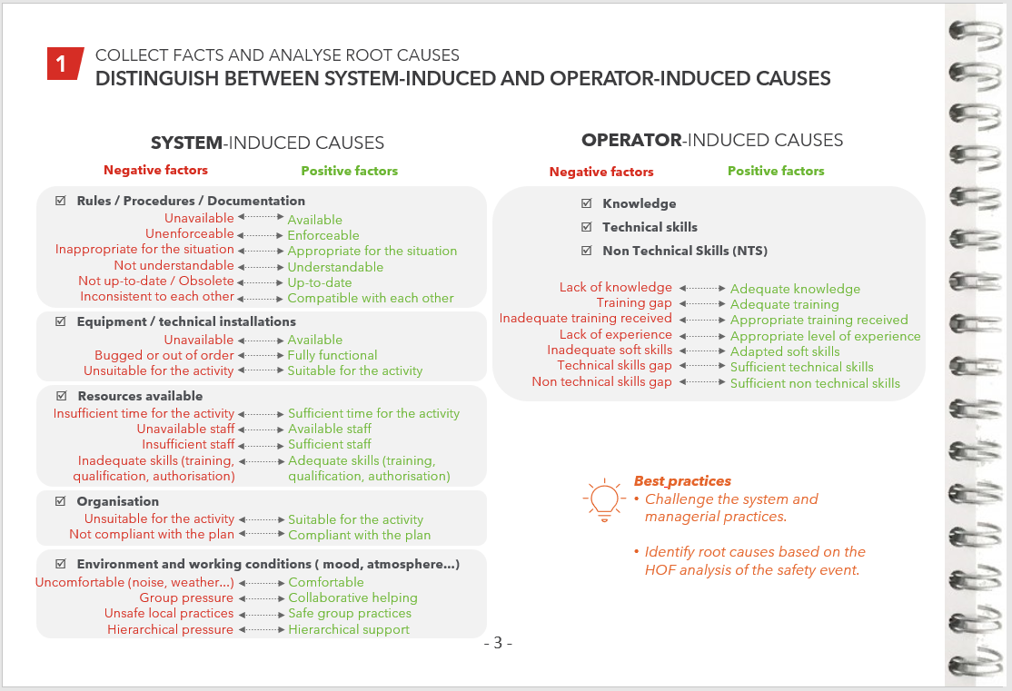
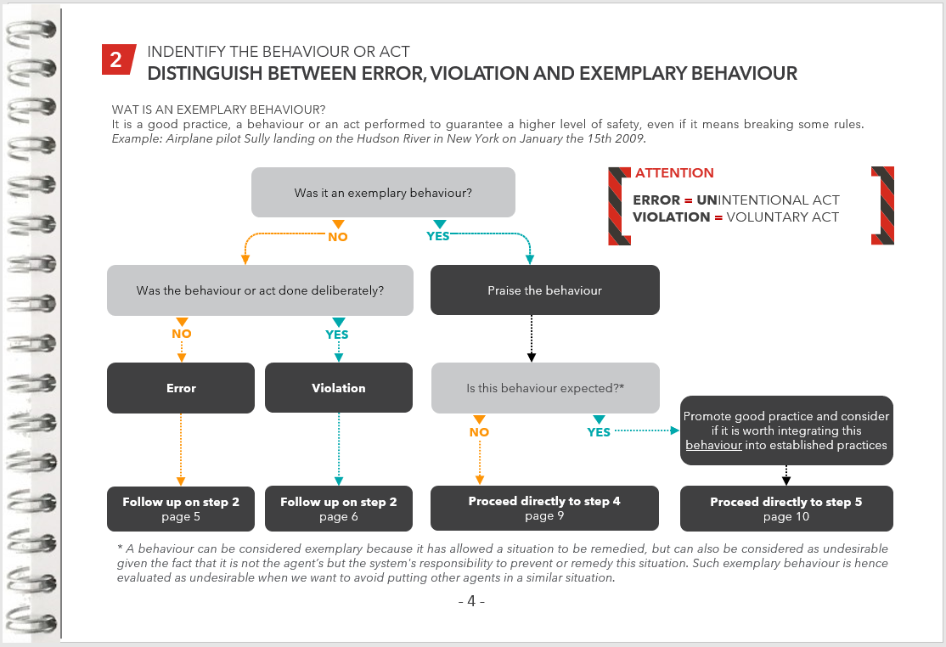
The Just & Fair approach
COLLECT FACTS AND ANALYSE ROOT CAUSES
1
IDENTIFY THE BEHAVIOUR OR ACT
2
EVALUATE THE ACCEPTABILITY OR UNACCEPTABILITY OF THE BEHAVIOUR OR ACT
3
Take appropriate measures regarding the actors, the team and the system
4
Providing feedback TO ALL PARTIES INVOLVED
5

Slide 13
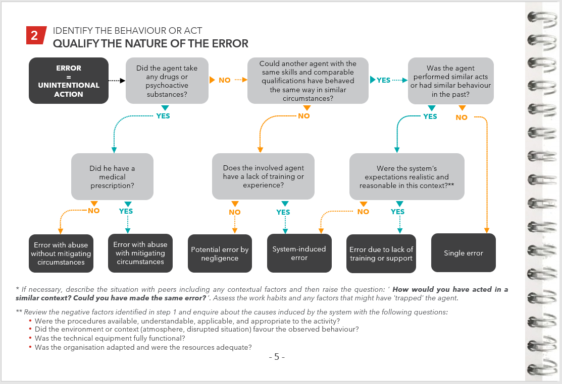
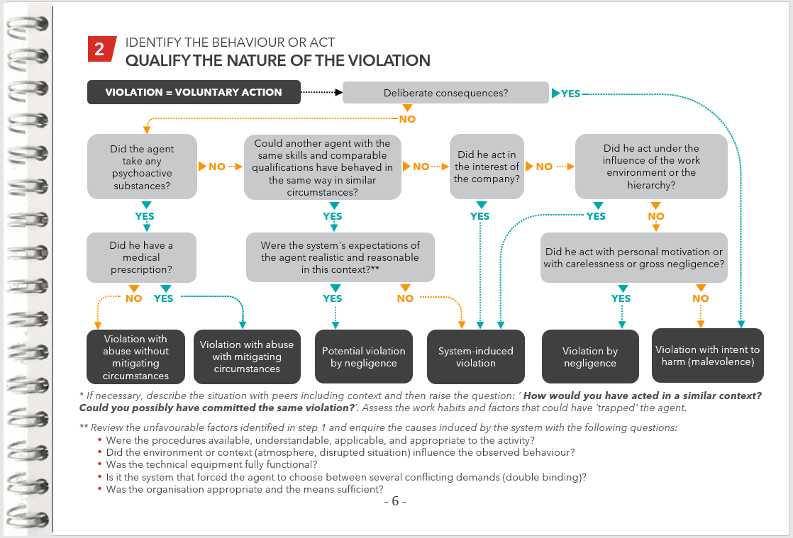
The Just & Fair approach
COLLECT FACTS AND ANALYSE ROOT CAUSES
1
IDENTIFY THE BEHAVIOUR OR ACT
2
EVALUATE THE ACCEPTABILITY OR UNACCEPTABILITY OF THE BEHAVIOUR OR ACT
3
Take appropriate measures regarding the actors, the team and the system
4
Providing feedback TO ALL PARTIES INVOLVED
5

Slide 14
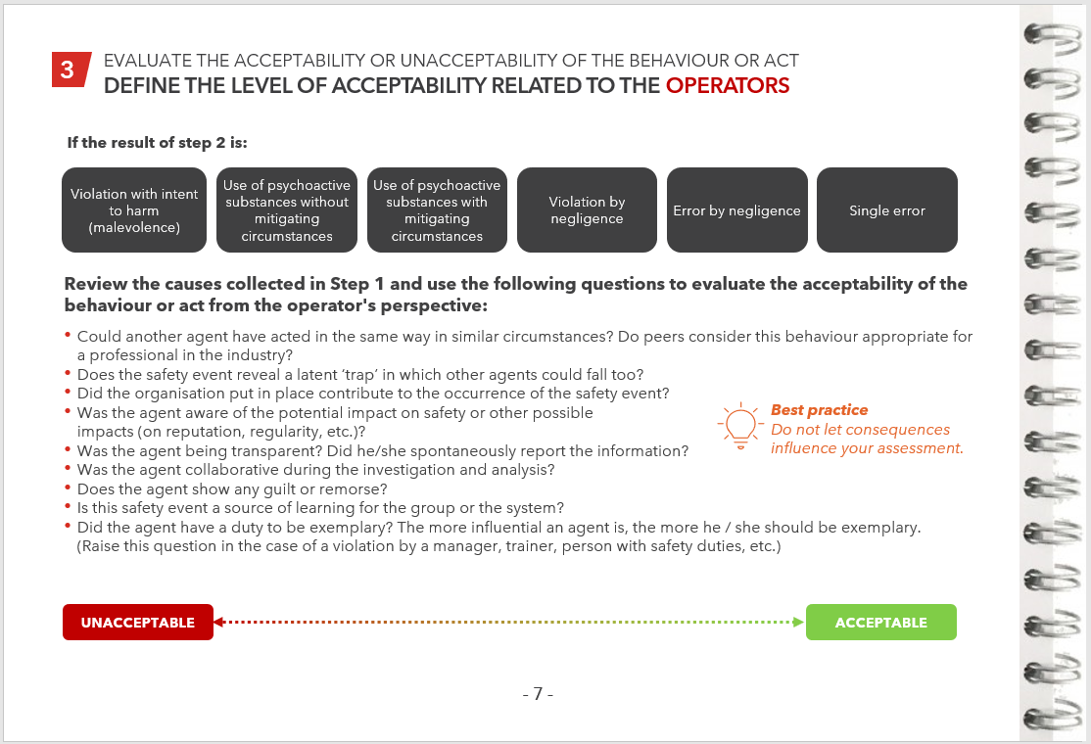
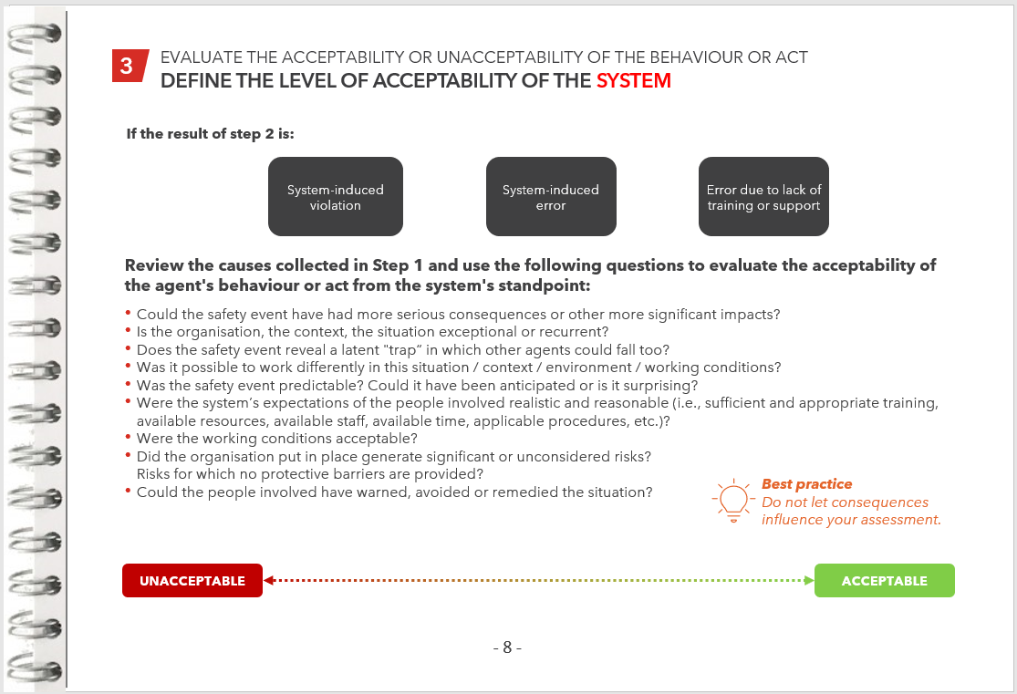
The Just & Fair approach
COLLECT FACTS AND ANALYSE ROOT CAUSES
1
IDENTIFY THE BEHAVIOUR OR ACT
2
EVALUATE THE ACCEPTABILITY OR UNACCEPTABILITY OF THE BEHAVIOUR OR ACT
3
Take appropriate measures regarding the actors, the team and the system
4
Providing feedback TO ALL PARTIES INVOLVED
5

Slide 15
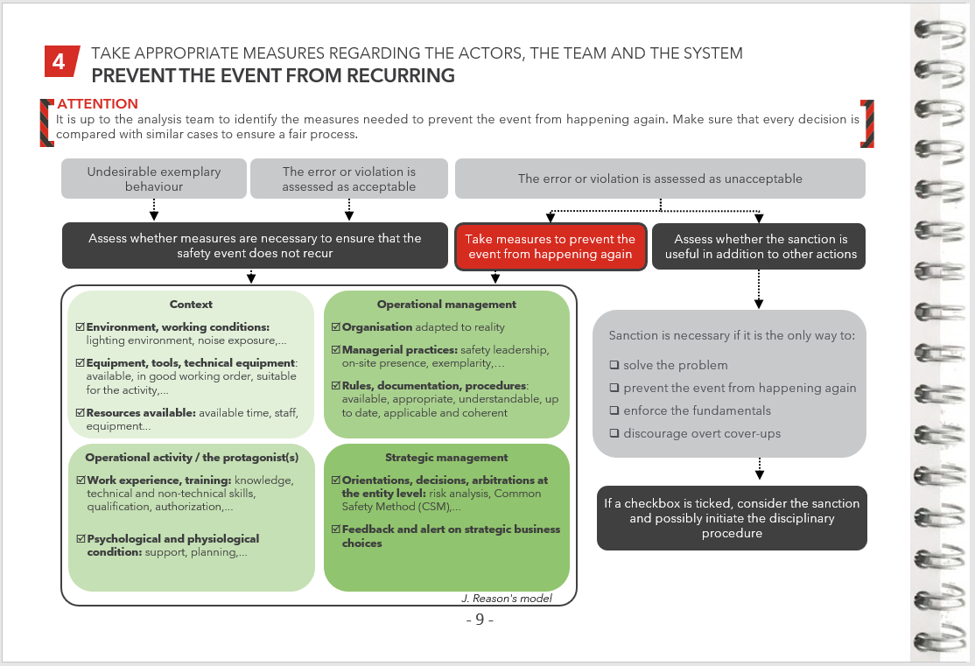
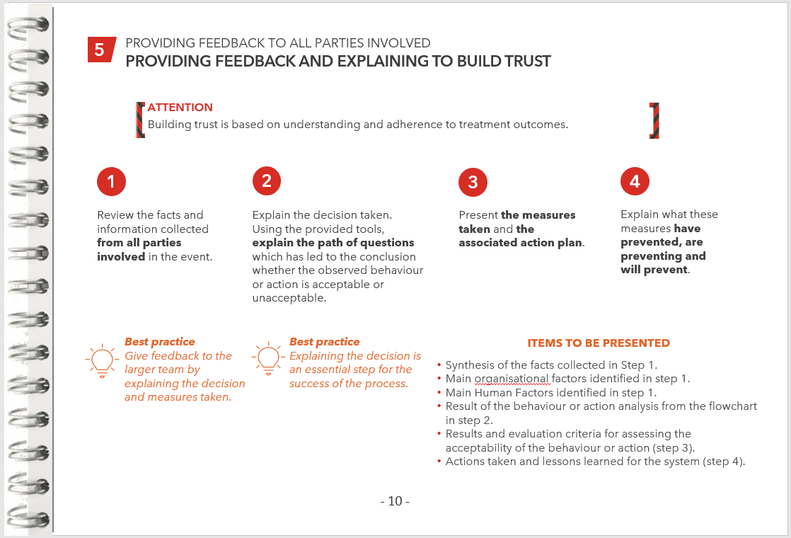
The Just & Fair approach
COLLECT FACTS AND ANALYSE ROOT CAUSES
1
IDENTIFY THE BEHAVIOUR OR ACT
2
EVALUATE THE ACCEPTABILITY OR UNACCEPTABILITY OF THE BEHAVIOUR OR ACT
3
Take appropriate measures regarding the actors, the team and the system
4
Providing feedback TO ALL PARTIES INVOLVED
5

Slide 16
Conclusion
Just & Fair approach helps SNCF to get a better understanding of its system’s strengths and weaknesses.
The work carried out contributes to one of the 7 characteristics of the SNCF’s Safety Culture model.
The state of play results showed a heterogeneous level of maturity between the different operational entities.
SNCF will have to be attentive to keep the process alive and continue to feed it.
To sustain the approach, the group decided to write a charter to encourage the freedom to speak thanks to a management’s commitment not to sanction spontaneously reported errors.

Slide 17
COMPANY LOGO

