Slide 1
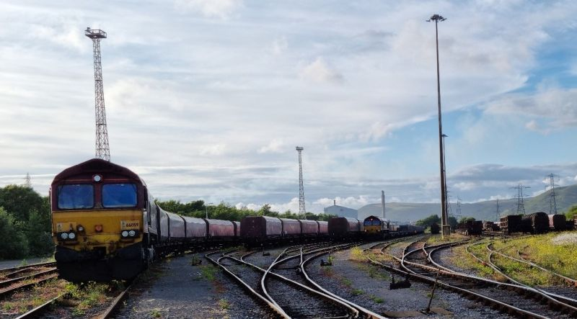
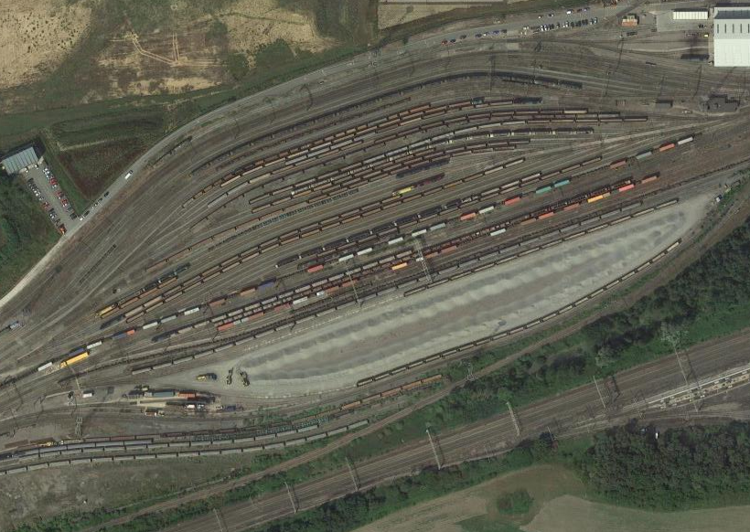
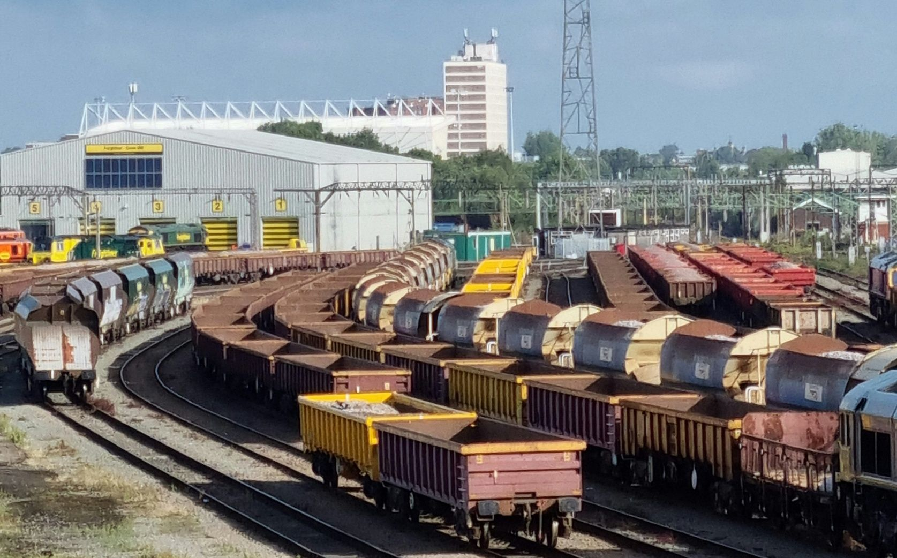
A STRUCTURED INCIDENT ANALYSIS OF HUMAN PERFORMANCE IN
FREIGHT TRAIN PREPARATION
Dr David Golightly, Lecturer in Human-Systems Integration, Newcastle University
James Lonergan, Rail Safety and Standards Board (RSSB)
David Ethell, David Ethell Consulting
Huw Gibson, RSSB (now Trimetis)
Dougie Hill, RSSB

Slide 2
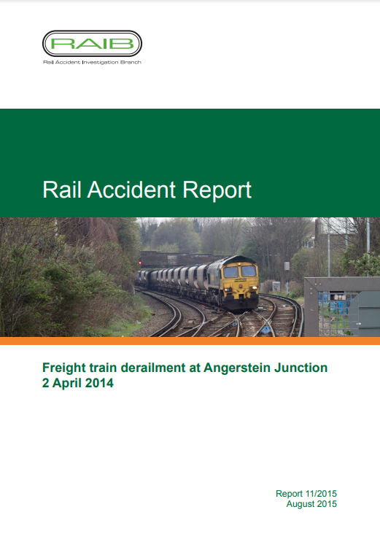
Background
Critical importance of rail freight
Safety (for people, for delivery)
Condition of freight vehicles on the network
  Importing risk onto the network
Human performance is key to freight tasks
  Lacking a structured analysis

Slide 3
Aims and Objectives
Overall aim – understand how failures in human performance impact condition of freight vehicles on the network
Objectives
Identify adverse events (accidents and incidents), relevant to freight preparation, where human performance played a role
Identify and classify the types of human performance failures that led to adverse events
Identify and classify the factors underpinning human performance failures that subsequently lead to an adverse event
Use the analysis to identify future research and risk-reduction actions.

Slide 4
Analytical framework

Slide 5
Method
Set of candidate incident reports filtered for relevance
Sample (3) analysed by DG. Covered
  Characteristics (see overview analysis)
  HF framework
Sample analysis discussed with JL and RSSB SME in HF Framework
Based on consensus, all reports were analysed by DG
Whole analysis shared with all authors for comment
Analysis report revised and confirmed with all authors

Slide 6
Overview analysis
Report types
10 RAIB
Freight type
13 intermodal
Failure type
14 wagon brakes
1 SPAD
11 detailed
16 brief
8 bulk /aggregate
6 miscellaneous
3 loco brakes
2 other brake
7 other wagon issues
Point of identification
4 before departure
5 on arrival
18 on the network
Outcome
High-level pathway
16 Human performance failure
14 no or minor (wheelset) damage
4 derailments
3 collision
3 wagon runaways
2 SPADs
1 wagon door issue
11 Mechanical failure but enabled / exacerbated by human performance failure

Slide 7
Detailed analysis – Human Performance Factor
Human performance factor | Sub-categories
Slip or lapse (16) | Forgot, misremembered or missed out (12) Misheard or mis-saw something (3) Said wrong thing or did wrong thing unintentionally (1)
Decision error (13) | Misunderstanding, wrong assumptions (10) Lack of knowledge (2) Don’t know (1)
Don’t know (10) | N/A
Biased by habits or previous experience (4) | N/A
Rush (3) | N/A
Distracted (1); Inexperience or unfamiliarity (1) | N/A

Slide 8
Detailed analysis – Incident Factor
Infrastructure, vehicles, equipment, clothing (43)
Poorly designed (15)
Unreliable (11)
Poor maintenance (10)
Not available (4)
Don’t know (2)
Process and procedures (20)
No process or not comprehensive (14)
Incorrect or incomplete (3)
Process change issues (1)
Difficult to understand (1)
Don’t know (1)
Risk management (20)
Ineffective risk assessment (10)
Management not fixing safety problem (5)
Management not finding out about a safety problem (4)
Don’t know (1)

Slide 9
Discussion of analysis
High number of slip / lapse or decision error
Majority at train preparation phases – action or inspection
Maintenance is a major factor
Operational practice and complexity of operations is also a factor
Workload is about resource, rather than cognitive workload
Variable report and investigation quality
Lack of analysis of upstream issues

Slide 10
Follow-on work, and outstanding questions
Complete
  Confirmation through interviews and surveys of freight staff
  Confirmation through comparison with Six Sigma
Ongoing
  Observations of
    Site complexity
    Ground staff planning and workload
    Maintenance
Research questions
  Report quality, and incident training
  Frequency analysis
  Improved data
  What does good performance look like?
  Understand the role of technology to alleviate issues

Slide 11

Control
2
Maintenance Depot
Customer Site Building
Customer Loading Area
4
5
Fuel point
Parts storage
3
1
Office
Operational main line
Operational main line
Ineffective site layout
-Leads to increased movements, equates to more risk
-Lost time due to inefficient working system
-Requires more complicated reorganising
-Potentially encourages unsafe behaviours e.g. not getting right equipment as too far away
Site cabin
Crippled wagon
Footbridge
Locomotive
Wagon type A
Wagon type B
Wagon type C

Slide 12
Follow-on work, and outstanding questions
Complete
  Confirmation through interviews and surveys of freight staff
  Confirmation through comparison with Six Sigma
Ongoing
  Observations of
    Site complexity
    Ground staff planning and workload
    Maintenance
Research questions
  Report quality, and incident training
  Frequency analysis
  Improved data
  What does good performance look like?
  Understand the role of technology to alleviate issues

Slide 13
A STRUCTURED INCIDENT ANALYSIS OF HUMAN PERFORMANCE IN
FREIGHT TRAIN PREPARATION
Thank you to National Freight Safety Group and RSSB for their support of the analysis
Thank you to Newcastle University QR PSF for supporting attendance at IRSC 2022

