Slide 1
IRSC 2022
I N T E R N A T I O N A L R A I L W A Y
S A F E T Y C O U N C I L
S E V I L L A , O C T O B E R 1 6 - 2 1 , 2 0 2 2

Slide 2
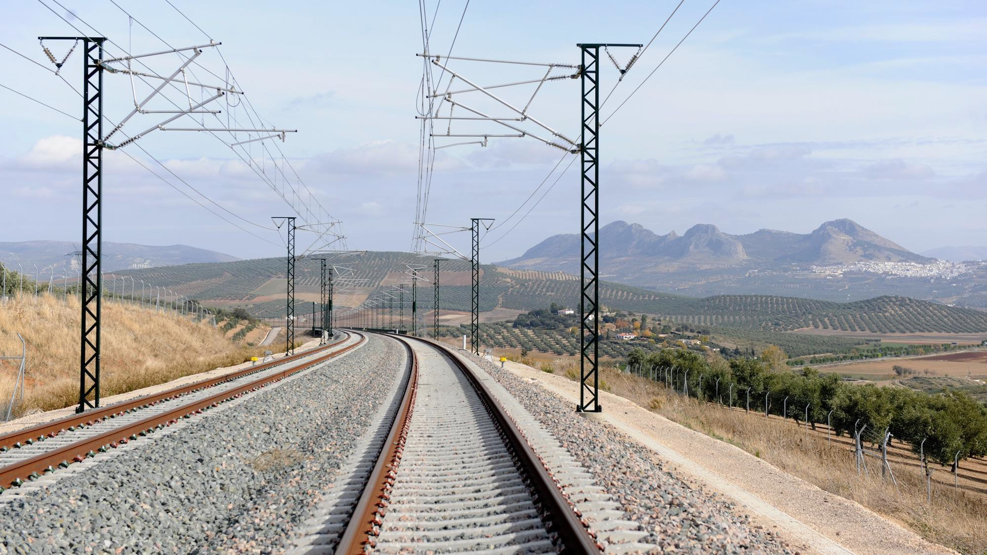
Ian Naish
NAISH TRANSPORTATION CONSULTING
I R S C 2 0 2 2
I N T E R N A T I O N A L R A I L W A Y S A F E T Y C O U N C I L
S E V I L L A , O C T O B E R 1 6 - 2 1 , 2 0 2 2

Slide 3
What I will talk about
IRSC
Evolution of IRSC over the years
Future of IRSC
Accidents
Case studies: Lac Megantic, Quebec and Guernsey, Saskatchewan
I R S C 2 0 2 2
I N T E R N A T I O N A L R A I L W A Y S A F E T Y C O U N C I L
S E V I L L A , O C T O B E R 1 6 - 2 1 , 2 0 2 2

Slide 4
IRSC Overall Intent
Open forum, all to contribute
Learn from safety investigations
Forum for international experts to meet and discuss issues
Positive achievements – break-out, tech visits
Areas of concern - core group; Chatham House issue
I R S C 2 0 2 2
I N T E R N A T I O N A L R A I L W A Y S A F E T Y C O U N C I L
S E V I L L A , O C T O B E R 1 6 - 2 1 , 2 0 2 2

Slide 5
IRSC 1990-1999
Inspired by JRE
Countries with mature networks – Far East, Australasia, Europe, North America
Presentations included TGVs, regional commuter lines, track, equipment and operational / signals issues
Human factors and sms were identified during this period “man-machine interface”
James Reason mentioned
Papers v presentations
Memorable moment - London 2000: Safety cost of TGV
I R S C 2 0 2 2
I N T E R N A T I O N A L R A I L W A Y S A F E T Y C O U N C I L
S E V I L L A , O C T O B E R 1 6 - 2 1 , 2 0 2 2

Slide 6
IRSC 2000-2009
IRSC Tokyo 2001 postponed (September 11th attack)
Developing countries and more (smaller) countries attending
E.g. S. Africa, India, S. Korea, Ireland, Nordic countries
2003 Paris: Wider range of issues, including trespassing, vandalism, and worse
Core Group rules established
Railway associations - Sunday meeting
Memorable moment: Mr. Kato, JRE, re future safety threats
I R S C 2 0 2 2
I N T E R N A T I O N A L R A I L W A Y S A F E T Y C O U N C I L
S E V I L L A , O C T O B E R 1 6 - 2 1 , 2 0 2 2

Slide 7
IRSC 2010-Present
Regulators’ Sunday meeting.
Environmental themes increasing.
Core group – too big now?
Chatham House Rules being followed?
First memorable moment JRE – IRSC not in their 25 year plan.
Second memorable moment: Dublin air safety presentation – just before B737Max disasters.
Presentations v papers.
Covid-19 stalls conferences.
I R S C 2 0 2 2
I N T E R N A T I O N A L R A I L W A Y S A F E T Y C O U N C I L
S E V I L L A , O C T O B E R 1 6 - 2 1 , 2 0 2 2

Slide 8
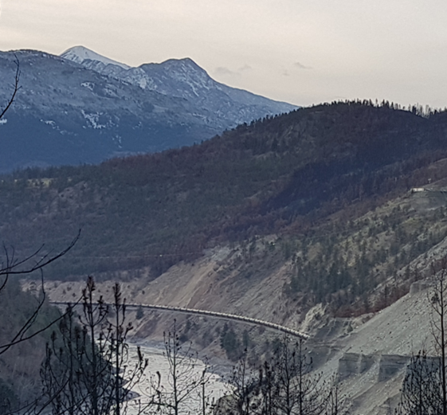
Issues for future IRSCs
Size of core group/ conference format
Environmental issues / climate change
Track / infrastructure issues
Software issues?
New technologies
Safety communications and government and industry credibility
I R S C 2 0 2 2
I N T E R N A T I O N A L R A I L W A Y S A F E T Y C O U N C I L
S E V I L L A , O C T O B E R 1 6 - 2 1 , 2 0 2 2

Slide 9
Key Issues from three major Canadian accidents
2013 Lac Megantic QC: 47 fatalities - issues includes corporate culture, track and locomotive condition, operating procedures, safety management deficiencies, regulatory capture…..
2019/20 Guernsey SK: repeated regulator warnings but no action
Were they predictable?
2019 Field Hill BC runaway: longer trains, poor equipment condition, decision to proceed in cold weather conditions
I R S C 2 0 2 2
I N T E R N A T I O N A L R A I L W A Y S A F E T Y C O U N C I L
S E V I L L A , O C T O B E R 1 6 - 2 1 , 2 0 2 2

Slide 10
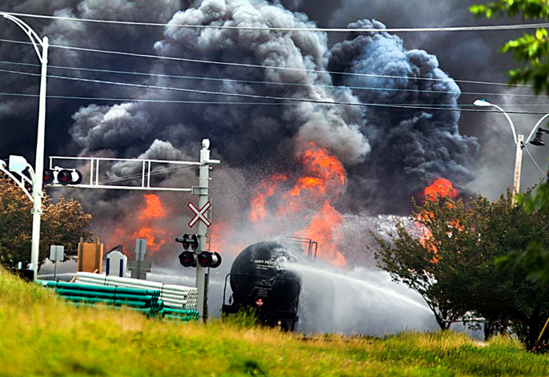
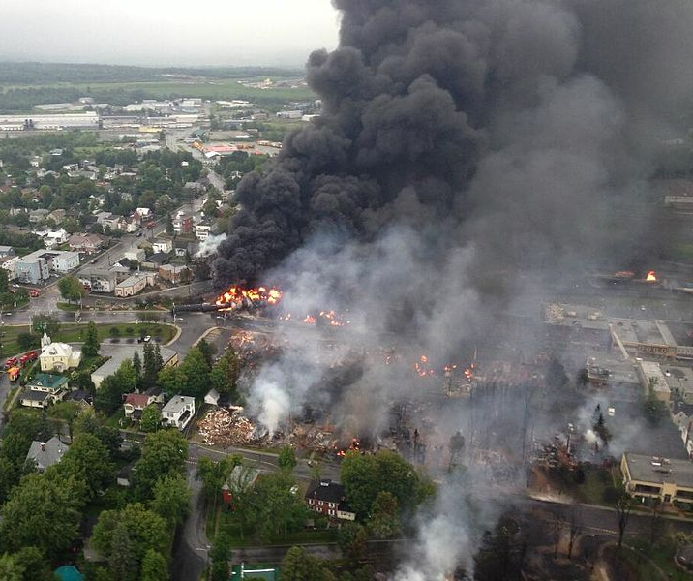
Lac Mégantic, Québec, 6 July 2013
Runaway unmanned freight train
72 wagons of light crude oil (6.7M litres)
Derailed in town at 95+ km/h
59 wagons breached, 6M litres released
47 fatalities
2,000 evacuated
Source: CBC website
Source: Sûreté du Québec
I R S C 2 0 2 2
I N T E R N A T I O N A L R A I L W A Y S A F E T Y C O U N C I L
S E V I L L A , O C T O B E R 1 6 - 2 1 , 2 0 2 2

Slide 11
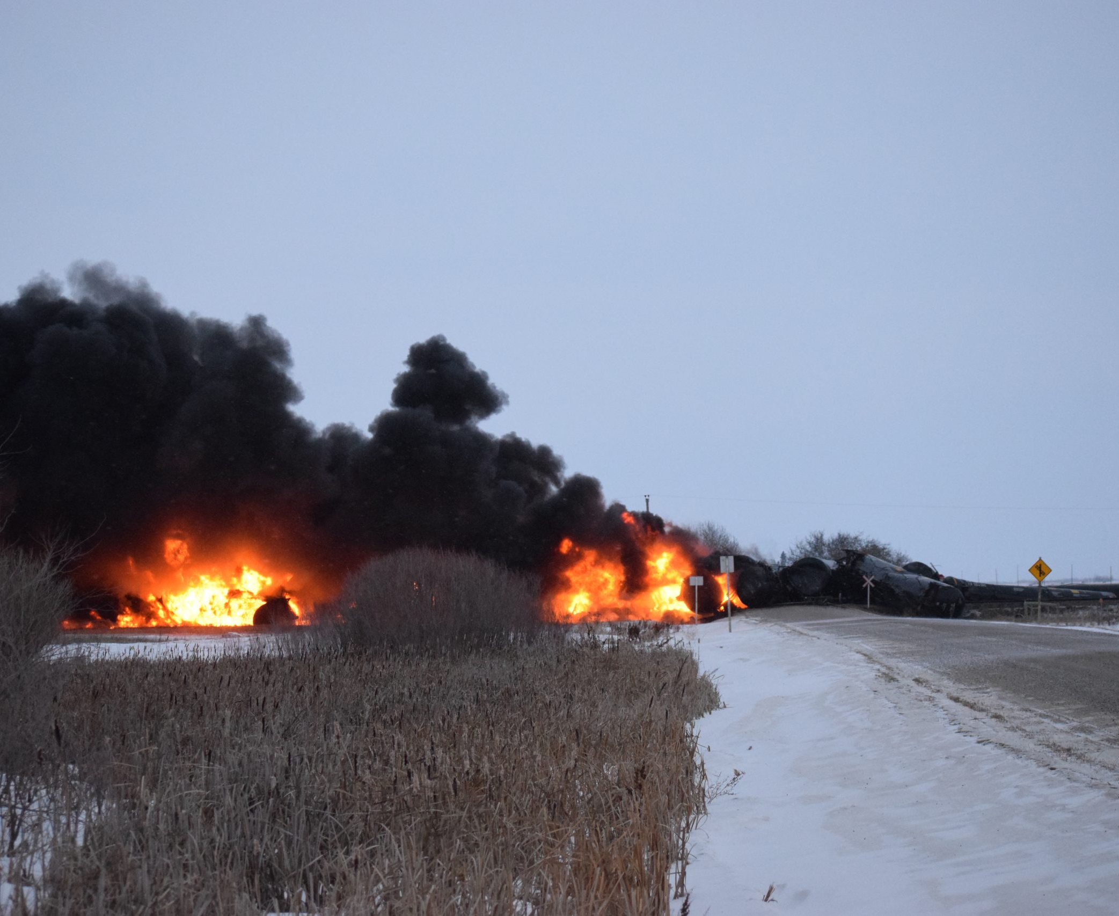
Guernsey Saskatchewan, 2019/20
Two derailments within two months in same area
Non-signalled territory
Oil wagons, both releases approx. 1.5M L
Speeds above 55 km/h
Wagons included modern designs
Dept. of Transport – 2016/2019 warnings
SMS – highly probable no risk analysis
If risk analysis done, why the accidents?
I R S C 2 0 2 2
I N T E R N A T I O N A L R A I L W A Y S A F E T Y C O U N C I L
S E V I L L A , O C T O B E R 1 6 - 2 1 , 2 0 2 2

Slide 12
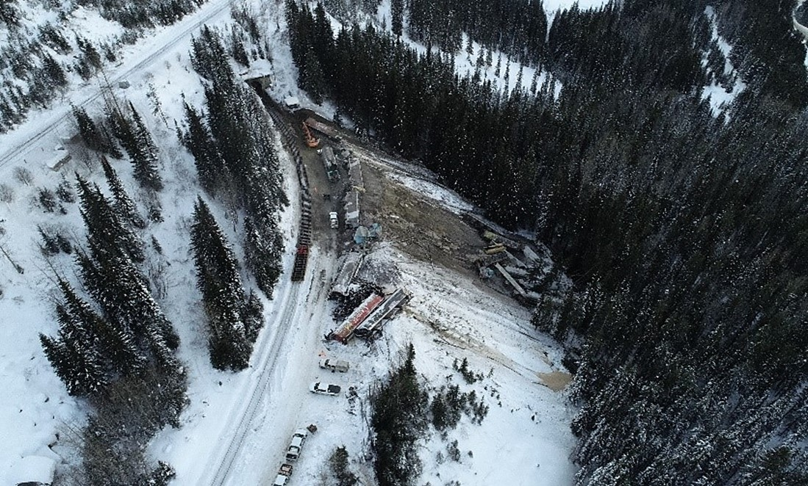
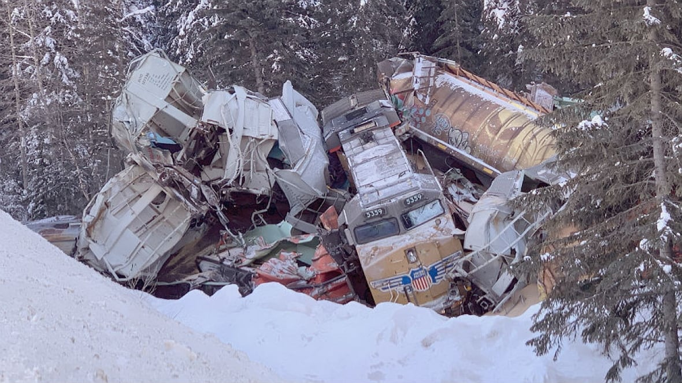
Field Hill BC 2019
News Headline: “Lawsuit claims TSB caved to threats by CP Rail and muzzled its lead investigator”
Sources: CPR and CBC News
I R S C 2 0 2 2
I N T E R N A T I O N A L R A I L W A Y S A F E T Y C O U N C I L
S E V I L L A , O C T O B E R 1 6 - 2 1 , 2 0 2 2

Slide 13
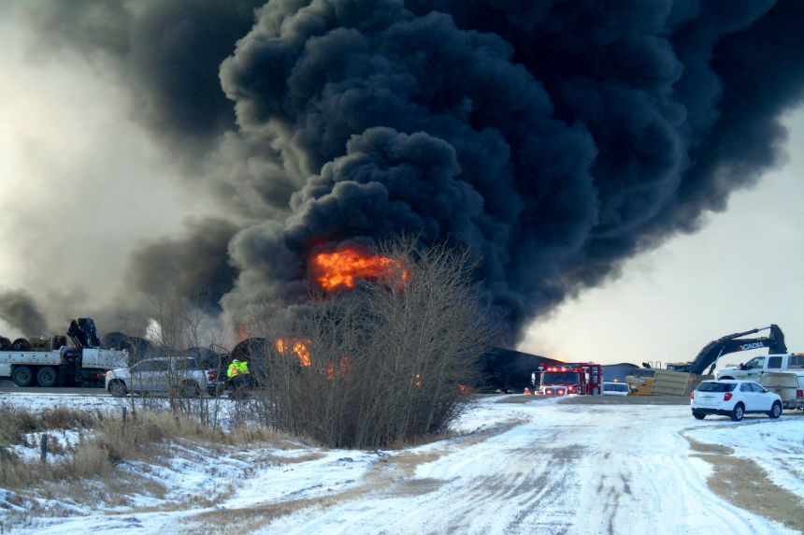
Conclusions
Corporate, regulatory and investigative failures
Regarding Lac Mégantic, Québec:
CEO quote: “one-man crews are safer than two-man crews because there's less exposure for employee injury and less distraction”
Source: B Bosker
I R S C 2 0 2 2
I N T E R N A T I O N A L R A I L W A Y S A F E T Y C O U N C I L
S E V I L L A , O C T O B E R 1 6 - 2 1 , 2 0 2 2

Slide 14
Access to Information - the two most common results:
I R S C 2 0 2 2
I N T E R N A T I O N A L R A I L W A Y S A F E T Y C O U N C I L
S E V I L L A , O C T O B E R 1 6 - 2 1 , 2 0 2 2

Slide 15
So what can we do to improve safety?
Use European Rail Agency suggested best practices:
Trust and openness between industry, regulator and investigations agencies
Be as open as possible
Have teeth, and use them, plus:
Review the Nolan Principles (UK), which apply to any public office holder
Always be aware of Reason’s philosophy (sense of unease)
and Westrum definitions of pathological organizations

Slide 16
Transport Canada SMS audit results
Only one fine paid in the last 13 years related to sms audits - $9,000 CAD paid within a month.
One assessed fine in 2021 - $133,000CAD - under appeal by the railway.

Slide 17
Areas to Think about
IRSC Conference Format and Values
Similar safety issues, and superb discussions, over 30 years, but
What is ideal core group size?
Is there an ideal conference size?
Are we as open as we used to be?
How do we define success?
Safety Professionals
Ask how and why safety has improved over time
Is a laissez-faire regulatory approach appropriate?
When making changes, ask: what could go wrong?

Slide 18
For Today’s Sessions
Important to understand the effects of specific cultures
How do today’s presentations fit the above?
Remember: industry and regulatory agencies all have cultural issues
Do IRSC conferences have them?
SMS - at what cost, for what benefit?
Don’t believe your own publicity!

Slide 19
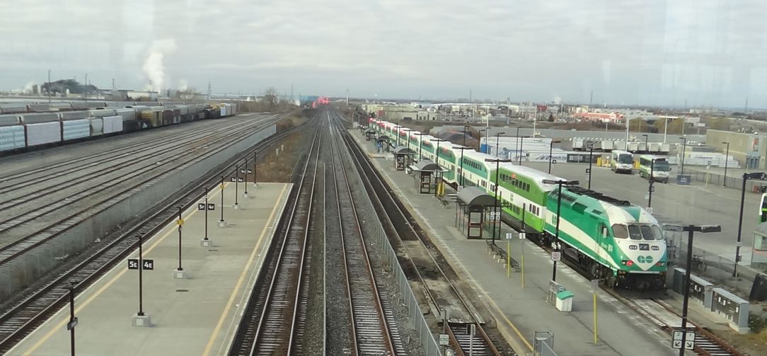
Thank you!

Slide 20
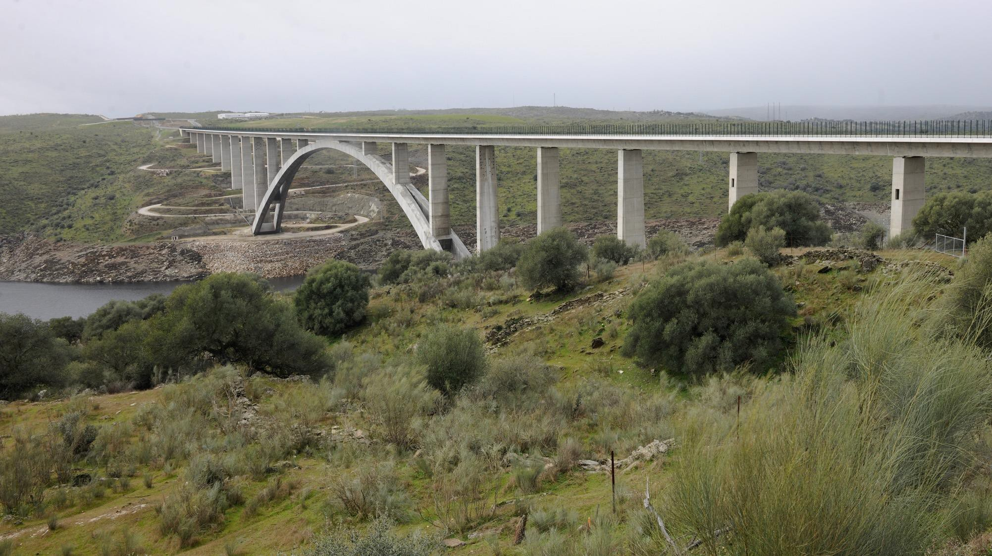
w w w . i r s c 2 0 2 2 . c o m

