Slide 1


IRSC 2022
INTERNATIONAL RAILWAY
SAFETY COUNCIL
COMPANY LOGO
SEVILLA, OCTOBER 16-21, 2022

Slide 2
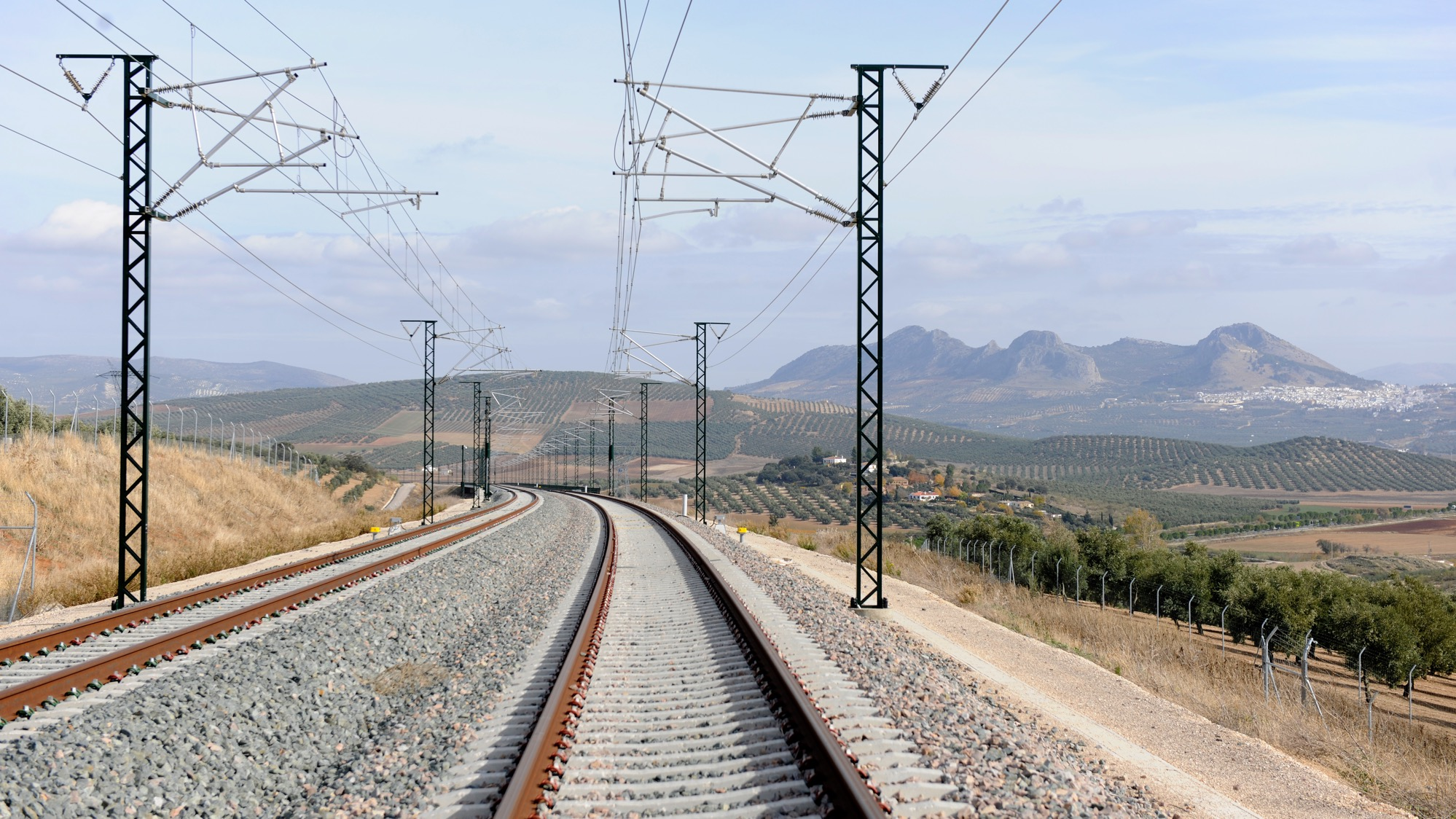



FABIO SGROI
H&S Manager – ITALO
IRSC 2022
INTERNATIONAL RAILWAY SAFETY COUNCIL
SEVILLA, OCTOBER 16-21, 2022
COMPANY LOGO

Slide 3
ITALO SAFETY CULTURE ASSESSMENT
IRSC 2022
COMPANY LOGO
INTERNATIONAL RAILWAY SAFETY COUNCIL
SEVILLA, OCTOBER 16-21, 2022

Slide 4
INDEX
CHAPTER 1
ITALO – ABOUT US
CHAPTER 2
ERA-SCS AND WSC SURVEYS
CHAPTER 3
ACTIONS AFTER SURVEYS
CHAPTER 4
CONCLUSIONS
COMPANY LOGO

Slide 5
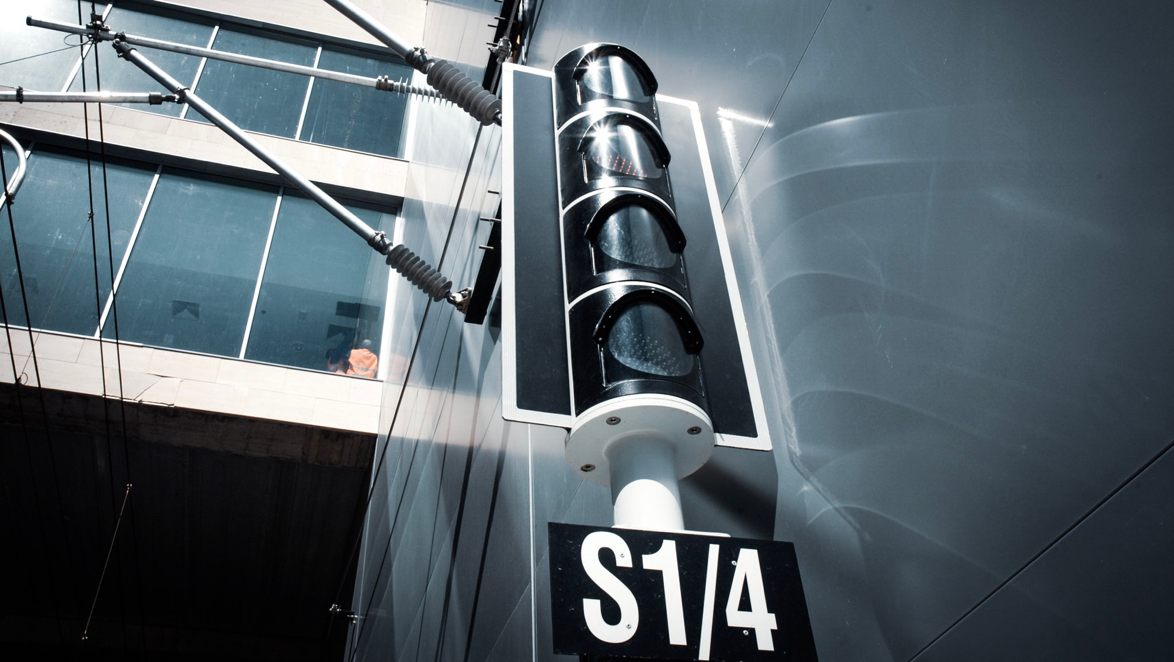
CHAPTER 1
ITALO – ABOUT US
IRSC 2022
COMPANY LOGO
INTERNATIONAL RAILWAY SAFETY COUNCIL
SEVILLA, OCTOBER 16-21, 2022

Slide 6
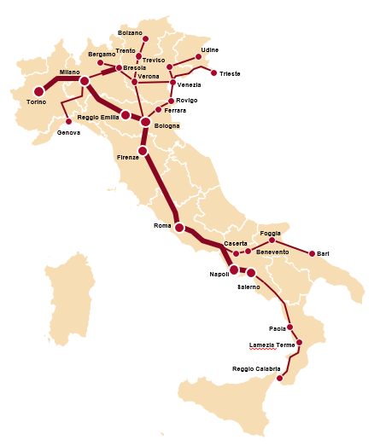
ITALO – Nuovo Trasporto Viaggiatori
First, private high-speed operator in EU, Italo took benefit of the liberalisation of the Italian passengers rail services to raise rail transport quality standards
Employees
+1.350 employees (+1.100 operating staff)
  Average age: 32 years old
  95% qualified by Italo
Network
116 daily services
  49 cities & 56 stations
  +29 mln trains*km/year scheduled
Numbers
+20 million passengers in 2019
  ~39% market share
  70% average load factor
Fleet
51 High Speed trains
  25 AGV rolling stocks
  26 EVO trains
COMPANY LOGO

Slide 7
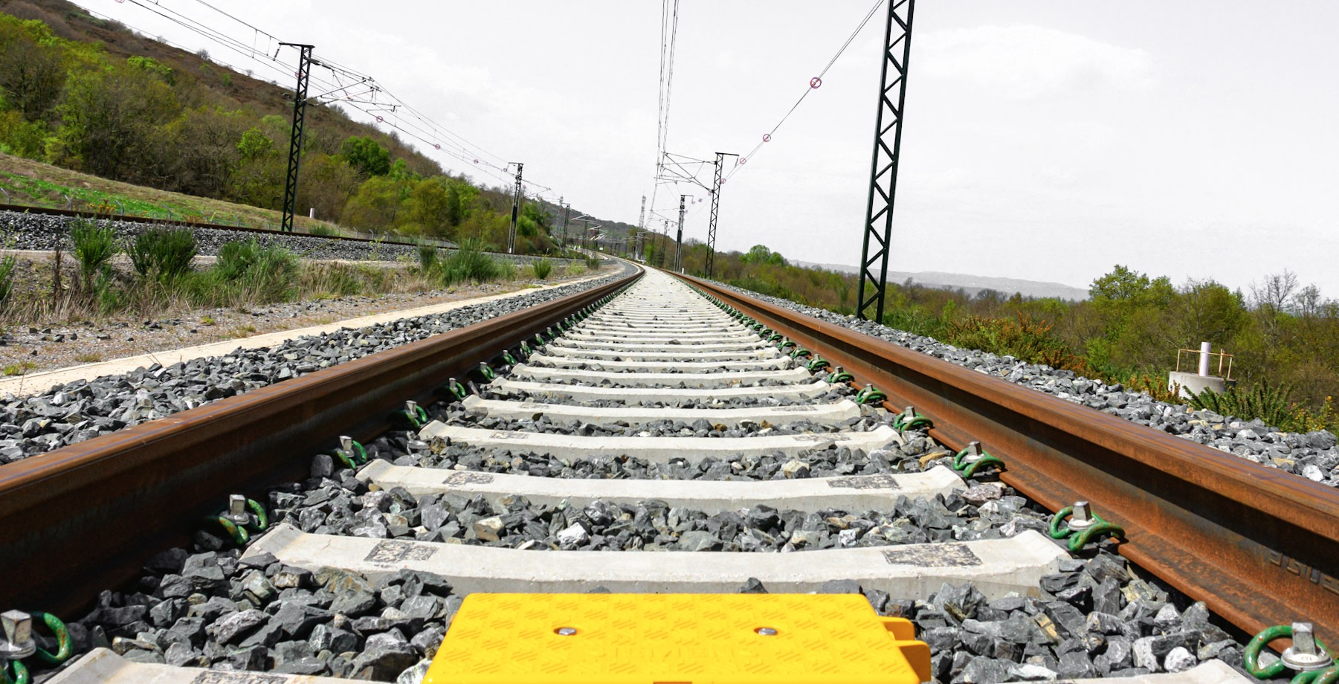
CHAPTER 2
ERA-SCS AND WSC SURVEYS
IRSC 2022
COMPANY LOGO
INTERNATIONAL RAILWAY SAFETY COUNCIL
SEVILLA, OCTOBER 16-21, 2022

Slide 8




EUROPEAN RAIL SAFETY CLIMATE SURVEY (ERA-SCS)
STRENGHTS:
Ability to identify risks proactively;
Understanding of the complexity of the railway context;
Monitoring of Safety indicators;
Ability to learn from worker feedback on Safety audits;
Attention to high levels of Safety compared to the business;
Distribution of roles, tasks, responsibilities, procedures and rules in line with Safety vision and policies;
Effective communication of Safety rules and procedures.
Survey Results
805 RESPONDENTS
59% WORKFORCE
IMPROVEMENT POINTS:
Teamwork, collaboration and information exchange;
Development of management actions geared towards achieving Safety targets.
COMPANY LOGO

Slide 9

WORK- RELATED STRESS ASSESSMENT
RISK FACTORS:
Conflict in the relationship between managers and workers on the management of daily operations;
Overlapping of new commercial services with safety procedures;
Perception of high workload and to be understaffed;
Low participation in corporate decisions;
Business changes not clear.
FOCUS GROUP (FG)
PROTECTIVE FACTORS:
Awareness of their role and sense of belonging to Italo;
Importance of their work, responsibility;
Support and solidarity among colleagues;
Absence of vexatious or violent dynamics;
Hope for change in the future;
Safety at work as value.
200 ITALO’S EMPLOYEES:
7 TOP MANAGER
2 FG TO THE MIDDLE MANAGER
23 FG TO A SAMPLE OF WORKERS
COMPANY LOGO

Slide 10
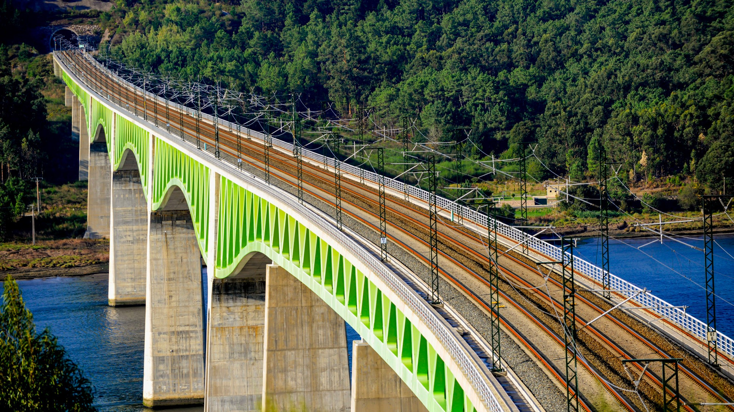
CHAPTER 3
ACTIONS AFTER THE SURVEYS
IRSC 2022
COMPANY LOGO
INTERNATIONAL RAILWAY SAFETY COUNCIL
SEVILLA, OCTOBER 16-21, 2022

Slide 11





COMMUNICATION OF THE RESULTS AND ACTIONS
Dec.
2021
Discussion with the Workers’ Health and Safety Representatives (RLS)
Jan.
2022
Communication of the survey results to Italo employees
TOP MANAGEMENT COMMITMENT
Apr.
2022
World Cafè Methodology
Operations;
Stations;
Staff.
60 Top & Middle Manager
COMPANY LOGO

Slide 12
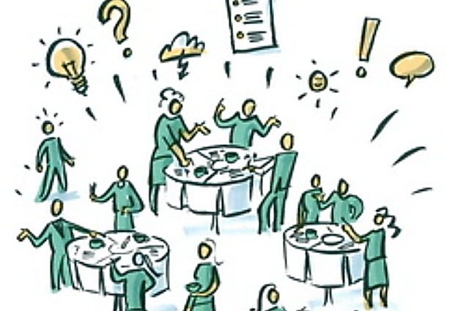





WORLD CAFÈ – ASPECTS EXPLORED
Application of procedures
Development of management culture
The World Cafè is a method which makes use of an informal cafè setting for participants to explore specific issues by discussing them in small table groups.
Relationship with workers
Corporate vision
Discussion is held in multiple rounds of 20-30 minutes, with the cafè ambiance intended to allow for more relaxed and open conversations to take place.
INTERACTION & REINFORCING
COMPANY LOGO

Slide 13


MANAGERIAL GYM
Application of Management Skills
Giu
Jun. - Oct. 2022
Giu
40 Top & Middle Manager & Operational Staff
WORKING FOR TASK/TOWARDS GOALS

Slide 14
CHAPTER 4
CONCLUSIONS
IRSC 2022
COMPANY LOGO
INTERNATIONAL RAILWAY SAFETY COUNCIL
SEVILLA, OCTOBER 16-21, 2022

Slide 15
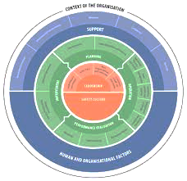




CONCLUSIONS
Objectives
Improve Safety culture through a motivational change
Achieve a change in managerial skills
COMPETENCE
New Climate Survey in 2024
Develop Safety Leadership, Just Culture, HOF
HUMAN RESOURCES
DEAL WITH CHANGES

