Slide 1


IRSC 2022
INTERNATIONAL RAILWAY
SAFETY COUNCIL
SEVILLA, OCTOBER 16-21, 2022

Slide 2
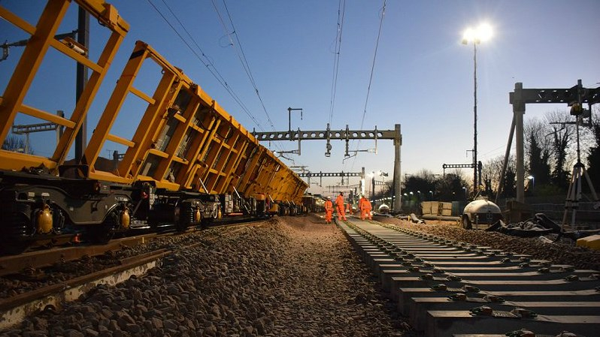


Iain Ferguson B.Sc.(Hons)PgDip CFIOSH
Director of Safety, Health and Environment, Eastern Region
IRSC 2022
INTERNATIONAL RAILWAY SAFETY COUNCIL
SEVILLA, OCTOBER 16-21, 2022

Slide 3
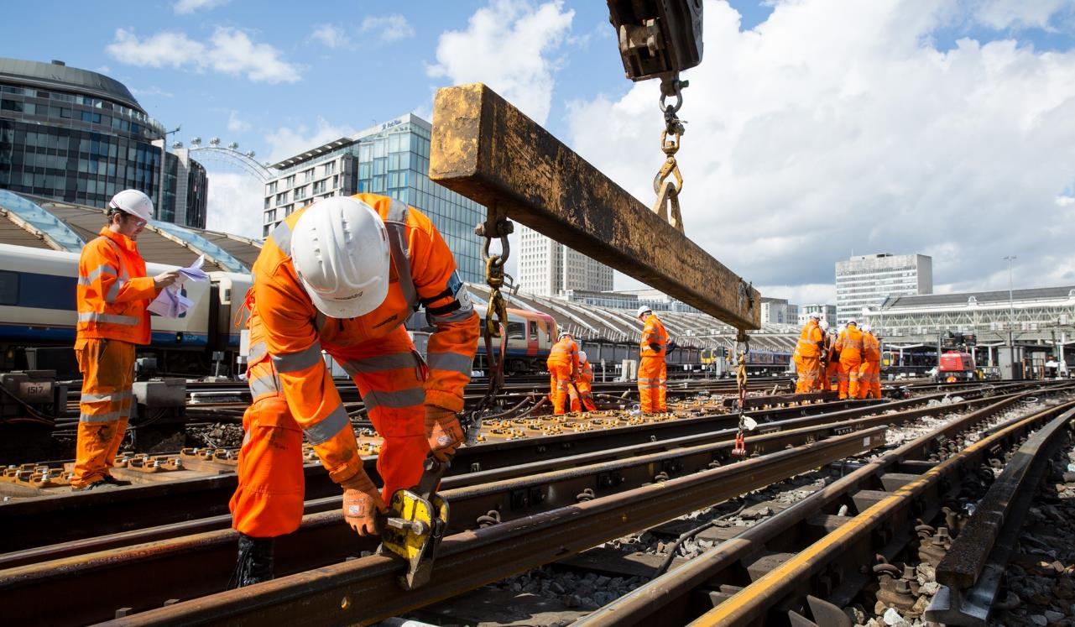
Creating an organisation where it is inevitable that everyone goes home safe everyday
IRSC 2022
INTERNATIONAL RAILWAY SAFETY COUNCIL
SEVILLA, OCTOBER 16-21, 2022

Slide 4
Overview
What is Network Rail Eastern Region?
An overview of NR Eastern Region
What is our challenge?
How do you make it inevitable that everyone goes home safe everyday?
How we are tackling the challenge?
How do you make it inevitable that everyone goes home safe everyday?
Where are we on our journey?
Are we doing what we said we need to do?
Is it making a difference?

Slide 5
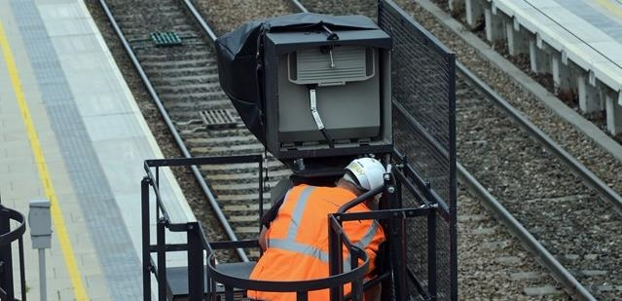

What is Network Rail Eastern Region?
IRSC 2022
INTERNATIONAL RAILWAY SAFETY COUNCIL
SEVILLA, OCTOBER 16-21, 2022

Slide 6
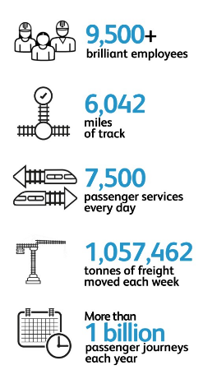
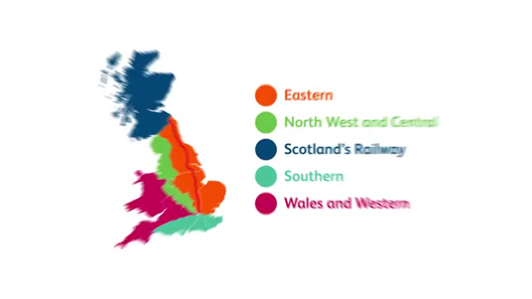
Eastern Region
Notes:
https://youtu.be/1YeT5YFSUfA
https://youtu.be/0HQhVBIlD80
https://youtu.be/xX3v4WsLt5U
https://youtu.be/aJMwONdUl9s
https://youtu.be/of6iRq1sx3w?t=59
https://youtu.be/ue6Na6ZOhwc?t=95

Slide 7
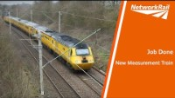
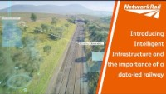
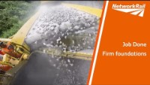
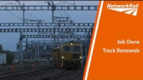
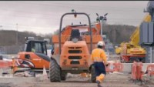
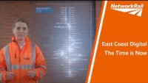
Eastern Region
Notes:
https://youtu.be/1YeT5YFSUfA
https://youtu.be/0HQhVBIlD80
https://youtu.be/xX3v4WsLt5U
https://youtu.be/aJMwONdUl9s
https://youtu.be/of6iRq1sx3w?t=59
https://youtu.be/ue6Na6ZOhwc?t=95

Slide 8
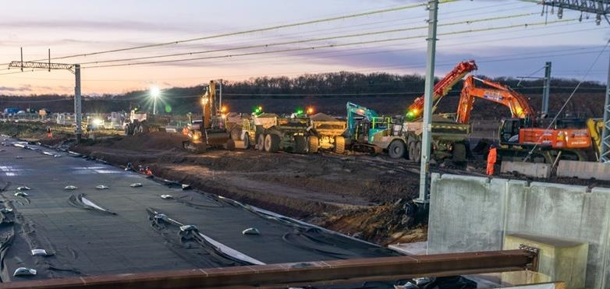
What is the challenge?
IRSC 2022
INTERNATIONAL RAILWAY SAFETY COUNCIL
SEVILLA, OCTOBER 16-21, 2022

Slide 9


Gareth
Matthew
Martin
Dritan
Zac
Ben
Michael
Scott
Christopher
Donald
Spike
Brett
James
Steven
Kevin
Tyler
John
Aden
didn’t get
Make it “Inevitable”

Slide 10
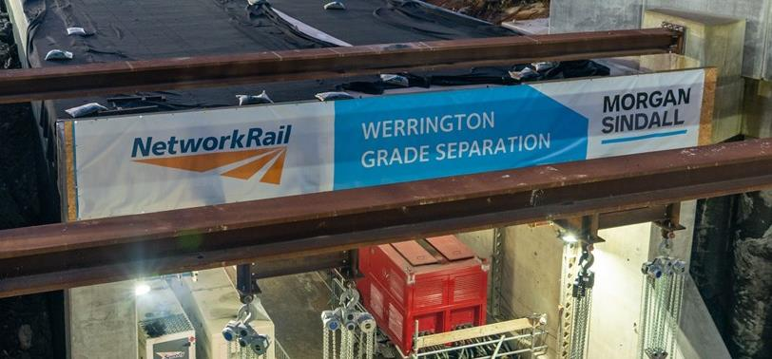
How are we responding?
IRSC 2022
INTERNATIONAL RAILWAY SAFETY COUNCIL
SEVILLA, OCTOBER 16-21, 2022

Slide 11
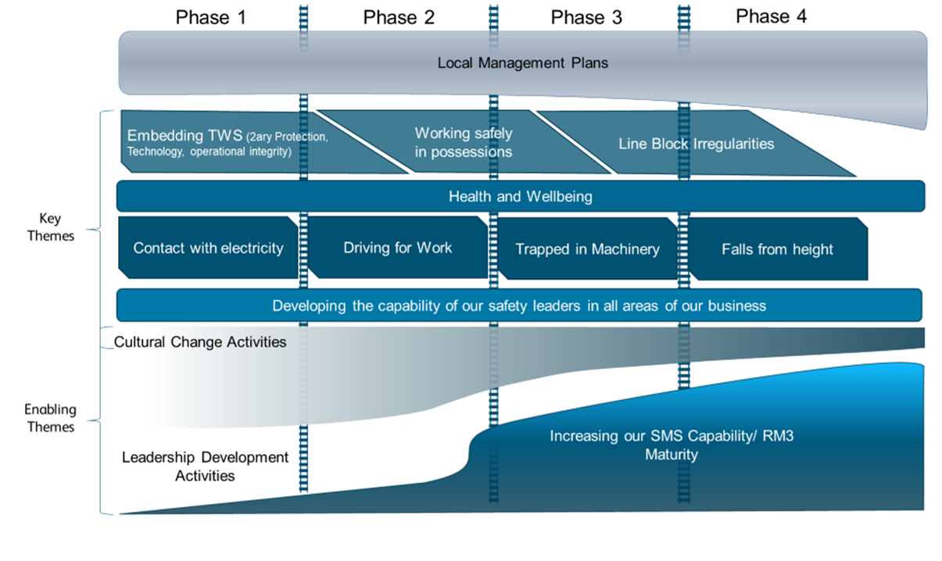
“Diagnose, Prescribe, Deliver”

Slide 12
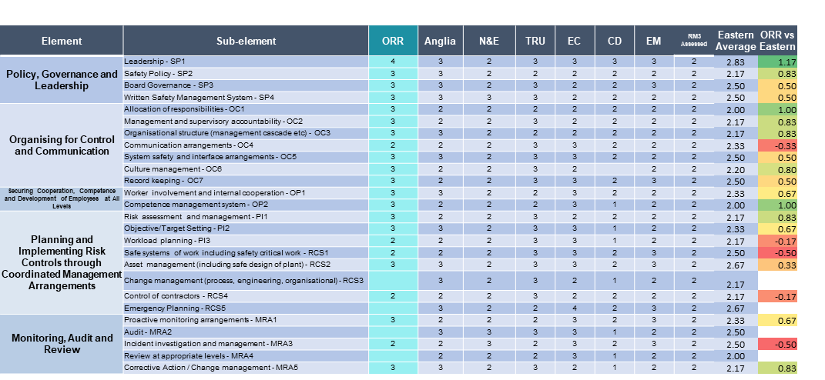
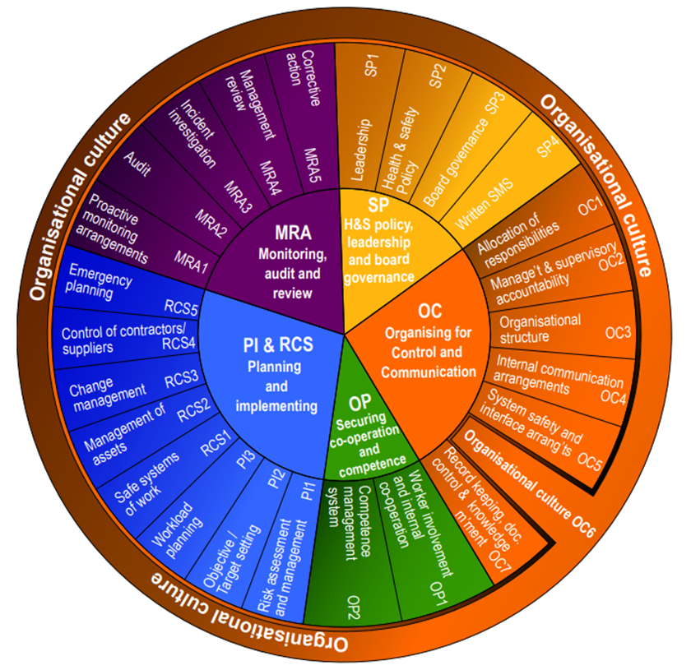
“Diagnose, Prescribe, Deliver”

Slide 13
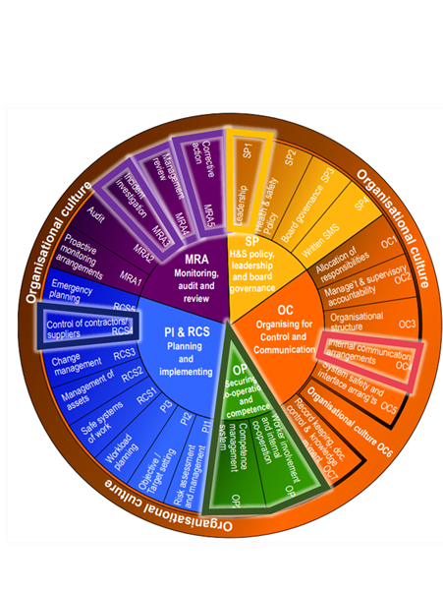
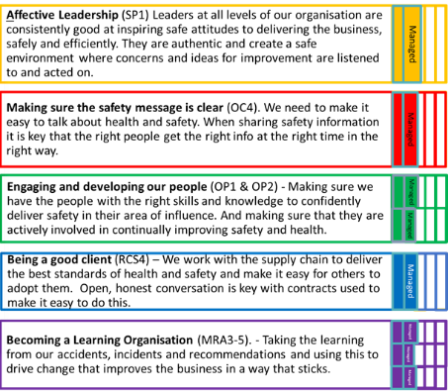
“Diagnose, Prescribe, Deliver”

Slide 14
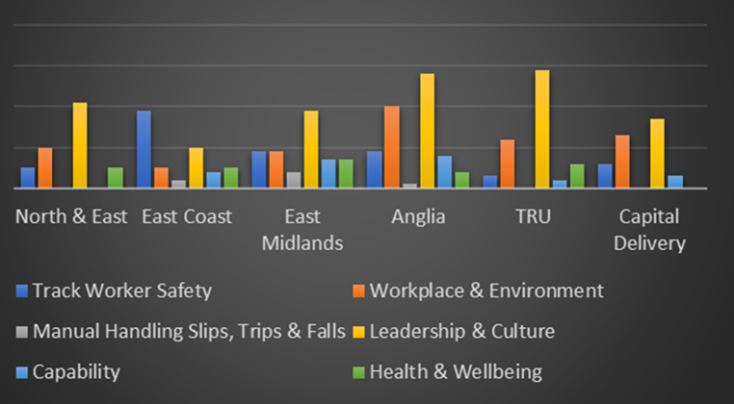
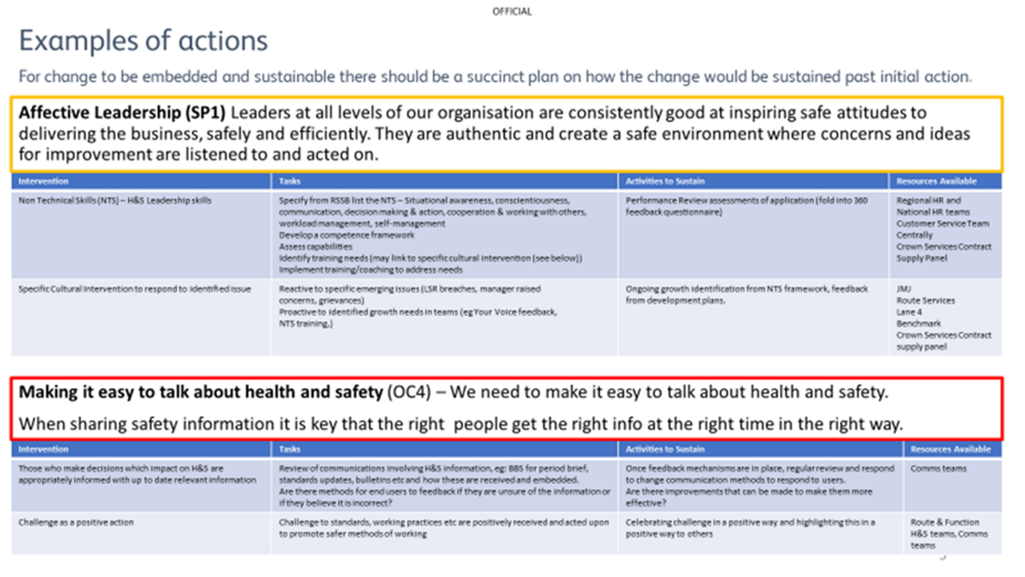
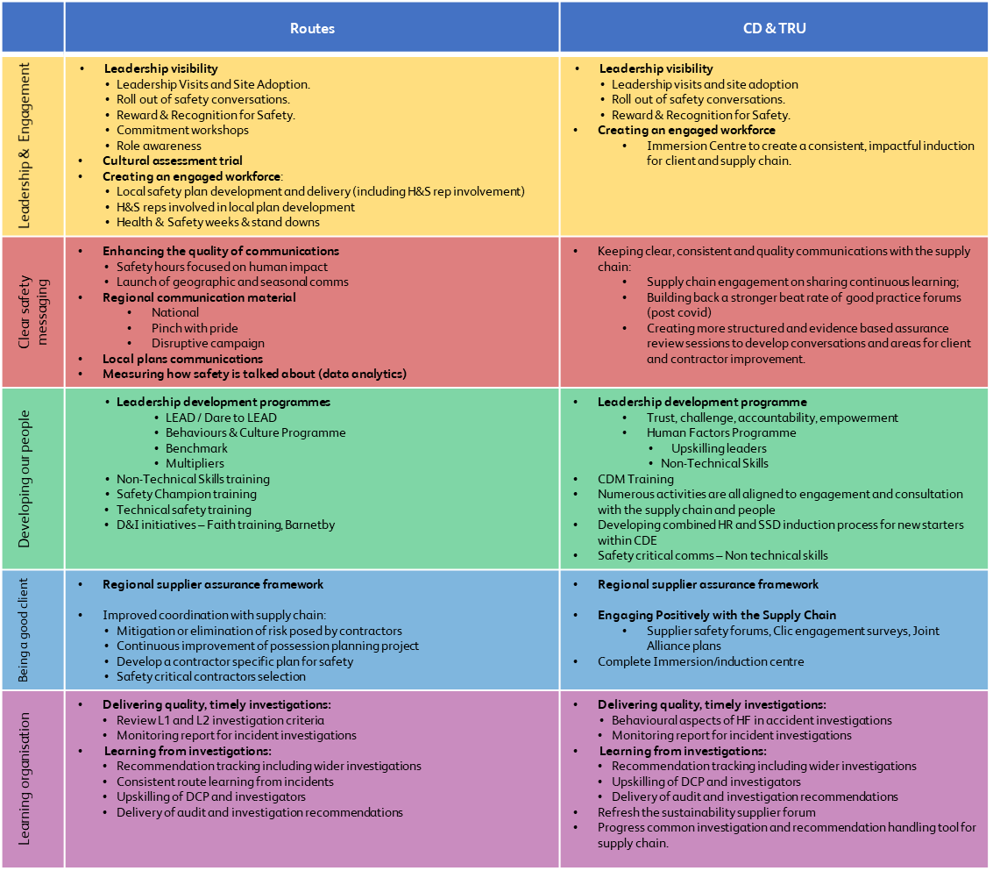
“Diagnose, Prescribe, Deliver”

Slide 15
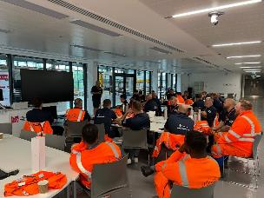
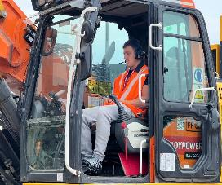
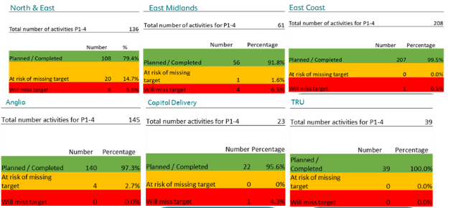
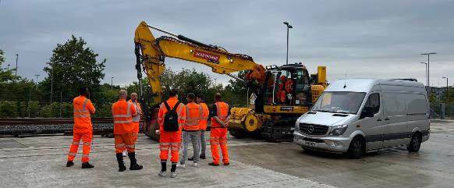
“Diagnose, Prescribe, Deliver”

Slide 16
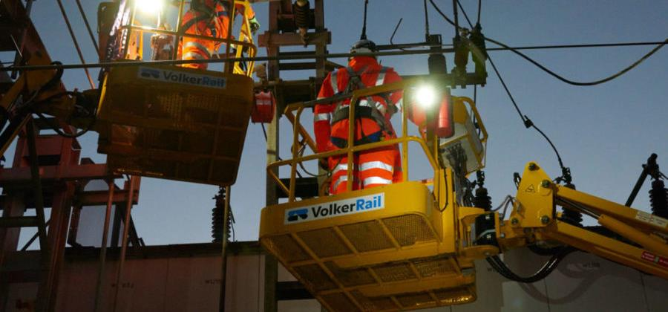
Is it working?
IRSC 2022
INTERNATIONAL RAILWAY SAFETY COUNCIL
SEVILLA, OCTOBER 16-21, 2022

Slide 17
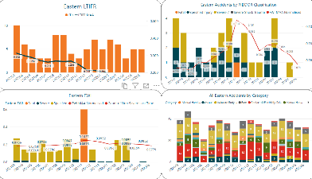
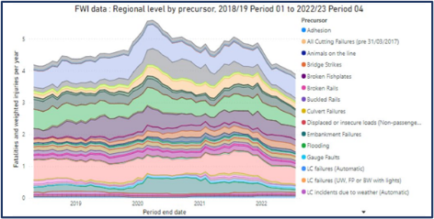
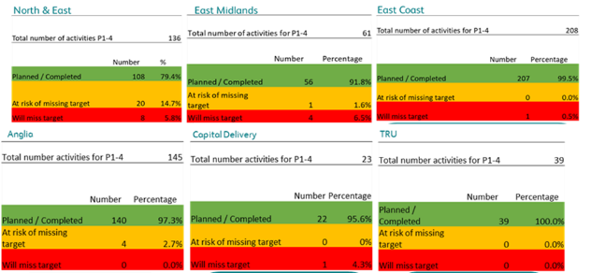
Just the start

Slide 18
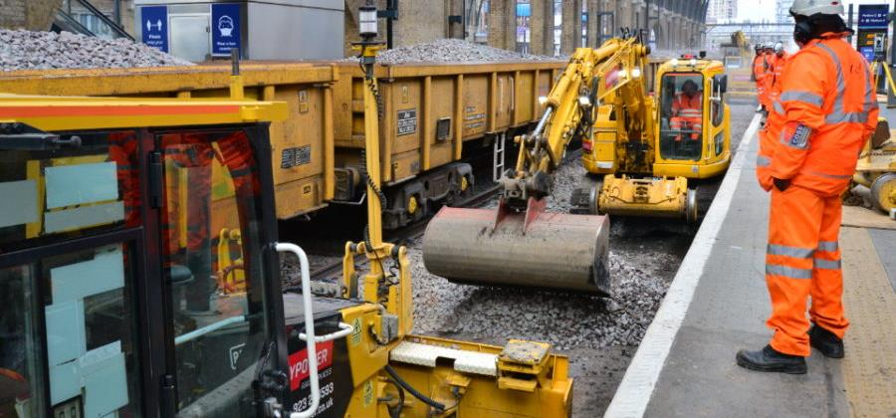
What’s next?
IRSC 2022
INTERNATIONAL RAILWAY SAFETY COUNCIL
SEVILLA, OCTOBER 16-21, 2022

Slide 19
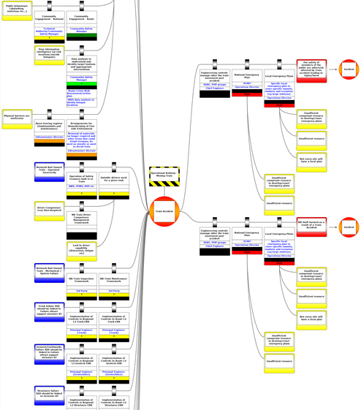
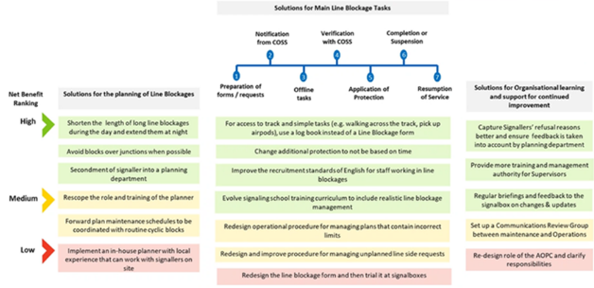
Seek and Solve

Slide 20


