Slide 1


IRSC 2022
INTERNATIONAL RAILWAY
SAFETY COUNCIL
SEVILLA, OCTOBER 16-21, 2022

Slide 2
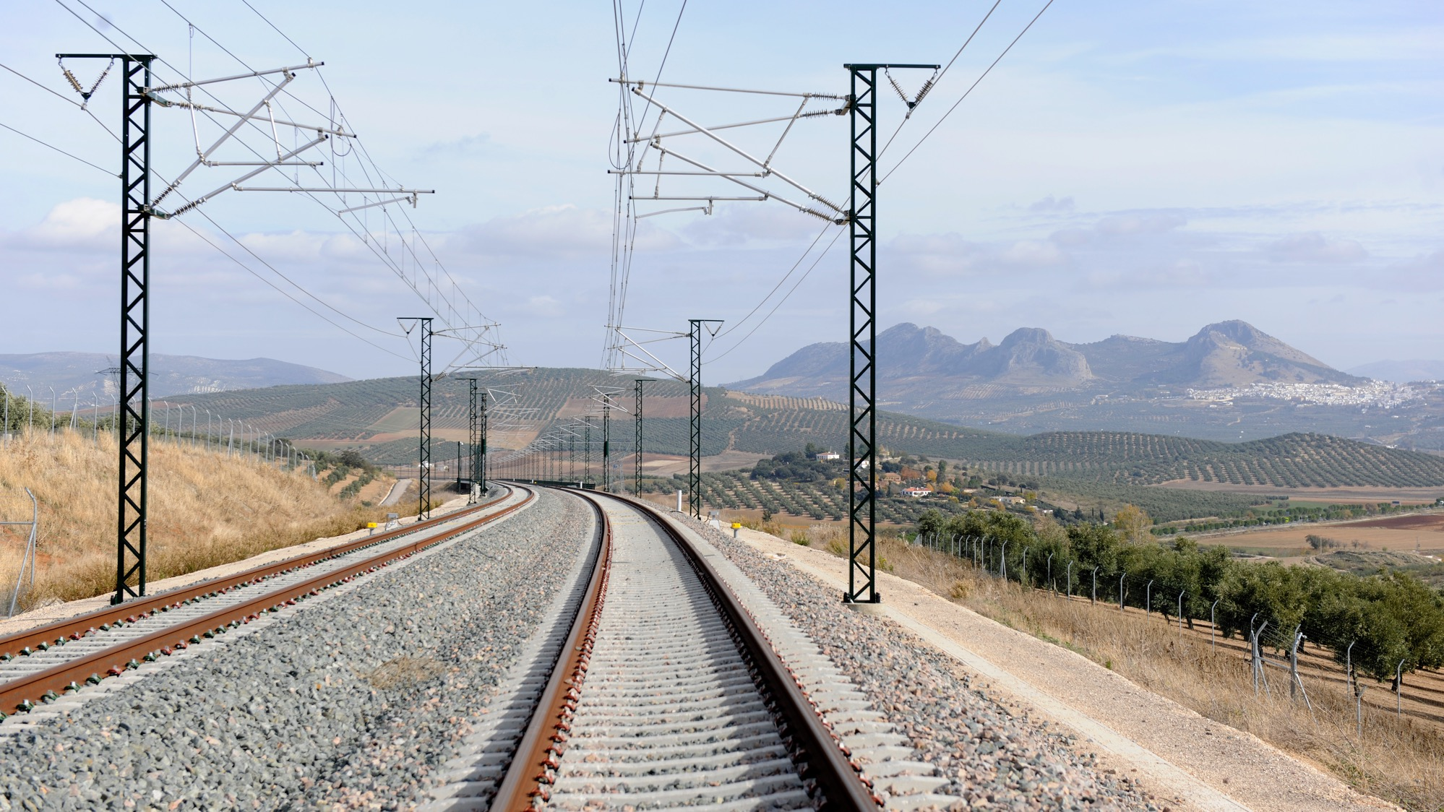



KIRSI PAJUNEN
Finnish Transport and Communications Agency (Traficom)
IRSC 2022
INTERNATIONAL RAILWAY SAFETY COUNCIL
SEVILLA, OCTOBER 16-21, 2022

Slide 3
SAFETY CULTURE AND SAFETY MANAGEMENT SYSTEMS – AN AUTHORITY PERSPECTIVE
IRSC 2022
INTERNATIONAL RAILWAY SAFETY COUNCIL
SEVILLA, OCTOBER 16-21, 2022

Slide 4
INDEX
MODELS AND ASSESSMENT
Relations between ERA Safety Management System and Safety Culture Model
PROPOSAL FOR A REGULATORY APPROACH
NEXT STEPS

Slide 5
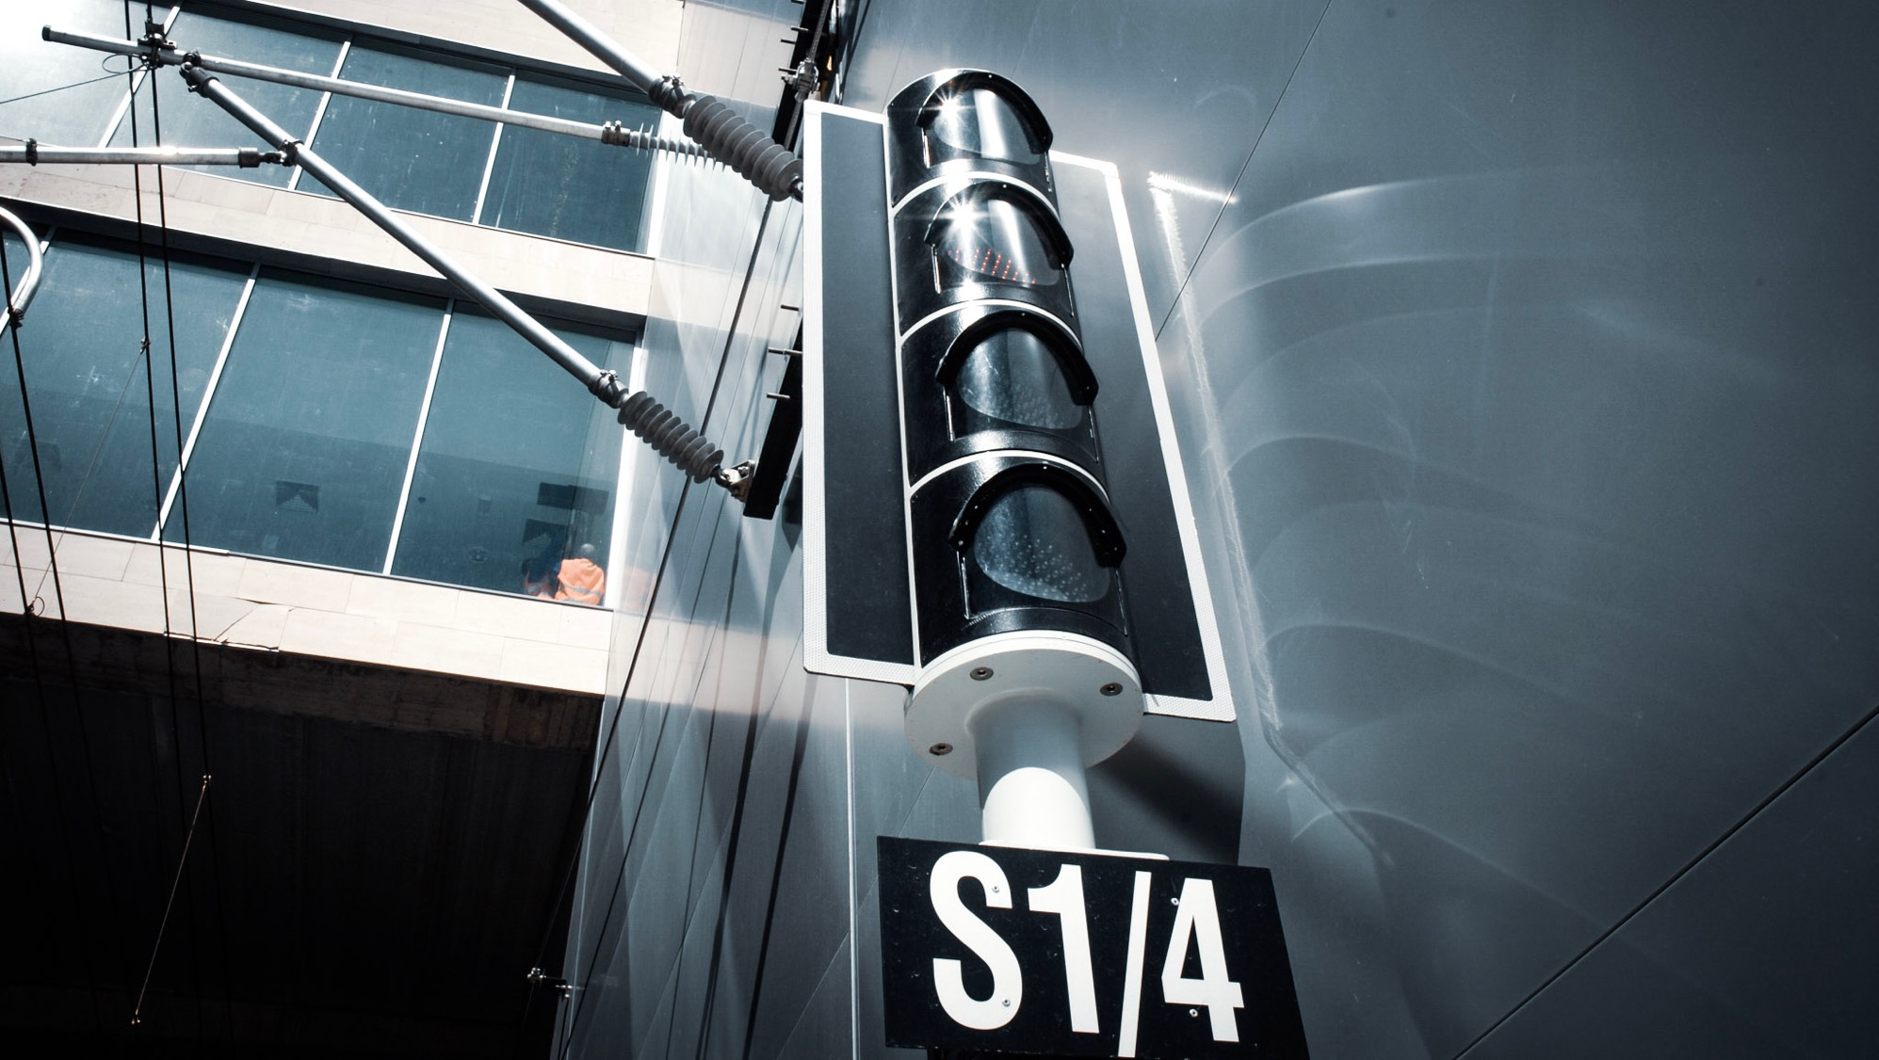
MODELS AND ASSESSMENT
IRSC 2022
INTERNATIONAL RAILWAY SAFETY COUNCIL
SEVILLA, OCTOBER 16-21, 2022

Slide 6
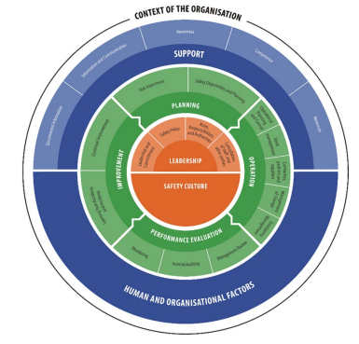
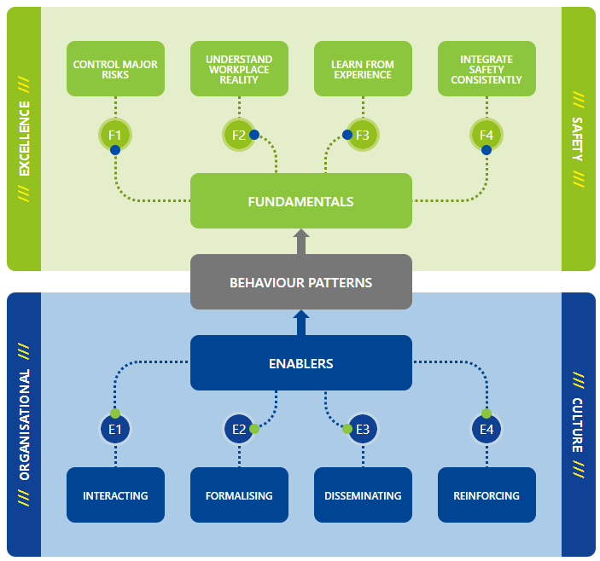
SAFETY MANAGEMENT SYSTEM AND SAFETY CULTURE MODELS

Slide 7
RELATION BETWEEN ERA SMS REQUIREMENTS AND SAFETY CULTURE MODEL
Overlap between models, but no contradictions
Both models include leadership aspects, no explicit leadership model
HOF not described in detail, organizational factors considered
SC model includes good “additions” to safety management
SMS model can provide framework for SC development, requires understanding of models

Slide 8
TYPES OF ELEMENTS IN SAFETY CULTURE MODEL
Nearly identical with SMS elements
Indications of SMS implementation
Roles, responsibility, resource allocation...
Indicative aspects of safety culture
Communication, leadership...
Questioning attitude, understanding system complexity...
Shared patterns of behavior, basic assumptions and values
Only parts of interpersonal values

Slide 9
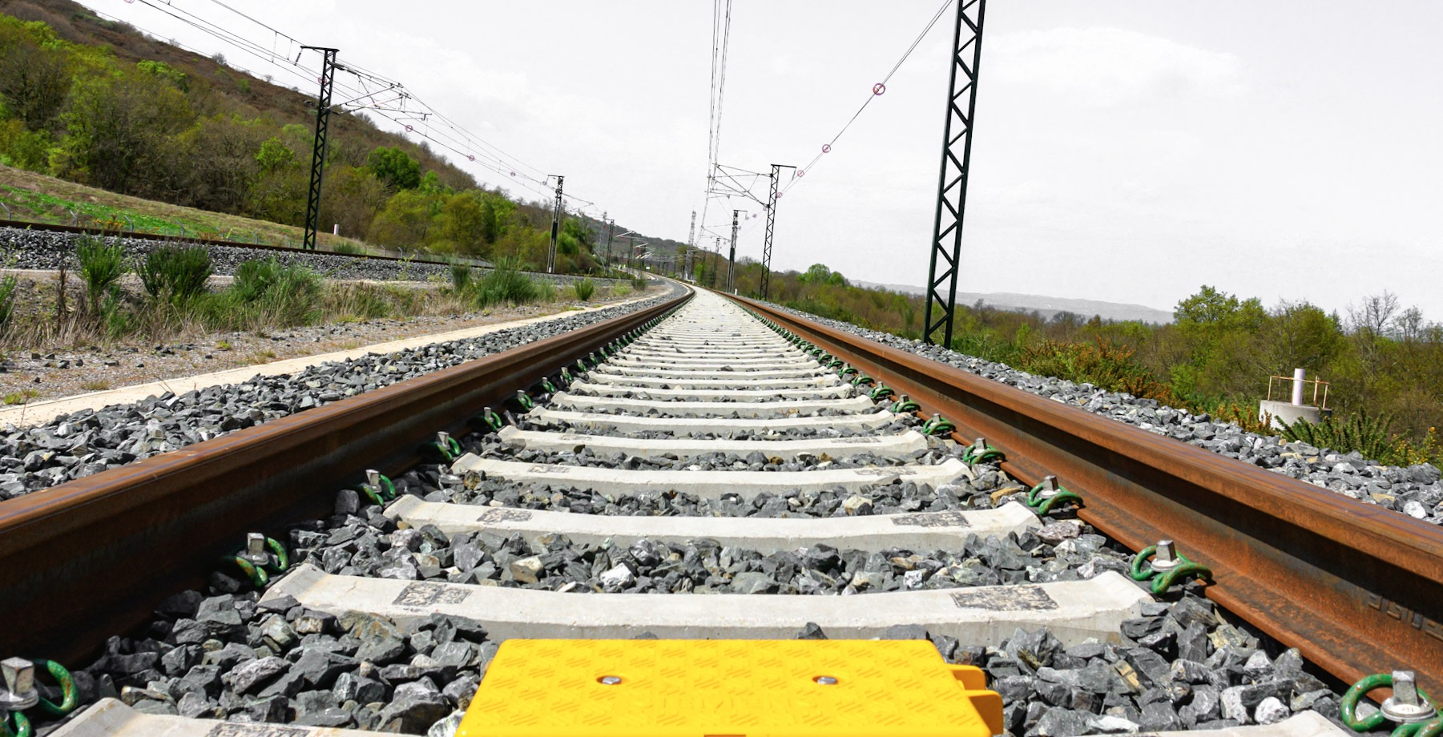
PROPOSAL FOR A REGULATORY APPROACH
IRSC 2022
INTERNATIONAL RAILWAY SAFETY COUNCIL
SEVILLA, OCTOBER 16-21, 2022

Slide 10
APPROACHES TO SAFETY CULTURE ASSESSMENT
Focused assessment
Short interviews
Full assessment
Short interviews
Wide assessment
Document analysis / participation in SMS audits
Comprehensive document analysis/ dedicated SC audit
Long interviews
Comprehensive document analysis
Dedicated SC audit/participation in SMS audit

Slide 11
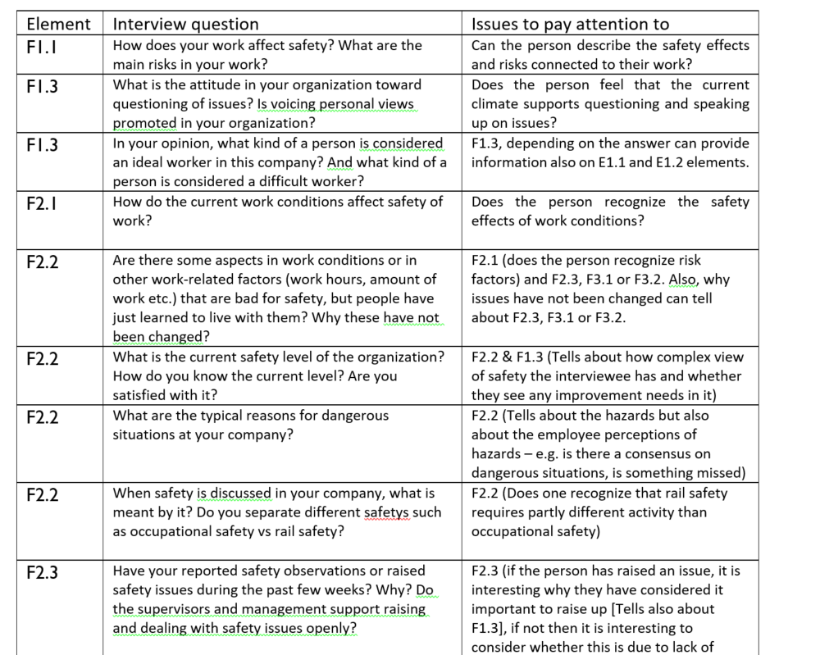
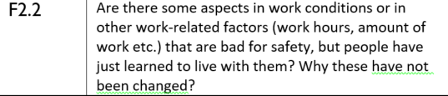

EXAMPLES OF SAFETY CULTURE ISSUES CONSIDERED IN INTERVIEWS

Slide 12

NEXT STEPS
IRSC 2022
INTERNATIONAL RAILWAY SAFETY COUNCIL
SEVILLA, OCTOBER 16-21, 2022

Slide 13
NEXT STEPS
Empirical testing
Interviews in Traficom
SMS auditing method
Developed with auditors
Publication of project results
Workshops

Slide 14

Thank you for your attention!

