Slide 1
The Sixth Sensor:
How IoT Smart Sensors Can Address Operational Challenges Introduced by Increasing Automation in Railways

Slide 2
Introduction

Slide 3
Automatic Train Control
ATC = ATP + ATO + ATS

Slide 4
Grades of Automation

Slide 5
Automation Benefits and Drawbacks
Reduce OPEX
Initial CAPEX
Reduce injury risk
Increase throughput
Remove human error
Benefits
Drawbacks
Loss of hands-on experience
Increase complexity
Remove human awareness

Slide 6
Operational “Sixth Sense”

Slide 7
Operational “Sixth Sense”
Perception
Knowledge
Intuition
“Sixth Sense”

Slide 8
Loss of Operational “Sixth Sense”
Perception
Knowledge
AUTOMATION
AUTOMATION
Intuition
AUTOMATION
“Sixth Sense”
AUTOMATION

Slide 9
IoT Architecture

Slide 10
IoT Features And Challenges
Features
MEMS Sensors
Cloud Computing
Predictive Data Analytics
Edge Computing
Challenges
Security/Encryption
Bandwidth
SIL Rating

Slide 11
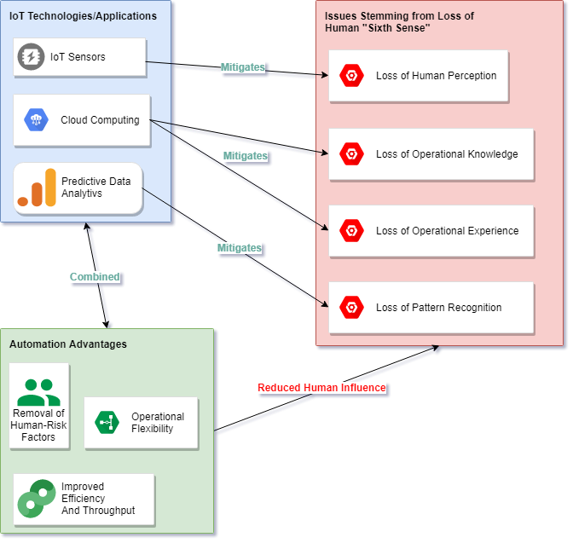
Automation and IoT – Convergence

Slide 12
Conclusion
Automation
Operational “Sixth Sense”
IoT – Architecture and Useful Features
IoT/Automation Convergence
Questions?

Slide 13
CONTACT US
P: Brisbane +617 3360 4949
Perth +618 6145 2288
Sydney +612 8379 4999
E: rsa@railsystemsaustralia.com.au
W: railsystemsaustralia.com.au

