Slide 1
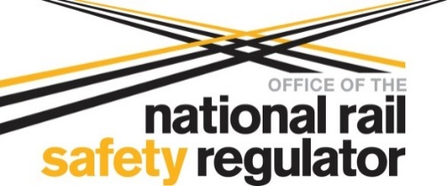
A Systems Approach to Safe System Integration in Major Rail Projects
Dr Raden Kusumo
13 October 2019

Slide 2
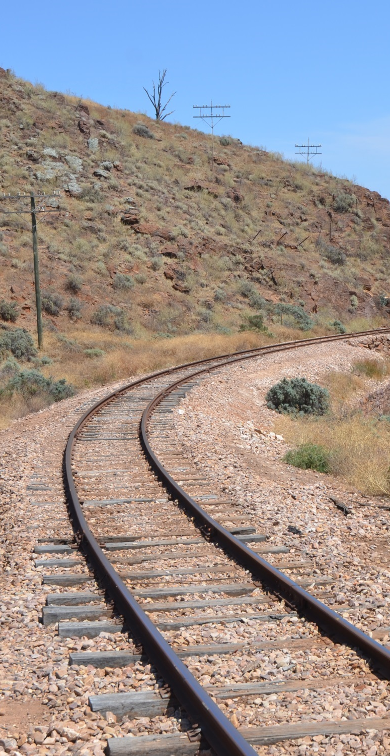
Presentation
Complexity in major rail projects.
RSNL requirements on system integration.
A systems approach to system integration
System integration through out system lifecycle
Case Study

Slide 3
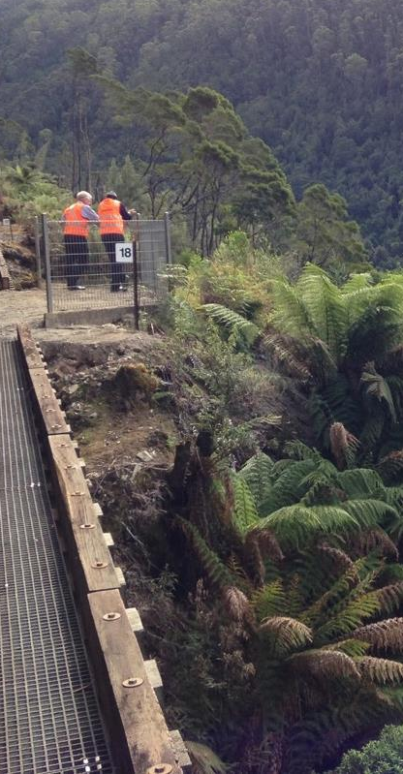
Complexity in major rail projects
Railways rely on various interdependent systems:
operate seamlessly together forming a system of systems of system
Major projects complexity:
implement/change a number of rail systems
new and legacy systems
variety of complex technologies
different suppliers for subsystems
Rail systems must be safely integrated to ensure safe railway operations

Slide 4
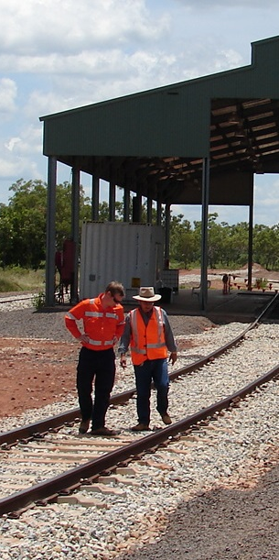
RSNL requirements on system integration
No specific requirements.
RSNL related requirements:
S.46 – Management of risks
S.52 – Duties of rail transport operators
S.53 – Duties of designers, manufacturers, suppliers, etc.
RSNL Regulation related requirements:
Sch 1, C.12 – Management of change
Sch 1, C.19 – General engineering and operational systems safety requirements
Sch 1, C. 20 – Process control

Slide 5
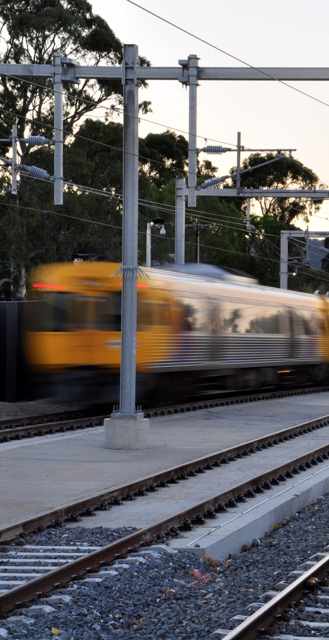
Why adopt a systems approach?
Allows projects to manage the increasing complexity of railway systems integration
Ensures projects can meet their safety duties that are stipulated in the RSNL

Slide 6
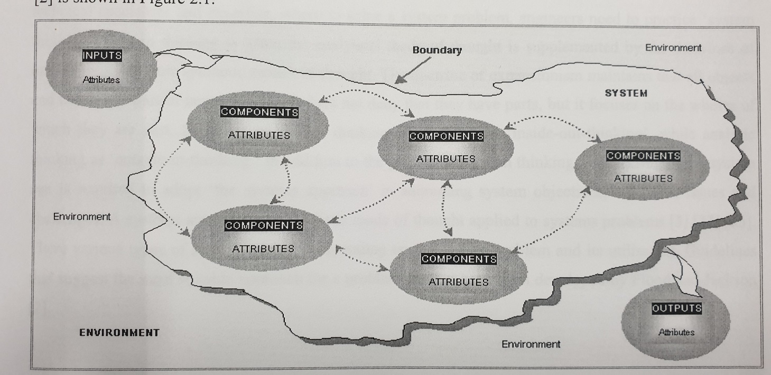
A systems approach

Slide 7
Typical Train Radio System (TRS)

Slide 8
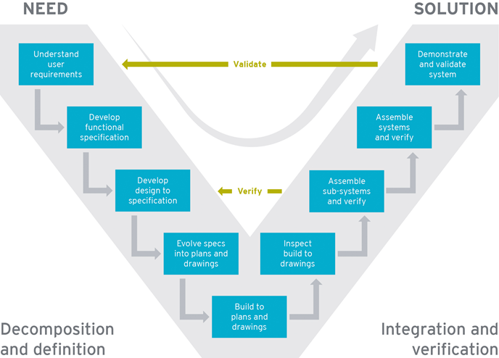
A system life cycle

Slide 9
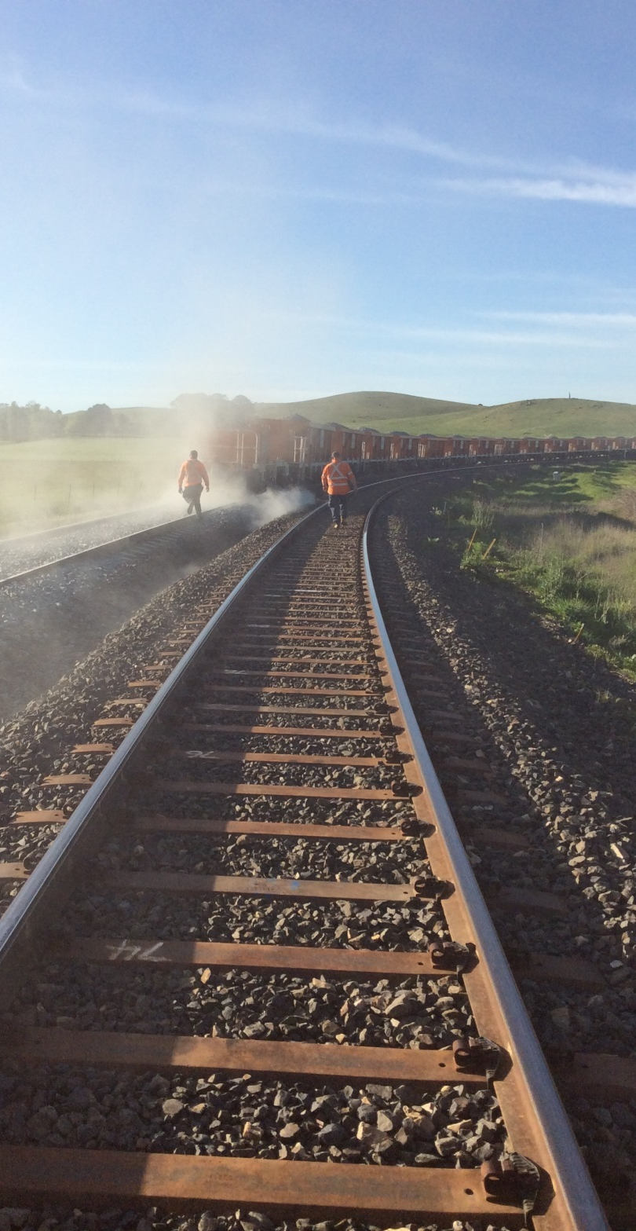
A systems approach to system integration
At each lifecycle phase determine:
How the subsystems will be integrated?
How these subsystems will interface with:
Existing railway infrastructure
Different types of rolling stock
Different types of user

Slide 10
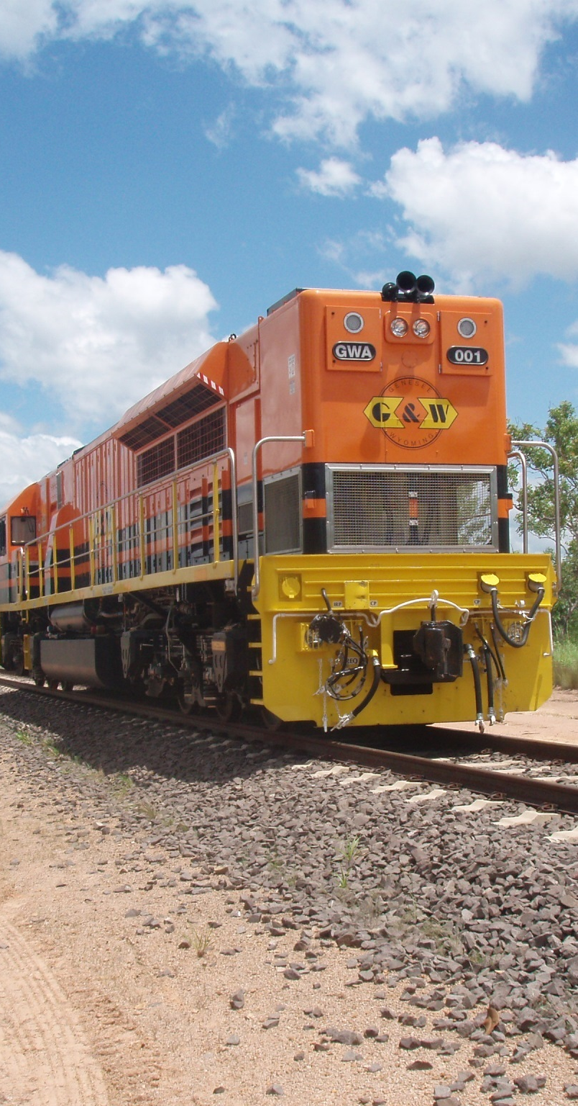
Requirement specification phase
Specify interface requirements:
Between subsystems
With legacy systems
Safety Related Application Conditions (SRACs) on the existing railway systems

Slide 11
TRS interface requirements
Functional
REC management
Operational
DMI interactions
Physical
DMI in-cab position
SRACs
Electromagnetic emission

Slide 12
Design phase
Interface compatibility between connected railways systems.
Risk assessment:
Interface failures
Overall system failures
Railway operations safety
Compliance with SRACS.
Risk control verification.

Slide 13
TRS design phase
Interface compatibility analysis
Batteries power interface
Interface hazard analysis
UMI interference
System hazard analysis
DMI alarm failure
SRACs compliance
Electromagnetic emission
Risk control verification
Alarms to monitor power supply

Slide 14
Installation phase
Installation and configuration errors may result in:
System failure
Wrong side failures of interconnected systems
System interface verification:
Correct implementation
Conformance with design
Risk assessment:
Design deviation

Slide 15
System testing phase
System standalone tests:
Factory Acceptance Test
Site Acceptance Test
Include testing system interfaces:
Legacy systems interfaces
Subsystems interfaces

Slide 16
TRS system testing
Safely receive the inputs:
Clearly receiving emergency voice communication
Safety functions are not compromised:
failure of local power supply
Safely generate the required outputs:
Clearly transmitting emergency voice communication
Outputs will not compromise interconnected systems:
Interference with the signalling systems

Slide 17
System integration phase
Safety verification & validation:
systematically testing the effect of one subsystem on another subsystem
changes in the behaviour of subsystems
changes in the behaviour of whole integrated system
Safety verification:
safety related system is built right
completeness, correctness and consistency
Safety validation:
right safety system is built

Slide 18
TRS system integration
Function correctly
Transmit emergency calls
Meet operational requirements
Transmission delay
Will not compromise existing systems
Interference with signaling systems during testing
Management of risks associated with:
Testing activities
Changes in system configuration

Slide 19
System operation & maintenance phase
Continuously monitor:
All faults and corrective actions
All residual risks
All system SRACs

Slide 20
TRS operation & maintenance phase
Operational faults:
Connectivity with other train communication systems
Drop out rates
Effectiveness of risk controls:
Driver training
Compliance with SRACs:
Power monitoring alarm

Slide 21
Case Study
TRS Implementation:
Modified-of-the-shelf
SIL 0 according to CENELEC Standards
Installed in multiple rail corridors and different train types.
Design, installed and tested as stand alone system
Using limited number of base stations

Slide 22
Case Study
Initial testing shows significantly higher time delay in transmission:
Fails to meet operational and safety requirements
Internal software modification:
Optimise base station selection
Impact of modification:
Additional risk assessments on faults and modification.
System retesting
System SIT retesting for each rail corridor and train type
Additional safety artefacts to demonstrate safe SFAIRP.
Delays to project.

Slide 23
Questions & Discussion Thank you

